Slide 1
Achondroplasia Clinical Binder
Vosoritide clinical trials and early experience with vosoritide

Slide 3
Study 901
Only slider for Study 901.
Study 901 was a prospective, observational study,
363 participants (ranging from newborn to 13.5 years of age) were followed every 3 months (mean follow-up,
20.4 months). The study helped establish patterns of growth in children with untreated achondroplasia.
  The study found that, compared with children of average stature, children with achondroplasia:
  Have a similar pattern of growth up to 12 years of age
  Have a smaller magnitude of growth at all ages
  Have a magnitude of growth deficit that generally increases with age
Savarirayan 2022 Study 901: pp2A, C, 3C, D, 5C]
Savarirayan, Genet Med. 2022.

Slide 4



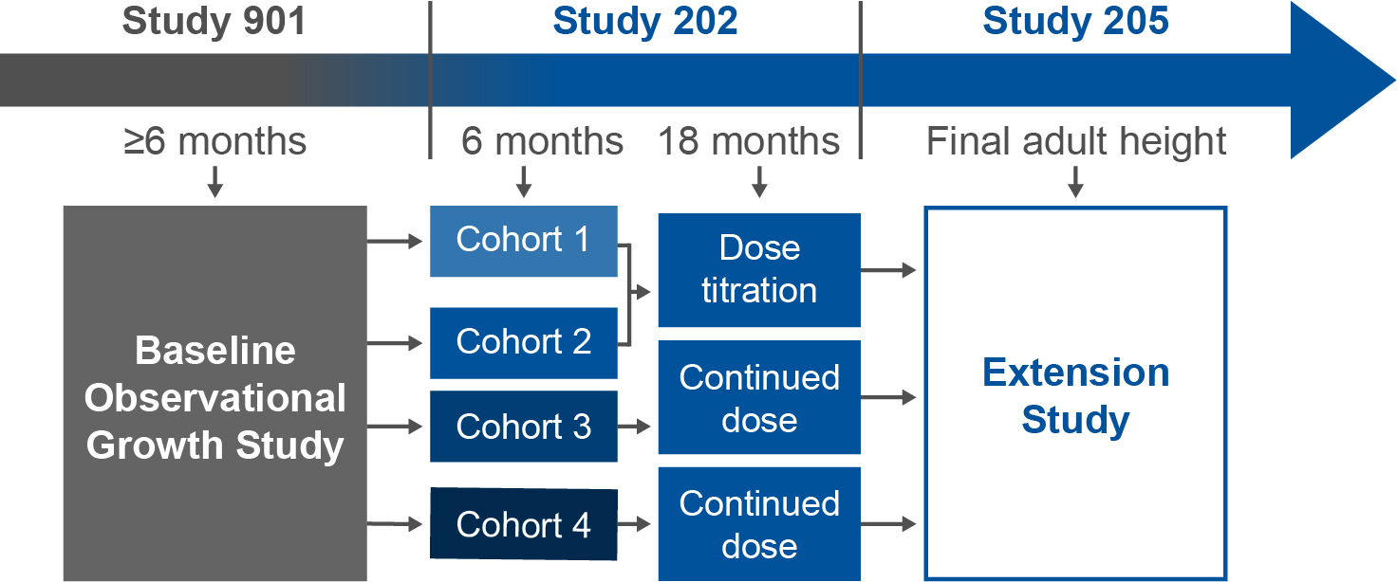


Primary Objective
  To evaluate the safety
  and side-effect profile
  of vosoritide and to
  determine the
  dose to further
  investigate in
  phase 3 studies
Study Population
  Participants must have completed ≥6
  months in baseline study (Study 901)
5
14
Age:
0
Years
<18
[Savarirayan 2019 study 202: p3B-D]
N = 35
[Savarirayan 2019 study 202: p2A, 4B]
Study Design
  Study 202 was the first
  clinical trial involving
  treatment with vosoritide.
  Cohorts 1-4 varied by dose:
  C1: 2.5 μg/kg, C2: 7.5 μg/kg,
  C3: 15 μg/kg, and C4: 30 μg/kg
ACT_001
[Savarirayan 2019 study 202: p2A, 3A]
Efficacy: 6 months
  A dose-dependent increase in AGV was observed after 6 months of treatment with vosoritide.
Safety
  Vosoritide was generally well
  tolerated at all doses
  Across all doses, injection-site
  reactions were the most
  common drug-related AE
  All events were mild
  and transient
[Savarirayan 2019 study 202: p5D]
Long-term Efficacy
  Vosoritide was associated with improvements in height gain
  over 60 months and positive height Z-scores over 96 months.
[Savarirayan 2019 study 202: p5B, C, 6A]
AE, adverse event; AGV, annualized growth velocity; C, cohort.
Savarirayan, NEJM. 2019.

Slide 5
Study 202/205
Only slider for Study overview.
Study 202 was the first clinical trial involving treatment
with vosoritide in children with achondroplasia. It was a multinational, open-label, sequential cohort, phase 2,
dose-escalation study among children ages 5 to 14.
A total of 35 children were enrolled in 4 sequential cohorts.
Study 202 had a 6-month dose-finding phase followed by an 18-month treatment phase during which patients either continued to receive their initial dose or received an escalated dose. Participants who completed the 24-month study
enrolled in the open-label extension trial (Study 205).
The 42-month findings were published in the New England Journal of Medicine in 2019. Since that publication, data from up to 7 years of treatment have been presented at the American College of Medical Genetics and Genomics (ACMG) meeting in 2024.
Savarirayan, NEJM. 2019.
[Savarirayan 2019 study 202: p2A,B, p3A 4B, 4C, 5A]

Slide 6




Inclusion Criteria
Study population slider
ACT_008
  Aged 5 to 14 years at study entry
  Have achondroplasia confirmed by
  genetic testing
  Have completed
  $≥$6 months in Study 901
For full list of inclusion criteria, see Clinicaltrials.gov NCT01603095.
Savarirayan, NEJM. 2019.
[Savarirayan 2019: p2A][CT.gov study 202: p4A]

Slide 7




Exclusion Criteria
Study population slider
ACT_009
  Have hypochondroplasia or short stature condition other than achondroplasia
  Growth plates have fused
  History of
  renal insufficiency or anemia
  Recent or prolonged growth hormone therapy
  Have had recent
  bone-related surgery
For full list of exclusion criteria, see Clinicaltrials.gov NCT01603095.
Savarirayan, NEJM. 2019.
[CT.gov study 202: p4B, 5A, 6A]

Slide 8


Participant Baseline Characteristics
Across All Cohorts
Study population slider
SEX
AGE AT SCREENING
5
14
ACT_041
0
Age Range
(Years)
<18
Male 46%
Median age
7.0 years
Female 54%
Savarirayan, NEJM. 2019.
[Savarirayan 2019 study 202: p4B]

Slide 9
Age Group at Screening by Cohort
Study population slider
Age group at screening, n (%) | Cohort 1 2.5 μg/kg (n = 8) | Cohort 2 7.5 μg/kg (n = 8) | Cohort 3 15 μg/kg (n = 10) | Cohort 4 30 μg/kg (n = 9) | All cohorts (N = 35)
5 to <8 years | 6 (75) | 3 (38) | 4 (40) | 5 (56) | 18 (51)
8 to <10 years | 1 (12) | 1 (12) | 4 (40) | 4 (44) | 10 (29)
10 to ≤14 years | 1 (12) | 4 (50) | 2 (20) | 0 | 7 (20)
[Savarirayan 2019 study 202: p4B]
Savarirayan, NEJM. 2019.

Slide 10
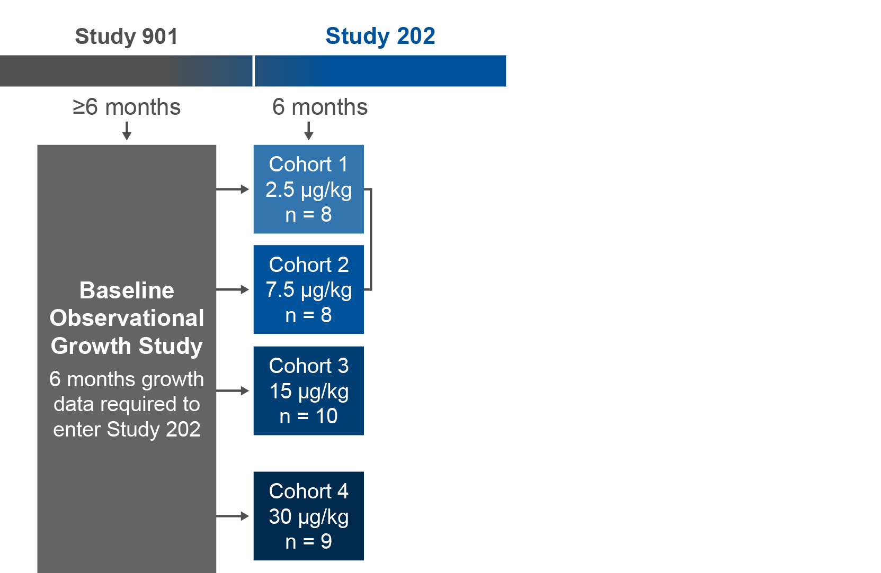
Dose-Finding Phase
Study design slider 1
During the initial 6 months, patients were treated in
4 sequential cohorts with
once-daily subcutaneous administration of vosoritide.
The 6-month data showed a dose-dependent response. These findings established the dosing for the next phase of Study 202 and the 15 μg/kg dose in subsequent trials.
ACT_002a
Savarirayan, NEJM. 2019.
[Savarirayan 2019 study 202: p2A, 3AB]

Slide 11
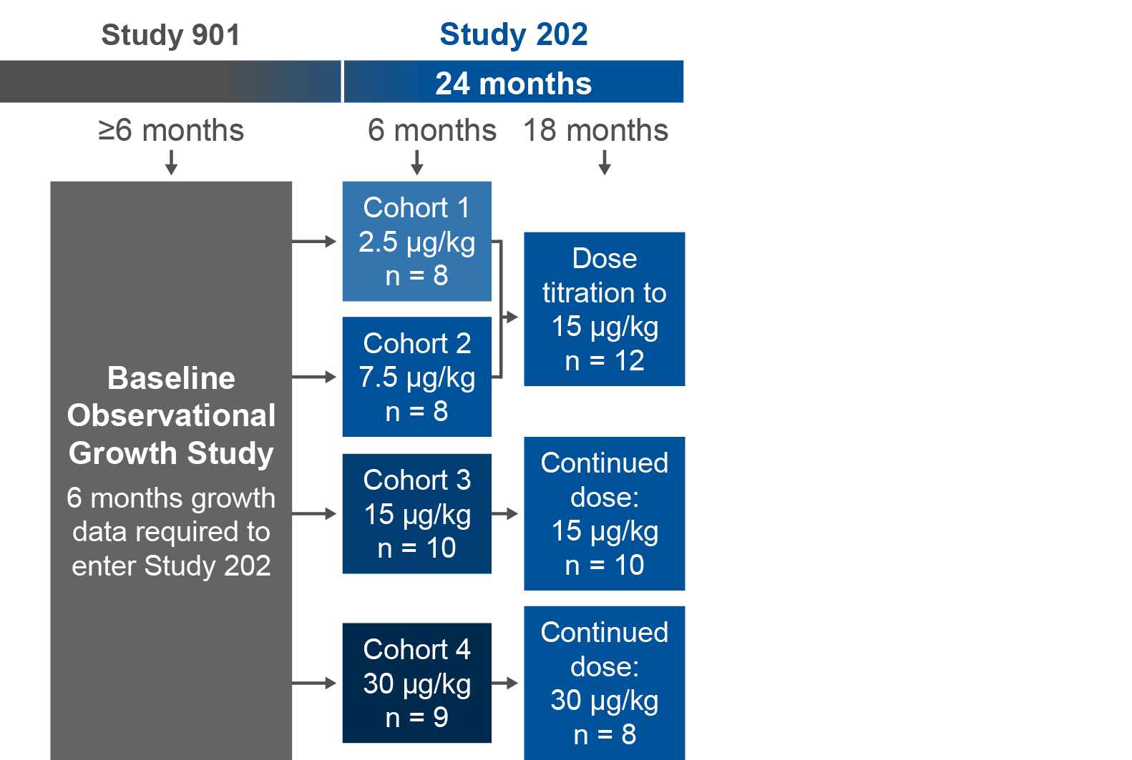
24-Month Treatment Phase
Study design slider 2
ACT_002b
Based on emerging data, at 6 months, doses in Cohorts 1 and 2 were titrated to 15 μg/kg.
Cohort 3 (15 μg/kg) and Cohort 4 (30 μg/kg) remained on the starting dose for the remainder of the
24-month treatment phase.
[Savarirayan 2019 study 202: p2A, 3AB]
Savarirayan, NEJM. 2019.

Slide 12
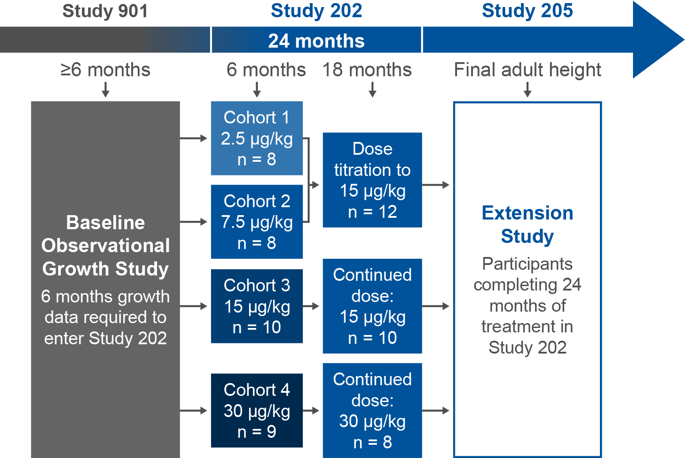
Extension Study
Study design slider 3
Participants continued their assigned doses of vosoritide in Study 205 (either 15 μg/kg or 30 μg/kg ) in the extension study (Study 205).
ACT_002c
Savarirayan, NEJM. 2019.
[Savarirayan 2019 study 202: p2A,3A][CT.gov Study 205: p5A]

Slide 13



Safety Outcomes
Study design slider 4
A primary objective for Study 202 was to evaluate the safety and side effect profile for vosoritide. Safety outcomes included AEs and SAEs at
6 months and over entire study period as well as outcomes related to certain common clinical manifestations associated with achondroplasia:
ACT_011
  Clinical examination (eg, ECG,
  vital signs,
  hip assessment)
  Laboratory
  testing (eg,
  immunogenicity)
  Imaging assessments
  (eg, bone age, BMD)
AE, adverse event; BMD, bone mineral density; ECG, electrocardiogram; SAE, serious adverse event.
Savarirayan, NEJM. 2019.
[CT.gov 202: p8A, B] [Savarirayan 2019: p3B, C]

Slide 14

Efficacy Outcomes
Study design slider 5
Evaluation of vosoritide efficacy was a secondary objective of Study 202. Efficacy outcomes included:
  Change from baseline (at 6 months and 24 months) in:
  AGV
  Height z scores
  Body segment proportionality
ACT_010
  Lab testing for certain biomarkers indicative of treatment effect:
  Urinary cGMP (marker of vosoritide activity)
  Serum CXM (marker of bone growth)
AGV, annualized growth velocity; cGMP, cyclic guanosine monophosphate; CXM, collagen X marker.
Savarirayan, NEJM. 2019.
[CT.gov 202: p9A-C, p10A-C, p11A, B, 12A] [Savarirayan 2019 Study 202: p3D: p8C, p10C]

Slide 15
What Is AGV?
Efficacy 6 months slider 1
Annualized growth velocity (AGV) is the difference in standing height over the course of a year, calculated as follows:
Height
at recent visit
Height
at prior visit
365.25 days
# days between visits
[
]
EXAMPLE
[
95.2 cm
92.7 cm
]
365.25 days
182 days
5.0 cm/
year
Savarirayan, NEJM. 2019.
[Savarirayan 2019 study 202: p7B]

Slide 16
AGV at 6 Months by Cohort
Efficacy 6 months slider 2
A primary efficacy end point for Study 202 was change in AGV from baseline during the initial 6 months. The 6-month data showed dose-dependent increases in AGV and similar safety and efficacy at 15 μg/kg and 30 μg/kg. These findings established the dosing for the next phase
of Study 202 and the 15 μg/kg dose in subsequent trials.
[Savarirayan 2019 study 202: 3A, 10D]
AGV Over 6 Months By Cohort
Growth velocity | Cohort 1 2.5 μg/kg (N = 8) | Cohort 2 7.5 μg/kg (N = 8) | Cohort 3 15 μg/kg (N = 10) | Cohort 4 30 μg/kg (N = 9)
Mean change from baseline cm/year (SD) | -0.37 (1.59) | 1.28 (1.44) | 2.01 (2.00) | 2.08 (2.14)
95% CI | -1.84, 1.10 | 0.07, 2.48 | 0.58, 3.44 | 0.30, 3.87
The mean change in AGV at 6 months for the 15.0 μg/kg (Cohort 3) and 30 μg/kg (Cohort 4) doses was similar.
[Savarirayan 2019 study 202: 10D]
SD, standard deviation.
Savarirayan, NEJM. 2019.

Slide 17
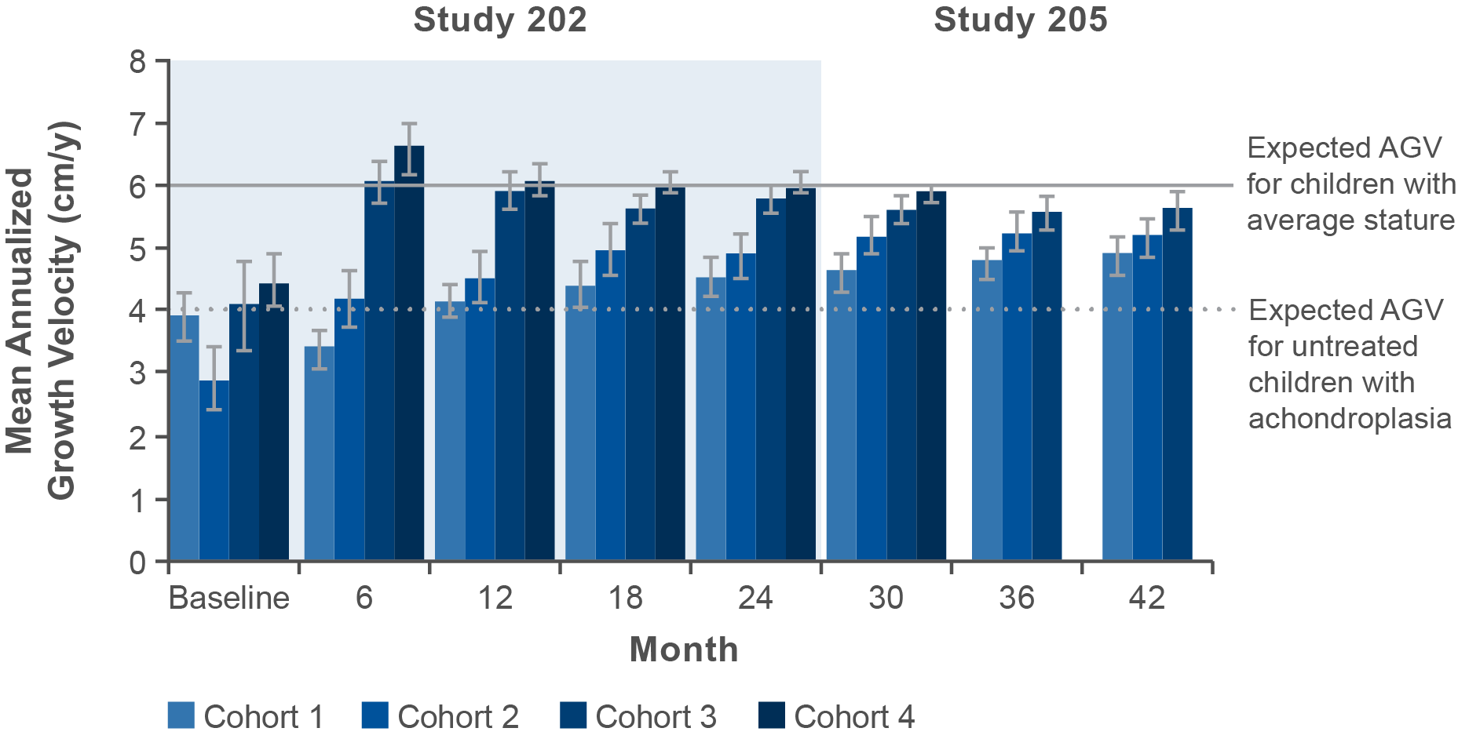
AGV Up to 42 Months in Study 202/205
Long-term data slider 1
In all cohorts, the AGV increased from baseline during each 12-month interval by 1.10 to 2.34 cm per year for up to 42 months (data up to
30 months are available for Cohort 4). Mean AGV was 5.51 cm/year
and 5.60 cm/year among participants who received 15 µg/kg/day
and 30 µg/kg/day of vosoritide, respectively. As no significant difference
in efficacy or safety was observed between the 15-µg/kg/day and
30-µg/kg/day doses, the 42-month findings support the use of the
15 µg/kg in phase 3 clinical trials.
ACT_003
By 42 months, the increased AGV was similar between Cohorts 1 and 2, who initially received the lower doses.
[Savarirayan 2019 study 202: p5D, E, 6B, 7B, 10B]
Savarirayan, NEJM. 2019.

Slide 18
Biomarker Results
Long-term data slider 2
Two biomarkers were included in Study 202 as indicators of treatment effect, urinary guanosine monophosphate (cGMP), and indicator of vosoritide pharmacologic activity, and serum collagen X marker (CXM),
a biomarker of endochondral bone growth.
cGMP
A transient dose-dependent increase in cGMP concentration was observed on day 1 (from pre-dose level to 2 hours after vosoritide administration). This transient increase was sustained throughout the dose-finding study—an indicator of durable pharmaceutical activity.
CXM
A dose-dependent increase in the median CXM concentration from the pretreatment level was observed by day 29. The CXM concentration remained elevated from month 12 through month 24 across all cohorts (all cohorts were at a daily dose of either 15 μg/kg or 30 μg/kg during this time). These biomarker findings were consistent with the treatment effect observed for AGV increases and helped establish the 15 μg/kg dose.
Savarirayan, NEJM. 2019.
[Savarirayan 2019 study 202: p3D, 9B, 10C]

Slide 19

Further Analysis of Study Data Using Comparator Populations
Long-term data slider 3
Two primary populations of untreated children were used as comparators to better understand treatment effects with vosoritide:
ACT_012
  Age-matched children with achondroplasia from CLARITY
  Age-matched children of average stature from a CDC database
CLARITY is a multi-center study using registry data from
1957 to 2017 for 1,354 and 20 deceased individuals with achondroplasia across 4 academic skeletal dysplasia centers
in the US. The study provides natural history data for untreated children that includes various measurements of growth
(body length, weight, head circumference) and surgical burden.
CDC, Centers for Disease Control and Prevention.
[Hoover-Fong 2021 CLARITY: p2A-E]

Slide 20
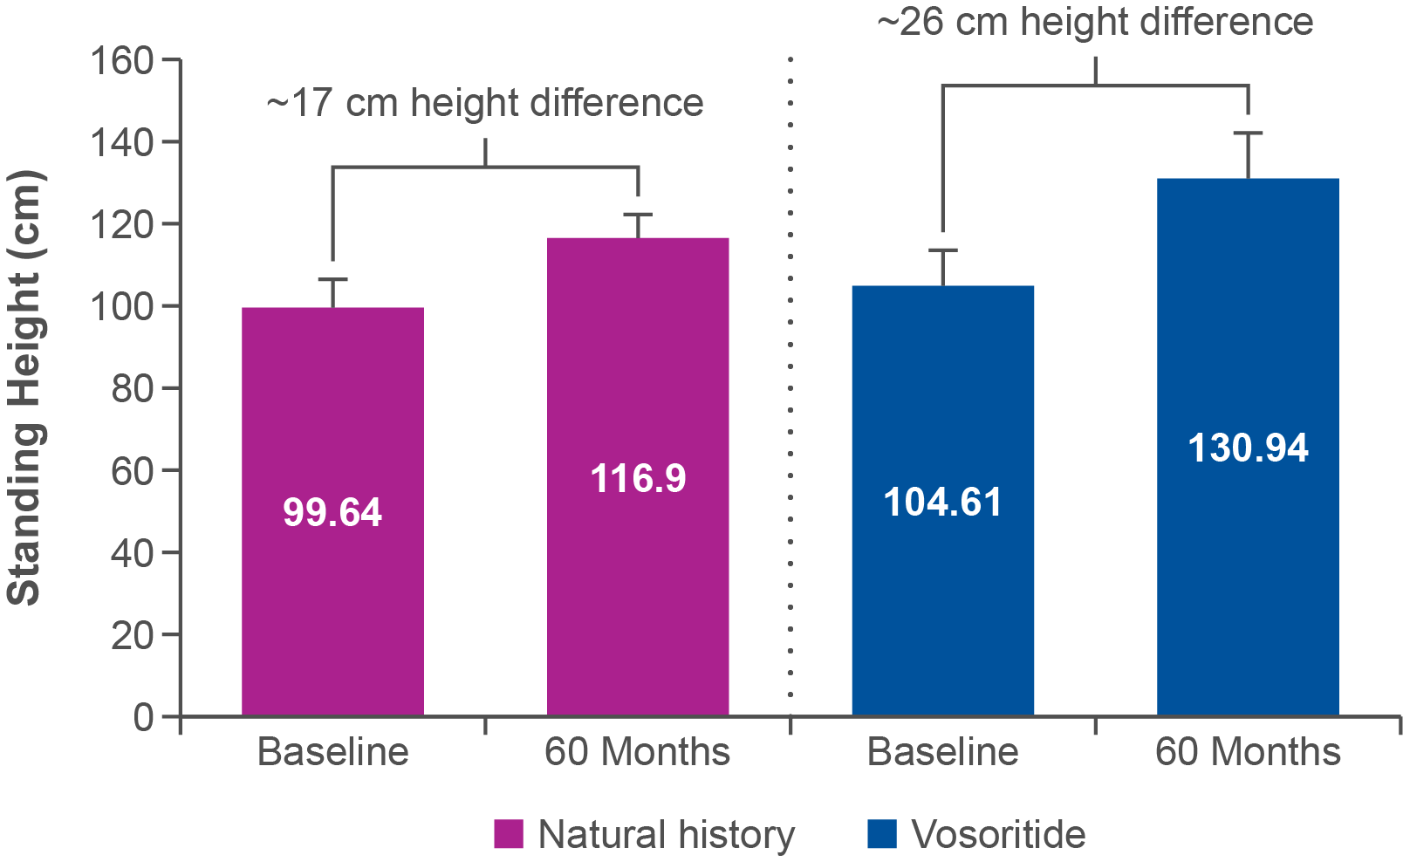
Height Gain Over 60 Months vs
Natural History Data From CLARITY
Long-term data slider 4
Over 60 Months in 202/205, the vosoritide-treated participants had an additional 9.08 cm cumulative height gain compared to those in the CLARITY natural history population (P = 0.0002).
ACT_006
Hoover-Fong J et al, Genet Med. 2021. BioMarin Data on File.
[ACH medical deck DOF: p27A]

Slide 21
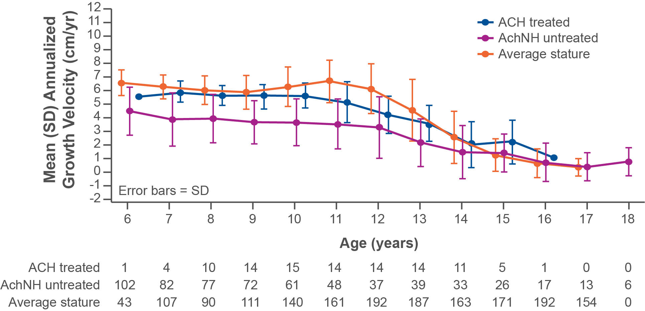
Mean 12-Month Interval AGV With Vosoritide vs Comparator Populations Over 7 Years in Females
Long-term data slider 5
ACT_004
Vosoritide treatment was consistently associated with higher AGVs in females with ACH aged 6-17 years compared to age-matched untreated children with ACH. Mean AGVs of treated children are comparable to that of average stature children prior to puberty but are maintained over a longer duration.
[Hoover-Fong 2024 ACMG Study 205: p1A]
There is no evidence of a pubertal growth spurt in children with ACH.
AchNH: achondroplasia natural history.
Hoover-Fong J, et al. Presented at ACMG 2024.
AchNH reference derived from CLARITY (Hoover-Fong J, et al. Orphanet J Rare Dis. 2021.)
Average stature reference is non-African American data from Kelly A, et al. J Clin Endocrinol Metab. 2014.

Slide 22
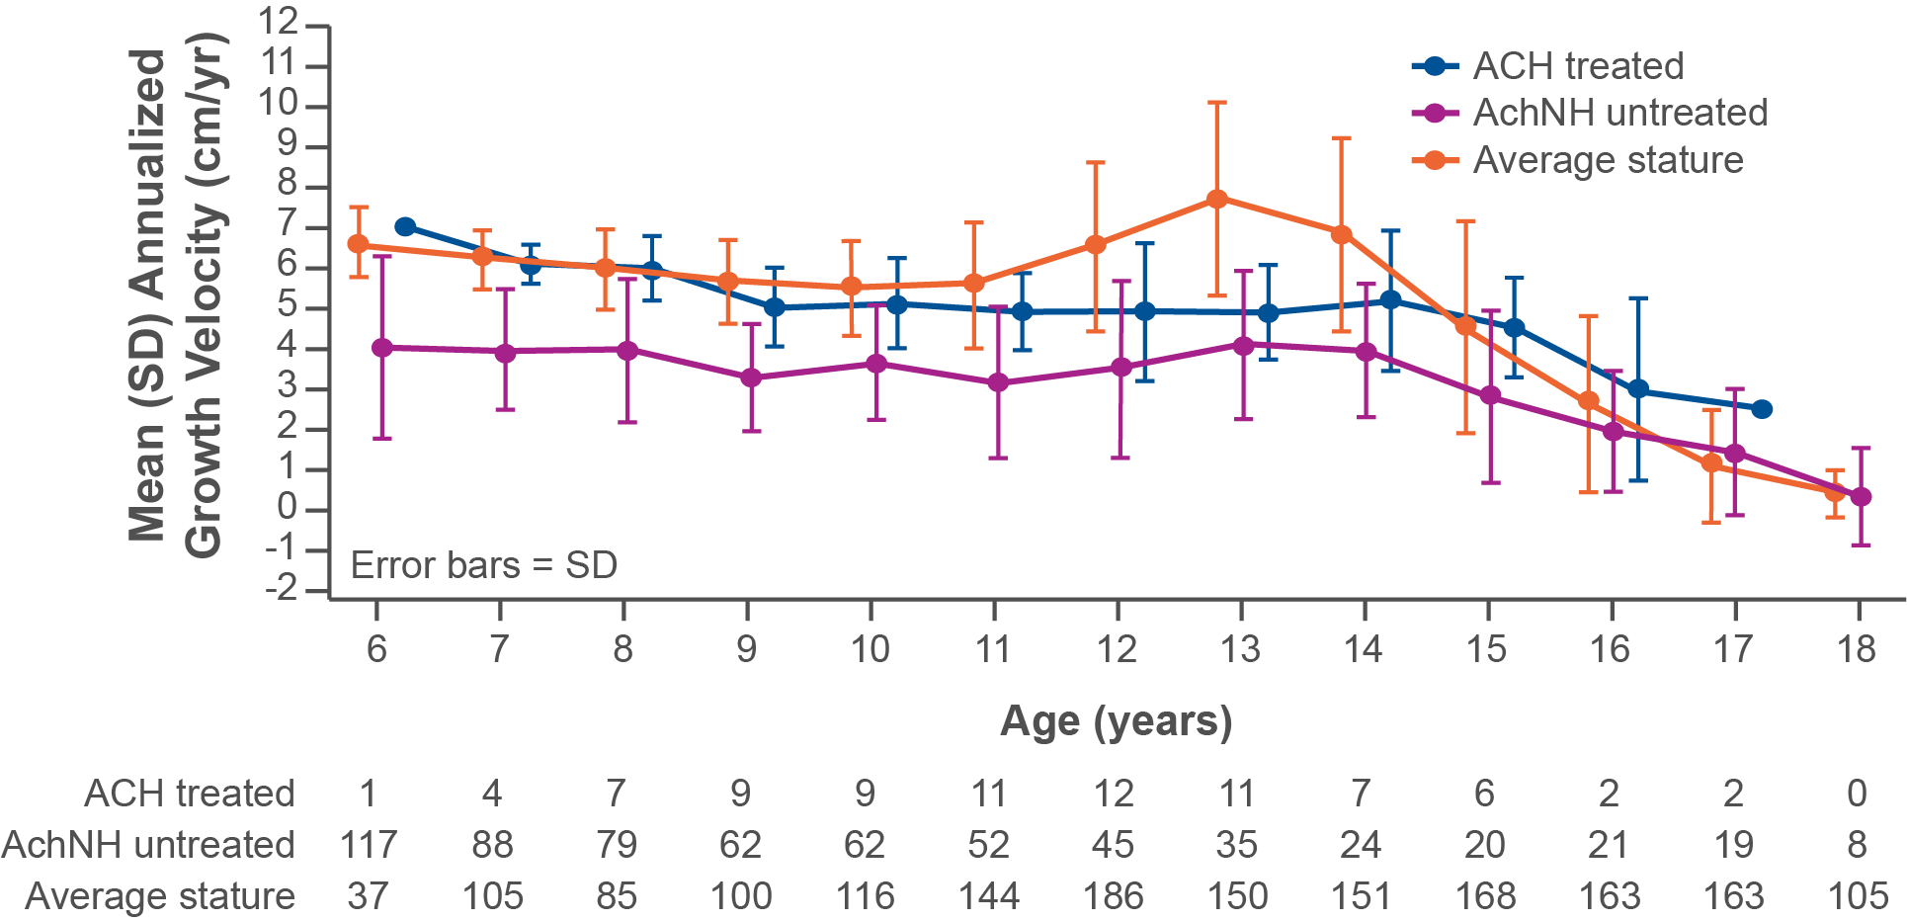
Mean 12-Month Interval AGV With Vosoritide vs Comparator Populations Over 7 Years in Males
Long-term data slider 6
Vosoritide treatment was also consistently associated with higher AGVs
in males with ACH aged 6-17 years compared to age-matched untreated children with ACH. Similar to what was observed in female participants, mean AGVs of treated male children are comparable to that of average stature children prior to puberty but are maintained over a longer duration.
ACT_005
There is no evidence of a pubertal growth spurt in children with ACH.
[Hoover-Fong 2024 ACMG Study 205: p1B]
Hoover-Fong J, et al. Presented at ACMG 2024
AchNH reference derived from CLARITY (Hoover-Fong J, et al. Orphanet J Rare Dis. 2021.)
Average stature reference is non-African American data from Kelly A, et al. J Clin Endocrinol Metab. 2014.

Slide 23
What are height z scores?
Long-term data slider 7
  Height z score is a standard deviation (SD) calculation
  of standing height relative to age- and sex-matched comparators
  Z scores indicate how far a particular child is from the height of children of the same sex and age in the comparator population
  A positive height z score indicates the child's height
  is above that of the comparator population; a negative
  z score indicates the child's height is below that of the comparator population
Z scores for Study 202/205 were derived using age-
sex-specific reference data (means and SDs) from
CLARITY and from an average stature population (CDC).
The mean height z score for Study 202/205 was -5.12.
CDC, Centers for Disease Control and Prevention.
Savarirayan et al. Supplementary appendix. NEJM. 2019.
[CT.gov Study 202: p9C, 10A, B][Savarirayan 202 appendix: p33A]

Slide 24
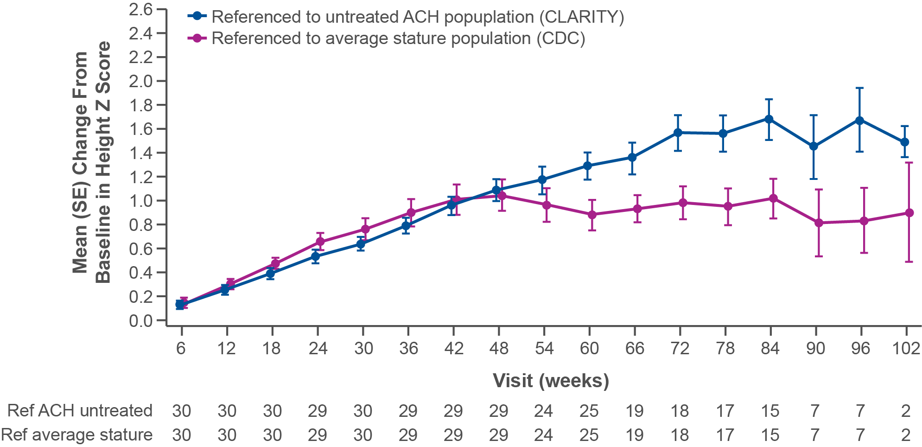
Height Z Scores Over 7 Years Versus Comparators
Long-term data slider 8
This graph shows the mean change in baseline of height z scores in vosoritide-treated participants compared to 2 separate comparator populations. Durability of treatment effect is reflected in these scores. Recall that z scores indicate how far a particular child is from the height
of children of the same sex and age in the comparator population, so in this analysis they are comparing 202/205 participants to the untreated populations in CLARITY and the CDC database.
ACT_007
There was an additional height gain of 11.03 cm in 17 subjects treated with 15 µg/kg
or 30 µg/kg of vosoritide for 7 years compared with untreated age- and sex-matched children with achondroplasia (CLARITY).
Hoover-Fong J, et al. Presented at ACMG 2024.
[Hoover-Fong 2024 ACMG Study 205: p1C]

Slide 25
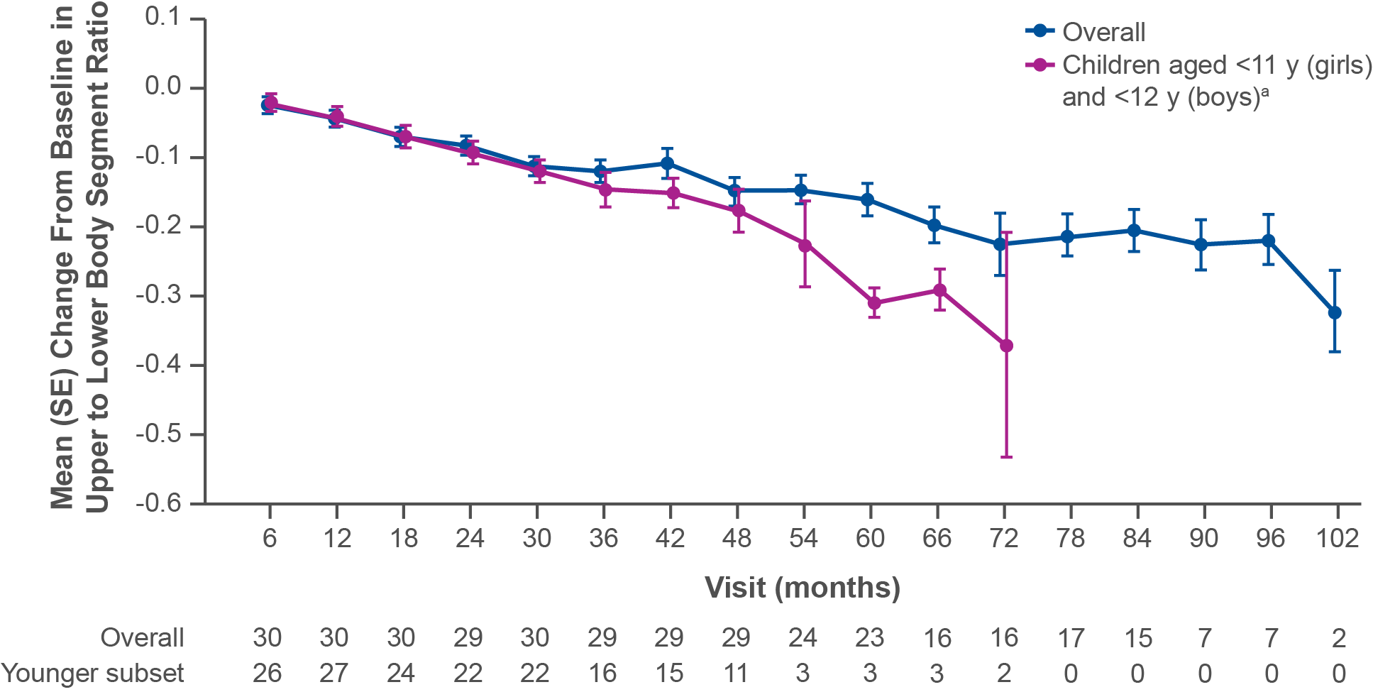
Upper to Lower Body Segment Ratio Over
7 Years
Long-term data slider 9
The graph shows the body segment proportionality over 7 years for the overall treatment population and a subset of children aged <11 years (females)/<12 years (males). Upper to lower body segment ratios continued to improve over time, with changes particularly apparent in the younger subset of children for whom there may be more opportunity to impact this parameter.
ACT_013
[Hoover-Fong 2024 ACMG Study 205: p1D]
ªAssessments beyond these ages are excluded from analysis given any treatment is unlikely to impact proportionality.
Hoover-Fong J, et al. Presented at ACMG 2024.

Slide 26
Most Common AEs During Treatment Periods By Cohort
Safety slider 1
Vosoritide was generally well tolerated at all doses. Across all doses, injection-site reactions were the most common drug-related AE.
AE, n (%) | Vosoritide Dose Level |  |  |  | Overall (N = 35)
 | Cohort 1 2.5 µg/kg (N = 8) | Cohort 2 7.5 µg/kg (N = 15) | Cohort 3 15 µg/kg (N = 22) | Cohort 4 30 µg/kg (N = 9)
Injection-site erythema | 4 (50) | 7 (47) | 14 (64) | 9 (100) | 30 (86)
Injection-site reaction | 2 (25) | 8 (53) | 17 (77) | 9 (100) | 30 (86)
Pyrexia | 4 (50) | 2 (13) | 13 (59) | 3 (33) | 19 (54)
Cough | 4 (50) | 2 (13) | 10 (45) | 4 (44) | 17 (49)
Hypotension | 4 (50) | 5 (33) | 7 (32) | 2 (22) | 16 (46)
Injection-site swelling | 4 (50) | 2 (13) | 8 (36) | 2 (22) | 16 (46)
Nasopharyngitis | 1 (12) | 3 (20) | 12 (55) | 2 (22) | 16 (46)
Headache | 4 (50) | 3 (20) | 8 (36) | 3 (33) | 14 (40)
[Savarirayan 2019 study 202: p5B, C, 6A]
AE, adverse event.
Savarirayan, NEJM. 2019.
Full table

Slide 27
Most Common AEs (≥20%) During Treatment Periods By Cohort
AE, n (%) | Vosoritide Dose Level |  |  |  | Overall (N = 35)
 | Cohort 1 2.5 µg/kg (N = 8) | Cohort 2 7.5 µg/kg (N = 15) | Cohort 3 15 µg/kg (N = 22) | Cohort 4 30 µg/kg (N = 9)
Injection-site erythema | 4 (50) | 7 (47) | 14 (64) | 9 (100) | 30 (86)
Injection-site reaction | 2 (25) | 8 (53) | 17 (77) | 9 (100) | 30 (86)
Pyrexia | 4 (50) | 2 (13) | 13 (59) | 3 (33) | 19 (54)
Cough | 4 (50) | 2 (13) | 10 (45) | 4 (44) | 17 (49)
Hypotension | 4 (50) | 5 (33) | 7 (32) | 2 (22) | 16 (46)
Injection-site swelling | 4 (50) | 2 (13) | 8 (36) | 2 (22) | 16 (46)
Nasopharyngitis | 1 (12) | 3 (20) | 12 (55) | 2 (22) | 16 (46)
Headache | 4 (50) | 3 (20) | 8 (36) | 3 (33) | 14 (40)
Nasal congestion | 1 (12) | 2 (13) | 7 (32) | 2 (22) | 12 (34)
Upper respiratory tract infection | 0 | 1 (7) | 10 (45) | 2 (22) | 12 (34)
Ear pain | 2 (25) | 3 (20) | 6 (27) | 2 (22) | 11 (31)
Vomiting | 2 (25) | 2 (13) | 6 (27) | 3 (33) | 11 (31)
Ear infection | 1 (12) | 4 (27) | 7 (32) | 2 (22) | 10 (29)
Oropharyngeal pain | 1 (12) | 2 (13) | 7 (32) | 1(11) | 10 (29)
Otitis media | 1 (12) | 0 | 7 (32) | 3 (33) | 10 (29)
Pain in arms or legs | 1 (12) | 0 | 5 (23) | 4 (44) | 10 (29)
Injection-site urticaria | 1 (12) | 2 (13) | 3 (14) | 4 (44) | 9 (26)
Arthropod bite | 1 (12) | 2 (13) | 5 (23) | 1 (11) | 8 (23)
Fall | 2 (25) | 1 (7) | 4 (18) | 2 (22) | 8 (23)
Viral infection | 0 | 0 | 7 (32) | 1 (11) | 8 (23)
Upper abdominal pain | 1 (12) | 1 (7) | 4 (18) | 1 (11) | 7 (20)
Rhinorrhea | 2 (25) | 1 (7) | 3 (14) | 1 (11) | 7 (20)
Savarirayan, NEJM. 2019.
[Savarirayan 2019 study 202: p6A]

Slide 28
Summary of Vosoritide Safety and Tolerability
Safety slider 2
  Across all doses, injection-site reactions were the most common
  drug-related AE; all events were mild and transient
  AEs of hypotension were nonserious and transient and resolved without medical intervention
  SAEs occurred in 4 of 35 subjects; SAEs included grade 3 obstructive sleep apnea, grade 1 tonsillar hypertrophy, grade 3 thyroglossal cyst, and grade 3 syrinx
  No bone-related AEs were observed over the entire treatment period
No difference in safety was discerned between the 15-μg/kg/day and 30-μg/kg/day doses.
AE, adverse event; SAE, serious adverse event.
Savarirayan, NEJM. 2019.
[Savarirayan 2019 study 202: p5B, C, 6A]

Slide 29


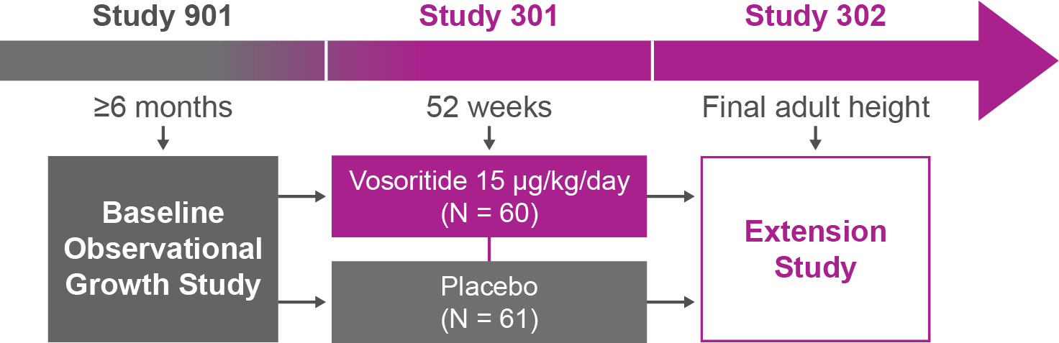

Primary Objective
To evaluate the efficacy
and safety of
vosoritide (15 μg/kg)
compared with
placebo in children
Study Population
Participants must have completed
≥6 months in baseline study (Study 901)
5
17
Age:
0
Years
<18
[Savarirayan 2020 study 301: p3A]
N = 121
[Savarirayan 2020 study 301: p2B]
Study Design
Initial approvals of
vosoritide were based
on this phase 3,
double-blind, randomized,
placebo-controlled trial
of vosoritide at 15 μg/kg
ACT_014
[Savarirayan 2020 study 301: p2A, B, 3C, E]
Efficacy: 52 weeks
  Vosoritide (15μg/kg) resulted in a highly significant increase in AGV and height z scores after 52 weeks.
HRQoL
Vosoritide was associated with improved HRQoL, particularly in measures pertaining to physical and social improvements.
Safety
  The most common treatment-related AEs were nonserious, transient injection-site reactions.
[Savarirayan 2020 study 301: p8A]
Long-term Efficacy
  Mean AGV scores over 4 years and height z scores over
  6 years demonstrated durability of treatment effect with vosoritide.
[Savarirayan 2024 ACMG Study 302 QOL: p1C]
[Savarirayan 2024 ACMG 302 poster: p1A-D]
[Savarirayan 2020 study 301: p7D, E]
AGV, annualized growth velocity; HRQOL, health-related quality of life.
Savarirayan, et al. Lancet. 2020.

Slide 30
Study 301/302
Study 301 was a multinational, phase 3, randomized,
double-blind, placebo-controlled trial that compared once-daily subcutaneous administration of vosoritide at 15.0 µg/kg
with placebo among children ages 5 to <18 years with achondroplasia. A total of 121 children were enrolled in the
2 cohorts. Those who completed the 52-week study (N = 119) enrolled in extension Study 302, which continues until participants reach full adult height.
The 52-week findings for Study 301 were published in
The Lancet in 2020. The most recent findings reported here are from 4-year data presented at the American College of Medical Genetics and Genomics in 2024.
[Savarirayan 2020 study 301: p2A, B]
Savarirayan, et al. Lancet. 2020.

Slide 31



Inclusion Criteria
Study population slider
ACT_008
  Aged 5 to <18 years at study entry
  Have achondroplasia confirmed by
  genetic testing
  Have completed
  ≥6 months in Study 901
For full list of inclusion criteria, see Clinicaltrials.gov NCT03197766.
Savarirayan, et al. Lancet. 2020.
[CT.gov stud 301: p4A, B, 5A] [Savarirayan 2020 study 301: p3D]

Slide 32




Exclusion Criteria
Study population slider
  Have hypochondroplasia or short stature condition other
  than achondroplasia
  Growth plates have fused or decreased growth velocity (<1.5 cm/yr) for 6 months
  History of certain medical conditions
  (eg, renal insufficiency, anemia, severe untreated sleep apnea)
  Recent or prolonged growth hormone therapy
  Have had recent
  bone-related surgery
For full list of exclusion criteria, see Clinicaltrials.gov NCT03197766.
Savarirayan, et al. Lancet. 2020.
[CT.gov stud 301: p4A, B, 5A] [Savarirayan 2020 study 301: p3D]

Slide 33


Participant Baseline Characteristics
Study population slider
SEX (Placebo)
SEX (Vosoritide)
Male 48%
Male 46%
Female 52%
Female 54%
[Savarirayan 220 study 301: p4B]
Savarirayan, et al. Lancet. 2020.

Slide 34
Participant Baseline Characteristics
Study population slider
AGE AT SCREENING
(Placebo)
AGE AT SCREENING
(Vosoritide)
5
17
5
17
0
Age Range
(Years)
<18
0
Age Range
(Years)
<18
Median age
9.0 years
Median age
8.3 years
[Savarirayan 220 study 301: p4B]
Savarirayan, et al. Lancet. 2020.

Slide 35
Age Group at Screening/First Dose
Study population slider
Age category | Placebo/Vosoritide N = 61 | Vosoritide/Vosoritide N = 60
≥5 to <8 years | 15 (24.6) | 31 (53.4)
≥8 to <11 years | 21 (34.4) | 16 (27.6)
≥11 to <15 years | 24 (39.3) | 11 (19.0)
≥15 to <18 years | 1 (1.6) | 0
Age at first dose (median) | 10.29 | 7.59
[Savarirayan 2020 study 301: p4B][DOF Medical deck]
Savarirayan, et al. Lancet. 2020.

Slide 36
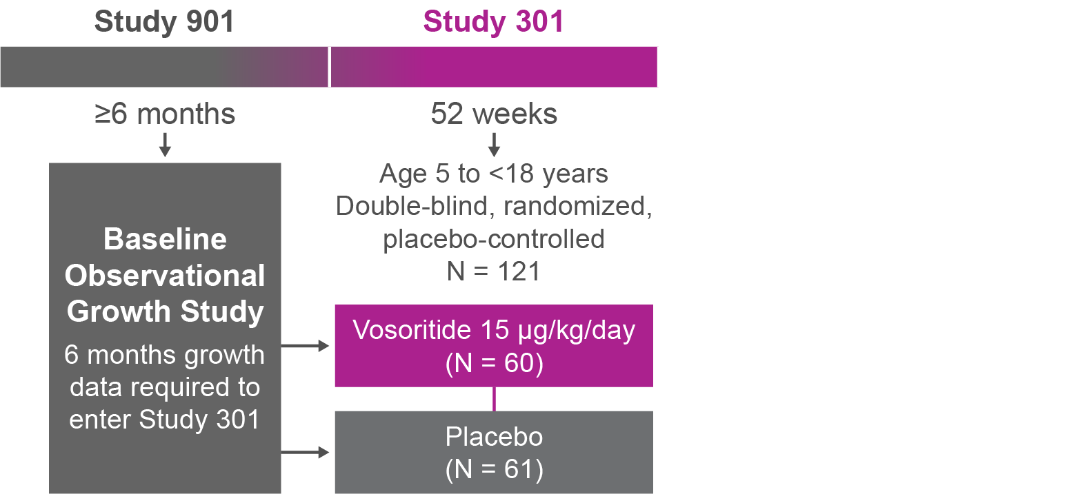
Treatment Period
Study design slide
Patients received either 15 μg/kg of vosoritide or placebo for 52 weeks.
ACT_015a
[Savarirayan 2020 study 301: p3C]
Savarirayan, et al. Lancet. 2020.

Slide 37
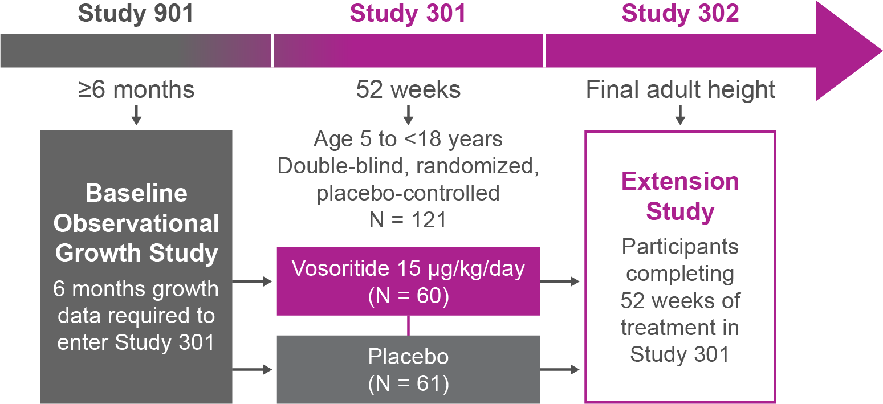
Extension Study
Study design slide 2
All enrolled participants in the extension study received vosoritide at 15 μg/kg.
ACT_015b
Once the 52-week placebo-controlled study was completed, patients could enroll
in the ongoing extension study, in which all participants are receiving vosoritide.
[Savarirayan 2021 study 302: p2A]
Savarirayan, et al. Lancet. 2020.

Slide 38



Efficacy Outcomes
Study design slider 3
Several efficacy outcomes were included in Study 302, such as:
  The primary efficacy outcome was change in AGV from baseline at 52 weeks in patients administered vosoritide versus placebo.
  Secondary outcomes included change from baseline in:
  Height z scores
  Body segment proportionality
  Lab testing for certain biomarkers:
  Urinary cGMP (marker of
  vosoritide activity)
  Serum CXM (marker of
  bone growth)
  QOL and functional independence measures
AGV, annualized growth velocity; cGMP, cyclic guanosine monophosphate; CXM, collagen X marker; QOL, quality of life.
Savarirayan, et al. Lancet. 2020.
[CT.gov 301: p6B, 7A] [Savarirayan 2020: p3A]

Slide 39

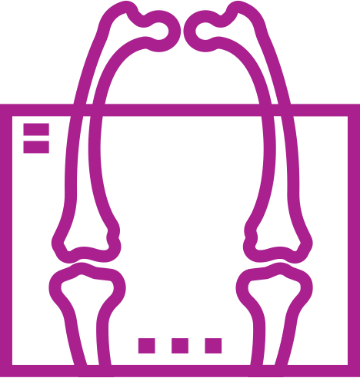
Safety End Points
Study design slider 4
Safety outcomes included TRAEs after initiation of the study drug and up to 30 days after treatment stopped, as well as:
  Clinical examination (eg, ECG,
  vital signs, hip assessment)
  Laboratory
  testing (eg,
  immunogenicity)
  Imaging assessments
  (eg, BMD, growth plate assessment)
BMD, bone mineral density; ECG, electrocardiogram; TRAE, treatment-related adverse event.
Savarirayan, et al. Lancet. 2020.
[CT.gov 202: p8A] [Savarirayan 2020 Study 301: p3B]

Slide 40
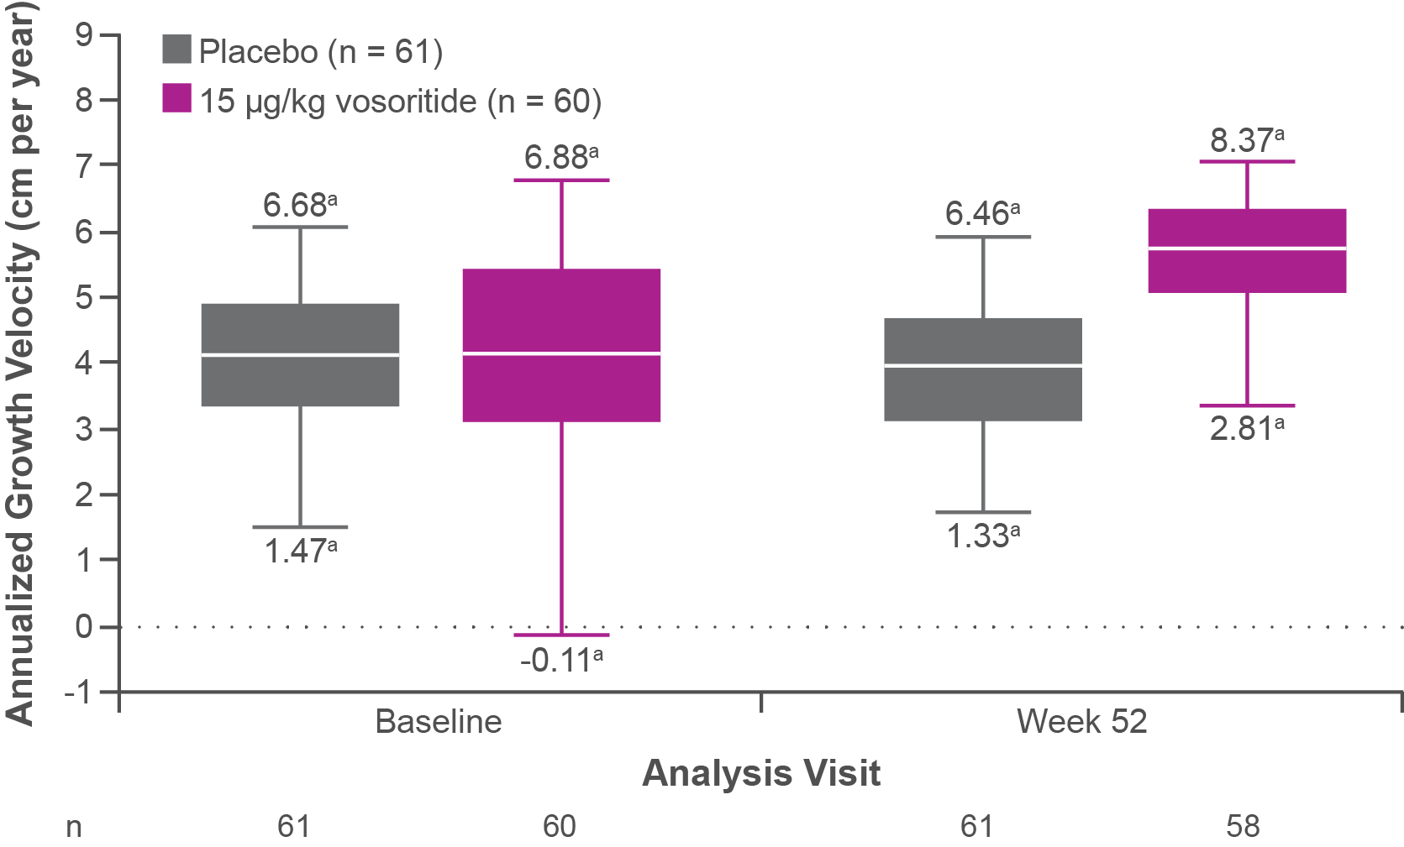
Box and Whisker Plot for Mean AGV Over 52 Weeks for Both Treatment Arms
52 weeks efficacy slider 1
The box and whisker plot shows the primary efficacy end point results. The increase in AGV from baseline to 52 weeks in subjects treated with vosoritide versus placebo was 1.57 cm/year (1.71 cm/year for vosoritide versus 0.13 cm/year for placebo).
ACT_016
ªOutliers.
Savarirayan, et al. Lancet. 2020.
[Savarirayan 2020 study 301: p5B, 6A, B]

Slide 41
Key Secondary Outcomes at 52 Weeks
52 weeks efficacy slider 2
As shown in the table below, relative to placebo, vosoritide was associated
with a significant improvement in height z score of +0.28. The upper to lower body segment ratio did not show improvement over 52 weeks with vosoritide.
 | Placebo (N = 61) | Vosoritide (N = 60) | Difference in least-squares means | Two-sided P value
Change from baseline in height z score | -0.01 (-0.10-0.09) | 0.27 (0.18 to 0.36) | 0.28 (0.17 to 0.39) | <0.0001
Change from baseline in upper to lower body segment ratio | −0.02 (−0.05 to 0.01) | −0.03 (−0.06 to 0.00) | −0.01 (−0.05 to 0.02) | 0.51
Savarirayan, et al. Lancet. 2020.
[Savarirayan 2020 study 301: p5C]

Slide 42
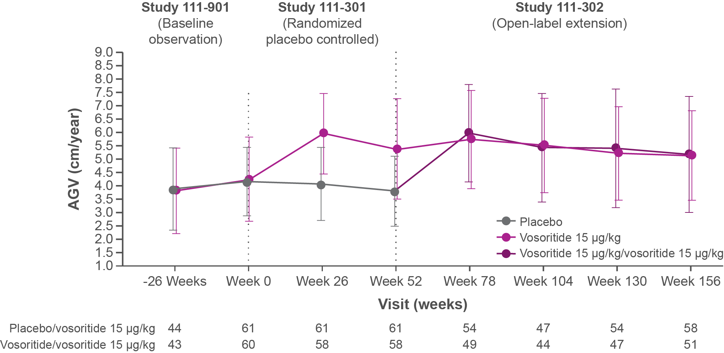
Mean AGV With Vosoritide vs Placebo Over 3 Years
Long-term efficacy slider 1
The graph shows AGV over 156 weeks (3 years). Within 6 months of starting therapy, those in the placebo arm had similar AGV to those who received treatment during the entire period.
ACT_017
AGV was assessed over 6-month intervals. The improvement in AGV observed in Study 301 was maintained in Study 302.
Savarirayan, et al. Genet Med. 2021.
[Savarirayan 2021 study 302: p2B, 3B] [ACH Medical Deck DOF: p29A]

Slide 43
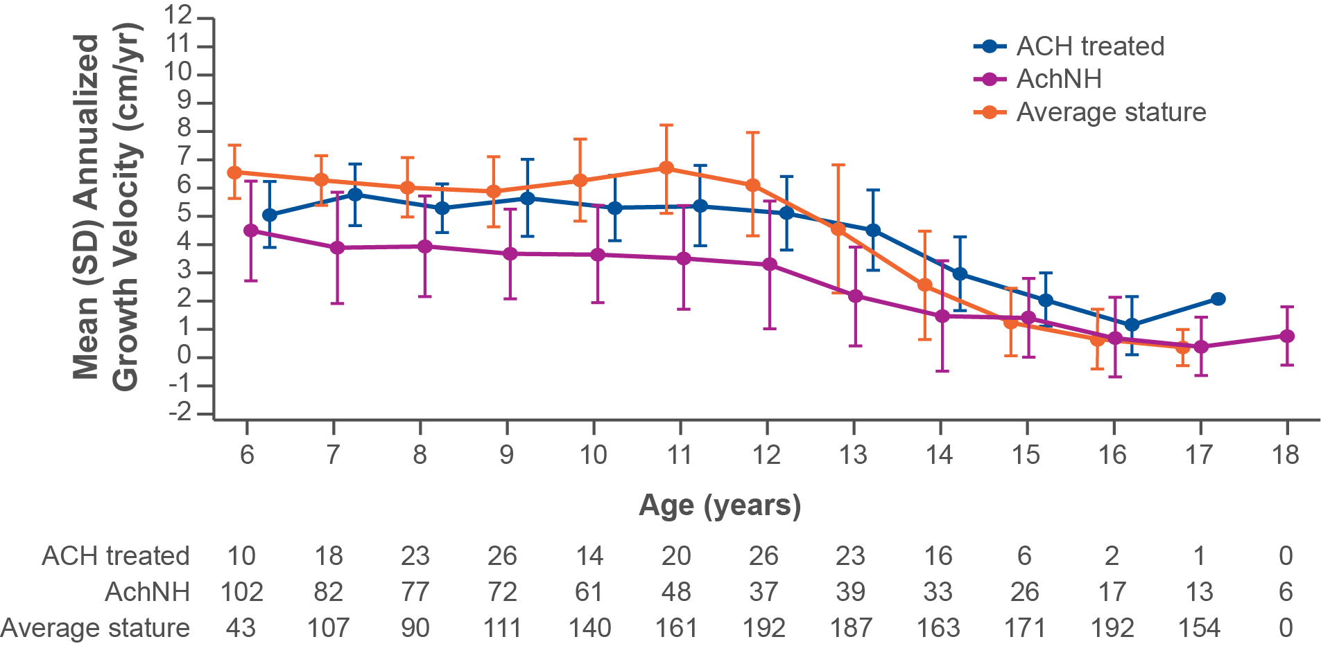
12-Month Interval AGV Over 4 Years in Females Treated With Vosoritide vs Untreated Comparators
Long-term efficacy slider 2
This graph shows 12-month interval AGV by ages of vosoritide-treated female patients in Study 301/302 compared to an untreated achondroplasia population (CLARITY) and average stature population (CDC). Mean AGV is higher for vosoritide-treated participants than for untreated comparators in CLARITY. Mean AGVs of treated children are comparable to that of average stature children prior to puberty but are maintained over a longer duration.
ACT_018
The Mean (SD) of the mean differences in AGV between treated and untreated across integer ages 6–17 years is 1.46 (0.61) cm/yr in females. There is no evidence of a pubertal growth spurt in children with achondroplasia.
Savarirayan, et al. Presented at ACMG 2024.
[Savarirayan 2024 ACMG_302: p1A]

Slide 44
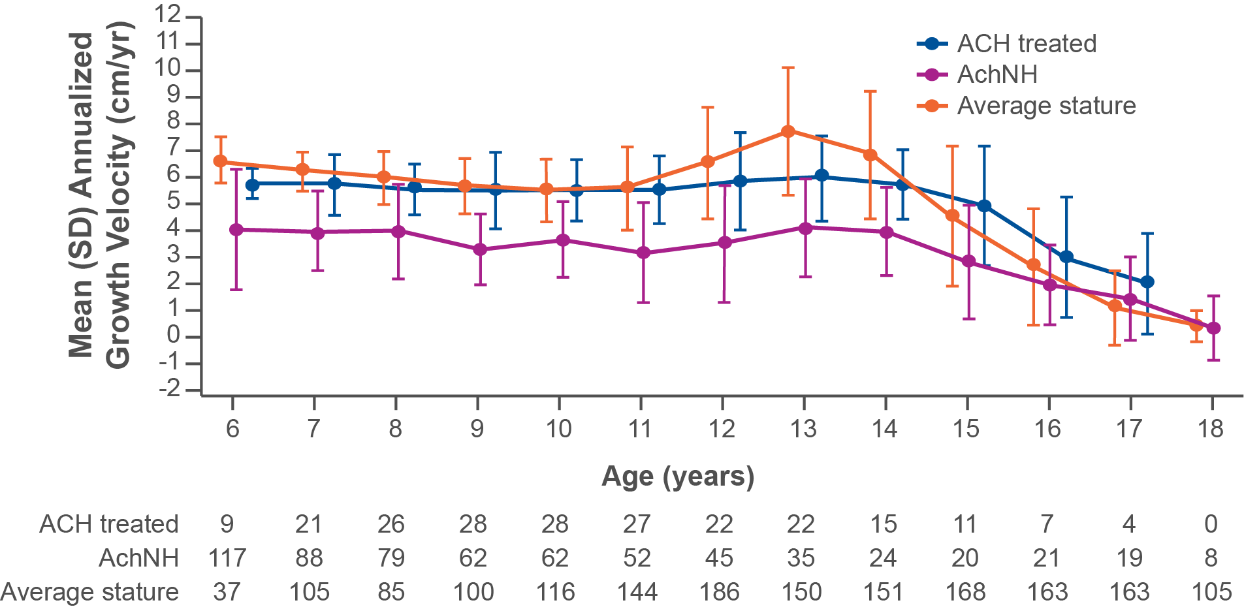
12-Month Interval AGV Over 4 Years in Males Treated With Vosoritide vs Untreated Comparators
Long-term efficacy slider 3
This graph shows 12-month interval AGV by ages of vosoritide-treated male patients in Study 301/302 compared to an untreated achondroplasia population (CLARITY) and average stature population (CDC). Similar to what was observed in female participants, mean AGV is higher for vosoritide-treated participants than for untreated comparators in CLARITY. Mean AGVs of treated children are comparable to that of average stature children prior to puberty but are maintained over a longer duration.
ACT_019
A growth spurt is generally absent among those with achondroplasia. AGV remains higher for those who are treated with vosoritide versus the untreated population in CLARITY.
The Mean (SD) of the mean differences in AGV between treated and untreated across integer ages 6–17 years is 1.73 (0.52) cm/yr in males. There is no evidence of a pubertal growth spurt in children with achondroplasia.
Savarirayan, et al. Presented at ACMG 2024.
[Savarirayan 2024 ACMG Study 302 LT: p1B]

Slide 45
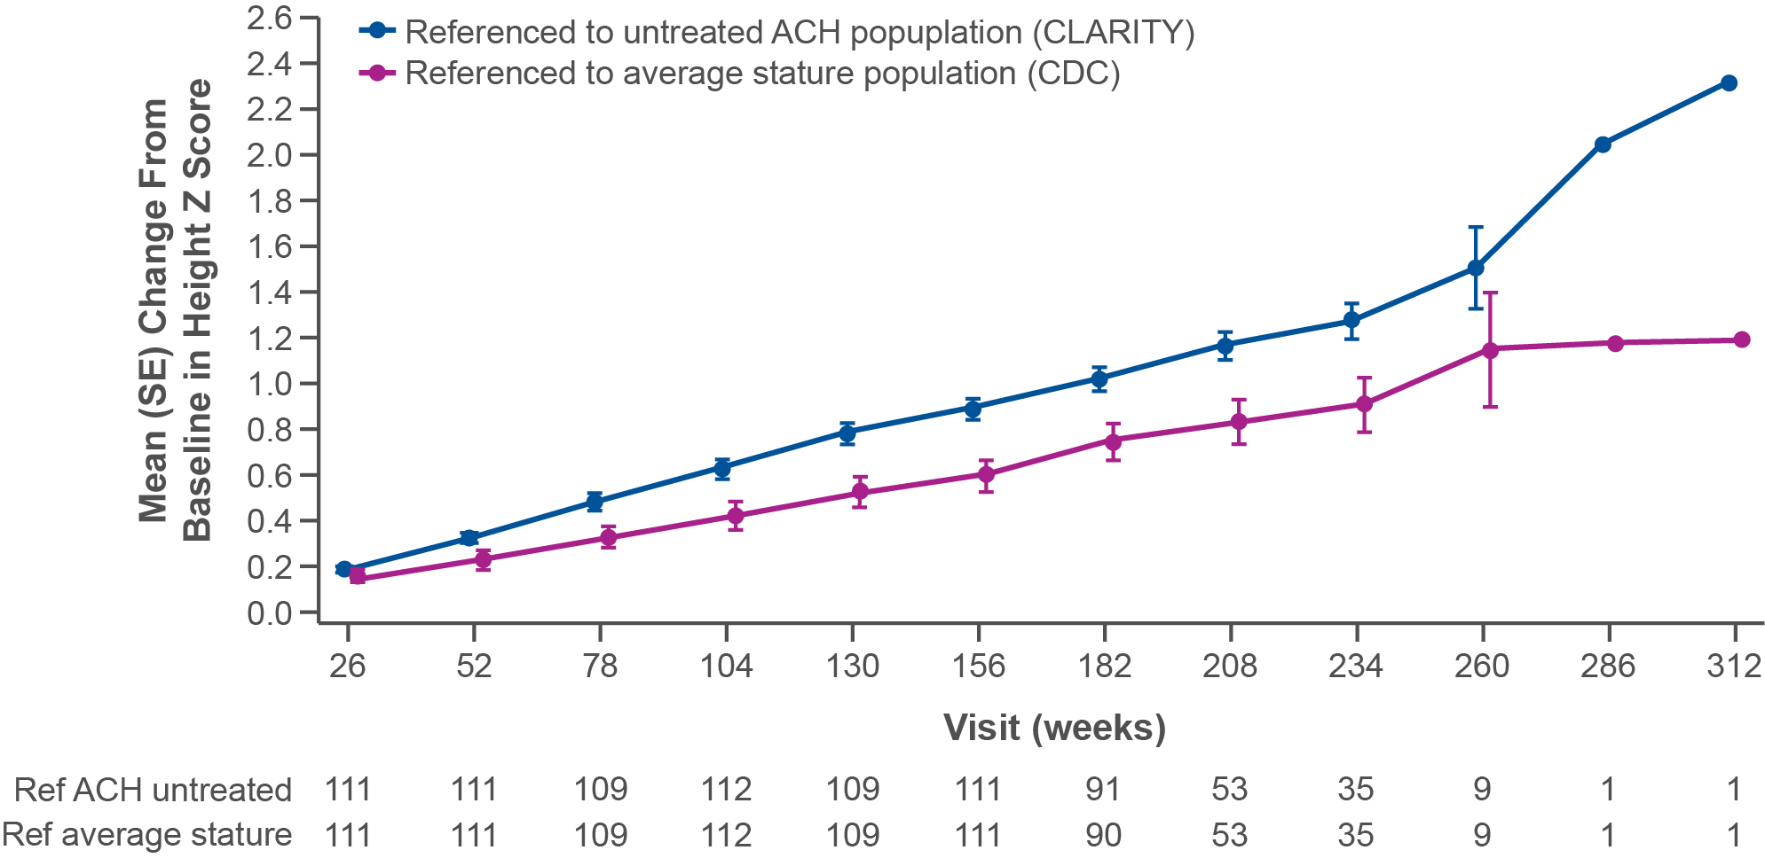
Mean Change in Height Z Scores Over 6 Years
Long-term efficacy slider 4
The graph shows change in height z score of vosoritide-treated participants versus 2 untreated reference populations, CLARITY and those with average stature (CDC). Height z scores continue to increase over time. The positive mean change from baseline (-5.13) illustrates the durability of treatment over time.
ACT_020
Over this time-period, an additional height gain of 5.75 cm (95% CI 4.93, 6.57) over 3 years for treated children vs. untreated ACH age- and sex-matched controls was observed.
Savarirayan, et al. Presented at ACMG 2024.
[Savarirayan 2024 ACMG Study 302 LT: p1C]

Slide 46
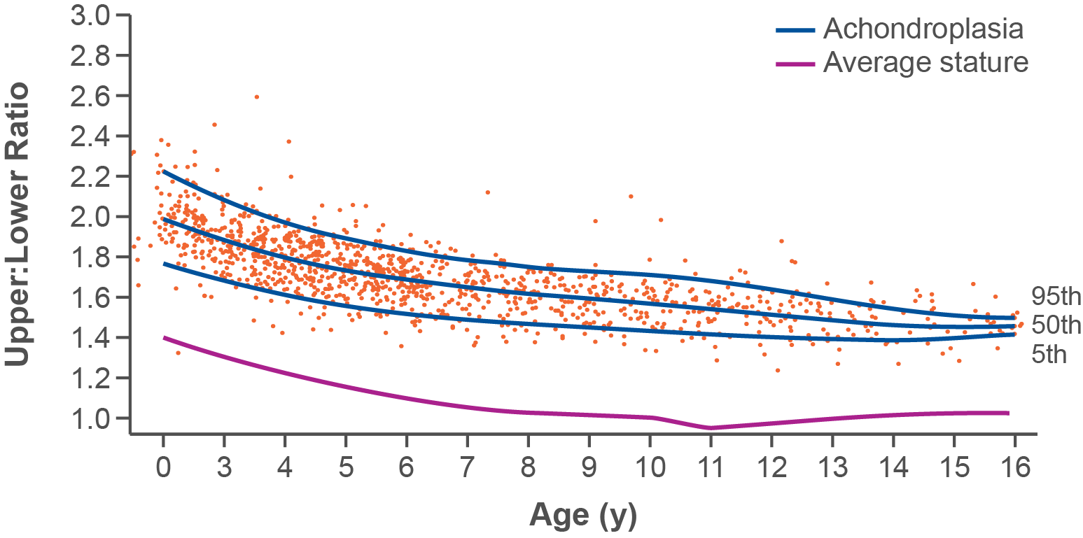
Body segment proportionality
Long-term efficacy slider 5
The upper to lower body segment ratio in untreated children with achondroplasia is greater than that of their peers of average stature (upper body segment is longer than the lower body segment). Therefore, a decrease in the ratio is a good outcome.
ACT_021
[ACH medical deck DOF: p38A]
Hoover-Fong J et al., presented at ACMG 2023. Hoover-Fong et al. Am J Clin Nutr. 2008.

Slide 47
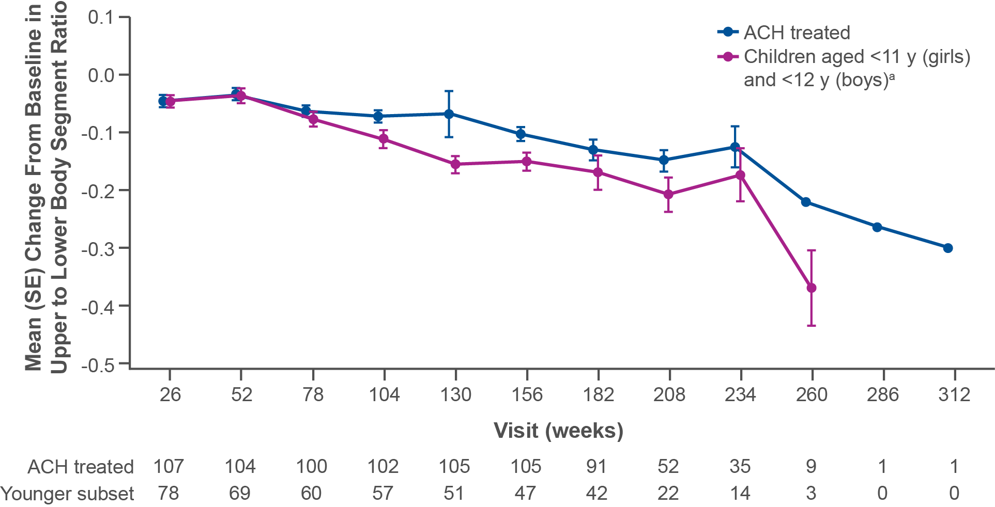
Change in Upper to Lower Body Segment Ratio in the Overall Population and in Younger Subset
Long-term efficacy slider 6
The graph shows the body segment ratio over a 4-year period for the overall treatment population and a subset of younger children.
Upper to lower body segment ratios continued to improve over time.
The improvements were greater among the subset of children aged
<11 years (females)/<12 years (males) for whom there may be more opportunity to impact this parameter.
ACT_022
ªAssessments beyond these ages are excluded from analysis given any treatment is unlikely to impact proportionality.
Savarirayan, et al. Presented at ACMG 2024.
[Savarirayan 2024 ACMG Study 302 LT: p1D]

Slide 48
HRQoL
HRQoL slider
The Quality of Life in Short Stature Youth (QoLISSY) is
a self-reported questionnaire of HRQoL in children with achondroplasia. In Study 301/302, the QoLISSY consisted of 5 core domains that help measure aspects of the child’s functioning and well-being.
Children and caregivers completed the QoLISSY at baseline and at 6-month intervals
As the QoLISSY was designed for those ≥8 years of age, scores were not available for all participants at baseline
Physical
Emotional
Coping
Social
Beliefs about height
[Savarirayan 2024 ACMG Study 302 QOL: p1A-D]
HRQoL: health-related quality of life. Savarirayan, et al. Presented at ACMG 2024.

Slide 49
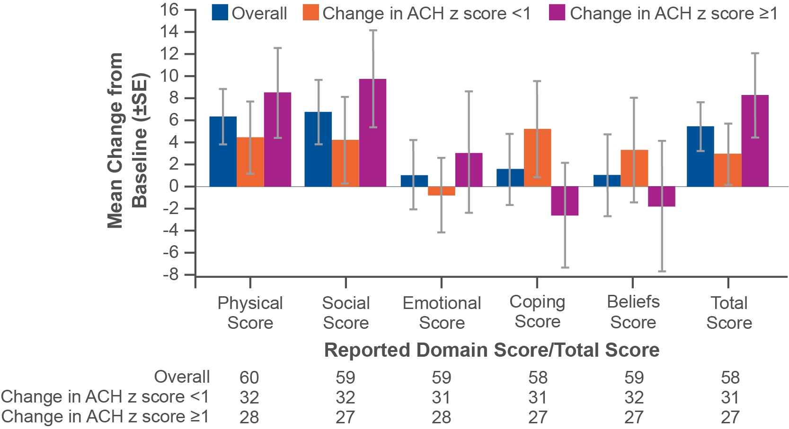
Change from Baseline in Self-reported QoLISSY scores at Year 3 in the Treated Population
HRQoL slider
The chart shows mean change from baseline of self-reported QoLISSY scores across 5 domains for the overall study population and stratified by the magnitude of change in the height z scores. These data suggest that vosoritide improves HRQoL among children with achondroplasia, particularly for the physical domain scores.
ACT_023
Among participants with greater improvements in their height z scores (≥1 SD), improvements in QoLISSY scores were generally more substantial.
ªHeight z scores were derived using age/sex-specific reference data from CLARITY.
HRQoL, health-related quality of life; SD, standard deviation.
Savarirayan, et al. Presented at ACMG 2024.
[Savarirayan 2024 ACMG Study 302 QOL: p1C]

Slide 50
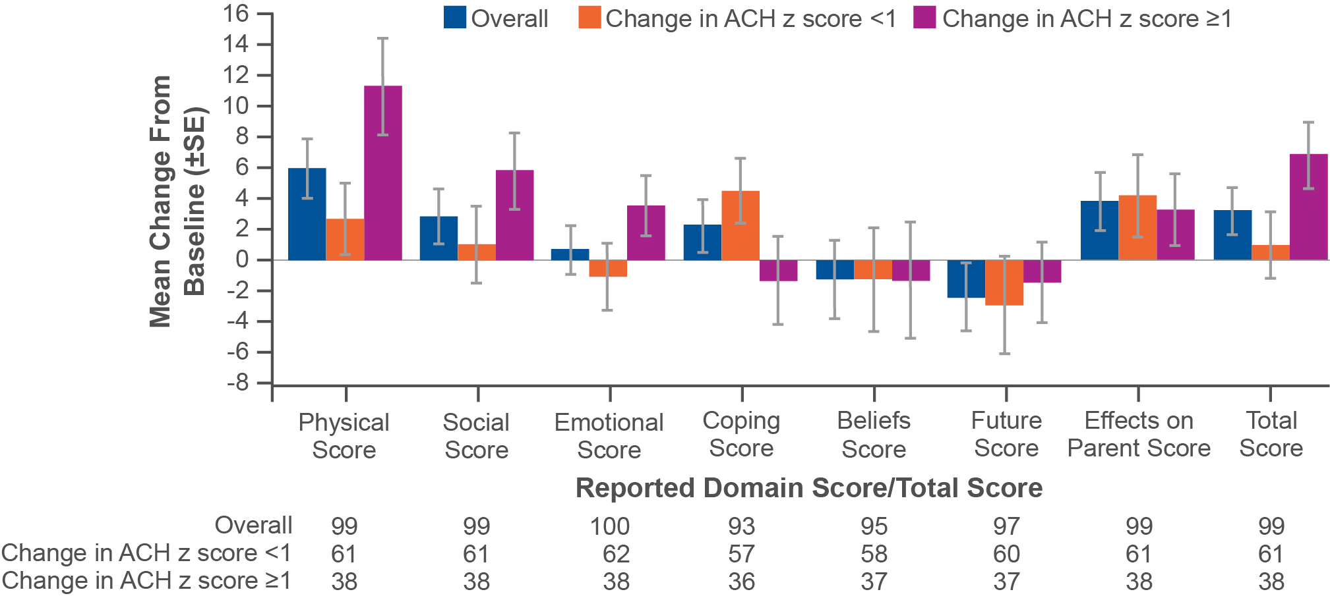
Change from Baseline in Caregiver reported QoLISSY scores at Year 3 in the Treated Population
HRQoL slider
The chart shows mean change from baseline of caregiver-reported QoLISSY across 7 domains. Caregivers had 2 additional scoring domains: questions that pertained to the child’s future and questions about the effects of the child’s diagnosis on parents. Improvements in HRQoL were generally greatest in the physical and social domains.
ACT_024
Caregivers of children with achondroplasia whose height z scores improved by SD ≥1 reported greater improvements in HRQoL compared with caregivers of children with achondroplasia who did not have this magnitude of improvement (SD<1).
ªHeight z scores were derived using age/sex-specific reference data from CLARITY.
HRQoL, health-related quality of life; SD, standard deviation.
Savarirayan, et al. Presented at ACMG 2024.
[Savarirayan 2024 ACMG Study 302 QOL: p1B]

Slide 51
Injection-site reactions were the most common AE
Safety slider 1
Most Common AEs During Treatment Phase
Most Common AEs in Study 301
AE, n (%) | Placebo (N = 61) | Vosoritide (N = 60)
 | Incidence | Incidence
Any adverse event | 60 (98%) | 59 (98%)
Injection-site reaction | 29 (48%) | 44 (73%)
Injection-site erythema | 40 (66%) | 41 (68%)
Injection-site swelling | 6 (10%) | 23 (38%)
Nasopharyngitis | 18 (30%) | 16 (27%)
Vomiting | 12 (20%) | 16 (27%)
Headache | 16 (26%) | 14 (23%)
Pyrexia | 13 (21%) | 10 (17%)
Arthralgia | 4 (7%) | 9 (15%)
Savarirayan, et al. Lancet. 2020.
Full table
[Savarirayan 2020 study 301: p7A]

Slide 52
Most Common AEs (≥10%) In the
Full Safety Population
New slide type accessed off of safety slider 1
Most Common AEs in Study 301
AE, n (%) | Placebo (N = 61) |  | Vosoritide (N = 60)
 | Incidence | Event rate | Incidence | Event rate
Any adverse event | 60 (98%) | 2121 (34.8) | 59 (98%) | 7345 (126.7)
Injection-site reaction | 29 (48%) | 229 (3.8) | 44 (73%) | 2280 (39.3)
Injection-site erythema | 40 (66%) | 1215 (19.9) | 41 (68%) | 3987 (68.7)
Injection-site swelling | 6 (10%) | 53 (0.9) | 23 (38%) | 322 (5.6)
Nasopharyngitis | 18 (30%) | 29 (0.5) | 16 (27%) | 26 (0.4)
Vomiting | 12 (20%) | 16 (0.3) | 16 (27%) | 25 (0.4)
Headache | 16 (26%) | 30 (0.5) | 14 (23%) | 23 (0.4)
Pyrexia | 13 (21%) | 22 (0.4) | 10 (17%) | 11 (0.2)
Arthralgia | 4 (7%) | 7 (0.1) | 9 (15%) | 11 (0.2)
Injection-site urticaria | 2 (3%) | 5 (0.1) | 8 (13%) | 71 (1.2)
Upper respiratory tract infection | 10 (16%) | 12 (0.2) | 8 (13%) | 8 (0.1)
Blood pressure decreased | 3 (5%) | 3 (0.05) | 7 (12%) | 10 (0.2)
Cough | 8 (13%) | 10 (0.2) | 7 (12%) | 8 (0.1)
Diarrhea | 2 (3%) | 2 (0.03) | 6 (10%) | 8 (0.1)
Ear infection | 6 (10%) | 6 (0.1) | 6 (10%) | 8 (0.1)
Ear pain | 3 (5%) | 3 (0.05) | 6 (10%) | 11 (0.2)
Influenza | 3 (5%) | 3 (0.05) | 6 (10%) | 8 (0.1)
Oropharyngeal pain | 4 (7%) | 4 (0.1) | 6 (10%) | 13 (0.2)
Otitis media | 6 (10%) | 9 (0.1) | 6 (10%) | 7 (0.1)
Savarirayan, et al. Lancet. 2020.
[Savarirayan 2020 study 301: p5C]

Slide 53


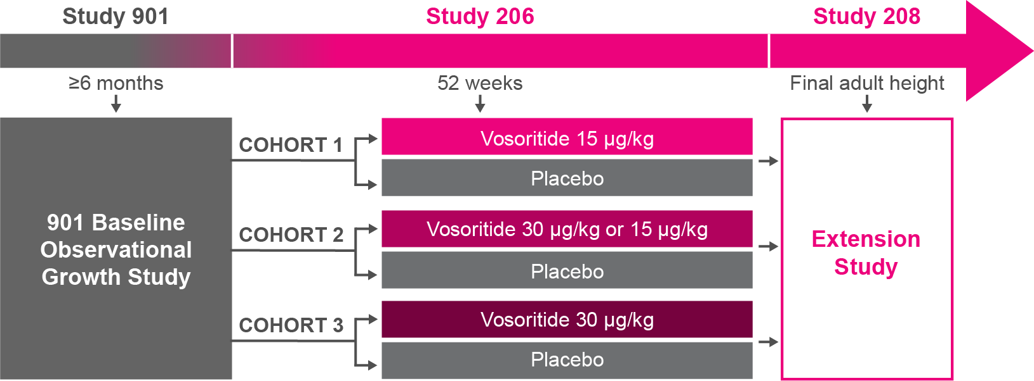

Primary Objective
Study Population
To determine the
impact of treatment
with vosoritide in younger children
with achondroplasia (infants and toddlers)
Participants must have completed ≥6
months in baseline study (Study 901)
0
5
Age:
0
Years
<18
[Savarirayan 2024 study 206: p2B]
N = 75
[Savarirayan 2024 study 206: p2B, 3A, B]
Study Design
  The cohorts in
  Study 206 were
  stratified by age:
  C1: 24 to <60 months,
  C2: 6 to <24 months,
  and C3: 0 to
  <6 months.
ACT_025
[Savarirayan 2024 study 206: p2B, 3A, B, 4C]
52-Week Efficacy
  Improvements in height z score in Study 206 were consistent with those observed in older children (Study 301).
Safety
  Safety profile consistent with that in treated children over 5 years of age
  Most common AEs observed were
  mild and self-limiting injection
  site reactions
[Savarirayan 2024 study 206: p2C, 10C]
Long-term Efficacy
  After 4 years, children treated with vosoritide gained 90% of height gained by average stature children.
[Savarirayan 2024 study 206: p2C, 10B]
[Savarirayan ACMG 2024 study 208: p1F]
Savarirayan, et al. Lancet Child Adolesc Health. 2024.
[Savarirayan 2024 study 206: p2A, B, 3A, B, 4C]

Slide 54
Study 206/208
Study 206 was a randomized, placebo-controlled, phase 2, 52-week trial among 75 children 3 to 59 months.
This trial represented the youngest participants treated with vosoritide to date. Children were randomized by age into 3 cohorts to receive vosoritide or placebo:
Cohort 1: ≥24 to <36 months and ≥36 to <60 months
Cohort 2: 6 to <15 months and ≥15 to <24 months
Cohort 2: <6 months
Children who completed the study were eligible to
receive vosoritide in the extension study, Study 208.
Study 206 findings were published in The Lancet Child and Adolescent Health in 2024. Data for children receiving up to 4 years of treatment in Study 206/208 were reported at ACMG 2024.
Savarirayan, et al. Lancet Child Adolesc Health. 2024.
[Savarirayan 2024 study 206: p2A, 3A, B]

Slide 55




Inclusion Criteria
Study population slider
ACT_008
  Aged 0 to 5 years at study entry
  Have achondroplasia confirmed by
  genetic testing
  Have completed
  $≥$6 months in Study 901
For full list of inclusion criteria, see Clinicaltrials.gov NCT03583697.
Savarirayan, et al. Lancet Child Adolesc Health. 2024.
[CT.gov stud 206: p4A][Savarirayan 2024 Study 206 : p2A, 3A]

Slide 56




Exclusion Criteria
Study population slider
  Have hypochondroplasia or short stature condition
  other than achondroplasia
  History of CMC likely
  to require surgical intervention within
  60 days of screening
  History of certain medical conditions
  (eg, insulin-requiring diabetes, autoimmune disease, arrhythmia)
ACT_026
  Recent or prolonged growth hormone therapy
  Have any history of
  bone-related surgery
For full list of exclusion criteria, see Clinicaltrials.gov NCT03583697.
Savarirayan, et al. Lancet Child Adolesc Health. 2024.
[CT.gov stud 206: p4B][Savarirayan 2024 Study 206: p2A, 3A]

Slide 57


Participant Baseline Characteristics
Study population slider
SEX (Placebo)
SEX (Vosoritide)
Male 41%
Male 58%
Female 59%
Female 42%
[Savarirayan 2024 study 206: p4D]
Savarirayan, et al. Lancet Child Adolesc Health. 2024.

Slide 58
Participant Baseline Characteristics
Study population slider
AGE AT SCREENING
(Placebo)
AGE AT SCREENING
(Vosoritide)
0
5
0
5
0
Age Range
(Years)
<18
0
Age Range
(Years)
<18
Median age
27.8 months
Median age
24.4 months
Savarirayan, et al. Lancet Child Adolesc Health. 2024.
[Savarirayan 2024 study 206: p4D]

Slide 59
Sentinel Subjects
Each Study 206 cohort included 11 sentinel subjects.
These sentinels completed 8 days of dosing in a
lead-in phase.
  Stopping criteria and PK data were reviewed by an independent DMC prior to randomization of the remaining cohort
  PK data review was by cohort (oldest cohort first)
  Once sentinel data were evaluated, the remaining participants were randomized
[Savarirayan 2024 study 206: p3A, B, 4C]
DMC, data monitoring committee; PK, pharmacokinetic.
Savarirayan, et al. Lancet Child Adolesc Health. 2024.

Slide 60
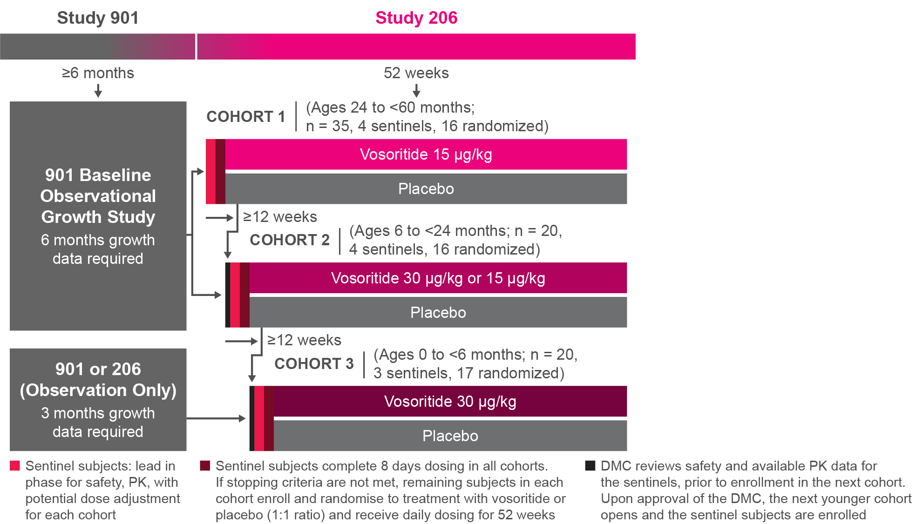
Treatment Period
Study design slide
Subjects received either vosoritide
or placebo for
52 weeks. Those in the treatment arms received 30 μg/kg
of vosoritide while they were <2 years of age. Once subjects reached
2 years of age, they received 15 μg/kg of vosoritide.
ACT_027a
Savarirayan, et al. Lancet Child Adolesc Health. 2024.
[Savarirayan 2024 study 206: p2A, 3A, B, 4C]

Slide 61
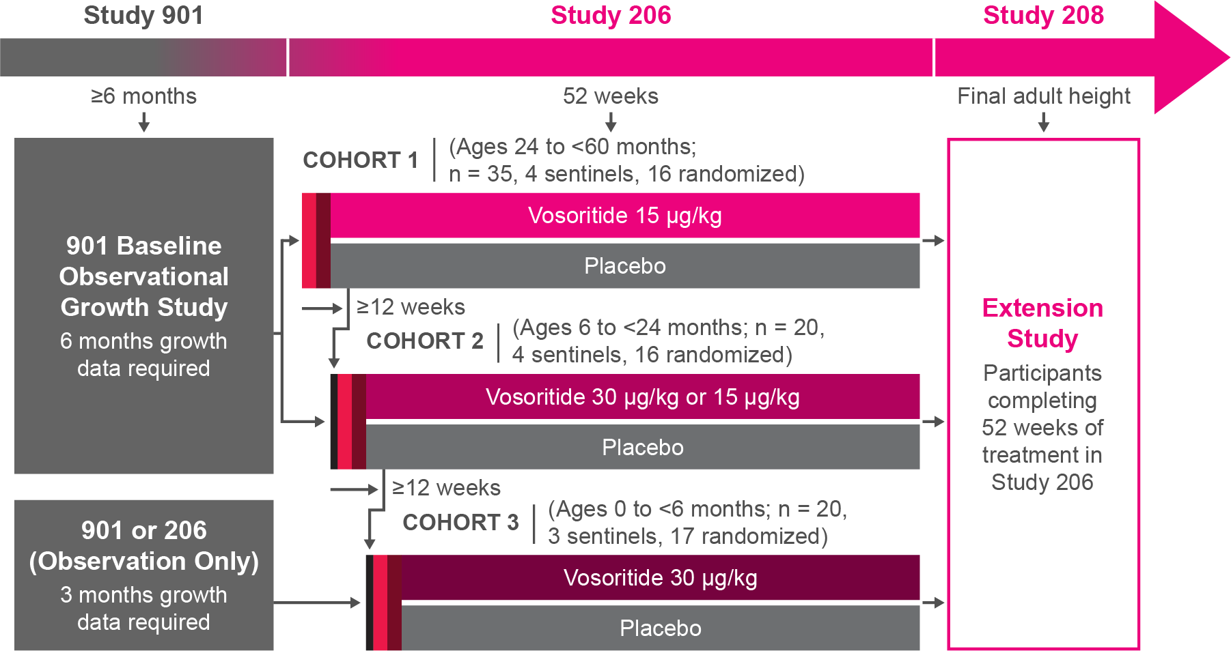
Extension Study
Study design slide
ACT_027b
Subjects completing Study 206 continued in the open-label extension study. The dosing parameters were the same (age-dependent).
Savarirayan, et al. Lancet Child Adolesc Health. 2024.
[Savarirayan 2024 study 206: p2A, 3A, B, 4C]

Slide 62



Safety End Points
Study design slider
The primary objective was to evaluate safety and tolerability of vosoritide in younger children. Safety outcomes included TRAEs after initiation of the study drug and up to 30 days after treatment stopped, as well as:
  Clinical examination (eg, ECG,
  vital signs, hip assessment)
  Laboratory
  testing (eg,
  immunogenicity)
  Imaging assessments
  (eg, BMD)
BMD, bone mineral density; ECG, electrocardiogram; TRAE, treatment-related adverse event.
Savarirayan, et al. Lancet Child Adolesc Health. 2024.
[CT.gov 206: p7A-D] [Savarirayan 2024 study 206: p3D, 4A]

Slide 63


Efficacy Outcomes
Study design slider
  The study was not powered for efficacy comparisons.ª Outcomes included change from baseline (at 52 weeks) in:
  Height z scores (primary efficacy outcome)
  Height gain
  AGV
  Body segment proportionality
  Lab testing for certain biomarkers:
  Urinary cGMP (marker of
  vosoritide activity)
  Serum CXM (marker of
  bone growth)
  QOL and functional independence measures
ªThere were no prior statistical hypotheses and consequently no type I error control for testing any of the efficacy end points. It is therefore not meaningful to speak of statistical significance in relation to the results.
AGV, annualized growth velocity; cGMP, cyclic guanosine monophosphate; CXM, collagen X marker;
QOL, quality of life.
Savarirayan, et al. Lancet Child Adolesc Health. 2024.
[CT.gov 206: p6A] [Savarirayan 2024 Study 206: p3D, 4A, B]

Slide 64
Dosing in Study 206
52-week efficacy slide 1
The PK data among sentinel patients in Cohort 1 showed the 15 μg/kg dose was appropriate for that age group
(5 to 12 years). Sentinel participants in Cohort 2 initially received 15 μg/kg. After data showed the mean exposure at 15 μg/kg among the younger children was less than what was observed in prior phase 2 studies, dosing was adjusted to 30 μg/kg thereafter for those <2 years of age (which included those in Cohort 3).
All children <2 years of age in the study continued to receive 30 μg/kg until they reached 2 years of age,
after which they received 15 μg/kg.
Savarirayan, et al. Lancet Child Adolesc Health. 2024.
[Savarirayan 2024 Study 206: p5C]

Slide 65
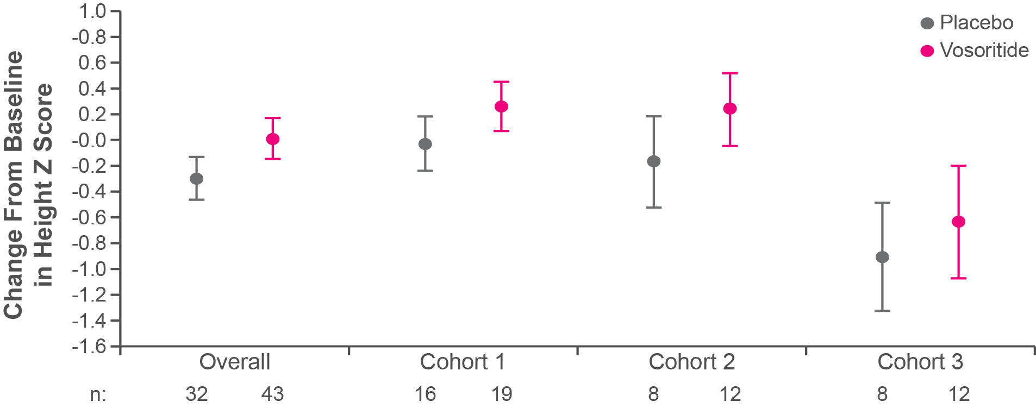
Changes in Height Z Score After 1 Year in Children <5 Years of Age
52-week efficacy slide 2
Mean baseline height z score for the overall population was -3.8 and -4.3 in the vosoritide and placebo groups, respectively. Improvements in height z score over 52 weeks were consistent across all 3 cohorts and were also consistent with improvements observed in trials with older children (age ≥5 years).
ACT_028
Overall population (all enrolled, N = 75) increased height z score by 0.30 SD (95% CI 0.07, 0.54)ª
ªHeight z score in the randomized population (n = 64), which did not include the sentinels, increased by 0.25 SD (95% CI -0.02, 0.53) with vosoritide (n = 32) compared to placebo (n = 32).
SD, standard deviation. Savarirayan, et al. Lancet Child Adolesc Health. 2024.
[Savarirayan 2024 study 206: p6B, 9B, 10C]

Slide 66
Statistical Analyses
Long-term efficacy
Two statistical approaches were used for Study 206/208 comparator analyses: cross sectional (CS) and longitudinal (LONGL).
CS analyses:
  Subjects from CLARITY were matched to each treated subject by sex and age (+/-1 month)
  A T test was used to determine treatment gain at
  follow-up time point adjusted by subtracting the difference at baseline
[Savarirayan 2024 ACMG Study 208: 1H]

Slide 67
Statistical Analyses
Long-term efficacy
LONGL analyses:
  Subjects from CLARITY were matched to each treated subject at baseline by sex, age (+/-1 month), height z score (+/- 1 SD), height (+/- 5 cm)
  Subjects from Observational/Placebo (Obs/pbo) data source (untreated subjects from Study 901, Study 206, and Study 301) were included in the control arm based on age and sufficient follow-up (no matching)
  ANCOVA models provide LS mean difference for
  change from baseline at follow-up time point
[Savarirayan 2024 ACMG Study 208: 1H]
ANCOVA, analysis of covariance; LS, least squares; SD, standard deviation
Savarirayan, et al. presented at ACMG 2024.

Slide 68
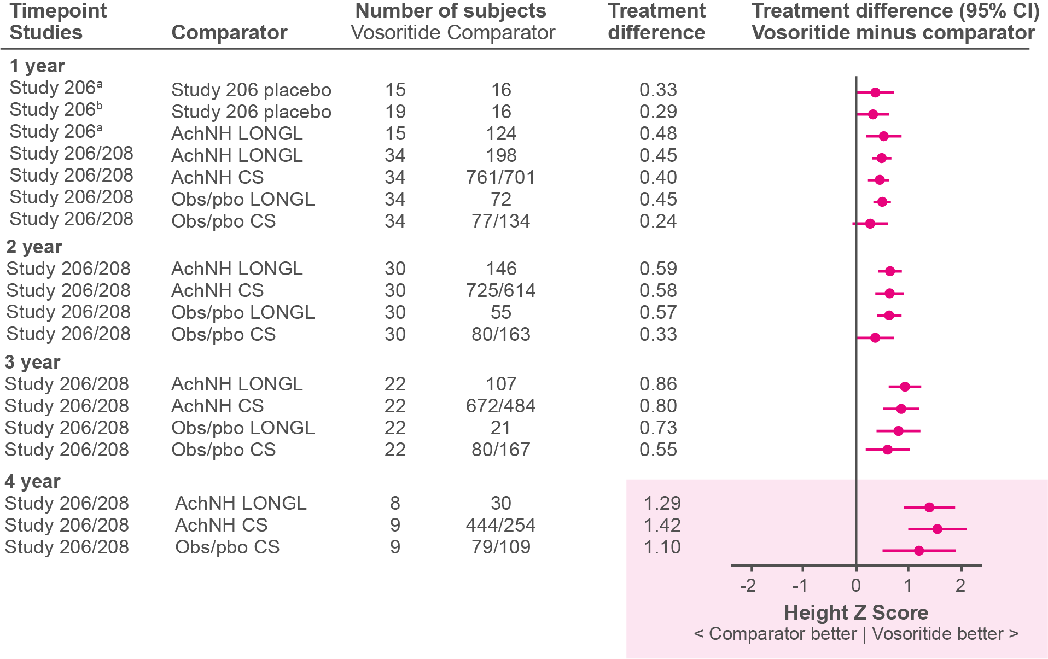
Height Z Scores vs Comparators Among Older Children (≥2 years of age)
Long-term efficacy
The chart below shows height z scores with vosoritide versus placebo after 52 weeks as well as cross-sectional and longitudinal analysis of vosoritide versus untreated children from CLARITY, Study 901,
and placebo groups. Long-term results were reported by age group. Among the older children (≥2 years of age), there was a consistent and sustained treatment effect with mean height z score >1 SD after 4 years.
ACT_029
ªRandomized participants only. ^{b}Sentinels included.
AchNH: achondroplasia natural history; ANCOVA, analysis of covariance; LS, least squares;
SD, standard deviation.
Savarirayan, et al. presented at ACMG 2024.
[Savarirayan 2024 ACMG Study 208: 1B]

Slide 69
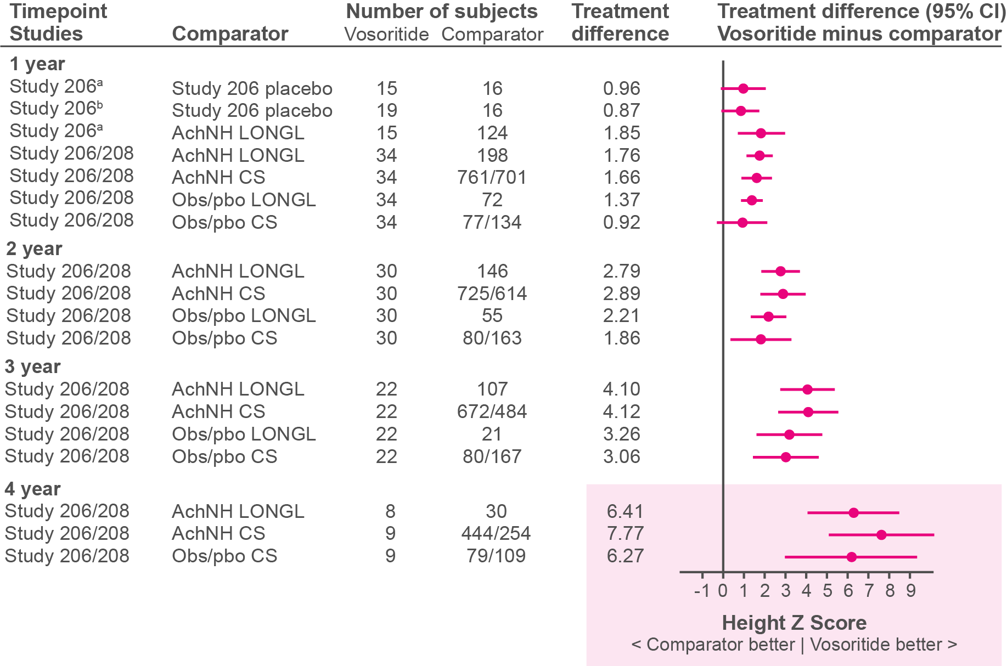
Height Gain vs Comparators Among Older Children (≥2 years of age)
Long-term efficacy
Below are the height gain results for older children (≥2 years of age)
for vosoritide versus untreated children from CLARITY, Study 901,
and placebo groups. The difference in height gain with vosoritide versus untreated comparators was >6 cm after 4 years.
ACT_030
[Savarirayan 2024 ACMG Study 208: 1D]
ªRandomized participants only. ^{b}Sentinels included.
Savarirayan, et al. presented at ACMG 2024.

Slide 70
Comparative Height Restoration Among Older Children (≥2 years of age)
Long-term efficacy
The table below shows relative height gain with up to 4 years of treatment with vosoritide among older children (≥2 years of age) compared with untreated children with achondroplasia and those with average stature. After 4 years, children treated with vosoritide gained 90% of the height gained by average stature children. By comparison, untreated children
in CLARITY gained 66% of the height gained by children with
average stature.
 | Height Gain (cm) After x-Year Follow-up | Height Gain (cm) After x-Year Follow-up
 | After 4 Years |  | After 3 Years |  | After 2 Years
 | Vosoritide | AchNH | Vosoritide | AchNH | Vosoritide | AchNH
 | (N = 9) | (N = 30) | (N = 22) | (N = 107) | (N = 30) | (N = 146)
Average stature | 26.21 | 26.36 | 20.43 | 20.47 | 13.89 | 13.94
ACH | 23.71 | 17.31 | 17.59 | 13.49 | 11.99 | 9.21
% Height gain ACH vs average stature | 90.45 | 65.66 | 86.10 | 65.90 | 86.29 | 66.08
[Savarirayan 2024 ACMG Study 208: 1F]
Savarirayan, et al. presented at ACMG 2024.

Slide 71
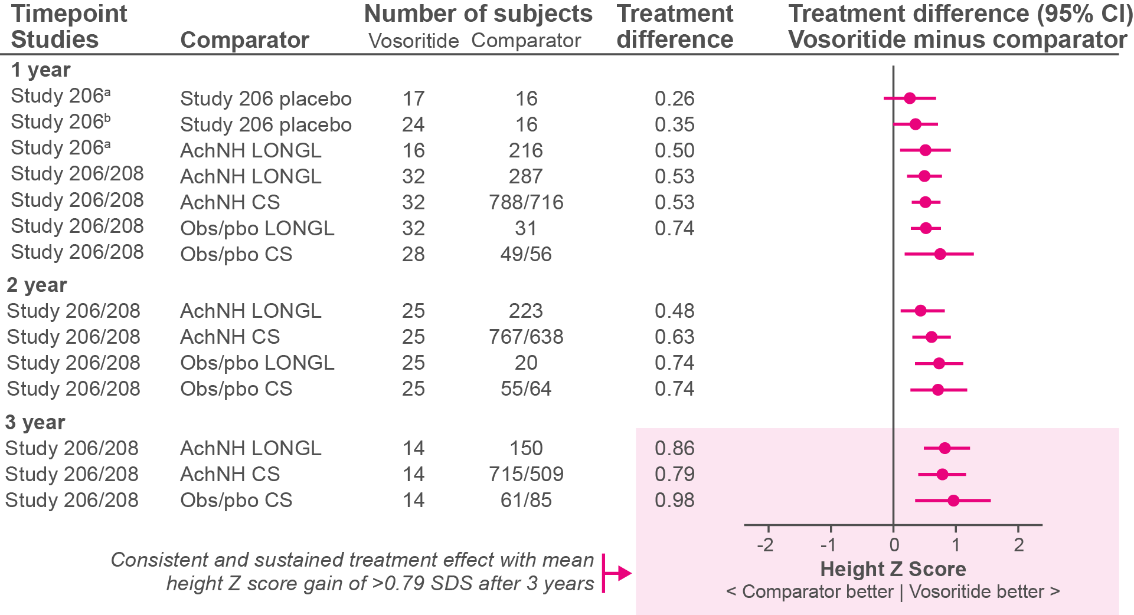
Height Z Scores vs Comparators Among Younger Children (<2 years of age)
Long-term efficacy
The chart below shows height z scores among younger children (<2 years of age) with vosoritide versus placebo after 52 weeks as well as cross-sectional and longitudinal analysis of vosoritide versus untreated children from CLARITY, Study 901, and placebo groups. Among younger children, there was a consistent and sustained treatment effect with mean height z score >0.79 SD after 3 years.
ACT_031
ªRandomized participants only. ^{b}Sentinels included.
Savarirayan, et al. presented at ACMG 2024.
[Savarirayan 2024 ACMG Study 208: 1C]

Slide 72
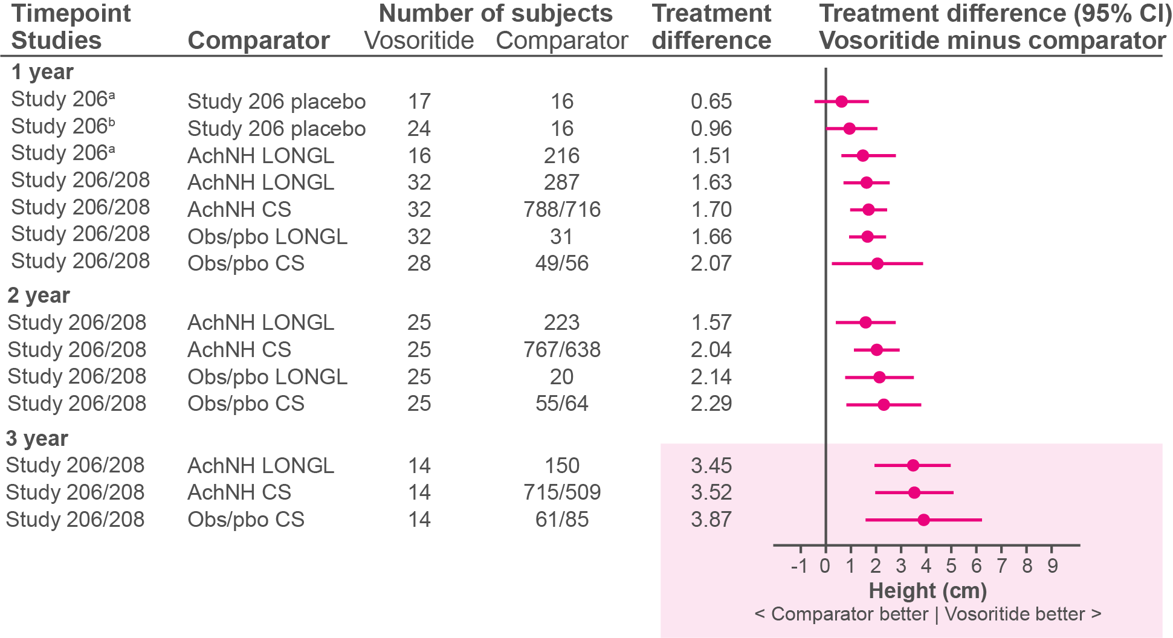
Height Gain vs Comparators Among Younger Children (<2 years of age)
Long-term efficacy
Below are the height gain results for younger children (<2 years of age) for up to 3 years of treatment with vosoritide versus untreated children from CLARITY, Study 901, and placebo groups. The difference in height gain with vosoritide versus untreated comparators was >3.45 cm after
3 years.
ACT_032
ªRandomized participants only. ^{b}Sentinels included.
Savarirayan, et al. presented at ACMG 2024.
[Savarirayan 2024 ACMG Study 208: 1E]

Slide 73
Comparative Height Restoration Among Younger Children (<2 years of age)
Long-term efficacy
Relative height gain results are shown in the table below. Data for younger children (<2 years of age) were available for up to 3 years of treatment with vosoritide. After 3 years, children treated with vosoritide gained 80% of height gained by average stature children. This is compared with untreated children from CLARITY, who achieved 67%
of height gained by children with average stature.
 | Height Gain (cm) After x-Year Follow-up | Height Gain (cm) After x-Year Follow-up
 | After 3 Years |  | After 2 Years |  | After 1 Year
 | Vosoritide | AchNH | Vosoritide | AchNH | Vosoritide | AchNH
 | (N = 14) | (N = 150) | (N = 25) | (N = 223) | (N = 32) | (N = 287)
Average stature | 26.37 | 26.46 | 20.77 | 20.81 | 11.78 | 11.70
ACH | 21.10 | 17.66 | 15.30 | 13.74 | 9.45 | 7.81
% Height gain ACH vs average stature | 80.02 | 66.74 | 73.68 | 66.02 | 80.21 | 66.73
[Savarirayan 2024 ACMG Study 208: 1G]
Savarirayan, et al. presented at ACMG 2024.

Slide 74
Most Common AEs During Treatment Phase
Safety slider
AEs with onset or worsening after initiation of the study drug and up to 30 days after discontinuation were included. Injection site reactions and viral infection were the most common AEs.
Preferred Term | Placebo (N = 32) |  | Vosoritide (N = 43)
Preferred Term | Incidence, n (%) | Events, m (rate) | Incidence, n (%) | Events, m (rate)
Injection site reaction | 13 (40.6) | 154 (4.8) | 34 (79.1) | 3057 (71.5)
Injection site erythema | 13 (40.6) | 1738 (54.3) | 33 (76.7) | 5100 (119.4)
Injection site swelling | 2 (6.3) | 3 (0.1) | 8 (18.6) | 36 (0.8)
Injection site urticaria | 1 (3.1) | 1 (0.0) | 6 (14.0) | 22 (0.5)
Injection site induration | 0 | 0 | 5 (11.6) | 14 (0.3)
Viral infection | 4 (12.5) | 8 (0.2) | 8 (18.6) | 28 (0.7)
There were no clinically relevant differences in the safety profile of vosoritide between age cohorts.
[Savarirayan 2024 study 206: p6A]
Savarirayan, et al. Lancet Child Adolesc Health. 2024.
Full table

Slide 75
Study 206: Incidence of TEAEs Reported With >5% Higher Frequency in Vosoritide vs Placebo
Preferred Term | Placebo (N = 32) |  | Vosoritide (N = 43)
Preferred Term | Incidence, n (%) | Events, m (rate) | Incidence, n (%) | Events, m (rate)
Injection site reaction | 13 (40.6) | 154 (4.8) | 34 (79.1) | 3057 (71.5)
Injection site erythema | 13 (40.6) | 1738 (54.3) | 33 (76.7) | 5100 (119.4)
Injection site swelling | 2 (6.3) | 3 (0.1) | 8 (18.6) | 36 (0.8)
Injection site urticaria | 1 (3.1) | 1 (0.0) | 6 (14.0) | 22 (0.5)
Injection site induration | 0 | 0 | 5 (11.6) | 14 (0.3)
Viral infection | 4 (12.5) | 8 (0.2) | 8 (18.6) | 28 (0.7)
Fall | 3 (9.4) | 5 (0.2) | 7 (16.3) | 9 (0.2)
Arthropod bite | 2 (6.3) | 2 (0.1) | 6 (14.0) | 7 (0.2)
Constipation | 2 (6.3) | 4 (0.1) | 5 (11.6) | 7(0.2)
Dermatitis diaper | 1 (3.1) | 1 (0.0) | 4 (9.3) | 5 (0.1)
Lower respiratory tract infection | 1 (3.1) | 3 (0.1) | 4 (9.3) | 4 (0.1)
Rhinitis | 0 | 0 | 4 (9.3) | 8 (0.2)
Sleep apnoea syndrome | 0 | 0 | 3 (7.0) | 3 (0.1)
Viral upper respiratory tract infection | 0 | 0 | 3 (7.0) | 3 (0.1)
Epistaxis | 0 | 0 | 3 (7.0) | 3 (0.1)
Savarirayan, et al. Lancet Child Adolesc Health. 2024.
[Savarirayan 2024 study 206: p6A]

Slide 76


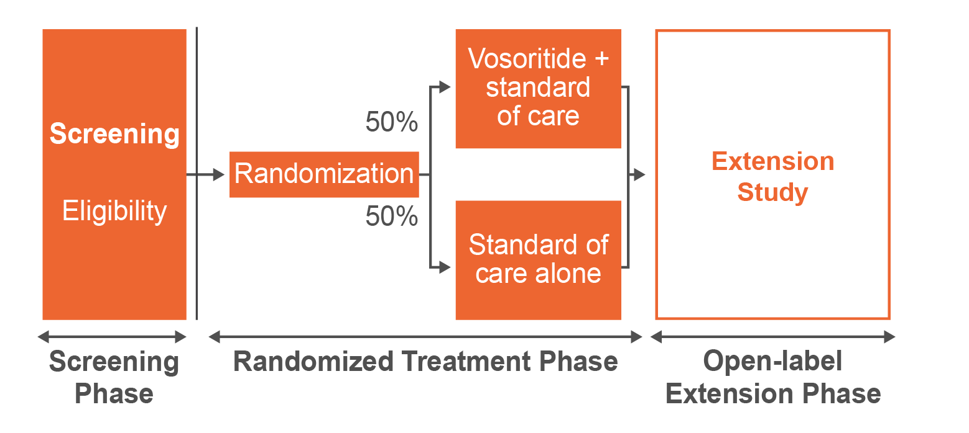


Primary Objective
  To investigate the safety of vosoritide treatment in infants and
  young children with
  achondroplasia
  who are at risk
  of requiring
  cervicomedullary
  decompression
  surgery
Study Population
  Infants <12 months
0
12
Age:
0
Months
24
N = 20
[Savarirayan 2021 Study 209: p6A, 9C]
[Savarirayan 2021 Study 209: p6B]
ACT_033
Study Design
[Savarirayan 2021 Study 209: p10A]
Efficacy
Safety
Savarirayan,, et al. Sci Prog. 2021.

Slide 77
Study 209
For children with achondroplasia, the most important medical complication that drives morbidity and mortality in early childhood is narrowing of the foramen magnum, which can cause cervicomedullary compression, disordered breathing, and sudden infant death.
Study 209 is a randomized, controlled, open-label clinical study to investigate the safety of vosoritide treatment plus standard of care versus standard of care in 20 infants and young children with achondroplasia who are at risk of requiring cervicomedullary decompression surgery.
Based on data from ongoing trials, children <2 years of age in the vosoritide treatment arm received 30 μg/kg until they reach 2 years of age and those age ≥2 years received 15 μg/kg.
[Savarirayan 2021 Study 209: p2B, 3A, 6B]
Savarirayan,, et al. Sci Prog. 2021.

Slide 78



Inclusion Criteria
Study population slider
  Aged 0 to <12 months at study entry
  Have achondroplasia documented by
  genetic testing
  Have evidence of cervicomedullary compression that may require surgery
For full list of inclusion criteria, see Clinicaltrials.gov NCT04554940.
Savarirayan,, et al. Sci Prog. 2021.
[CT.gov stud 209: p4A][Savarirayan 2021 Study 209: p7A]

Slide 79



Exclusion Criteria
Study population slider
  Have hypochondroplasia or short stature condition other
  than achondroplasia
  Growth plates have fused or decreased growth velocity (<1.5 cm/yr) for 6 months
  History of certain medical conditions
  (eg, renal insufficiency, autoimmune disease, recurrent symptomatic hypotension)
  Recent or prolonged growth hormone therapy
  Have had prior cervicomedullary decompression surgery
For full list of exclusion criteria, see Clinicaltrials.gov NCT04554940.
Savarirayan,, et al. Sci Prog. 2021.
[CT.gov stud 209: p4B] [Savarirayan 2021 Study 209: p7B, 8A]

Slide 80
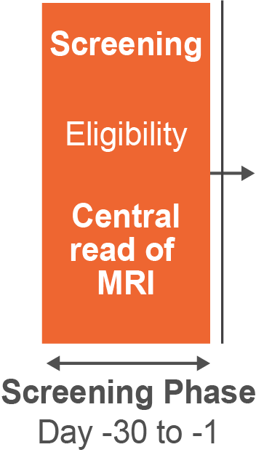
Study Design: Eligibility
Study design slider 1
Prior to randomization, eligibility was determined through a central read of MRI results using the AFMS scoring system. An AFMS 2 or AFMS 3 was required.
ACT_034a
[Savarirayan 2021 Study 209: p12B]
AFMS, achondroplasia foramen magnum score.
Savarirayan,, et al. Sci Prog. 2021.

Slide 81
AFMS
Study design slider 2
The AFMS is an MRI-based grading system that assigns
a score (AFMS 0 to 4) to reflect the severity of foramen magnum stenosis. The score relies on the progressive effect of the decreased foramen magnum on the neuraxis (eg, cord compression and signal changes).
AFMS Risk Score | MRI classification
0 | Normal foramen magnum
1 | Narrowed foramen magnum with preserved CSF surrounding the cord
2 | Loss of CSF without cord remodeling
3 | Cord compression at the cranio-cervical junction without cord signal changes
4 | Cord compression and cord signal changes
AFMS, achondroplasia foramen magnum score; CSF, cerebrospinal fluid.
Savarirayan,, et al. Sci Prog. 2021.
[Savariryan 2021 Study 209: p5A, B]

Slide 82
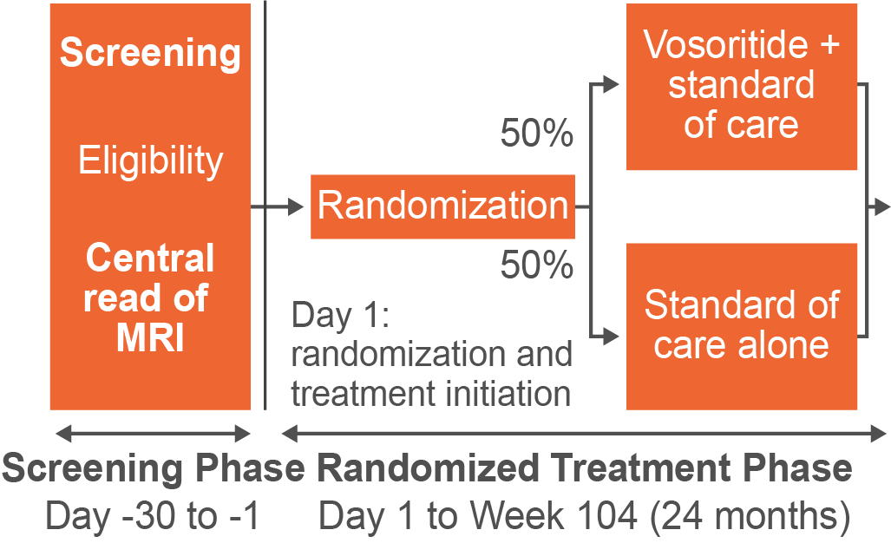
Study Design: Randomized Treatment Phase
Study design slider 3
Patients received vosoritide plus standard of care or standard of care alone for 24 months.
ACT_034b
[Savariryan 2021 Study 209: p10A]
Savarirayan,, et al. Sci Prog. 2021.

Slide 83
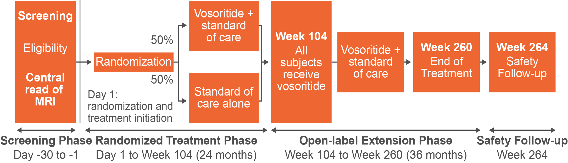
Study Design: Open-Label Extension Phase
Study design slider 4
ACT_034c
Starting at Week 104, patients were eligible to receive vosoritide plus standard of care for an additional 156 weeks. Subjects then completed a safety follow-up 4 weeks after treatment ended.
Savarirayan,, et al. Sci Prog. 2021.
[Savariryan 2021 Study 209: p10A]

Slide 84



Efficacy Outcomes
Study design slider 5
The efficacy outcomes focus on assessing the effects of vosoritide on several markers of risk for cervicomedullary decompression surgery, including:
  Frequency of cervicomedullary decompression surgery over the study course
  Change from baseline in MRI measurements of areas around the foramen magnum, brain stem, and
  spinal cord
ACT_035
  Change in clinical
  signs and symptoms every 6 months (including
  neurological exam)
  Polysomnography
  to assess
  sleep-disordered breathing
Savarirayan,, et al. Sci Prog. 2021.
[Savarirayan 2021 study 209: p12B, 13D, 5B]

Slide 85

Safety End Points
Study design slider 6
Safety outcomes included AEs and SAEs after initiation of the study drug, as well as:
  Clinical examination
  (eg, compete physical
  exam, ECG, vital signs,
  neurological exam)
  Laboratory testing
  (eg, chemistry, hematology)
AE, adverse event; ECG, electrocardiogram; SAE, serious adverse event.
Savarirayan,, et al. Sci Prog. 2021.
[Savarirayan 2021 study 209: p15A]

Slide 86


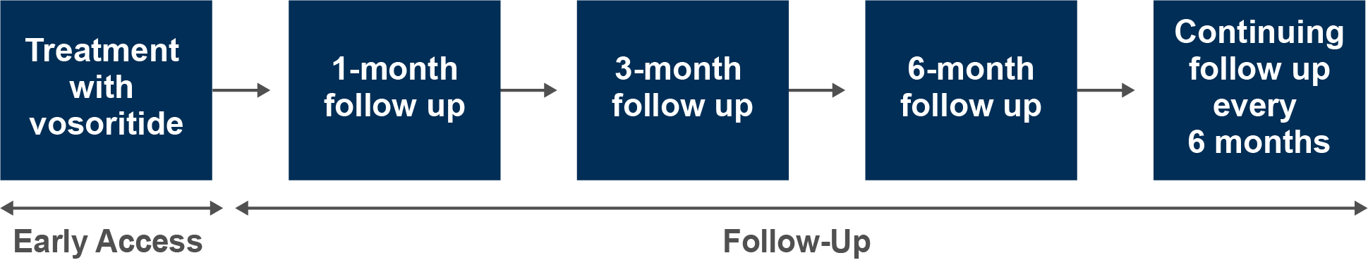

Primary Objective
  To evaluate the efficacy
  and safety of vosoritide
  in a real-world setting
Study Population
  The first patient enrolled in
  September 2021
[Cormier-Daire ESPE: p1D]
5
17
Age:
0
Years
<18
N = 57
Study Design
  In September 2021, early access to vosoritide was initiated in patients aged ≥5 years
  with open epiphyses.
ACT_036
[Cormier-Daire ESPE: p1B]
Efficacy
  Patients treated in this early access program demonstrated good adherence and remained on treatment.
  Results in this real-world study were consistent with those in the vosoritide clinical trials.
Safety
  A total of 21 AEs were reported
  All events were mild, and the majority were injection site reactions and vomiting
  No SAEs related to
  treatment were reported
[Cormier-Daire ESPE: p1E, K]
[Cormier-Daire ESPE: p1J]
AE, adverse event; SAE, serious adverse event.
Cormier-Daire et al, presented at ESPE 2023.

Slide 87
France ATU: Real World Access Program
  Vosoritide became available in France through a temporary authorization for use (ATU) starting in June 2021
  In August 2021, the European Medicines Agency (EMA) approved vosoritide for patients aged ≥2 years until
  closure of epiphyses. After EMA approval, the ATU transitioned to an Early Access Post-Marketing
  Authorization
  The results presented are from this real-world
  access program for the entire treatment period
  from 24 June 2021 to 13 December 2022
[Cormier-Daire ESPE: p1A]
Cormier-Daire et al, presented at ESPE 2023.

Slide 88


Participant Baseline Characteristics
Study population slider
SEX
AGE AT FIRST DOSE
5
13
0
Age Range
(Years)
<18
Male 51%
Median age
8.6 years
Female 49%
[Cormier-Daire ESPE: p1D]
Cormier-Daire et al, presented at ESPE 2023.

Slide 89
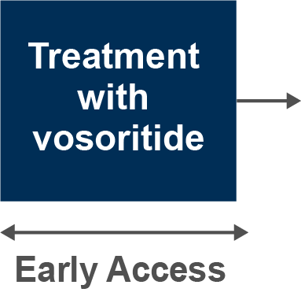
Study Design: Early Access
Study design slider 1
ACT_037a
During the early access period, 57 patients were treated with
vosoritide. Among these patients, 22 were treated for 12 months.
[Cormier-Daire ESPE: p1B]
Cormier-Daire et al, presented at ESPE 2023.

Slide 90
Study Design: Follow Up
Study design slider 2
ACT_037b
Patients and families received treatment education and were followed up at month 1, 3, 6 and every 6 months thereafter.
[Cormier-Daire ESPE: p1B]
Cormier-Daire et al, presented at ESPE 2023.

Slide 91
Data Collected At Each Visit
Study design slider 3
 | Treatment access request | Day 0 visit (start of treatment) | Month 1 | Month 3 | Month 6, then every 6 months | End of follow-up
Documentation of Ach | x
Demographics | x |  | x |  | x
Physical examination | x |  |  | X (annual examination)
Anthropometric and morphological measurements |  | x |  | X (annual examination)
X-ray of the left hand and/or knee | x |  |  | x (annual examination)
Tanner stage |  | x | x | x | x | x
Vosoritide treatment |  | x | x | x | x | x
Adverse event data |  |  | x | x | x | x
Cormier-Daire et al, presented at ESPE 2023.
[Cormier-Daire ESPE: p1C]

Slide 92
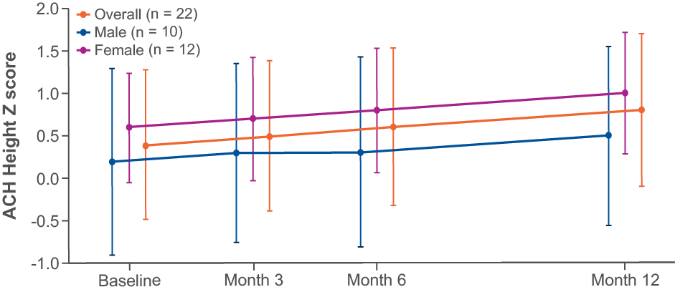
Height Z Scores of Patients Treated for
12 Months vs Untreated Children
Efficacy slider 1
ACT_038
Height z scores increased by 0.4 SD.
SD, standard deviation.
Cormier-Daire et al, presented at ESPE 2023.
[Cormier-Daire ESPE: p1F]

Slide 93
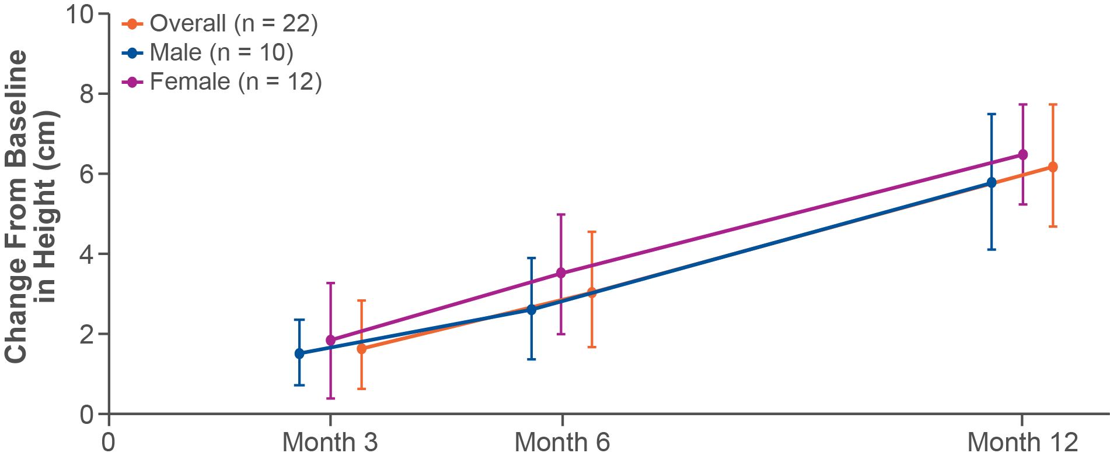
With Vosoritide for 12 Months
Change from Baseline in Height in Patients
Efficacy slider 2
ACT_039
[Cormier-Daire ESPE: p1G]
Height increased by 6.2 cm over 12 months.
  Over 12 months, absolute height increased by:
  5.8 (1.71) cm among males,
  6.5 (1.28) cm among females
Cormier-Daire et al, presented at ESPE 2023.

Slide 94
AGV in Patients Treated for 12 Months
Efficacy slider 3
AGV increased by 6 over 12 months.
Mean AGV in cm/year (SD) | Male (n = 10) | Female (n = 12) | Overall (n = 22)
6 months | 5.6 (2.14) | 6.4 (2.76) | 6.1 (2.49)
12 months | 5.7 (1.72) | 6.3 (1.17) | 6.0 (1.44)
[Cormier-Daire ESPE: p1H]
Cormier-Daire et al, presented at ESPE 2023.

Slide 95
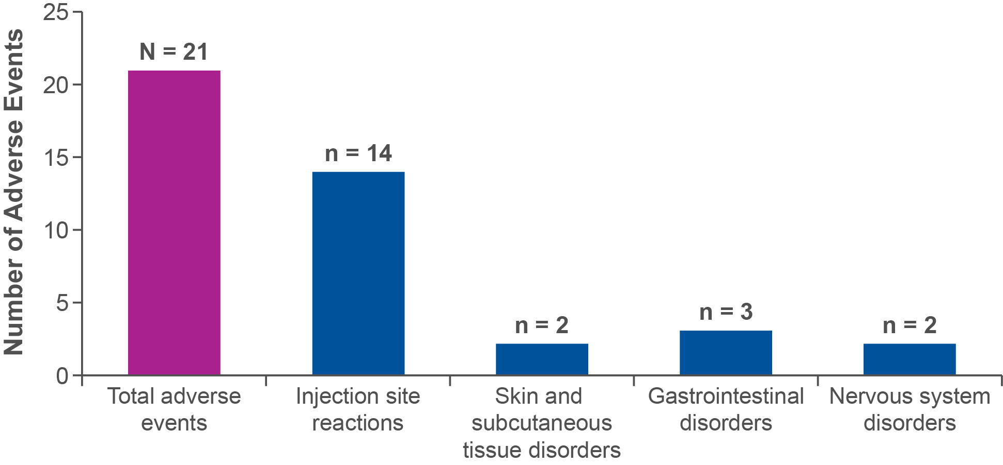
Most Common AEs Among Patients
Safety slider
[Cormier-Daire ESPE: p1E]
The most common AEs were injection site reactions and vomiting.
No SAEs related to study treatment were reported
No patients discontinued vosoritide treatment
ACT_040
A total of 21 AEs were reported during the study.
AE, adverse event; SAE, serious adverse event.
Cormier-Daire et al, presented at ESPE 2023.

Slide 96
Primary Objective
  To monitor efficacy, safety, and
  other treatment-related
  data in real time
Study Population
  Included males and females < 2 years of
  age (N = 17), 2 to 15 years of age
  (N = 169), and those >15 years of age
  (N = 74) with achondroplasia
[Kunkel 2023: p1B]
Age:
<2
Years
<18
N = 259
Study Design
  This study used data from the CrescNet® registry, which has data for 259 children across
  16 centers. The study examined height gain among those who were treated with vosoritide
  (N = 85) for 1 year and the risk of multisystemic complications, such as cervicomedullary compression (using AFMS scores).
  A cranial MRI was performed in 94 patients to exclude or diagnose cervicomedullary compression.
[Kunkel: 2023 p1B, 2A]
Efficacy
  Vosoritide was started in 85 children at a mean age of 6.9 years
  An increase of 0.45 in height
  SDS was observed after 1 year
  of treatment
Risk of Cervicomedullary Compression
  Approximately 40% of individuals
  (37 out of 93) who had a cranial
  MRI performed showed significant
  cervicomedullary compression
  risk (AFMS scores of 3-4).
[Kunkel: 2023 p1B, 2A]
AFMS, achondroplasia foramen magnum score.
Kunkel et al, presented at ESPE 2023.

Slide 97
CrescNet Database
Crescnet slider 1
A multidisciplinary working group along with patient advocacy groups in Europe developed a data set for patients with achondroplasia. The information was incorporated into an existing patient registry platform called CrescNet®, established at the University of Leipzig for children with various conditions. So far, the registry has data for hundreds of children with achondroplasia.
CrescNet can be used to evaluate long-term outcomes by monitoring several parameters, such as the frequency of multisystem complications and the use of health care resources over time.
[Kunkel: 2023 p1A, B, 2A]
Kunkel et al. Presented at ESPE 2023.

Slide 98
References
Cormier-Daire V, Edouard T, Isidor B, et al. Real-world safety and effectiveness of vosoritide:
results from an early access program in France. Poster presented at the 2023 ESPE European Society for Paediatric Endocrinology. September 21-23, 2023. The Hague, Netherlands.
A Phase 2 Study of BMN 111 to Evaluate Safety, Tolerability, and Efficacy in Children With Achondroplasia. NCT02055157. Accessed March 26, 2024. https://clinicaltrials.gov/study/ NCT02055157
A Study to Evaluate Long-Term Safety, Tolerability, & Efficacy of BMN 111 in Children With Achondroplasia. NCT02724228: Accessed March 11, 2024. https://clinicaltrials.gov/study/NCT02724228.
A Clinical Trial to Evaluate the Safety and Efficacy of BMN 111 in Infants and Young Children With Achondroplasia. NCT03583697. Accessed March 9, 2024. https://clinicaltrials.gov/study/NCT03583697
A Clinical Trial to Evaluate Safety of Vosoritide in At-risk Infants With Achondroplasia. NCT04554940. Accessed March 9, 2024. https://clinicaltrials.gov/study/NCT04554940
A Study to Evaluate the Efficacy and Safety of BMN 111 in Children With Achondroplasia. NCT03197766. Accessed March 9, 2024. https://clinicaltrials.gov/study/NCT03197766
Hoover-Fong J, Alade, AY, Hashmi SS, et al. Achondroplasia Natural History Study (CLARITY):
a multicenter retrospective cohort study of achondroplasia in the United States. Genet Med. 2021;23(8):1498-1505. doi:10.1038/s41436-021-01165-2
Hoover-Fong JE, Irving M, Cacino CA, et al Persistence of Growth-Promoting Effects in Children With Achondroplasia: Update from a Phase 2 Extension Study With Vosoritide. Poster presented at the 2024 ACMG Annual Clinical Genetics Meeting. March 12-16, 2024. Toronto, ON, Canada.
Hoover-Fong JE, Schulze KJ, McGready J, Barnes H, Scott CI. Age-appropriate body mass index in children with achondroplasia: interpretation in relation to indexes of height. Am J Clin Nutr. 2008;88:364–371.
Kunkel P, Al Halak M, Bechthold-Dalla Pozza S, et al. Multidisciplinary approach in achondroplasia – real world experience after drug approval of vosoritide. Presented at: 2023 ESPE European Society
for Paediatric Endocrinology; 21–23 September 2023; The Hague, Netherlands.
Savarirayan R, Tofts L, Irving M, et al. Safe and persistent growth-promoting effects of vosoritide in children with achondroplasia: 2-year results from an open-label, phase 3 extension study. Genet Med. 2021;23(12):2443-2447. doi:10.1038/s41436-021-01287-7

Slide 99
References
Savarirayan R, Tofts L, Irving M, et al. Persistent Growth-Promoting Effects of Vosoritide in Children With Achondroplasia is Accompanied By Improvement in Physical Aspects of Quality of Life. Poster presented at the 2024 ACMG Annual Clinical Genetics Meeting. March 12-16, 2024. Toronto, ON, Canada.
Savarirayan R, Tofts L, Irving M, et al. Persistent Growth-Promoting Effects of Vosoritide in Children With Achondroplasia for Up to 4 Years: Update from Phase 3 Extension Study. Poster presented at the 2024 ACMG Annual Clinical Genetics Meeting.
March 12-16, 2024. Toronto, ON, Canada.
Savarirayan R, Irving M, Bacino CA, et al. C-type natriuretic peptide analogue therapy in children with achondroplasia. N Engl J Med. 2019;381(1):25–35. doi: 10.1056/NEJMoa1813446.
Savarirayan R, Irving M, Harmatz P, et al. Growth parameters in children
with achondroplasia: A 7-year, prospective, multinational, observational study. Genet Med. 2022;24(12):2444-2452. doi:10.1016/j.gim.2022.08.015
Savarirayan R, Irving M, Maixner W, et al. Rationale, design, and methods of a randomized, controlled, open-label clinical trial with open-label extension to investigate the safety of vosoritide in infants, and young children with achondroplasia at risk of requiring cervicomedullary decompression surgery. Sci Prog. 2021;104(1):368504211003782. doi:10.1177/00368504211003782
Savarirayan R, Tofts L, Irving M, et al. Once-daily, subcutaneous vosoritide therapy in children with achondroplasia: a randomised, double-blind, phase 3, placebo-controlled, multicentre trial [published correction appears in Lancet. 2020 Oct 10;396(10257):1070]. Lancet. 2020;396(10252):684-692. doi:10.1016/S0140-6736(20)31541-5
Savarirayan R, Wilcox WR, Harmatz P, et al Persistence of Growth Promoting Effects in Infants and Toddlers With Achondroplasia: Results From a Phase II Extension Study With Vosoritide. Poster presented at the 2024 ACMG Annual Clinical Genetics Meeting. March 12-16, 2024. Toronto, ON, Canada.
Savarirayan R, Wilcox WR, Harmatz P, et al. Vosoritide therapy in children with achondroplasia aged 3-59 months: a multinational, randomised, double-blind, placebo-controlled, phase 2 trial. Lancet Child Adolesc Health. 2024;8(1):40-50. doi: 10.1016/S2352-4642(23)00265-1. Epub 2023 Nov 18.

