Slide 1
Introduction to the Transplant Center

Slide 2
Important Information
This background information MUST NOT be used in promotion or distributed outside Sanofi. Please remember that when you are discussing Sanofi products with our customers, this discussion must be completely consistent with approved labeling, applicable law, FDA regulations, and Sanofi policies.
You are only permitted to use review committee-approved materials in your communications with customers.
All off-label inquiries must be referred to your local MSL or to Medical Information. If you have any questions about the materials, messaging, or scientific communications you may use with any customer or patients, please ask your manager.

Slide 3
Table of Contents
ITC_101
Role of Transplant Centers in Multiple Myeloma
Essential Elements of a Transplant Program
Transplant Program Personnel
Review: Autologous HSCT Pathway

Slide 4
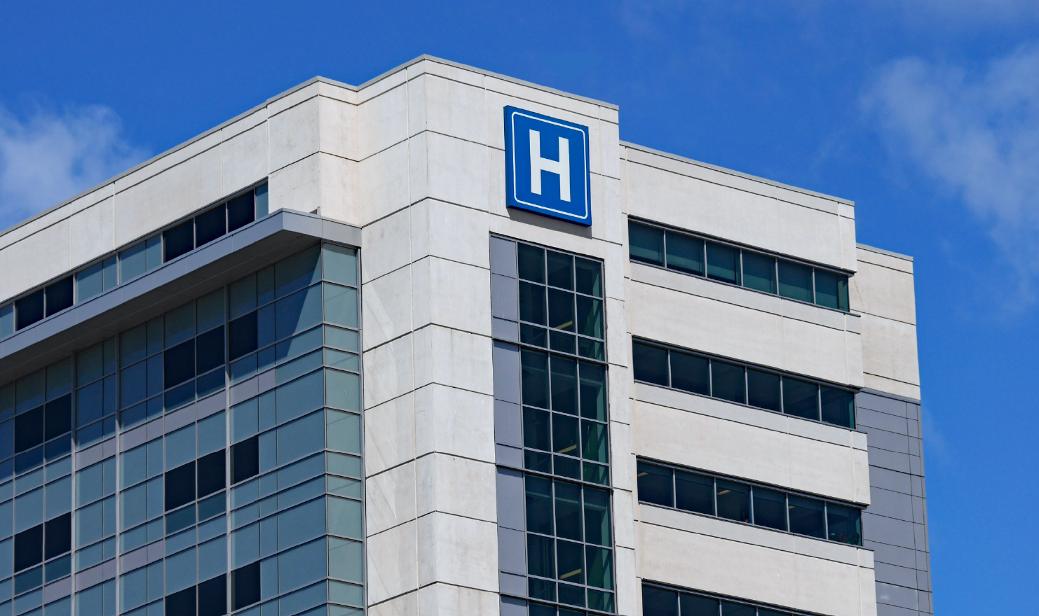
Role of Transplant Centers in Multiple Myeloma Care
ITC_102
High-dose chemotherapy with autologous stem cell rescue (autologous stem cell transplant [ASCT]) is the standard of care for fit patients with multiple myeloma
Has the potential to provide deep responses and long-term remission
While highly effective, ASCT is complex and lengthy, requires hospitalization, and may be associated with adverse events and additional short- and long-term risks
For these reasons, ASCT is only performed in a relatively limited number of specialized transplant centers that have the appropriate facilities and personnel to manage these patients
Autologous SCT (ASCT) is often referred to in guidelines and the literature as “high-dose chemotherapy with autologous stem cell rescue.”
Benefit of ASCT in MM

Slide 5
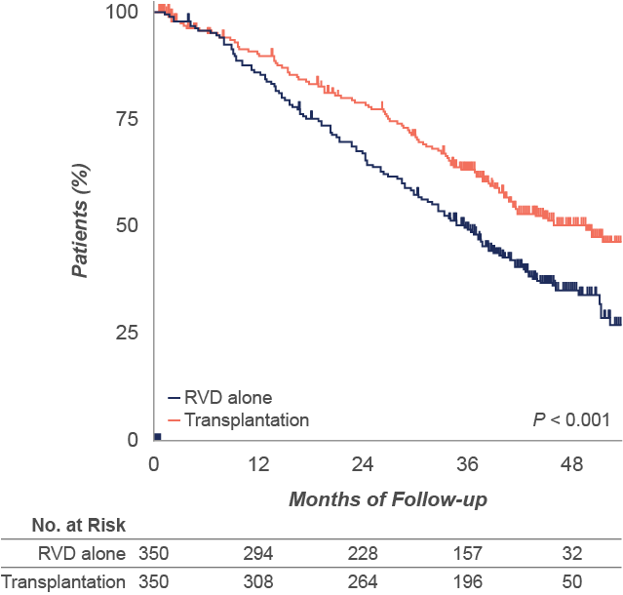
Benefit of ASCT in Multiple Myeloma
ITC_103
The benefit of ASCT in multiple myeloma (MM) treatment has been demonstrated in multiple studies and is greatest in patients with high-risk disease. The results of one study, which compared a first-line therapy for transplant-eligible patients with or without subsequent ASCT, are shown below.
PFS: RVD vs RVD + Transplant
In a study of lenalidomide, bortezomib, and dexamethasone (RVD) with or without transplantation, transplantation was associated with significantly longer PFS than RVD therapy alone. There was no significant difference in OS.
 | RVD Alone | RVD + ASCT | P
PFS, median | 36 months | 50 months | <0.001
OS at 4 years | 82% | 81%
[Attal 2017, p 1315A, B]
[Attal 2017, p 1316A]

Slide 6
Essential Elements of a Transplant Program
ITC_104
Select each icon to learn more

Slide 7
Essential Elements of a Transplant Program
ITC_104
Inpatient Center
ASCT is associated with side effects from conditioning chemotherapy and serious risks associated with pancytopenia (hemorrhage, anemia, infection)
Patients who undergo ASCT are hospitalized for approximately 2 to 3 weeks
Inpatient HSCT facilities include:
Rooms with isolation capability and air filtration
24-hour medical and nursing staff coverage with a low staff-to-patient ratio
Emergency resuscitation equipment

Slide 8
Essential Elements of a Transplant Program
Ancillary Medical Services
An intensive care unit to manage infections and other potentially life-threatening adverse events, including cardiac support, respiratory support, and hemodialysis
Infectious disease clinicians and laboratory support to address risk for opportunistic infections
Radiation oncology if total body irradiation is used as part of the conditioning regimen
ªIn centers that perform allogeneic transplants.

Slide 9
Essential Elements of a Transplant Program
Laboratory Services
Transplant centers are equipped with 24-hour laboratory services for:
Basic clinical chemistry
Hematologic analyses
Screening for bacterial, fungal, and viral infections
Monitoring drug levels

Slide 10
Essential Elements of a Transplant Program
Blood Banking
Patients who undergo ASCT frequently require transfusions of red blood cells and platelets to address anemia and bleeding risk caused by pancytopenia during reconstitution
Blood banking services provide blood typing, cross matching, and supply blood products for transfusion

Slide 11
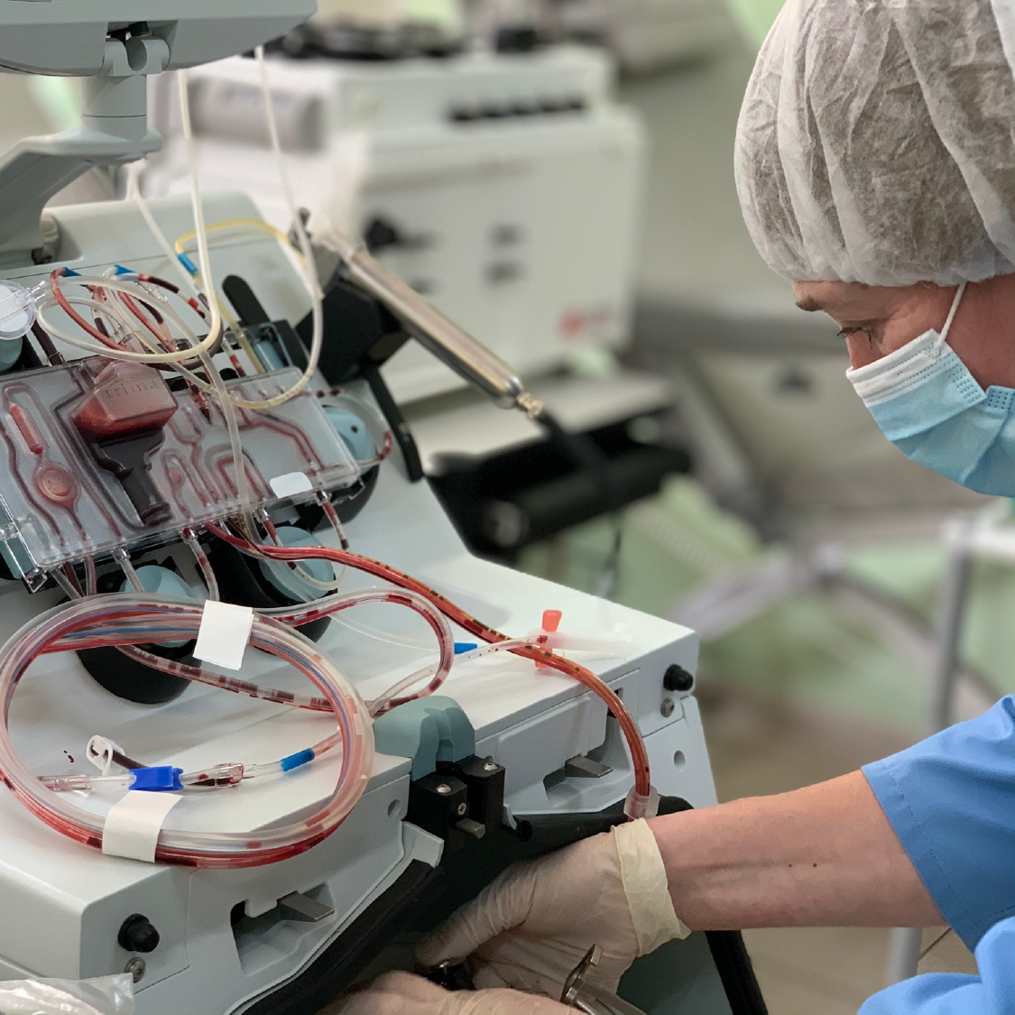
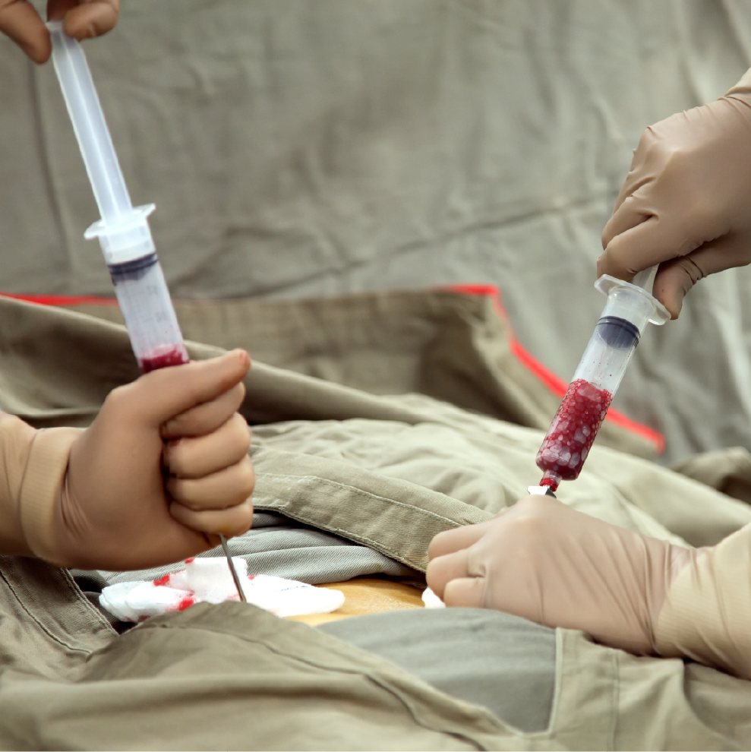
Essential Elements of a Transplant Program
ITC_105
Stem Cell Collection
Apheresis services to collect peripheral blood stem cells
Some centers may have bone marrow harvest facilities
[EBMT 2019, p 30B]
[EBMT 2019, p 30C]

Slide 12
Essential Elements of a Transplant Program
Other Elements of Transplant Programs
Radiology
Routine diagnostic imaging
Diagnosis of adverse events
Placement of catheters
Pharmacy
Pretransplant workups, medication review, and verification of conditioning regimens
Drug preparation, dispensing, monitoring, and medication management, including dispensing and monitoring conditioning chemotherapy
Antibiotic, antifungal, and antiviral prophylaxis and treatment

Slide 13
Transplant Program Personnel: Medical Staff
ITC_106
Although not all transplant programs are structured similarly, most include a similar array of physicians, medical staff, and pharmacists. Because HSCT is complex, all centers have an extensive network of support staff and administrators that coordinate care, maintain quality, and address patients’ psychosocial needs.
Clinical Program Directors
Board certified in hematology, medical oncology, immunology or ≥10 years of experience
Responsible for administrative and clinical operations
Responsible for all elements of the design of the clinical program, including quality management, selection/care of recipients and donors, and cell collection and processing
Responsible for ensuring all staff are adequately trained
Attending Physicians and Consulting Specialists
Attending physicians have specialty certification in hematology, medical oncology, or immunology and are responsible for direct patient care
Accredited facilities must have access to a full range of consulting specialists (cardiology, infectious disease, pulmonary medicine, neurology, nephrology, radiation oncology, etc.)
Advanced Practice Providers
Provide support across the continuum of care for HSCT
Pre-HSCT staging and evaluation
Collaboration with physicians on treatment plan and procedures
Stem cell collection
Management of early HSCT issues (toxicities, infections, etc.)
Diagnosis and evaluation of late HSCT issues (GVHD, post-transplant immunodeficiencies, relapse)
[FACT 2023, p 34A]
[FACT 2023, p 31-32A]
[Raley 2019, pp 6A,B; 7A; 9A]
[FACT 2023, p 33A]

Slide 14
Transplant Program Personnel: Support Staff
Title | Description
BMT nurse manager | Serves as a resource for nurses involved in the HSCT pathway Maintains compliance and safety throughout the department Assists in developing individualized care plans Hiring and training of nursing team
Nurse | Conditioning chemotherapy administration Managing transplant complications Monitoring for complications and ongoing assessments Championing patient care
Pharmacist | Pretransplant workups, medication review, and verification of conditioning regimens Drug preparation, dispensing, monitoring, and medication management
Clinical transplantation coordinator/BMT administrator | Acts as a facilitator, educator, and point of contact for patients and families Scheduling and arranging for pretransplant workups, developing a treatment roadmap for recipients, and coordinating post-HSCT follow-up
Quality manager | Establish, review, and maintain policies and standard operating procedures Collects and audits outcomes data, identifies errors/adverse events, and assists in implementing preventive measures to minimize risk for recurrence

Slide 15
Review: ASTC Pathway
ITC_107
Select each hotspot to learn more.
Diagnosis: symptomatic MM
Mobilization and collection
Determination of transplant eligibility
Fit
Initiate primary therapy for transplant candidates
Response after primary therapy
Autologous transplantª
Conditioning
Primary therapy for non-transplant candidates
Reinfusion
Primary therapy for non-transplant candidates
Watch a brief introduction to ASCT
Maintenance therapy
Watch a thorough review of the complete ASCT journey
ªAutologous HSCT is a category 1 recommendation in the NCCN guidelines. Other options include continuous myeloma therapy or maintenance therapy or tandem autologous or allogeneic transplant for patients with high-risk disease (not shown).

Slide 16
Determination of Transplant Eligibility
All patients are assessed for HSCT eligibility. Criteria for eligibility vary by center, but are based on:
Performance status and the presence of comorbidities
Adequate renal, cardiac, pulmonary, and liver function
Adequate psychosocial and financial support
No evidence of myelodysplasia on bone marrow examination
There is no strict age cutoff for eligibility. Instead, eligibility is determined by functional capacity (“physiologic age”) rather than chronologic age.

Slide 17
Primary Therapy for Transplant Candidates
Primary therapy is intended to reduce the number of tumor cells in the bone marrow and peripheral blood, reduce symptoms, and address end-organ damage.
[Kumar 2023, p 2A]
PRIMARY THERAPY
MAINTENANCE THERAPY
Preferred Regimens
Bortezomib/lenalidomide/dexamethasone Carfilzomib/lenalidomide/dexamethasone
Other Recommended Regimens
Daratumumab/lenalidomide/bortezomib/dexamethasone
Preferred Regimens
Lenalidomide
Other Recommended Regimens
Bortezomib
[NCCN Myeloma 2024, p 24A]

Slide 18
Autologous HSCT
Mobilization and Collection Patients receive granulocyte colony-stimulating factor (G-CSF; filgrastim) alone or in combination with a mobilizing agent, such as plerixafor or motixafortide, and stem cells are collected from peripheral blood by apheresis. Stem cells are collected daily until the goal is reached—usually enough for 2 transplants.
Conditioning Chemotherapy Conditioning chemotherapy consists of high-dose chemotherapy intended to eliminate malignant cells before “rescue” with the stem cells collected in the previous step. In multiple myeloma, most patients receive melphalan, a cytotoxic agent, as conditioning chemotherapy.
Reinfusion and Engraftment Approximately 1 day after completion of conditioning, stem cells are reinfused. During this period, patients are highly pancytopenic and require red blood cell and platelet transfusions as well as G-CSF. Patients are monitored closely for bacterial, viral, and fungal infections.
Maintenance Therapy Patients may receive several years of maintenance therapy following autologous HSCT in certain cases.

Slide 19
Key Points and Implications
ITC_108
Role of Transplant Centers in Multiple Myeloma Care
ASCT is the standard of care for fit MM patients
ASCT is complex, lengthy, and may be associated with adverse events
ASCT must therefore be performed at specialized centers with dedicated facilities and highly trained personnel
Essential Elements of a Transplant Program
Inpatient centers are equipped to isolate patients during engraftment and provide intensive care to address the toxicities of conditioning therapy and infection risk
Apheresis services collect peripheral blood stem cells
Transplant programs also include an array of ancillary medical services (ICUs, infectious disease, radiation oncology, radiology, pharmacy, laboratory, blood banking)
Transplant Program Personnel
Medical staff include clinical program directors, attending physicians, consulting specialists, advanced practice providers, and nurses/nurse managers, all of whom have specific training in HSCT
Medical staff are supported by clinical transplantation coordinators, who help patients navigate the treatment pathway, pharmacists, quality managers, and other personnel
ASCT Pathway
ASCT is associated with considerable toxicities and risk; thus, it is not an option for all patients
Pathway:
Primary therapy to reduce tumor burden, reduce symptoms, and address end- organ damage
Mobilization and stem cell collection
Conditioning chemotherapy
Reinfusion and engraftment
Maintenance therapy
[IMF 2023, p 1A]
[IMF 2023, p 10A]
[EBMT 2019, p 27A]
[FACT 2023, p 33A, p 34A; pp31-32A; Raley 2019, p 6A, B]
[Kumar 2023, p 2A]
[EBMT 2019, p 30B]
[IMF 2023, p 9B]
[IMF 2023, p 1A]
[IMF 2023, p 10C, D]
[Kumar 2023, p 9A, IMF 2023, p 10C, D]
[NCCN Myeloma 2024, p 11A]
[Langebrake 2020, p 64A, B, C, D; EBMT 2019, p 32A; FACT 2023, p 40A]
[EBMT 2019, p 29A, B, C; 30A; 31A]

Slide 20
References
Ali MO, Al Hadidi S. High-dose (conditioning) regimens used prior to autologous stem cell transplantation in multiple myeloma. Transpl Cell Ther. 2022;28:572-580.
ArraGroup. RN nurse manager bone marrow transplant oncology. Accessed November 27, 2023. https://www.thearragroup.com/jobs/rn-nurse-manager-oncology-hematology-bmt-14494255
Canadian Cancer Center. Stem cell transplant for multiple myeloma. Accessed November 27, 2023. https://cancer.ca/en/cancer-information/cancer-types/multiple-myeloma/treatment/stem-cell-transplant
European Bone Marrow Transplant Society. The EBMT Handbook. Springer Nature Switzerland. 2020.
FACT-JACIE International Standards for Hematopoietic Cellular Therapy Product Collection, Processing, and Administration. 8th ed. 2021.
Holmberg LA, Deeg HJ, Sandmaier BM. Determining eligibility for autologous hematopoietic stem cell transplantation. Accessed November 27, 2023. https://www.uptodate.com/contents/determining-eligibility-for-autologous-hematopoietic-cell-transplantation
International Myeloma Foundation. What is autologous stem cell transplant (or bone marrow transplant)? Accessed November 27, 2023. https://www.myeloma.org/autologous-stem-cell-transplant
Kumar S. Multiple myeloma: Use of hematopoietic stem cell transplantation. Accessed November 27, 2023. https://www.uptodate.com/contents/multiple-myeloma-use-of-hematopoietic-cell-transplantation/

Slide 21
References
Langebrake C, Admiraal R, van Maarseveen E, et al. Consensus recommendations for the role and competencies of the EBMT clinical pharmacist and clinical pharmacologist involved in hematopoietic stem cell transplantation. Bone Marrow Transpl. 2020;55:62-69.
National Comprehensive Cancer Network. NCCN Clinical Practice Guidelines in Oncology. Multiple Myeloma. Version 2.2024—November 1, 2023. Available at: www.nccn.org
Raley DY for the ASBMT NP/PA Steering Committee. Guidelines for training in hematopoietic progenitor cell transplantation for nurse practitioners and physician assistants. Accessed November 26, 2023. www.astct.com.
Watters A. Complexity is the cornerstone of BMT nursing. 2019. Accessed November 27, 2023. https://voice.ons.org/stories/complexity-is-the-cornerstone-of-bmt-nursing

