Slide 1
The Pathology Lab
Personnel, Structure, and Key Concepts

Slide 2
Important Information
This background information MUST NOT be used in promotion or distributed outside Sanofi. Please remember that when you are discussing Sanofi products with our customers, this discussion must be completely consistent with approved labeling, applicable law, FDA regulations, and Sanofi policies.
You are only permitted to use review committee-approved materials in your communications with customers.
All off-label inquiries must be referred to your local MSL or to Medical Information. If you have any questions about the materials, messaging, or scientific communications you may use with any customer or patients, please ask your manager.

Slide 3
Contents
Introduction
The Pathology Specialty
Members of the Pathology Lab Team
The NSCLC Diagnostic Tissue Pathway
NSCLC Biopsy Tissues
Processing Tissues for Biomarker Analyses
Tissue Requirements for Biomarker Analyses
Biomarker Testing Considerations
Reporting Biomarker Results
Key Points and Implications
References

Slide 4
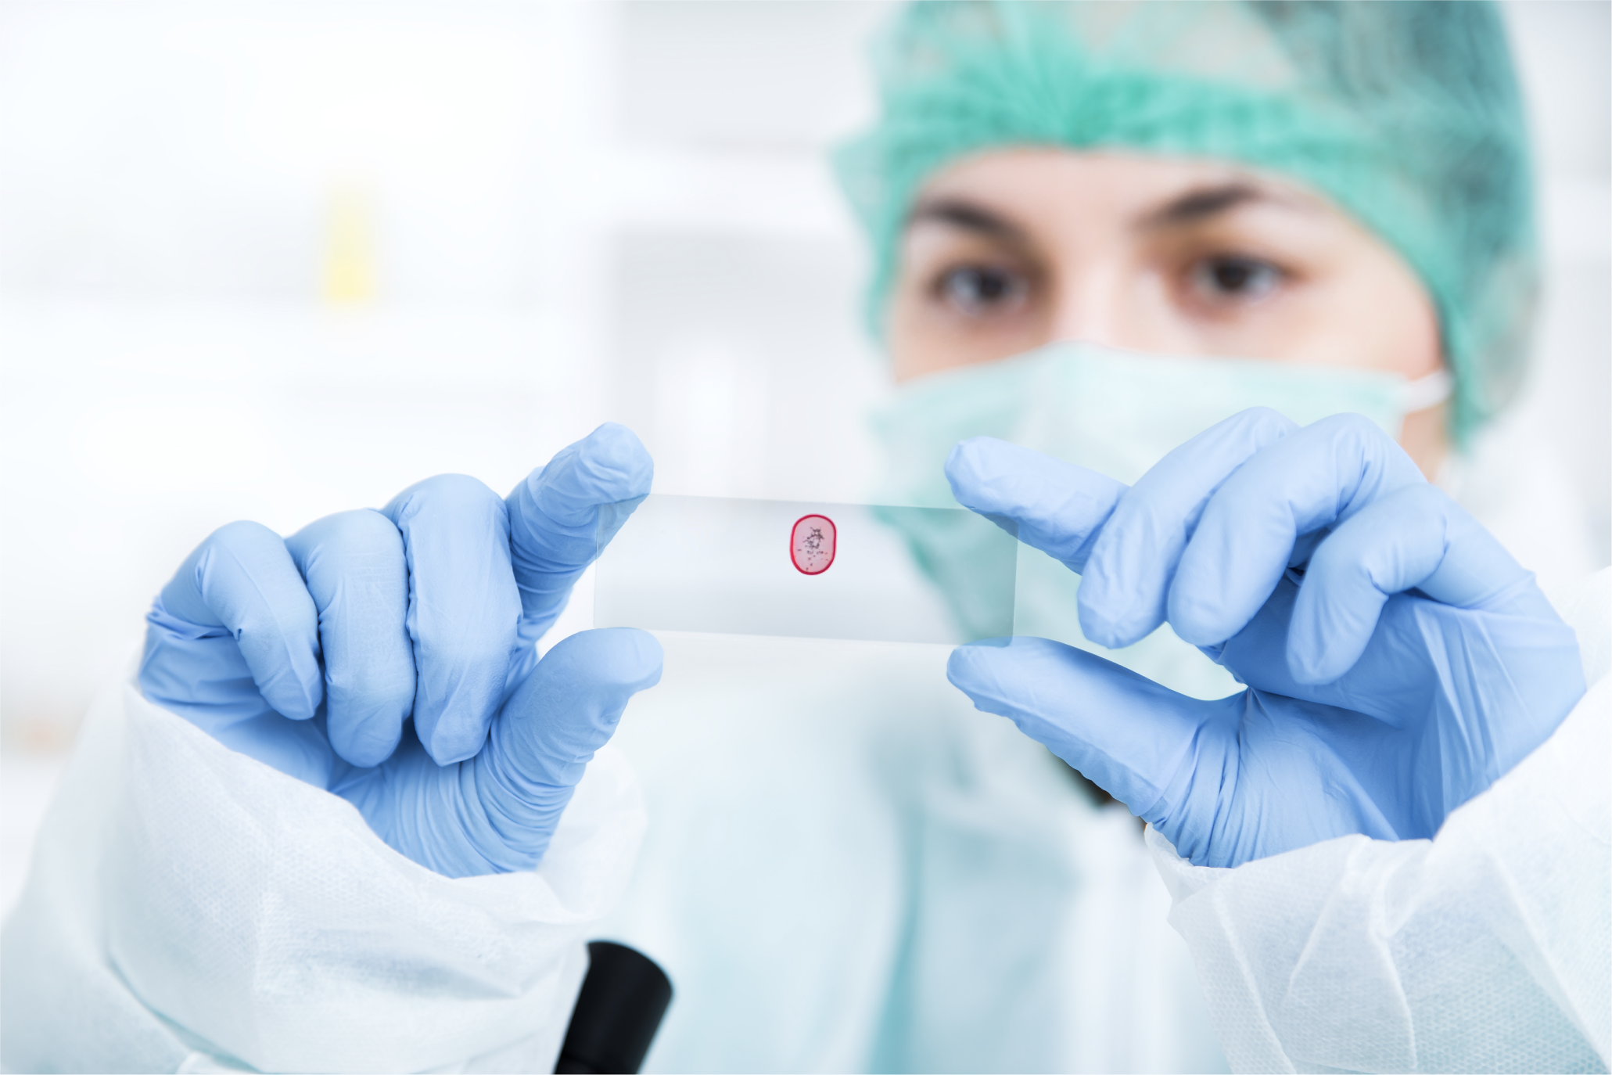
Introduction
Cancer care is multidisciplinary. In non-small-cell lung cancer (NSCLC), for example, the management of the disease can involve surgical oncologists, interventional radiologists, radiation oncologists, medical oncologists, pulmonologists, and the patient’s primary care provider, along with a broad range of support staff. Pathologists are also an integral part of this multidisciplinary team and—in fact—are often the first to confirm a cancer diagnosis when samples are seen in the lab. Pathologists can provide deeper insights into the genomics and protein expression patterns of specific tumors and are critical members of molecular tumor boards— multidisciplinary panels that help guide treatment decisions based on molecular analysis of tumors.
The treatment of tumors with targetable alterations relies on the analysis of tumor tissue and identification of a biomarker. This ensures that patients are receiving therapy that is potentially effective and that patients are not inappropriately exposed to a therapy that would not be expected to provide benefit.
Given the importance of biomarker testing in advanced NSCLC, and the potential role of treatments that target CEACAM5-expressing tumors, it is critical to understand and engage with pathology lab stakeholders.
PLB_001
This backgrounder will:
Explore the structure of pathology labs
Identify key personnel in pathology labs and their roles
Review key concepts in obtaining and processing tissue for biomarker analysis
Examine the reporting of biomarker results

Slide 5
The Pathology Specialty
Pathologists are integral members of the multidisciplinary team. They are responsible for assessing samples derived from tumor tissue and are involved not only in determining the tumor histology (for example, squamous or nonsquamous NSCLC), but also lead the comprehensive biomarker testing and analysis process to identify actionable biomarkers.
Anatomic and clinical pathology are 2 of the major primary certifications offered by the American Board of Pathology. Pathologists may be certified in one or both of these specialties. Molecular pathology is one of many subspecialty certifications that can be obtained; these clinicians are often directly involved in many aspects of molecular testing, ranging from performing the tests through developing and troubleshooting new assays.
PLB_002
[ABP 2023, p 3A]
[ABP 2023, p 3B; Brigham 2023, p 1A, B, C]
Anatomic Pathology
Anatomic pathologists study the effects of disease on tissues, both as a whole (grossly) and microscopically.
Histopathology involves the microscopic examination of intact biopsy tissue, often using staining techniques such as immunohistochemistry
Cytopathology involves the examination of single cells or groups of cells (as in a cervical Pap smear)
Clinical Pathology
Clinical pathologists diagnose disease based on laboratory analyses of body fluids. Clinical pathology includes a range of subspecialties, including, but not limited to:
Clinical chemistry
Hematopathology
Cytogenetics
Molecular genetics
Blood banking/transfusion medicine
Molecular Pathology
Molecular pathology is a subspecialty that uses molecular techniques to help diagnose and determine prognoses for a range of diseases, including malignant disease.
These clinicians have extensive, specific training in a wide spectrum of molecular, cytogenetic, and biochemical laboratory tests. They are also trained in lab management, quality assurance, troubleshooting of molecular tests, assay development and evaluation, and instrument evaluation.
[AACC 2023, p 1A, p 2A]
[Dark Intelligence Group 2023, pp 1-2A]
[Brigham 2023, p 1A, B, C]
Pathology directors are major stakeholders in determining whether and how
a new biomarker test may be implemented within the lab or externally.

Slide 6
Roles Within the Pathology Lab Team
Although not all pathology labs are structured similarly, pathology labs may include a broad array of MDs and PhDs in leadership or other positions, staff pathologists, and support staff. It is important to understand the roles of pathology lab staff, as many are key stakeholders in determining whether and how a new biomarker test may be implemented within the lab or externally.
Title | Stakeholder for New Tests? | Description
Laboratory Director | +++ | Board-certified MD, PhD, or medical laboratory scientist Most are pathologists; if the lab director is not a pathologist a consulting pathologist may be retained to interpret test results Responsible for managing overall operations, including maintaining accreditation standards
Department Directors | +++ | Board-certified MDs, PhDs, or medical laboratory scientists Direct departments within the pathology laboratory, such as immunohistochemistry (IHC), thoracic, and molecular pathology
Technical and General Supervisors | ++ | General supervisors (also known as lab managers) are often an MD or DO pathologist; sometimes may have lower degrees plus appropriate lab experience Responsible for oversight of day-to-day lab operations and personnel
Medical Laboratory Scientists, Medical Technologists, Clinical Laboratory Scientists | ++ | Responsible for performing routine and specialized tests Communicate results to pathologist Involved in quality control, evaluating new instruments, and implementing new test procedures
Clinical and Medical Laboratory Technicians |  | Perform routine tests
Specialized Roles |  | Pathology assistants conduct gross examination and dissection of anatomic samples Histotechnologists prepare tissue samples used to diagnose disease
[AACC (Lab Pros) 2023, p 3A]
[AACC (Lab Pros) 2023, p 4-5A]
[AACC (Lab Pros) 2023, p 5B]
[AACC (Lab Pros) 2023, p 6A]
[AACC (Lab Pros) 2023, p 7A, B; p 8A]

Slide 7
The NSCLC Tissue Diagnostic Pathway
Biopsy tissues follow a defined pathway from patient to pathology lab and back to the treating clinician, who makes the decision to use specific therapies. The timeline below, outlined by the National Cancer Institute, is an ideal-case scenario for newly diagnosed NSCLC, however, it is important to recognize that real-world pathways may vary dramatically from the scheme shown below, and are not consistent among healthcare systems.
PLB_003
[Fox 2023, p 5A]
When is Tissue
Sent for Biomarker
Testing?
Barriers to Biomarker Testing
BIOMARKER TESTING SITES
Samples can be tested locally or remotely:
The majority of hospitals have an in-house laboratory with varying capabilities; many biomarker analyses can be performed in-house but others may be sent to a reference laboratory
Independent reference labs are usually private commercial facilities that do high-volume and specialty testing
Outside of academic medical centers, most specialty/advanced biomarker testing is not done in local or in-house laboratories
REFLEX TESTING
Biomarker testing may be requested only after consultation with an oncologist, prolonging initiation of testing and delaying selection of targeted therapies. Reflex testing involves ordering a preapproved set of biomarkers at initial diagnosis, dramatically reducing time from diagnosis to delivery of clinically actionable results. Preapproved panels eliminate interprovider variation and accelerate testing, but require institutional planning and agreement, including decisions about workflow and testing facility or vendor.
Equipment, experience, and
available testing platforms
vary among hospitals; some
may use independent
reference labs for lower-volume or specialized
biomarker tests.
[AACC (Locations) 2023, p 1A, 2A; p 2B]
Watch a video on biomarker testing considerations
[Anand 2020, p 438A; Fox 2023, p 4A]
NEXT

Slide 8
When Is Tissue Sent for Biomarker Testing?
Biomarkers may be assessed at 1 or more timepoints during the treatment journey of the typical patient with NSCLC.
PLB_003b_1-4
After initial definitive diagnosis of NSCLC
Prior to making 1L metastatic treatment decision
After progression on standard-of-care 1L metastatic NSCLC therapy

Slide 9
Barriers to Biomarker Testing
Biopsy for comprehensive biomarker analysis is crucial for identifying appropriate treatments in NSCLC. Nevertheless, a number of clinical practice gaps can prevent patients from receiving the most effective personalized treatments. The clinical practice gaps that may be addressable by pathology labs are shown in red.
[Sadik 2022, p 2A]
Biopsy Referral
Initial solid or liquid
biopsy never performed
Biopsy
Insufficient tissue or tumor cell content in initial or repeat biopsy
Test Ordering
Appropriate testing not ordered, or treatment started before testing ordered
Insufficient Tissue
Tumor cell content of biopsy overestimated
Treatment Decision
Targeted treatment for selected dispute positive test results
Reporting
Extended turnaround time delays result in treatment being initiated prior to availability of results
Testing Performance
Inconclusive or false-negative results
Assay/Equipment
May not be available in a particular lab or may not be able to be sent out to reference lab in a timely manner
Watch a video describing barriers to adequate biomarker testing in cancer care.

Slide 10
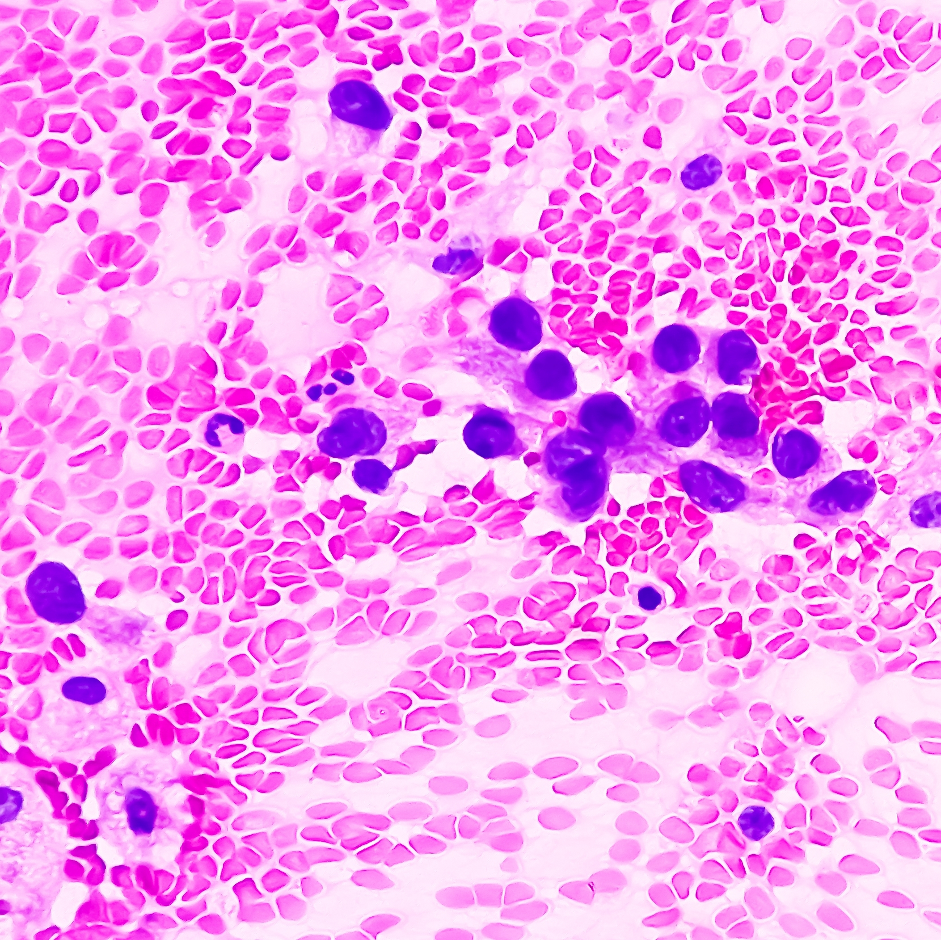
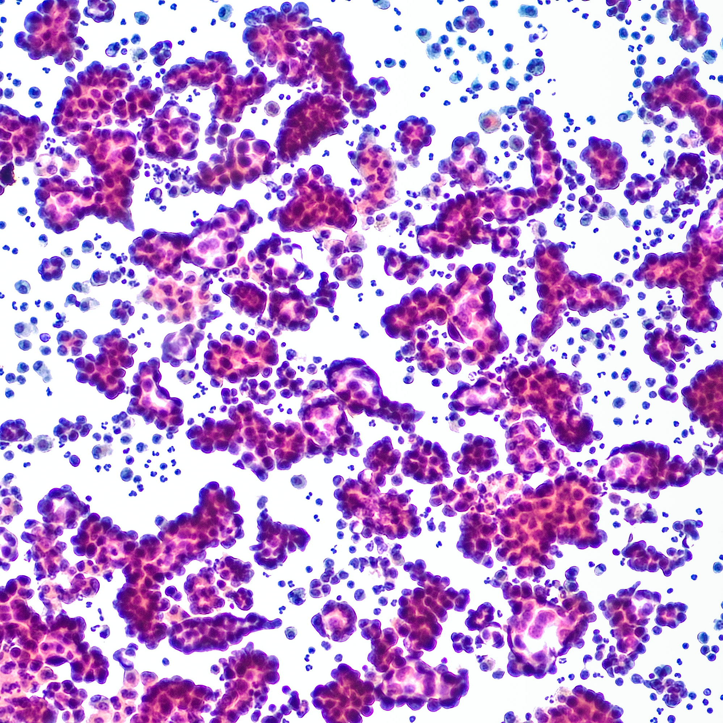
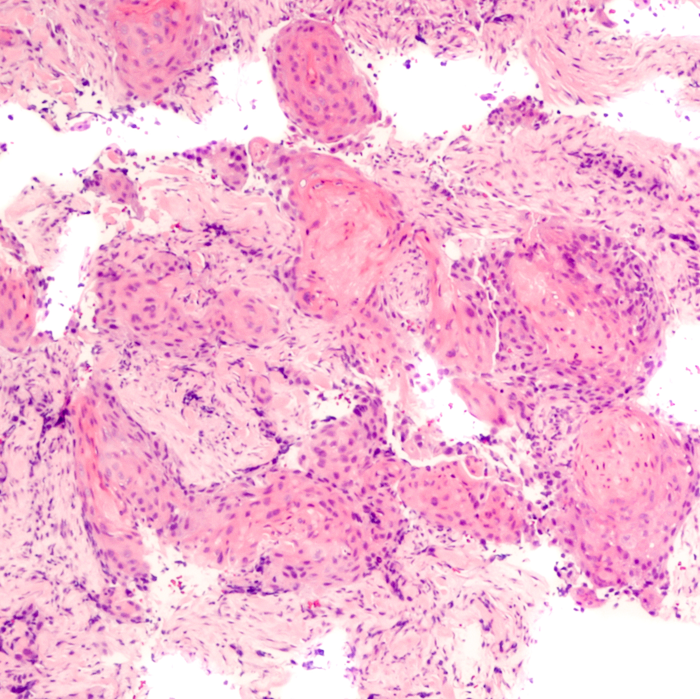
NSCLS Biopsy Tissues
Slides/smears
Per the FDA, CDx are medical devices that provide information that is essential for the safe and effective use of a corresponding drug or biologic product. CDx must demonstrate clinical validity with a defined cutoff value in trials.
PLB_004
Smear of tissue placed on slide for
staining. A few specialty labs can
perform NGS on these samples.
Not suitable for IHC.
Cell block
[Fox 2023, p 6A]
Cytologic samples spun down in a
centrifuge to form a pellet that can
be fixed and embedded in paraffin
for sectioning.
Per the FDA, CDx are medical devices that provide information that is essential for the safe and effective use of a corresponding drug or biologic product. CDx must demonstrate clinical validity with a defined cutoff value in trials.
Larger samples that are embedded,
fixed, and sectioned. Allows for IHC
and NGS.
Most patients with NSCLC present with advanced-stage unresectable disease, thus, treatment determining diagnoses must often be made using very limited tissue
Limited tissue availability is a critical issue in NSCLC, and samples must be obtained and handled in a way to ensure that adequate tissue is available for all likely diagnostic testing
Biopsy Modalities
NEXT
[Planchard 2018, p 2A]

Slide 11
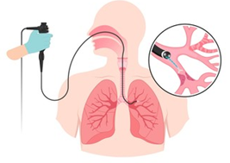
Biopsy Modalities
PLB_008-image
Open surgical biopsy
Usually performed during surgery for primary tumor; allows for extraction of large amounts of tumor tissue
Incisional biopsies remove parts of abnormal tissue (similar to core biopsies) but with greater yield
Excisional biopsies remove all abnormal tissue and parts of surrounding tissue
[ACS 2019, p 2A]
Thoracoscopic Surgery
Endoscopic removal of tissue through a small incision in the chest wall
Transbronchial Biopsy
Uses flexible bronchoscope through nose or mouth to biopsy central lesions
Generally increasing tissue yield
[Modi 2023, p 1A]
[Modi 2023, p 1B]
Percutaneous Core Needle Biopsy
Large needle is inserted to remove a small cylinder of tissue (~1/16 inch in diameter and 1/2 inch in length)
Liquid Biopsy
Minimally invasive biopsy modality to detect shed tumor cells and free tumor DNA for molecular genetic analysis. Examples include the Guardant 360 CDx, FoundationOne Liquid CDx, and cobas EGFR Mutation Test V2. Does not provide tissue suitable for IHC.
[ACS 2019, p 2B]
Percutaneous Fine-Needle Aspiration
Fine needle inserted into site of the tumor, allowing for the aspiration of a small tumor sample
[ACS 2019, p 1A]
[ASCO 2023, p 1A; p 2A]

Slide 12
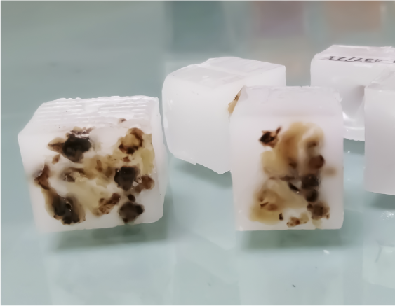
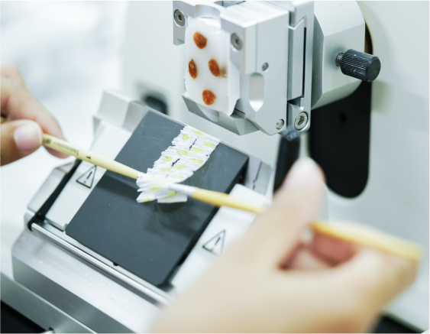
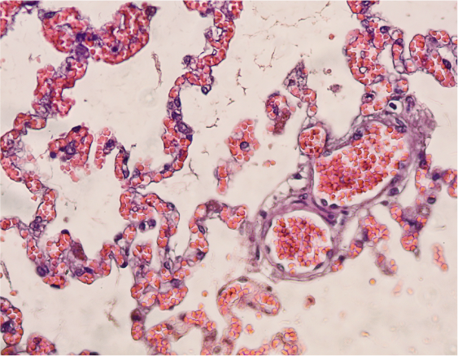
Processing Tissues for Biomarker Analysis
Biopsy tissues are processed in the pathology lab in a manner that allows them to be used for comprehensive biomarker testing, which may include a range of testing methodologies, including IHC and NGS.
PLB_005
Fresh tissue is “fixed” by immersing it in a solution of fixative (usually
formalin). Fixation prevents tissue from degrading, hardens the tissue to
assist in sectioning, and enhances its ability to take up dyes.
Fixation
[Healio 2022, p 11A]
The tissue is dehydrated and infiltrated with paraffin wax, resulting in a
formalin-fixed, paraffin-embedded (FFPE) block. If adequate tissue is
available, a block may be archived for reanalysis at a later date.
Embedding
[Healio 2022, p 12A]
The block is placed in a microtome and sliced thinly (0.4-0.5 μM).
Sectioning
[Healio 2022, p 12A]
Tissue sections are placed on a slide. Some are stained for pathologic
assessment and others are left unstained for further analyses, including
genomic testing and IHC. The most common stain is hematoxylin and
eosin (H&E).
Staining
[Healio 2022, p 13A]
Watch a video describing the tissue processing pathway

Slide 13
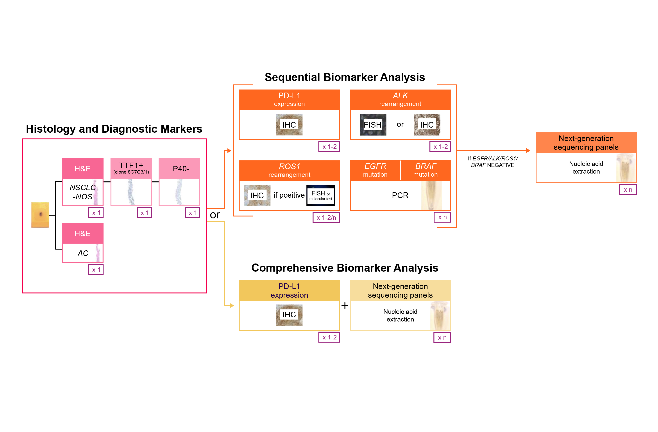
Tissue Requirements for Comprehensive Biomarker Analyses
Tissue availability is a critical consideration in NSCLC biomarker testing, particularly given the ever-expanding number of targetable molecular alterations. Tissue processing is not standardized, and local requirements for the amount of tissue needed for comprehensive testing vary. Depending on a number of local variables, the same tissue sample could be deemed adequate or inadequate for comprehensive testing.
[Fox 2023, p 4A]
PLB_006a & b
A typical sequential
assessment pathway requires
substantial tissue for nucleic
acid extraction, IHC, and FISH.
Adequate tissue availability is a
major issue in biomarker
testing in NSCLC, and if the
biopsy sample is small,
decisions may need to be made
on prioritizing specific assays.
NCCN Biomarker Analysis Recommendations
[Garrido 2020, p 996A]
[Garrido 2020, p 996B]
AC, adenocarcinoma; FISH, fluorescence in situ hybridization; H&E, hematoxylin and eosin; IHC, immunohistochemistry; NCCN, National Comprehensive Cancer Network®;
NOS, not otherwise specified; PCR, polymerase chain reaction. Purple text indicates number of sections required for a test. n, number of sections vary depending on testing provider.
Image reproduced courtesy of Garrido P, Conde E, de Castro J, et al. Updated guidelines for predictive biomarker testing in advanced non-small-cell lung cancer: A
National Consensus of the Spanish Society of Pathology and the Spanish Society of Medical Oncology. Clin Transl Oncol. 2020;22:989-1003. [CC BY 4.0
(https://creativecommons.org/licenses/by/4.0/)]. Available at https://link.springer.com/article/10.1007/s12094-019-02218-4.
NEXT

Slide 14
NCCN Biomarker Analysis Recommendations
At present (mid-2023), NCCN NSCLC guidelines recommend PD-L1 testing plus molecular testing that includes EGFR, KRAS, ROS1, BRAF, NTRK1/2/3, MET, RET, and ERBB2 (HER2).
The NCCN guidelines strongly advise broader molecular profiling with the goal of identifying rare driver mutations for which effective drugs may be available or to counsel patients regarding the availability of clinical trials. Broad molecular profiling is defined in the guidelines as molecular testing that identifies all targetable biomarkers in either a single assay or a combination of a limited number of assays, and optimally also identifies emerging biomarkers. However, the guidelines acknowledge that a tiered (sequential) approach based on low prevalence of certain co-occurring biomarkers is also acceptable.
The guidelines also note that if there is insufficient tissue available to test for EGFR, KRAS, ROS1, BRAF, NTRK1/2/3, MET, RET, and ERBB2 (HER2), repeat biopsy and/or plasma testing should ideally be done. If neither a repeat biopsy nor liquid biopsy is feasible, treatment is guided by available results. If results are unknown, patients are treated as though they do not have driver oncogenes.
[NCCN NSCLC Guidelines V3 2023, p 36]
[NCCN NSCLC Guidelines V3 2023, p 36]
[NCCN NSCLC Guidelines V3 2023, p 36]

Slide 15
Biomarker Testing Considerations
The term “predictive diagnostics” is a catchall term for testing used to identify patients likely to benefit from specific treatments or therapies. Predictive diagnostics fall into 2 broad categories: companion diagnostics and laboratory-developed tests.
Companion Diagnostics (CDx)
Per the FDA, CDx are medical devices that provide information that is essential for the safe and effective use of a corresponding drug or biologic product. CDx must demonstrate clinical validity with a defined cutoff value in trials.
CDx are often codeveloped with new drugs. They are reviewed in conjunction with their corresponding therapeutic product and are approved under the device authorities of the Federal Food, Drug, and Cosmetic Act.
Laboratory-Developed Tests (LDTs)
A laboratory-developed test is a type of in vitro diagnostic test that is designed, manufactured, and used within a single laboratory. LDTs are analytically validated (and sometimes clinically validated) by the laboratory in which they are used. The uses of such tests are often the same as for FDA-cleared or approved tests, but some labs may choose to offer their own tests.
[FDA (Companion Diagnostics) 2023, p 1A]
[FDA (LDTs) 2023, p 1A]
[FDA 2018, p 10A]
[AACC (Oversight) 2023, p 3A, 4B]
[FDA (Companion Diagnostics) 2023, p 1B]
[FDA (LDTs) 2023, p 1E]
[FDA 2014, p 8A]
Testing platforms available to specific hospitals may vary:
Some hospitals may use assays that are approved as CDx; others may use LDTs. Even in hospitals that use external reference laboratories, contracted external labs may not use the assay that is approved as a CDx
The use of approved CDx depends on the availability of equipment in a specific lab and whether the approved CDx can easily fit into the lab’s workflow, as well as on cost

Slide 16
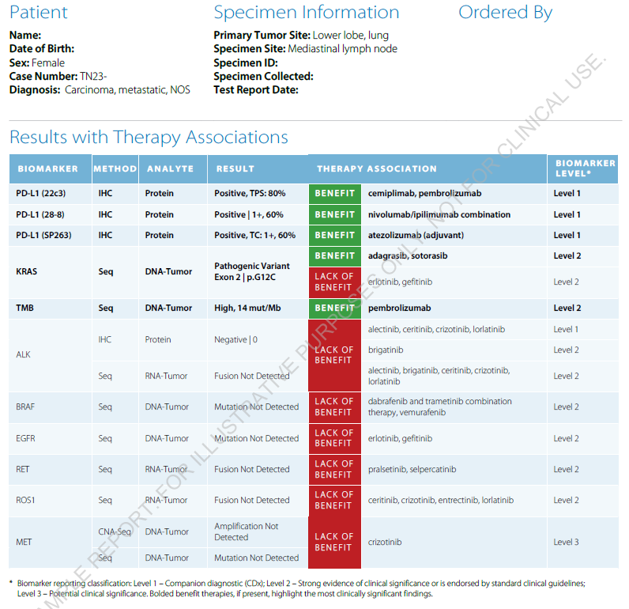
Reporting Biomarker Results
[Fox 2023, p 4A]
This figure shows an example of a biomarker report (in this case, from Caris). The primary section of all such reports identify the results for FDA-approved therapies. Many reports also include a broad range of additional markers with less clear treatment or prognostic implications, including some biomarkers that may have utility in ongoing clinical trials
PLB_006c
[Caris 2023, p 1, p 7]
Analyte (protein, tumor
DNA, tumor RNA)
Result (positive, negative,
not detected)
Method (IHC, sequencing, copy
number alterations [CNA])
Benefit/lack of benefit associated
with approved therapies
Actionable
biomarkers
“Level” refers to the level of
evidence for a biomarker:
Level 1: Companion diagnostic
Level 2: Strong evidence of clinical significance or endorsed by guidelines
Level 3: Potential clinical significance
Multiple companion diagnostic assays were used to assess PD-L1 expression, due to differences in the approved companion diagnostic for different agents in this class.

Slide 17
Key Points and Implications
The Pathology Lab
Pathology labs are staffed with a diverse array of professionals, some of whom are key stakeholders in implementing new biomarkers
Laboratory directors, department directors, technical and general supervisors, and to a lesser extent medical laboratory scientists, medical technologists, and clinical laboratory scientists all have input into biomarker protocols
Biomarker Testing
Reflex testing is desirable to accelerate biomarker testing and reduce inter-provider variability; decisions about markers to include are made at the institutional/facility level
Biomarkers may be assessed on site at in-house laboratories or at an independent reference lab; lower-volume or specialized biomarker tests are more likely to be outsourced
The use of CDx vs LDTs varies; even in cases where a CDx is available, a lab may choose to use an LDT
PLB_007
[Anand 2020, p 438A; Fox 2023, p 4A]
[AACC (Locations) 2023, p 1A, 2A; p 2B]
Biopsies and Tissue Requirements
Large biopsy samples (such as core needle biopsies or resections) are desirable to provide adequate tissue for testing
Often, only limited tissue can be obtained from patients with NSCLC and samples may not be adequate for all tests
In cases of limited tissue availability, clinicians must make choices regarding prioritization of tests
[Fox 2023, p 6A]
[Planchard 2018, p 2A]
[Garrido 2020, p 996B]

Slide 18
References
American Board of Pathology. Certification Requirements. Accessed May 11, 2023. https://www.abpath.org/index.php/to-become-certified/requirements-for-certification
American Association of Clinical Chemistry. Anatomic Pathology. Accessed May 11, 2023. https://www.testing.com/articles/anatomic-pathology/
American Association of Clinical Chemistry. Medical Laboratory Professionals: Who’s Who in the Lab. Accessed May 11, 2023. https://www.testing.com/articles/medical-laboratory-professionals/
American Association of Clinical Chemistry. Oversight of laboratory developed tests. Accessed May 12, 2023. https://www.aacc.org/advocacy-and-outreach/position-statements/2017/oversight-of-laboratory-developed-tests
American Cancer Society. Types of Biopsies Used to Look for Cancer. Accessed May 27, 2023. https://www.cancer.org/treatment/understanding-your-diagnosis/tests/testing-biopsy-and-cytology-specimens-for-cancer/biopsy-types.html
American Society of Clinical Oncology. Liquid Biopsies for Cancer: What to Know and What to Expect. Accessed May 27, 2023. https://www.cancer.net/blog/2022-11/liquid-biopsies-cancer-what-know-and-what-expect
Brigham and Women’s Hospital. Molecular Genetic Pathology Fellowship. Accessed May 27, 2023. https://www.brighamandwomens.org/pathology/fellowship-programs/molecular-genetic pathology-fellowship
Caris. Sample Report. 2023.
[ABP 2023]
[AACC 2023]
[AACC (Lab Pros) 2023]
[AACC (Oversight) 2023]
[ACS 2019]
[ASCO 2023]
[Brigham 2023, p 1A, B, C]
[Caris 2023]

Slide 19
References
Dark Intelligence Group. Clinical Pathology. Accessed May 11, 2023. https://www.darkintelligencegroup.com/tag/clinical-pathology/
Fox AH, Nishino M, Osarogiagbon RU, et al. Acquiring tissue for advanced lung cancer diagnosis and comprehensive biomarker testing: A National Lung Cancer Roundtable best-practice guide. CA Cancer J Clin. 2023;1-18.
Garrido P, Conde E, de Castro J, et al. Updated guidelines for predictive biomarker testing in advanced non-small-cell lung cancer: A National Consensus of the Spanish Society of Pathology and the Spanish Society of Medical Oncology. Clin Transl Oncol. 2020;22:989-1003.
Healio. Learn Genomics. Accessed September 7, 2022. https://www.healio.com/hematology-oncology/learn-genomics/pathology-assessment-of-tumortissue/initial-pathology-assessment
Modi P, Uppe A. Lung biopsy techniques and clinical significance. StatPearls [Internet]. StatPearls Publishing; 2023.
National Comprehensive Cancer Network. NCCN Clinical Practice Guidelines in Oncology. Non-Small Cell Lung Cancer. Version 3.2023—April 13, 2023. Accessed May 31, 2023. Available at: www.nccn.org
Planchard D, Popat S, Kerr K, et al. Metastatic non-small cell lung cancers: ESMO Clinical Practice Guidelines for diagnosis, treatment and follow-up. Ann Oncol. 2018;29(Suppl 4):iv192-iv297.
Sadik H, Pritchard D, Keeling D-M, et al. Impact of clinical practice gaps on the implementation of personalized medicine in advanced non-small-cell lung cancer. JCO Prec Oncol. 2022;6:e2200246.
[Dark Intelligence Group 2023]
[Fox 2023]
[Garrido 2020]
[Healio 2022]
[Modi 2023]
[NCCN NSCLC Guidelines V3 2023]
[Planchard 2018]
[Sadik 2022]

Slide 20
References
United States Food and Drug Administration. Companion Diagnostics. Accessed May 12, 2023. https://www.fda.gov/medicaldevices/productsandmedicalprocedures/invitrodiagnostics/ucm407297.htm.
United States Food and Drug Administration. In vitro companion diagnostic devices. Accessed May 12, 2023. https://www.fda.gov/media/81309/download
United States Food and Drug Administration. Laboratory Developed Tests. Accessed May 12, 2023. https://www.fda.gov/medical-devices/in-vitro-diagnostics/laboratory-developed-tests
[FDA (Companion Diagnostics) 2023]
[FDA 2014]
[FDA (LDTs) 2023]

