Slide 1
Hematologic Malignancies Associated with Tumor Lysis Syndrome
Confidential. For internal use only. The information contained in this training is for internal, educational purposes only. Do not copy or distribute outside of Sanofi or use in promotion. MAT-US-2301078-V1.0 02/2023
Notes:
IMAGE:
https://www.shutterstock.com/image-illustration/acute-lymphoblastic-leukemia-bone-marrow-smear-1213902283

Slide 2
Important Information
Notice:
These materials MUST NOT be used in promotion or distributed outside Sanofi. Please remember that when you are discussing Sanofi products with our customers, this discussion must be completely consistent with approved labeling, applicable law, FDA regulations, and Sanofi policies.
You are only permitted to use review committee-approved materials in your communications with customer.
All off-label inquiries must be referred to your local MSL or to Medical Information. If you have any questions about the materials, messaging, or scientific communications you may use with any customer or patients, please ask your manager.

Slide 3
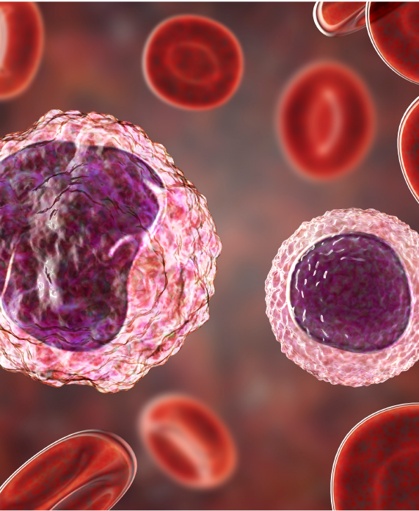
Overview
AHB_009
Risk in Leukemia and Lymphoma Patients
According to worldwide statistics, in 2018, leukemia was the 15th-most frequently diagnosed cancer and the 11th-leading cause of cancer mortality. In 2018, leukemia accounted for approximately 437,000 new cancer diagnoses and over 300,000 cancer deaths globally. Leukemia also has higher mortality in more developed countries.
According to the global cancer statistics, non-Hodgkin lymphomas accounted for about 545,000 new cases and nearly 260,000 new associated deaths in 2020.
Patients with risk factors such as exposure to radiation, chemotherapy, chemicals, and smoking, as well as those with family history and genetic abnormalities, are at greater risk of developing leukemia and lymphoma.
[Bispo 2020, p2A, 2B]
[Sung 2021, p4A]
[Bispo 2020, p5A]
Notes:
IMAGE:
https://www.shutterstock.com/image-illustration/monocyte-left-lymphocyte-right-surrounded-by-1187307604

Slide 4
Diffuse Large B-Cell Lymphoma (DLBCL)
AHB_002a
DLBCL is the most common type of non-Hodgkin lymphoma (NHL) in the US. It is characterized by the proliferation of malignant B cells that accumulate in the involved lymph node and destroy its structure.
[Padala 2022, p1A, 1B]
[Liu 2019, p3A]
Prevalence/Incidence
DLBCL accounts for about 25% to 30% of all new NHLs cases worldwide
The incidence of new cases of DLBCL in the US is 5.6 per 100,000 per year (based on 2015-2019 cases)
The incidence rates of newly diagnosed cases of DLBCL are projected to increase by 11% over 2020 to 2025 in the US
Demographic
Median age of diagnosis is 66 years in the US
Hispanics have the highest incidence of new cases of DLBCL in the US (5.4-7.3 per 100,000 new cases) followed by:
Whites (4.5-6.9 per 100,000 new cases)
Asians/Pacific Islanders (4.5-6.3 per 100,00 new cases)
Blacks (3.5-5.0 per 100,000 new cases)
DLBCL occurs more frequently in males (6.7 per 100,000 new cases) than females (4.6 per 100,000 new cases)
In the US, the highest rates of new DLBCL cases are seen in 65‑74-year-olds (26.2%)
[Cancer Stat Facts_DLBCL, p8A]
[Padala 2022, p1A, 2A]
[Mondello 2022, p1A]
[Cancer Stat Facts_DLBCL, p2B]
[Cancer Stat Facts_DLBCL, p7A]
[Kanas 2022, p4A, B]
[Cancer Stat Facts_DLBCL, p7A]
[Cancer Stat Facts_DLBCL, p8B]

Slide 5
Diffuse Large B-Cell Lymphoma (DLBCL)
AHB_001
Signs and Symptoms
DLBCL typically starts in the lymph nodes but can also start in organs and tissues outside the lymph nodes (eg, bones, brain or spinal cord, gastrointestinal tract)
Enlarged lymph nodes are commonly seen in patients with DLBCL
B symptoms are seen in 30% of patients and can include:
Testing and Diagnosis
Diagnosis can be made using the following tests and procedures:
Excisional biopsy
Complete blood count (CBC)
Positron emission tomography (PET)
Diagnosis is made using an excisional biopsy of an enlarged, abnormal-looking lymph node
Lymph node biopsy selection is based on PET scan and lymph node location
When observed, the lymphoma cells are dispersed throughout the affected tissue and look bigger than the neighboring lymphocytes
[CCS_DLBCL, p1A]
[CCS_DLBCL_2, p2A, 4A, 6A]
[CCS_CBC, p1A, 3A]
[Padala 2022, p3B]
[Padala 2022, p3B]
[Liu 2019, p3A]
[CCS_DLBCL_2, p2B, 6B]
Fever
Night sweats
Weight loss
[CCS_DLBCL, p1B]
Glossary terms are bolded text on this page. Click on these terms for formal definitions.

Slide 6
Diffuse Large B-Cell Lymphoma (DLBCL)
Grading and Staging
The current Lugano classification is based on the Ann Arbor classification
Staging is assessed at the time of diagnosis using an iliac crest bone marrow biopsy
Staging is based on the location and extent of extranodal site involvement
Treatment
6 cycles of R-CHOP (rituximab, cyclophosphamide, doxorubicin, vincristine, prednisone) is the first-line standard of care for DLBCL
Based on patient disease characteristics, 4 cycles of R-CHOP plus 2 cycles of rituximab monotherapy can also be used
Response to treatment is monitored by clinical examination, laboratory values, and imaging studies
Relapse/refractory (RR) to first-line treatment occurs in about 20% to 50% of patients, allowing them to become eligible for second-line and subsequent treatment
Treatment options in the relapsed setting includes 3 CAR (chimeric antigen receptor)-T therapies (axicabtagene ciloleucel, tisagenlecleucel, lisocabtagene maraleucel), tafasitamab-cxix, and selinexor treatment
Anti-CD19 CAR-T cells are potentially curative in the third line and beyond
Prognosis and Survival
The 2012 to 2018 5-year relative survival was 64.6% in the US
Once third-line treatments have been explored, few treatment options remain, and overall survival is ≤7 months
[Mondello 2020, p2A]
[Kanas 2022, p1A]
[Padala 2022, p5A]
[Cancer Stat Facts_DLBCL 2022, p2A]
[Khan 2013, p1A]
[Mondello 2020, p2A]
[Kanas 2022, p1A]
[Khan 2013, p1B]
[Padala 2022, p5B]
In RR DLBCL, allogeneic stem cell transplant remains a potential curative treatment option.
[Kanas 2022, p1A]
[Kanas 2022, p1A, 1B]
[Liu 2019, p8A]
[Harris 2020, p1A]

Slide 7
Chronic Lymphocytic Leukemia (CLL)
AHB_002b
CLL is a cancer that begins in the blood stem cells. It is a malignancy characterized by increased production of mature but dysfunctional B lymphocytes.
[Mukkamalla 2022, p1A]
[CCS_CLL, p1A]
Prevalence/Incidence
CLL accounts for 25% to 30% of total leukemia population in the US
The incidence of new cases of CLL in the US is 4.7 per 100,000 per year (based on 2015-2019 cases)
The US incidence increases with age with 65- to 74-year-olds having the highest incidence of new cases (31.1%) (based on 2015-2019 cases)
In 2019, the prevalence of CLL in the US was an estimated 200,000 cases
Demographic
In the US, CLL most commonly occurs in the elderly, with a median age at diagnosis of 70 years old
Whites have the highest incidence of new cases of CLL in the US (4.1-7.7 per 100,000 new cases) followed by:
Blacks (2.3-4.7 per 100,000 new cases)
Asians/Pacific Islanders (0.8-1.6 per 100,000 new cases)
More males (6.4 per 100,000 new cases) than females (3.4 per 100,000 new cases) are affected
[Cancer Stat Facts_CLL, p6B]
[Mukkamalla 2022, p2A]
[Cancer Stat Facts_CLL, p2A]
[Cancer Stat Facts_CLL, p5A]
[Cancer Stat Facts_CLL, p6A]
[Cancer Stat Facts_CLL, p5A]
[Cancer Stat Facts_CLL, p2C]

Slide 8
Chronic Lymphocytic Leukemia (CLL)
AHB_004
Signs and Symptoms
In chronic leukemia, signs and symptoms usually develop gradually over time. Patients may present with few symptoms or be completely asymptomatic
Some symptoms that patients may present with include:
Testing and Diagnosis
Diagnosis is made from routine blood work that reveals abnormal lymphocytosis
Diagnosis of CLL requires the following:
Presence of at least 5 x 10⁹/L B lymphocytes in the peripheral blood and of a clonal B-cell population
Positive for light chain restriction, CD5, CD23, CD79b, and surface immunoglobulin expression
Low levels of CD20 under microscope examination
[Mukkamalla 2022, p4A]
[CCS_CLL_2, p1A]
[Strati 2018, p2A]
[Mukkamalla 2022, p3A]
Fever
Night sweats
Weight loss
Fatigue
Early satiety
Glossary terms are bolded text on this page. Click on these terms for formal definitions.

Slide 9
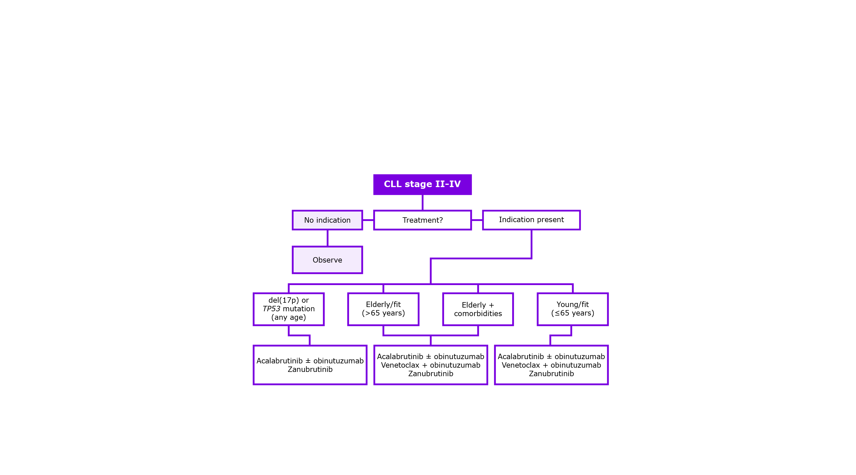
Chronic Lymphocytic Leukemia (CLL)
AHB_005
Grading and Staging
In the US, the modified Rai-Sawitsky staging is used
There are 5 stages of CLL – stage 0 followed by stages 1 to 4
Staging is based upon lymphocyte count, number of red blood cells and platelets, as well as the presence of an enlarged spleen, liver, and lymph nodes
Treatment
Optimal frontline therapy for patients with CLL is based on both the patient’s fitness and disease biological features
Prognosis and Survival
Survival with CLL ranges from 2 to >20 years
Patients with Rai staging 0 to 2 can survive up to 20 years with no treatment
Unfavorable prognostic favors include genetic alterations such as 17p and 11q deletions
CLL has a median survival of 10 years
CD38 and ZAP70 (involved in B-cell receptor signaling), and CD49d (a surface integrin) expression on CLL cells is associated with shorter survival
The 2012 to 2018 5-year relative survival was 87.9% in the US
[Mukkamalla 2022, p11A]
[Strati 2018, p6A]
[Mukkamalla 2022, p12C]
[CCS_CLL_3, p1A]
[Mukkamalla 2022, p12C]
[Mukkamalla 2022, p12C]
[CCS_CLL_3, p1A]
[Mukkamalla 2022, p12C]
Figure: Treatment strategy flow chart for chronic lymphocytic leukemia
[NCCN Guidelines_CLL-SLL: p11A, 13A, 22A, 24A]
[Strati 2018, p3A]
[Cancer Stat Facts_CLL, p3A]

Slide 10
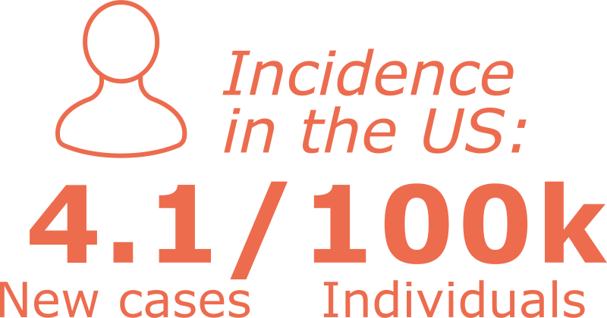
Acute Myeloid Leukemia (AML)
AHB_011
AML is one of the most common types of leukemia in adults. Characteristics of AML include ineffective erythropoiesis and bone marrow failure due to the clonal expansion of immature blast cells in the peripheral blood and bone marrow.
[Vakiti 2022, p1A]
Prevalence/Incidence
The incidence of new cases of AML in the US is 4.1 per 100,000 per year (based on 2015-2019 cases)
In the US in 2019, there were nearly 70,000 people living with AML
The US incidence increases with age, with 65- to 74-year-olds having the highest incidence of new cases (26.0%) (based on 2015-2019 cases)
Demographic
The median age of diagnosis is 68 years old in the US
Whites have the highest incidence of new cases of AML in the US (3.6-5.4 per 100,000 new cases) followed by:
Blacks (3.3-4.2 per 100,000 new cases)
Hispanics (3.0-4.0 per 100,000 new cases)
Asians/Pacific Islanders (2.9-4.3 per 100,000 new cases)
Males (5.1 per 100,000 new cases) are more frequently affected than females (3.4 per 100,000 new cases)
[Cancer Stat Facts_AML, p6B]
[Cancer Stat Facts_AML, p2A]
[Cancer Stat Facts_AML, p5A]
[Cancer Stat Facts_AML, p2B]
[Cancer Stat Facts_AML, p5A]
[Cancer Stat Facts_AML, p6A]
Glossary terms are bolded text on this page. Click on these terms for formal definitions.

Slide 11
Acute Myeloid Leukemia (AML)
AHB_008
Signs and Symptoms
Characteristic symptoms of AML include but are not limited to:
Depending on the severity of anemia, individuals can also experience symptoms such as, generalized weakness, fatigue, shortness of breath, and chest tightness
Testing and Diagnosis
AML can result from chromosomal translocations, genetic mutations, or changes in molecular levels
Mutations of the genes involved in hematopoiesis are characteristic of AML
AML should be suspected in anyone with a decreased cell count of white blood cells, hemoglobin, or platelets, the presence of circulating blast cells in the peripheral blood, easy bruising or bleeding, or recurrent infections
The diagnosis of AML includes the presence of at least 20% blasts in the bone marrow or peripheral blood
Diagnostic methods include:
Complete blood count and peripheral blood smear
Bone marrow samples
Routine cell exams by microscope
Computed tomography (CT) scans
[Vakiti 2022, p3A]
[Vakiti 2022, p2D]
[Vakiti 2022, p2C]
Recurrent infections
Anemia
Easy bruising
[Vakiti 2022, p3B]
[Vakiti 2022, p3C]
Excessive bleeding
Headaches
Bone pain
[ACS_AML, p1B, 2A, 3A, 4A]
[Vakiti 2022, p3A]
Glossary terms are bolded text on this page. Click on these terms for formal definitions.

Slide 12
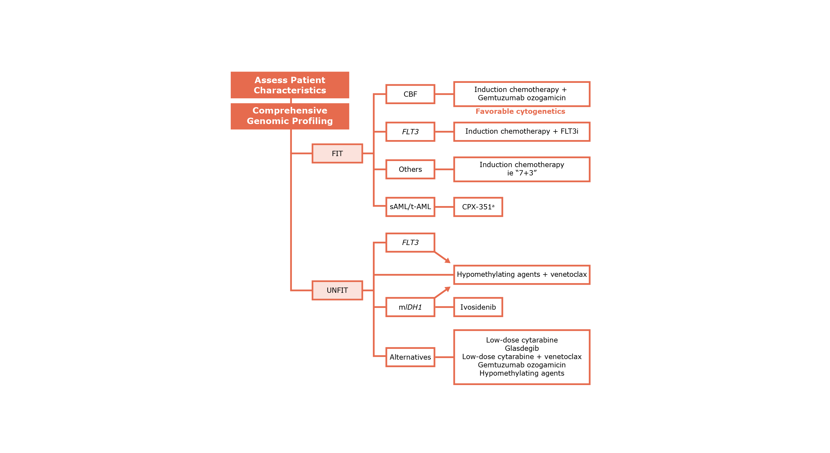
Acute Myeloid Leukemia (AML)
AHB_015
Grading and Staging
In 2016, the World Health Organization (WHO) categorized a revised classification system:
AML with recurrent genetic abnormalities
AML with myelodysplasia-related changes
Therapy-related myeloid neoplasms
AML not otherwise specified (NOS)
Myeloid sarcoma
Myeloid proliferations related to Down syndrome
Treatment
Prognosis and Survival
AML is a highly heterogeneous disease with variable prognosis
Poor prognosis in the elderly population
Elderly patients usually present with unfavorable cytogenetics, express multidrug resistance, and respond poorly to chemotherapy compared with younger patients
The 2012 to 2018 5‑year relative survival was 30.5% in the US
[Vakiti 2022, p5A]
[Vakiti 2022, p1A]
[Vakiti 2022, P1A, 2D]
[Laribi 2021, p1A]
sAML: secondary AML t-AML: therapy related AML
ªCPX-351 is a dual-drug liposomal formulation of cytarabine and daunorubicin in a 5:1 molar ratio
Figure: Approach to newly diagnosed AML
[NCCN Guidelines_AML: p20A, 97A, 107A, B, C, 111A]
[Cancer Stat Facts_AML, p3A]
Glossary terms are bolded text on this page. Click on these terms for formal definitions.

Slide 13
Burkitt Lymphoma (BL)
AHB_012
BL is an aggressive NHL that is associated with the Epstein-Barr virus (EBV). BL is a cancer of the lymphatic system and is characterized by the development of abnormal B lymphocytes.
[Graham 2022, p1A]
[CR UK_BL, p1A]
Prevalence/Incidence
BL accounts for approximately 1% to 5% of all NHLs
Sporadic BL has an incidence of 4 in 1 million for children under the age of 16 in North America and Europe
Demographic
The sporadic form is localized to North America and Europe with a median age of diagnosis of 45
Whites have the highest incidence of new cases of BL in the US (3.19 per million person-years) followed by:
Blacks (2.68 per million person-years)
BL is more prevalent in males (3.6 per million cases) than in females (0.6 per million cases) (based on 2019 US cases)
[Graham 2022, p2A]
[Graham 2022, p2A]
[Graham 2022, p2A]
[Mbulaiteye 2022, p4A, 6A]
[NCCR_BL, p1A]
Glossary terms are bolded text on this page. Click on these terms for formal definitions.

Slide 14
Burkitt Lymphoma (BL)
AHB_003
Signs and Symptoms
Due to the tumors rapid doubling time, patients often present with a rapidly growing mass, elevated LDH, and increased uric acid levels
Patients present with symptoms such as:
Abdominal pain secondary to ileocecal disease
Abdominal distention
Nausea
Vomiting
Gastrointestinal (GI) bleeding
Adult patients are more likely to present with fever, weight loss, and night sweats
Enlarging jaw lesion, periorbital swelling, or genitourinary involvement are characteristic of endemic BL (observed in children in sub-Saharan Africa)
In sporadic BL (localized to North America and Europe), the primary site is typically the abdomen, but can include the head and neck as well
Testing and Diagnosis
The World Health Organization (WHO) classifies BL into 3 clinical groups for diagnosis:
Endemic (linked to malaria and EBV)
Sporadic
Immunodeficiency-related (associated with HIV and organ transplantation)
Definitive diagnostic methods include:
Bone marrow biopsy
Fluorescence in situ hybridization (FISH)
Genetic testing
Histologic confirmation
Immunophenotyping
What is seen during testing and diagnosis:
Malignant B-cells express surface IgM
Cells are positive for B-cell markers CD19, CD20, CD79a, and PAX5
[Graham 2022, p3C]
[Graham 2022, p1A]
[Graham 2022, p3C]
[NIH_BL, p4A]
[Graham 2022, p3C]
[Graham 2022, p3C]
[Coffey 2015, p1A]
[Graham 2022, p3C]
[Graham 2022, p3B]
[Coffey 2015, p1A]
Glossary terms are bolded text on this page. Click on these terms for formal definitions.

Slide 15
Burkitt Lymphoma (BL)
Grading and Staging
For pediatric patients, the St. Jude staging system is used
In adult patients, the Ann Arbor and Murphy staging systems are used
Staging is based on the number and position of affected lymph nodes or other organs
Treatment
Treatment is stratified based on patient age and stage
In adult BL, standard chemotherapy regimens (ie, CHOP) are inadequate
The National Comprehensive Cancer Network (NCCN) recommends multiagent regimens with CNS prophylaxis
Pediatric patients that have complete surgical resection of disease are recommended to receive 2 cycles of moderate-intensity chemotherapy
In children with residual or stage III disease, 4 cycles of dose-intensive chemotherapy (ie, 2 cycles of cyclophosphamide, vincristine, prednisolone, doxorubicin, and high-dose methotrexate) are recommended, after which 2 cycles of cytarabine and high-dose methotrexate are initiated
Prognosis and Survival
Clinical and histopathologic staging predict prognosis in BL
The US 5-year relative survival is 90%, 48%, and 29% in children, adults, and the elderly, respectively (based on 2000-2013 cases)
With intense chemotherapy treatment, disease prognosis is excellent in children but poor in adults
Poor prognostic indicators include:
Poor response to cyclophosphamide, prednisolone, and vincristine
Detection of central nervous system (CNS) disease at presentation
Elevated lactose dehydrogenase (LDH) concentrations (twice the upper limit of normal)
[Graham 2022, p5A]
[Graham 2022, p3D]
[Graham 2022, p1A, 6C]
[Graham 2022, p5A]
[Graham 2022, p4A]
[Graham 2022, p4A]
[Mukhtar 2017, p1A, 3A, B]
[CR UK_BL, p4A]
[Graham 2022, p6C]
[Graham 2022, p3D]
[Graham 2022, p6D]
[Graham 2022, p6D]
[Graham 2022, p3D]
[Graham 2022, p6D]
Glossary terms are bolded text on this page. Click on these terms for formal definitions.

Slide 16
Chronic Myeloid Leukemia (CML)
AHB_013
CML is classified as a myeloproliferative neoplasm that affects both the peripheral blood and bone marrow. It is characterized by having the Philadelphia chromosome and is predominantly composed of proliferating granulocytes.
[Eden 2022, p1A]
Prevalence/Incidence
The incidence of new cases of CML in the US is 1.9 per 100,000 per year (based on 2015-2019 cases)
CML has a worldwide annual incidence rate of 0.87 people per 100,000, increasing with age up to 1.52 in patients >70 years
In the US in 2019, there were an estimated 63,000 people living with CML
The US incidence increases with age with 65- to 74-year-olds having the highest incidence of new cases (22.1%) (based on 2015-2019 cases)
Demographic
The median age of diagnosis is 65 years old in the US
Whites have the highest incidence of new cases of CML in the US (1.6-2.6 per 100,000 new cases) followed by:
Blacks (1.5-2.3 per 100,000 new cases)
Hispanics (1.3-2.0 per 100,000 new cases)
Asians/Pacific Islanders (0.9-1.6 per 100,000 new cases)
CML occurs more frequently in males (2.5 per 100,000 new cases) than in females (1.5 per 100,000 new cases)
[Cancer Stat Facts_CML, p6A]
[Cancer Stat Facts_CML, p5A]
[Eden 2022, p1B]
[Eden 2022, p1B]
[Cancer Stat Facts_CML, p2A]
[Cancer Stat Facts_CML, p6B]
[Cancer Stat Facts_CML, p5A]
Glossary terms are bolded text on this page. Click on these terms for formal definitions.

Slide 17
Chronic Myeloid Leukemia (CML)
AHB_007
Signs and Symptoms
In the chronic phase, CML most often shows symptoms related to anemia and splenomegaly
Fatigue and malaise are commonly associated with symptomatic anemia
Platelet dysfunction or thrombocytopenia may also result from CML
Once CML progresses to the accelerated or blast faces, the following symptoms may be present:
Testing and Diagnosis
Chronic phase
Less than 10% blasts, asymptomatic to mild symptoms, and responds to tyrosine kinase inhibitor therapy
Accelerated phase
Persistent or increasing high white blood cell count, splenomegaly, and thrombocytosis unresponsive to therapy
Persistent thrombocytopenia (less than 100 x 10⁹/L)
Greater than or equal to 20% basophils in peripheral blood
10%-19% blasts in peripheral blood or bone marrow (without extramedullary blast proliferation)
Additional chromosomal abnormalities in Philadelphia chromosome-positive cells at diagnosis
Any new clonal chromosomal abnormality in Philadelphia chromosome-positive cells during therapy
Blast phase
Greater than or equal to 20% blasts in the peripheral blood and/or bone marrow or extramedullary blast proliferation
Diagnostic methods include:
Complete blood count
Bone marrow samples
FISH
Polymerase chain reaction (PCR)
CT scans
[Eden 2022, p3A]
[Eden 2022, p8B]
[Eden 2022, p8C, 9A]
Headache
Bone pain
Fever
Joint pain
[Eden 2022, p9B]
[ACS_CML, p1A, B, 2B, 3A, B]
Bleeding
Infections
Lymphadenopathy
Glossary terms are bolded text on this page. Click on these terms for formal definitions.

Slide 18
Chronic Myeloid Leukemia (CML)
Grading and Staging
CML staging is determined based on disease phase (chronic phase, accelerated phase, and blast phase)
Treatment
There are 4 available first-line treatments that are FDA-approved for treatment of chronic phase CML:
Imatinib (first-generation)
Dasatinib (second-generation)
Nilotinib (second-generation)
Bosutinib (second-generation)
For accelerated and blast phase, second- or third-generation tyrosine kinase inhibitors (TKIs) should be started
Patients in the accelerated and blast phase should also be considered for early allogenic hematopoietic stem cell transplant (HSCT)
Prognosis and Survival
Without treatment, most CML cases progress to the blast phase and death occurs in under 5 years
With treatment, individuals diagnosed with chronic phase CML are expected to reach near-normal life expectancy
The 2012 to 2018 5-year relative survival was 70.4% in the US
Poor prognostic indicators are seen in the presence of 2 or more additional chromosomal abnormalities or a single additional chromosomal abnormality involving specific changes to chromosomes 17, 7, and 3
[Eden 2022, p4A]
[Eden 2022, p9C]
[Eden 2022, p8A]
[Eden 2022, p9C]
[Cancer Stat Facts_CML, p3A]
[Eden 2022, p4B]
[Eden 2022, p9D]
[Eden 2022, p4B]

Slide 19
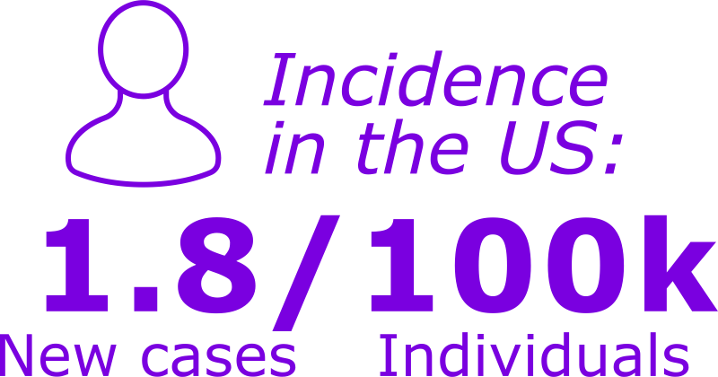
Acute Lymphocytic Leukemia (ALL)
AHB_014
ALL is characterized by a malignancy of B or T lymphocytes that result in the uncontrolled division of irregular lymphocytes and their progenitors
[Puckett 2022, p1A]
Prevalence/Incidence
The incidence of new cases of ALL in the US is 1.8 per 100,000 per year (based on 2015-2019 cases)
In the US in 2019, there were an estimated 107,600 people living with ALL
The US incidence is highest in the <20 years old age group (53.9%) (based on 2015-2019 cases)
Demographic
The median age of diagnosis is 17 years old in the US
Hispanics have the highest incidence of new cases of ALL in the US (2.3-2.9 per 100,000 new cases) followed by:
Whites (1.4-1.8 per 100,000 new cases)
Asians/Pacific Islanders (1.4-1.7 per 100,000 new cases)
Blacks (0.9-1.1 per 100,000 new cases)
ALL is more common in children with Down syndrome, Bloom syndrome, neurofibromatosis type 1 (NF1), and ataxia telangiectasia
Occurs more frequently in males (2.1 per 100,000 new cases) than in females (1.6 per 100,000 new cases)
[Cancer Stat Facts_ALL, p6B]
[Cancer Stat Facts_ALL, p2A]
[Cancer Stat Facts_ALL, p5A]
[Cancer Stat Facts_ALL, p2A]
[Cancer Stat Facts_ALL, p6A]
[Puckett 2022, p2B]
[Cancer Stat Facts_ALL, p5A]
Glossary terms are bolded text on this page. Click on these terms for formal definitions.

Slide 20
Acute Lymphocytic Leukemia (ALL)
AHB_006
Signs and Symptoms
Due to the replacement of the bone marrow with the tumor, ALL has symptoms related to anemia, thrombocytopenia, and neutropenia
Symptoms can include:
Testing and Diagnosis
Once ALL is diagnosed it should be followed-up with a laboratory evaluation consisting of a CBC, electrolyte and renal panel, and LDH level
National Comprehensive Cancer Network (NCCN) diagnosis guidelines:
Have presence of more than 20% bone marrow lymphoblasts
Hematoxylin and eosin-stained bone marrow clot and biopsy sections
Morphology of bone marrow aspirate assessed with Wright/Giemsa
Complete flow cytometric immunophenotyping
Baseline evaluation of the leukemic clone
[Puckett 2022, p1A, 2A]
[Puckett 2022, p3A]
[Puckett 2022, p2A]
[Puckett 2022, p3B]
Fatigue
Easy bruising/
bleeding
Infections
Glossary terms are bolded text on this page. Click on these terms for formal definitions.

Slide 21
Acute Lymphocytic Leukemia (ALL)
Grading and Staging
The WHO has many staging classifications of ALL based on the chromosomal rearrangements and genes affected
The WHO classifies ALL as:
B-lymphoblastic leukemia/lymphoma
T-lymphoblastic leukemia/lymphoma
Treatment
Successful treatment ALL in children involves administration of a multidrug regimen that is divided into 3 key phases:
Induction
Anthracycline, vincristine, 1-asparaginase, and a corticosteroid
Consolidation
Includes therapy with a variety of chemotherapeutic drugs
Maintenance
Uses oral 6-mercaptopurine or methotrexate delivered once weekly or once monthly
Treatment of ALL in the adult population can include targeted therapy such as TKIs imatinib mesylate, dasatinib, and nilotinib
Prognosis and Survival
Prognosis is diminished in:
Infants <1 year of age
Adults aged >60
Association of the MLL gene (chromosomal location 11q23) is also associated with a poor prognosis in children
The 2012 to 2018 5-year relative survival was 70.8% in the US
[Puckett 2022, p4A]
[Puckett 2022, p3E]
[Puckett 2022, p2B]
[Puckett 2022, p3C]
[Puckett 2022, p4A, p5B]
[Puckett 2022, p3D]
[Puckett 2022, p2B, 5A]
[Puckett 2022, p3E]
[Cancer Stat Facts_ALL, p3A]
[NIH_ALL, p14A, p15A]

Slide 22
Glossary
Click on the same glossary term to return to the page you were on.
Ataxia telangiectasia: A neurological disorder that causes degeneration in the brain that controls motor movements and speech.
Basophilic: A term used in the histological staining of cells. Basophilic refers to components stained with basic dyes.
Epstein-Barr virus (EBV): A common dormant virus that causes infectious mononucleosis and has been associated with certain cancers.
Erythropoiesis: The production of red bloods cells in the bone marrow. A type of hematopoiesis.
Genitourinary: A system involved in reproduction and getting rid of waste products in the form of urine.
Hematopoiesis: The formation of new blood cells.
Hematoxylin and eosin-staining: Also called H and E staining, is a common laboratory method that utilizes hematoxylin and eosin dyes to help visualize different parts of the cell under the microscope.
Heterogeneous: Diverse in character or content. Can also mean derived from a different source or species.
[Ataxia Telangiectasia _ NIH, p1A]
[Basophilic_ UofLeeds, p1A]
[NCI Definitions, p6A]
[NCI Definitions, p7A]
[NCI Definitions, p10A]
[NCI Definitions, p9A]
[NCI Definitions, p1A]
[NCI Definitions, p11A]

Slide 23
Glossary
Click on the same glossary term to return to the page you were on.
Histopathologic: The study of diseased cells and tissues using a microscope.
Ileocecal disease: Also known as neutropenic enterocolitis or typhlitis, a syndrome marked by inflammation of the cecum, usually accompanied by neutropenia.
Immunoglobulin: A protein made by white blood cells that helps the body fight infections.
Immunophenotyping: A method that uses antibodies to help classify cells based on the markers present on the cell surfaces.
Lymphocyte: A type of white blood cell that is made in the bone marrow and found in the blood and lymph tissue.
Lymphocytosis: An increase in white blood cells called lymphocytes.
Lymphoblast: An immature white blood cell that gives rise to a type of immune cell known as a lymphocyte.
[NCI Definitions, p12A]
[NCI Thesaurus, p1A]
[NCI Definitions, p13A]
[NCI Definitions, p2A]
[NCI Definitions, p14A]
[NCI Definitions, p14A]
[NCI Definitions, p3A]

Slide 24
Glossary
Click on the same glossary term to return to the page you were on.
Myeloproliferative neoplasm: A type of disease in which the bone marrow makes too many red blood cells, platelets, or certain white blood cells.
Neurofibromatosis type 1 (NF1): A rare genetic condition that causes tumors on the nerves, and developmental changes in the nervous system, muscles, bone, and skin.
Periorbital: Tissues surrounding or lining the orbit of the eye.
Philadelphia chromosome: Forms when pieces of chromosome 9 and 22 break off and trade places. Also called an BCR-ABL fusion gene.
Platelet: Small disk-shaped cell fragments found in the blood that are involved in clotting.
Splenomegaly: Enlarged spleen.
Thrombocytopenia: A condition where there is a deficiency of platelets in the blood.
[NCI Definitions, p16A]
[NCI Definitions, p17A]
[Periorbital_Merriam-Webster Medical, p3A]
[NCI Definitions, p4A]
[NCI Definitions, p18A]
[NCI Definitions, p19A]
[NCI Definitions, p20A]

Slide 25
References
American Cancer Society. Tests for Acute Myeloid Leukemia (AML) Updated 2018. Accessed January 27, 2021. https://www.cancer.org/cancer/acute-myeloid-leukemia/detection-diagnosis-staging/how-diagnosed.html
American Cancer Society. Tests for Chronic Myeloid Leukemia (CML) Updated 2021. Accessed January 27, 2021. https://www.cancer.org/cancer/acute-myeloid-leukemia/detection-diagnosis-staging/how-diagnosed.html
Bispo JAB, Pinheiro PS, Kobetz EK. Epidemiology and etiology of leukemia and lymphoma. Cold Spring Harb Perspect Med. 2020; 10: a034819.
Blansky D, Mantzaris I, Rohan T, et al. Influence of Rurality, Race, and Ethnicity on Non-Hodgkin Lymphoma Incidence. Clinical Lymphoma, Myeloma & Leukemia. 2020; 20(10): 668–676.
Burkitt lymphoma. National Cancer Institute, National Childhood Cancer Registry Explorer. Updated 2023. Accessed January 17, 2023. https://nccrexplorer.ccdi.cancer.gov/application.html?site=207&data_type=1&graph_type=2&compareBy=sex&chk_sex_3=3&chk_sex_2=2&race=1&age_range=1&advopt_precision=1&advopt_show_ci=on&advopt_display=1
Burkitt lymphoma. National Cancer Institute, National Institutes of Health. Updated 2023. Accessed January 13, 2023. https://seer.cancer.gov/seertools/hemelymph/51f6cf57e3e27c3994bd5324/
Canadian Cancer Society. Complete blood count (CBC). Updated 2023. Accessed January 11, 2023. https://cancer.ca/en/treatments/tests-and-procedures/complete-blood-count-cbc#ci_complete_blood_count_cbc_89_3950_00
Canadian Cancer Society. Diagnosis of leukemia. Updated 2023. Accessed January 9, 2023. https://cancer.ca/en/cancer-information/cancer-types/chronic-lymphocytic-leukemia-cll/diagnosis
Canadian Cancer Society. Diagnosis of non-Hodgkin lymphoma. Updated 2023. Accessed January 10, 2023. https://cancer.ca/en/cancer-information/cancer-types/non-hodgkin-lymphoma/diagnosis
Canadian Cancer Society. Diffuse large B-cell lymphoma. Updated 2023. Accessed January 9, 2023. https://cancer.ca/en/cancer-information/cancer-types/non-hodgkin-lymphoma/what-is-non-hodgkin-lymphoma/diffuse-large-b-cell-lymphoma
Canadian Cancer Society. Stages of chronic lymphocytic leukemia (CLL). Updated 2023. Accessed January 9, 2023. https://cancer.ca/en/cancer-information/cancer-types/chronic-lymphocytic-leukemia-cll/staging

Slide 26
References
Canadian Cancer Society. Symptoms of leukemia. Updated 2023. Accessed January 9, 2023. https://cancer.ca/en/cancer-information/cancer-types/chronic-lymphocytic-leukemia-cll/signs-and-symptoms
Canadian Cancer Society. What is chronic lymphocytic leukemia? Updated 2023. Accessed January 9, 2023. https://cancer.ca/en/cancer-information/cancer-types/chronic-lymphocytic-leukemia-cll/what-is-chronic-lymphocytic-leukemia
Cancer Stat Facts: Leukemia – Acute Lymphocytic Leukemia (ALL). National Cancer Institute, National Institutes of Health. Updated 2023. Accessed January 16, 2023. https://seer.cancer.gov/statfacts/html/alyl.html
Cancer Stat Facts: Leukemia — Acute Myeloid Leukemia (AML). National Cancer Institute, National Institutes of Health. Updated 2023. Accessed January 13, 2023. https://seer.cancer.gov/statfacts/html/amyl.html
Cancer Stat Facts: Leukemia — Chronic Lymphocytic Leukemia (CLL). National Cancer Institute, National Institutes of Health. Updated 2023. Accessed January 9, 2023. https://seer.cancer.gov/statfacts/html/clyl.html
Cancer Stat Facts: Leukemia — Chronic Myeloid Leukemia (CML). National Cancer Institute, National Institutes of Health. Updated 2023. Accessed January 16, 2023. https://seer.cancer.gov/statfacts/html/cmyl.html
Cancer Stat Facts: NHL – Diffuse Large B-Cell Lymphoma (DLBCL). National Cancer Institute, National Institutes of Health. Updated 2023. Accessed January 5, 2023. https://seer.cancer.gov/statfacts/html/dlbcl.html
Cancer Research UK. Burkitt Lymphoma. Updated 2020. Accessed January 30, 2023. https://www.cancerresearchuk.org/about-cancer/non-hodgkin-lymphoma/types/burkitt-lymphoma
Coffey DG, Lombardo KA, Towlerton AMH, et al. Comparative analysis of endemic and sporadic Burkitt lymphoma by RNA sequencing. Blood. 2015; 126(23):3896.
DiNardo CD, Jonas BA, Pullarkat V, et al. Azacitidne and Venetoclax in Previously untreated acute myeloid luekemia. NEJM. 2020; 383(7): 617-629.
Eden RE, Coviello JM. Chronic Myelogenous Leukemia. StatPearls. StatPearls Publishing; 2022. https://www.ncbi.nlm.nih.gov/books/NBK531459/
Faculty of Biological Sciences. What is H&E? University of Leeds. Updated 2022. Accessed December 13, 2022. https://www.histology.leeds.ac.uk/what-is-histology/H_and_E.php
26

Slide 27
References
Graham BS, Lynch DT. Burkitt Lymphoma. StatPearls. StatPearls Publishing; 2022. https://www.ncbi.nlm.nih.gov/books/NBK538148/
Harris LJ, Patel K, Martin M. Novel therapies for relapsed or refractory diffuse large B-cell lymphoma. Int. J. Mol. Sci. 2020; 21: 8553
Kanas G, Ge W, Quek RGW, et al. Epidemiology of diffuse large B-cell lymphoma (DLBCL) and follicular lymphoma (FL) in the United States and Western Europe: population-level projections for 2020–2025. Leuk Lymphoma. 2022; 63(1): 54–63.
Khan AB, Barrington SF, Mikhaeel NG. PET-CT staging of DLBCL accurately identifies and provides new insight into the clinical significance of bone marrow involvement. Blood. 2013; 122(1): 61-67.
Laribi K, Sobh M, Ghez D. Impact of age, functional status, and comorbidities on quality of life and outcomes in elderly patients with AML: review. Annals of Hematology. 2021; 100: 1359–1376.
Liu Y, Barta SK. Diffuse large B-cell lymphoma: 2019 update on diagnosis, risk stratification, and treatment. Am J Hematol. 2019; 94: 604–616.
Mbulaiteye SM, Devesa SS. Burkitt lymphoma incidence in five continents. Hemato. 2022; 3: 434–453.
Merriam-Webster Dictionary. Accessed Dec 13, 2022. https://www.merriam-webster.com/
Mondello P, Nowakowski GS. Treatment of aggressive B cell lymphomas: Updates in 2019. Curr Hematol Malig Rep. 2020; 15: 225–234.
Mukhtar F, Boffetta P, Risch HA. Survival predictors of Burkitt’s lymphoma in children, adults and elderly in the United States during 2000–2013. Int. J. Cancer. 2017; 140: 1494-1502.
Mukkamalla SKR, Taneja A, Malipeddi D, et al. Chronic Lymphocytic Leukemia. StatPearls. StatPearls Publishing; 2022. https://www.ncbi.nlm.nih.gov/books/NBK470433/
National Comprehensive Cancer Network. Acute Myeloid Leukemia (Version 3.2022). Accessed March 1, 2023. https://www.nccn.org/professionals/physician_gls/pdf/aml.pdf
National Comprehensive Cancer Network. Chronic Lymphocytic Leukemia/Small Lymphocytic Lymphoma (Version 2.2023). Accessed March 1, 2023. https://www.nccn.org/professionals/physician_gls/pdf/cll.pdf

Slide 28
References
National Institutes of Health. Adult Lymphoblastic Leukemia Treatment (PDQ®) - Patient Version. Updated 2021. Accessed January 27, 2023. https://www.cancer.gov/types/leukemia/patient/adult-all-treatment-pdq
National Institutes of Health. Ataxia Telangiectasia. Updated 2022. Accessed Dec 13, 2022. https://www.ninds.nih.gov/health-information/disorders/ataxia-telangiectasia#:~:text=Ataxia%2Dtelangiectasia%20is%20a%20rare,first%20five%20years%20of%20life
NCI Thesaurus. National Cancer Institute. National Institutes of Health. Accessed Dec 13, 2022. https://thesaurus.cancer.gov/ncitbrowser/pages/home.jsf?version=22.11d
NCI Dictionary of Cancer Terms. National Cancer Institute, National Institutes of Health. Updated 2022. Accessed December 12, 2022. https://www.cancer.gov/publications/dictionaries/cancer-terms
Padala SA, Kallam A. Diffuse Large B Cell Lymphoma. StatPearls. StatPearls Publishing; 2022. https://www.ncbi.nlm.nih.gov/books/NBK557796/
Puckett Y, Chan O. Acute Lymphocytic Leukemia. StatPearls. StatPearls Publishing; 2022. https://www.ncbi.nlm.nih.gov/books/NBK459149/
Strati P, Jain N, O’Brien S. Chronic lymphocytic leukemia: diagnosis and treatment. Thematic Review Series On Neoplastic Hematology And Medical Oncology. 2018; 93(5): 651–664.
Sung H, Ferlay J, Siegel RL, et al. Global cancer statistics 2020: GLOBOCAN estimates of incidence and mortality worldwide for 36 cancers in 185 countries. CA Cancer J Clin. 2021; 71: 209–249.
Vakiti A, Mewawalla P. Acute Myeloid Leukemia. StatPearls. StatPearls Publishing; 2022. https://www.ncbi.nlm.nih.gov/books/NBK507875/

