Slide 1
FINTEPLA® Training
MODULE 6: FINTEPLA Prescribing Information
ZOGENIX INC. – CONFIDENTIAL INFORMATION – FOR INTERNAL USE ONLY US-FIN12-2100005 March 2022

Slide 2
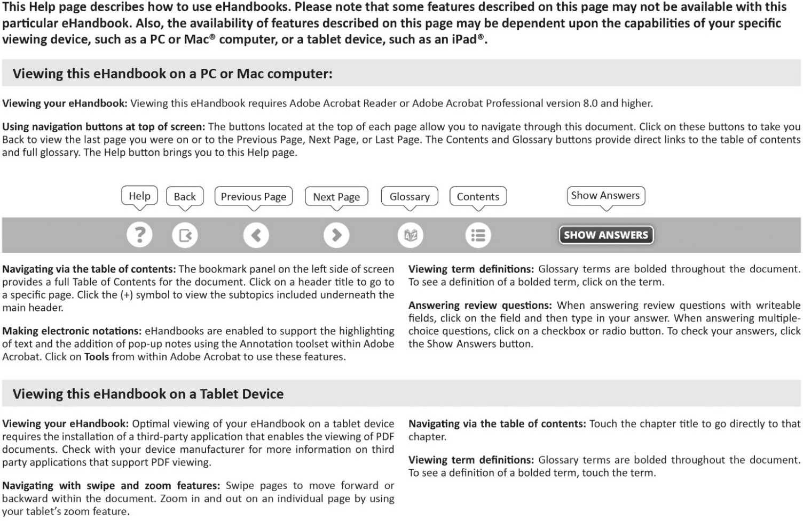
Navigating via the table of contents: the bookmark panel on the left side of the screen provides a full Table of Contents for the document. Click on a header title to go to a specific page. Client (+) symbol to view the subtopics included underneath the main header.

Slide 3
Table of Contents
FINTEPLA® Training
Module 6: FINTEPLA Prescribing Information
Module Introduction 4
How to Use This Module 4
Chapter 1: Indications and Dosage and Administration 5
Take Home Points 14
Knowledge Check 16
Chapter 2: Contraindications, Warnings and Precautions, and Adverse Reactions 20
Take Home Points 35
Knowledge Check 36
Chapter 3: Drug Interactions, Use in Specific Populations, Drug Abuse and Dependence, and Overdosage 42
Take Home Points 50
Knowledge Check 51
Chapter 4: Description, Clinical Pharmacology, and Nonclinical Toxicology 59
Take Home Points 65
Knowledge Check 66
Chapter 5: Clinical Studies 72
Take Home Points 83
Knowledge Check 85
Chapter 6: How Supplied, Storage and Handling, and Patient Counseling Information 93
Take Home Points 97
Knowledge Check 98
Glossary 104
References 107

Slide 4
Module Introduction
This module reviews the various sections in the FINTEPLA PI to help you gain confidence discussing FINTEPLA with healthcare professionals. The sections are presented in the order in which they appear within the PI. As you will see, each page of the PI is shown with corresponding numbered annotations that reinforce key information. Some of the annotations also provide additional background on disease state concepts and medical terminology.
How to Use This Module
Each chapter within this module has its own Learning Objectives, Take Home Points, and Knowledge Checks. Take Home Points summarize the key points and will help you use the module as a quick reference source in the future. Throughout the module, key terms appear in boldface green and are defined in the Glossary at the end.

Slide 5
Chapter 1: Indications and Dosage and Administration
Learning Objectives
Upon completion of this chapter, you will be able to:
Discuss the indications of FINTEPLA
Describe the dosage and administration of FINTEPLA

Slide 6
In June 2020, FINTEPLA was approved by the Food and Drug Administration (FDA) for the treatment of seizures associated with Dravet syndrome (DS) in patients 2 years of age and older. In March 2022, the indications for FINTEPLA were expanded to include patients with Lennox-Gastaut syndrome (LGS) 2 years of age and older.
As you have learned in other modules of this learning system, DS, which was previously known as severe myoclonic epilepsy in infancy (SMEI), is a severe and rare form of developmental epileptic encephalopathy (DEE) that typically presents during infancy and is commonly caused by a genetic variant of the SCN1A gene. With DS, seizures include generalized tonic-clonic and unilateral clonic seizures and are generally refractory to treatment with antiepileptic drugs (AEDs). Note that AEDs are also referred to as antiseizure medications (ASMs).
LGS is another severe and rare DEE with a peak onset between ages 3 to 5. It is characterized by multiple types of refractory seizures, most often tonic and atypical absence seizures. Other characteristics include abnormal electroencephalogram (EEG) patterns and cognitive impairment that is often accompanied by behavioral issues.
This highlights page provides an overview of the various sections of the FINTEPLA prescribing information (PI), which are described in more detail in subsequent pages.
1

Slide 7
The FINTEPLA highlights continue onto the second page of the FINTEPLA PI and provide hyperlinks to the various sections.
1

Slide 8
The FINTEPLA PI contains a boxed warning regarding valvular heart disease and pulmonary arterial hypertension. It explains that echocardiogram assessments are required before, during, and after treatment with FINTEPLA. The boxed warning also explains that FINTEPLA is available only through a restricted program under a Risk Evaluation and Mitigation Strategy (REMS) called the FINTEPLA REMS.
Echocardiography is a noninvasive test that uses ultrasound to visualize cardiac structures, and an echocardiogram is the graphic record produced by echocardiography. The heart contains four valves, including the:
Aortic valve
Mitral valve
These valves open to allow blood to flow through or out of the heart and close to keep blood from flowing backward. When these valves do not work properly, patients may have:
Regurgitation, which refers to when blood leaks in the wrong direction back through the valve
Mitral valve prolapse, which occurs when the flaps of the mitral valve do not close tightly; mitral valve prolapse may result in regurgitation
Stenosis, which occurs when the valve is narrowed and does not open properly; the flaps of the valve may thicken, stiffen, or fuse together, prohibiting the valve from fully opening
Pulmonary arterial hypertension is a condition that occurs when small arteries throughout the lungs narrow and become thickened, resulting in increased blood pressure in the lung. It can also lead to the heart working harder and losing its ability to efficiently pump blood throughout the body.
1
Pulmonary valve
Tricuspid valve

Slide 9
Section 1 explains that FINTEPLA is indicated for the treatment of seizures associated with DS and LGS in patients 2 years of age and older.
Section 2 describes the dosage and administration of FINTEPLA. As discussed in Section 2.1, an echocardiogram assessment should be obtained before starting FINTEPLA treatment to evaluate for valvular heart disease and pulmonary arterial hypertension.
2
1
2

Slide 10
As described in Section 2.2, FINTEPLA is orally administered and may be taken with or without food. The initial starting dosage for patients with DS or LGS is 0.1 mg/kg twice daily.
Dravet Syndrome (DS)
The initial maintenance dosage is also 0.1 mg/kg twice daily, which can be increased weekly based on efficacy and tolerability
For patients who are tolerating FINTEPLA at 0.1 mg/kg twice daily and require further reduction of seizures:
Patients not on concomitant stiripentol may benefit from a dosage increase up to a maximum recommended maintenance dosage of 0.35 mg/kg twice daily (maximum daily dosage of 26 mg)
Patients taking concomitant stiripentol plus clobazam may benefit from a dosage increase up to a maximum recommended maintenance dosage of 0.2 mg/kg twice daily (maximum daily dosage of 17 mg)
Stiripentol (Diacomit®) is an AED indicated for the treatment of seizures associated with DS in patients 2 years of age and older taking clobazam.
Clobazam (Onfi®) is an AED indicated for the adjunctive treatment of seizures associated with LGS in patients 2 years of age or older.
1

Slide 11
Lennox-Gastaut Syndrome (DS)
The initial starting dosage of 0.1 mg/kg twice daily should be increased weekly based on tolerability.
For patients who are tolerating FINTEPLA at 0.1 mg/kg twice daily:
Patients not on concomitant stiripentol should be titrated to a maximum recommended maintenance dosage of 0.35 mg/kg twice daily (maximum daily dosage of 26 mg)
Patients taking concomitant stiripentol plus clobazam should be titrated to a dosage increase up to a maximum recommended maintenance dosage of 0.2 mg/kg twice daily (maximum daily dosage of 17 mg)
The recommended titration schedule for patients with either indication is summarized in Table 1. Footnotes below Table 1 provide further details for specific patient populations.
NOTE the difference in maintenance and titration recommendations for patients with DS versus those with LGS:
For patients with DS, dosage may be increased based on clinical response to the maximum dosage, as needed
For patients with LGS, dosage should be increased as tolerated to the recommended maintenance dosage (i.e., Day 14).
Recommendations are also provided for patients taking concomitant strong CYP1A2 or CYP2D6 inhibitors or in patients with severe renal impairment. These are discussed in Sections 2.3 and 2.4, respectively.
1
1
2
2

Slide 12
Section 2.3 describes dosage modifications needed in patients who are taking FINTEPLA concomitantly with drugs that are strong CYP1A2 or CYP2D6 inhibitors. In these patients, the recommended maximum total daily dosage is 20 mg without concomitant stiripentol and 17 mg with concomitant stiripentol plus clobazam.
1

Slide 13
Section 2.4 states that the recommended maximum total daily dosage of FINTEPLA in patients with severe renal impairment (estimated glomerular filtration rate (eGFR) 15 to 29 mL/min/1.73m²) is 20 mg without concomitant stiripentol and 17 mg with concomitant stiripentol plus clobazam.
Section 2.5 describes the assessments that are needed during and after the administration of FINTEPLA to evaluate for valvular heart disease and pulmonary arterial hypertension. Specifically, it explains that an echocardiogram assessment should be obtained:
Every 6 months during treatment with FINTEPLA
3 to 6 months after the final dose of FINTEPLA
Section 2.6 of the FINTEPLA PI explains that a calibrated measuring device (either a 3 mL or 6 mL oral syringe) should be used to accurately measure and administer FINTEPLA. In addition, any unused FINTEPLA should be discarded if there is any remaining after 3 months of first opening the bottle or the “Discard After” date on the package and/or bottle has been reached, whichever is sooner. The labeling also states that FINTEPLA is compatible with commercially available gastric and nasogastric feeding tubes.
As explained in Section 2.7, abrupt discontinuation of AEDs should be avoided to minimize the risk of increased seizure frequency and status epilepticus. Therefore, the FINTEPLA dose should be gradually decreased when discontinuing its use.
Section 3 of the label states that FINTEPLA oral solution is available as a clear, colorless, cherry flavored liquid containing 2.2 mg/mL fenfluramine.
1
2
2
3
3
4
5
4
5

Slide 14
Take Home Points
The FINTEPLA PI contains a boxed warning regarding valvular heart disease and pulmonary arterial hypertension; echocardiogram assessments are required before, during, and after treatment with FINTEPLA; FINTEPLA is available only through a restricted program under a Risk Evaluation and Mitigation Strategy (REMS) called the FINTEPLA REMS
FINTEPLA is indicated for the treatment of seizures associated with DS and LGS in patients 2 years of age and older
Echocardiogram assessment should be obtained before starting FINTEPLA treatment to evaluate for valvular heart disease and pulmonary arterial hypertension
FINTEPLA is orally administered and may be taken with or without food
Dravet Syndrome
The initial starting and maintenance dosage is 0.1 mg/kg twice daily, which can be increased weekly based on efficacy and tolerability
Patients not on concomitant stiripentol who require further reduction of seizures may benefit from a dosage increase up to a maximum recommended maintenance dosage of 0.35 mg/kg twice daily (maximum daily dosage of 26 mg)
Patients taking concomitant stiripentol plus clobazam who require further reduction of seizures may benefit from a dosage increase up to a maximum recommended maintenance dosage of 0.2 mg/kg twice daily (maximum daily dosage of 17 mg)
Lennox-Gastaut Syndrome
The initial starting dosage is 0.1 mg/kg twice daily, which should be increased weekly based on tolerability
Patients not on concomitant stiripentol who are tolerating FINTEPLA should be titrated to the recommended maintenance dosage of 0.35 mg/kg twice daily (maximum daily dosage of 26 mg)
Patients taking concomitant stiripentol plus clobazam who are tolerating FINTEPLA should be titrated to the recommended maintenance dosage of 0.2 mg/kg twice daily (maximum daily dosage of 17 mg)

Slide 15
Take Home Points (continued)
FINTEPLA dosage modifications for patients with concomitant use of drugs that are strong CYP1A2 or CYP2D6 inhibitors:
Maximum total daily dosage: 20 mg without concomitant stiripentol
Maximum total daily dosage: 17 mg with concomitant stiripentol plus clobazam
FINTEPLA dosage modifications for patients with severe renal impairment (eGFR 15 to 29 mL/min/1.73m²):
Maximum total daily dosage: 20 mg without concomitant stiripentol
Maximum total daily dosage: 17 mg with concomitant stiripentol plus clobazam
Echocardiogram assessment should be obtained every 6 months during treatment with FINTEPLA and 3 to 6 months after the final dose of FINTEPLA
A calibrated measuring device (either a 3 mL or 6 mL oral syringe) should be used to accurately measure and administer FINTEPLA
Any unused FINTEPLA should be discarded if there is any remaining after 3 months of first opening the bottle or the “Discard After” date on the package and/or bottle has been reached, whichever is sooner
FINTEPLA dose should be gradually decreased when discontinuing its use
FINTEPLA oral solution is available as a clear, colorless, cherry flavored liquid containing 2.2 mg/mL fenfluramine

Slide 16
Knowledge Check
FINTEPLA is indicated for the treatment of seizures associated with DS and LGS in patients ________ years of age and older.
2
4
10
12
○
○
○
○

Slide 17
Knowledge Check
FINTEPLA is indicated for the treatment of seizures associated with DS and LGS in patients ________ years of age and older.
2
4
10
12
✓
○
○
○
○

Slide 18
Knowledge Check
Which of the following statements about the dosage and administration of FINTEPLA is true?
FINTEPLA must be administered with food.
The initial starting dosage is 0.35 mg/kg twice daily.
An echocardiogram assessment should be obtained before starting FINTEPLA treatment to evaluate for valvular heart disease and pulmonary arterial hypertension.
A teaspoon may be used to administer FINTEPLA.
○
○
○
○

Slide 19
Knowledge Check
Which of the following statements about the dosage and administration of FINTEPLA is true?
FINTEPLA must be administered with food.
The initial starting dosage is 0.35 mg/kg twice daily.
An echocardiogram assessment should be obtained before starting FINTEPLA treatment to evaluate for valvular heart disease and pulmonary arterial hypertension.
A teaspoon may be used to administer FINTEPLA.
○
○
✓
○
○

Slide 20
Chapter 2: Contraindications, Warnings and Precautions, Adverse Reactions
Learning Objectives
Upon completion of this chapter, you will be able to:
Explain the contraindications of FINTEPLA
Discuss the warnings and precautions associated with FINTEPLA
Describe the adverse reactions observed in clinical trials of FINTEPLA

Slide 21
Section 4 of the FINTEPLA PI explains that FINTEPLA is contraindicated in patients with hypersensitivity to fenfluramine or any of the excipients in FINTEPLA.
FINTEPLA is also contraindicated in patients who are concomitantly using monoamine oxidase inhibitors (MAOIs) or have used an MAOI within 14 days because of an increased risk of serotonin syndrome.
1

Slide 22
Section 5 of the FINTEPLA PI discusses its warnings and precautions, beginning with valvular heart disease (VHD) and pulmonary arterial hypertension (PAH).
Section 5.1 explains that cardiac monitoring with an echocardiogram before, during, and after treatment with FINTEPLA must be performed because of the association between serotonergic drugs with 5-HT2B receptor agonist activity and VHD and PAH. Monitoring patients with echocardiogram can provide evidence of VHD and PAH before a patient becomes symptomatic and aids in the early detection of these conditions. The FINTEPLA labeling notes that in clinical trials of up to 3 years duration, no patient treated with FINTEPLA developed VHD or PAH.
This section explains that echocardiograms should be obtained as follows:
Before beginning FINTEPLA
Every 6 months during FINTEPLA treatment
3 to 6 months after FINTEPLA treatment ends
Physicians must consider the benefits versus the risks of initiating or continuing FINTEPLA if any of the following signs are observed on an echocardiogram:
Valvular abnormality or new abnormality
VHD, as indicated by mild or greater aortic regurgitation or moderate or greater mitral regurgitation, with additional characteristics of VHD (e.g., valve thickening or restrictive valve motion)
PAH, as indicated by elevated right heart/pulmonary artery pressure (pulmonary artery systolic pressure [PASP] >35 mmHg)
1

Slide 23
Section 5.2 of the PI explains that FINTEPLA is only available through the FINTEPLA REMS Program, which is a restricted distribution program, because of the potential risk of valvular heart disease and pulmonary arterial hypertension.
More information about this program is available online at www.FinteplaREMS.com or by telephone at 1-877-964-3649.
1

Slide 24
The third warning and precaution in the FINTEPLA PI states FINTEPLA can cause decreases in appetite and weight as demonstrated in clinical trials. It is explained that measured weight decreases appeared to be dose-related and that approximately half of the patients with LGS and most patients with DS resumed the expected measured increases in weight during the open-label extension studies. It is explained that the growth of pediatric patients treated with FINTEPLA should be carefully monitored. During treatment with FINTEPLA, weight should be monitored regularly, and dose modifications should be considered if a decrease in weight is observed.
Section 5.4 of the PI explains that in controlled studies for DS (Studies 1 and 2 combined), the incidence of somnolence, sedation, and lethargy was as follows:
Patients treated with FINTEPLA: 25%
Patients treated with placebo: 11%
In the controlled study for LGS (Study 3), the incidence of somnolence, sedation, and lethargy was as follows:
Patients treated with FINTEPLA: 19%
Patients treated with placebo: 16%
The PI explains that, in general, these effects may diminish with continued treatment.
It should be noted that other central nervous system (CNS) depressants (e.g., alcohol) could potentiate these effects of FINTEPLA. Patients should be monitored for somnolence and sedation. Furthermore, patients should be advised to not drive or operate machinery until they have gained sufficient experience on FINTEPLA.
1
2
2

Slide 25
The fifth warning and precaution of the FINTEPLA PI explains that there is an increased risk of suicidal thoughts or behavior in patients taking AEDs for any indication and patients should be monitored for:
Emergence or worsening of depression
Suicidal thoughts or behavior
Any unusual changes in mood or behavior
Data from a pooled analysis of 199 placebo-controlled clinical trials of 11 different AEDs (not including FINTEPLA) for monotherapy or adjunctive therapy are presented.
Results are presented on the next screen.
1

Slide 26
Section 5.5 Suicidal Behavior and Ideation (continued)
Results showed that patients treated with an AED had about twice the risk of suicidal thinking or behavior compared to patients treated with placebo. In addition, the risk of suicidal thoughts or behavior was generally consistent among the drugs in the data analyzed.
Healthcare professionals must balance the risk of suicidal thoughts or behaviors with the risk of untreated illness when prescribing FINTEPLA to patients.
Section 5.6 explains that FINTEPLA should generally be withdrawn gradually because of the risk of increased seizure frequency and status epilepticus. Rapid discontinuation can be considered due to a serious adverse reaction.
Recall that discontinuation of FINTEPLA was also discussed in Section 2.7 of the PI.
1
2
2

Slide 27
The seventh warning and precaution of the FINTEPLA PI explains that serotonin syndrome may occur with FINTEPLA, particularly with concomitant administration of FINTEPLA with other serotonergic drugs, such as:
Selective serotonin-norepinephrine reuptake inhibitors (SNRIs)
Selective serotonin reuptake inhibitors (SSRIs)
Tricyclic antidepressants (TCAs)
Bupropion
Triptans
Dietary supplements (e.g., St. John’s Wort, tryptophan)
Drugs that impair metabolism of serotonin (i.e., MAOIs)
Dextromethorphan
Lithium
Tramadol
Antipsychotics with serotonergic agonist activity
Patients should be monitored for the emergence of signs and symptoms and treatment with FINTEPLA should be stopped if serotonin syndrome is suspected.
Remember that Section 4 states that FINTEPLA is contraindicated in patients who are concomitantly using MAOIs or have used an MAOI within 14 days due to an increased risk of serotonin syndrome.
1

Slide 28
Section 5.8 of the FINTEPLA PI explains that FINTEPLA can cause an increase in blood pressure. However, in clinical trials of up to 3 years in duration, no patient (pediatric or adult) receiving FINTEPLA developed a hypertensive crisis. Patients treated with FINTEPLA should have their blood pressure monitored.
The final warning and precaution of the FINTEPLA PI explains that fenfluramine can cause mydriasis, which is dilation of the pupil, and can lead to the development of angle closure glaucoma.
Angle-closure glaucoma, which is also referred to as narrow-angle glaucoma, is a sudden rise in eye pressure due to blocked drainage canals. Symptoms include headaches, eye pain, nausea, rainbows around lights at night, and very blurred vision.
Discontinuation of FINTEPLA should be considered in patients with acute decreases in visual acuity or ocular pain.
Section 6 of the PI describes the adverse reactions associated with FINTEPLA. It begins by explaining that several important adverse reactions are described in more detail in the various warnings and precautions sections of the FINTEPLA PI.
2
1
2
3
3

Slide 29
A total of 341 patients with DS were treated with FINTEPLA in controlled and uncontrolled trials and included:
312 patients treated with FINTEPLA for >6 months
284 patients treated with FINTEPLA for >1 year
138 patients treated with FINTEPLA for >2 years
A total of 262 patients with LGS were treated with FINTEPLA in controlled and uncontrolled trials. This included:
219 patients treated with FINTEPLA for >6 months
172 patients treated with FINTEPLA for >1 year
127 patients treated with FINTEPLA for >2 years
Dravet Syndrome
In placebo-controlled trials, 122 patients with DS who were taking concomitant standard of care AEDs were treated with FINTEPLA. The duration of treatment with FINTEPLA was 16 weeks in Study 1 and 17 weeks in Study 2. All patients in the studies were receiving ≥1 other AED.
The PI explains that somnolence was the most frequent adverse reaction leading to discontinuation in patients treated with any dose of FINTEPLA.
1
2
2
Studies 1 and 2 Discontinuation Rates Due to Adverse Reactions
Treatment | Discontinuation Rate
FINTEPLA 0.7 mg/kg/day | 13%
FINTEPLA 0.4 mg/kg/day in combination with stiripentol | 7%
FINTEPLA 0.2 mg/kg/day | 0%
Placebo | 6%

Slide 30
Dravet Syndrome (continued)
The most common adverse reactions that occurred in patients treated with FINTEPLA (≥10% and greater than placebo) were:
Decreased appetite
Somnolence, sedation, lethargy
Diarrhea
Constipation
Abnormal echocardiogram
Fatigue, malaise, asthenia
Ataxia, balance disorder, gait disturbance
Table 3 presents the adverse reactions that occurred in ≥5% of patients treated with FINTEPLA and a rate greater than those on placebo during the titration and maintenance phases of Study 1 and Study 2. Table 3 continues onto the next page.
As shown in the table, the most common adverse reactions among patients treated with FINTEPLA were decreased appetite and diarrhea.
Blood pressure increased
Drooling, salivary hypersecretion
Pyrexia
Upper respiratory tract infection
Vomiting
Decreased weight
Fall
Status epilepticus
1
2
2

Slide 31
Table 3 Adverse Reactions in ≥5% of Patients Treated With FINTEPLA and Greater Than Placebo in Studies 1 and 2 in Dravet Syndrome (continued)
1

Slide 32
Lennox-Gastaut Syndrome
Study 3 was a placebo-controlled trial that included patients with LGS who were taking concomitant standard of care AEDs. In this trial, 176 patients were treated with FINTEPLA and 87 patients were treated with placebo. Baseline demographic information was as follows:
Mean age: 13.7 years (range 2 to 35 years)
Patients ≥18 years of age: 29%
Female patients: 45%
White patients: 79%
The duration of treatment with FINTEPLA was 16 weeks. All patients were receiving ≥1 other AED.
The rates of discontinuation in each treatment group due to adverse reactions are summarized in the table below. Seizure and somnolence were the most frequent adverse reactions leading to discontinuation in patients treated with any dose of FINTEPLA.
1
2
2
Study 3 Discontinuation Rates Due to Adverse Reactions
Treatment | Discontinuation Rate
FINTEPLA 0.7 mg/kg/day | 6%
FINTEPLA 0.2 mg/kg/day | 5%
Placebo | 1%

Slide 33
Lennox-Gastaut Syndrome (continued)
The most common adverse reactions that occurred in patients treated with FINTEPLA (≥10% and greater than placebo) were:
Diarrhea
Decreased appetite
Fatigue
Somnolence
Vomiting
Table 4 presents adverse reactions that occurred in ≥5% of patients treated with FINTEPLA and a rate greater than those on placebo during the titration and maintenance phases of Study 3. As shown in the table:
In patients taking FINTEPLA 0.7 mg/kg/day, the most common adverse reactions were decreased appetite, fatigue, somnolence, and diarrhea
In patients taking FINTEPLA 0.2 mg/kg/day, the most common adverse reactions were decreased appetite, fatigue, somnolence, and vomiting
1
2
2

Slide 34
1
As you know, the FINTEPLA PI contains a boxed warning regarding valvular heart disease (VHD) and pulmonary arterial hypertension (PAH). You may recall that echocardiography is a noninvasive test that uses ultrasound to visualize the structure of the heart.
In FINTEPLA clinical trials, echocardiography was used to evaluate the safety of FINTEPLA in relation to VHD and PAH. Assessments were performed during placebo-controlled and open-label extension studies of up to 3 years in duration for 341 patients with DS and 263 patients with LGS. Screening for VHD assessed for mild or greater aortic regurgitation or moderate or greater mitral regurgitation, and assessed for additional characteristics of VHD (e.g., valve thickening or restrictive valve motion).
The FINTEPLA PI explains that no patients developed echocardiographic findings consistent with either VHD or PAH in the placebo-controlled studies or during the open-label extension study of up to 3 years in duration.
Two patients with LGS exhibited mild aortic regurgitation (AR). However, neither patient had any cardiac signs or symptoms, nor evidence of valvular structural changes. In addition, neither patient developed VHD. Zero patients with Dravet syndrome exhibited mild AR.
The rates of mild AR are consistent with those seen in the screening period prior to treatment (3 patients in LGS clinical trials and 1 patient in DS clinical trials).

Slide 35
Take Home Points
FINTEPLA is contraindicated in patients with hypersensitivity to fenfluramine or any of the excipients in FINTEPLA; FINTEPLA is also contraindicated in patients who are concomitantly using monoamine oxidase inhibitors (MAOIs) or have used an MAOI within 14 days because of an increased risk of serotonin syndrome
Warnings and precautions associated with FINTEPLA include:
Valvular heart disease and pulmonary arterial hypertension
FINTEPLA REMS Program
Decreased appetite and decreased weight
Somnolence, sedation, and lethargy
Suicidal behavior and ideation
In Studies 1 and 2, discontinuation rates due to adverse reactions were as follows: FINTEPLA 0.7 mg/kg/day: 13%; FINTEPLA 0.4 mg/kg/day in combination with stiripentol: 7%; FINTEPLA 0.2 mg/kg/day: 0%; Placebo: 6%
In Study 3, discontinuation rates due to adverse reactions were as follows: FINTEPLA 0.7 mg/kg/day: 6%; FINTEPLA 0.2 mg/kg/day: 5%; Placebo: 1%
During the titration and maintenance phases of Studies 1 and 2, the most common adverse reactions occurring in ≥5% of patients treated with FINTEPLA and at a rate greater than those on placebo were decreased appetite and diarrhea
During the titration and maintenance phases of Study 3, the most common adverse reactions occurring in ≥5% of patients treated with FINTEPLA 0.7 mg/kg/day and at a rate greater than those on placebo were decreased appetite, fatigue, somnolence, and diarrhea. In patients taking FINTEPLA 0.2 mg/kg/day, the most common adverse reactions were decreased appetite, fatigue, somnolence, and vomiting
No patients developed echocardiographic findings consistent with either valvular heart disease or pulmonary arterial hypertension in placebo-controlled studies or during the open-label extension study of up to 3 years in duration
Two patients with LGS exhibited mild aortic regurgitation (AR). However, neither patient had any cardiac signs or symptoms, nor evidence of valvular structural changes. In addition, neither patient developed VHD
Withdrawal of antiepileptic drugs
Serotonin syndrome
Increase in blood pressure
Glaucoma

Slide 36
Knowledge Check
FINTEPLA is contraindicated in patients who are concomitantly using monoamine oxidase inhibitors (MAOIs) or have used an MAOI within ______ days because of an increased risk of serotonin syndrome.
7
14
21
28
○
○
○
○

Slide 37
Knowledge Check
FINTEPLA is contraindicated in patients who are concomitantly using monoamine oxidase inhibitors (MAOIs) or have used an MAOI within ______ days because of an increased risk of serotonin syndrome.
7
14
21
28
○
✓
○
○
○

Slide 38
Knowledge Check
In Studies 1 and 2, the most common adverse reactions among patients treated with FINTEPLA (≥10% and greater than placebo) were:
Rash and pruritus
Hypotension and weakness
Breathlessness and myalgia
Decreased appetite and diarrhea
○
○
○
○

Slide 39
Knowledge Check
In Studies 1 and 2, the most common adverse reactions among patients treated with FINTEPLA (≥10% and greater than placebo) were:
Rash and pruritus
Hypotension and weakness
Breathlessness and myalgia
Decreased appetite and diarrhea
○
○
○
✓
○

Slide 40
Knowledge Check
In clinical trials of up to 3 years in duration in DS and LGS, no patients developed valvular heart disease or pulmonary arterial hypertension.
True
False

Slide 41
Knowledge Check
In clinical trials of up to 3 years in duration in DS and LGS, no patients developed valvular heart disease or pulmonary arterial hypertension.
True
False
✓

Slide 42
Chapter 3: Drug Interactions, Use in Specific Populations, Drug Abuse and Dependence, and Overdosage
Learning Objectives
Upon completion of this chapter, you will be able to:
Discuss the drug interactions associated with FINTEPLA
Explain the use of FINTEPLA in specific populations
Describe how FINTEPLA is classified as a controlled substance
Discuss overdosage information associated with FINTEPLA

Slide 43
In Section 7.1, the effects of other drugs on FINTEPLA are presented.
Stiripentol Plus Clobazam
If FINTEPLA is coadministered with stiripentol plus clobazam, the maximum daily dosage of FINTEPLA is 0.2 mg/kg twice daily, with a maximum total daily dosage of 17 mg. This information was also presented in Section 2.2 of the FINTEPLA PI.
Strong CYP1A2, CYP2B6, or CYP3A Inducers
Coadministration of FINTEPLA with strong CYP1A2, CYP2B6, or CYP3A inducers will decrease fenfluramine plasma concentrations, which may lower the efficacy of FINTEPLA. As a result, coadministration of FINTEPLA with these types of drugs should be avoided. However, if coadministration of FINTEPLA with a strong CYP1A2, CYP2B6, or CYP3A inducer is necessary, the patient should be monitored for reduced efficacy. An increase in FINTEPLA dosage may be considered if needed, but the maximum daily dosage of FINTEPLA should not be exceeded. (See Section 2.3 Dosage and Administration for more information.)
Strong CYP1A2 or CYP2D6 Inhibitors
Coadministration of FINTEPLA with strong CYP1A2 or CYP2D6 inhibitors will increase fenfluramine plasma concentrations. If FINTEPLA is coadministered with these types of drugs, the maximum daily dosage of FINTEPLA is 20 mg. If FINTEPLA is coadministered with stiripentol and a strong CYP1A2 or CYP2D6 inhibitor, the maximum daily dosage of FINTEPLA is 17 mg.
If treatment with any of the CYPs mentioned above is discontinued, gradual adjustments in the dosage of FINTEPLA should be considered.
1

Slide 44
Section 7.2 explains that patients should be monitored if cyproheptadine or potent 5-HT1A, 5-HT1D, 5-HT2A, or 5-HT2C serotonin receptor antagonists are coadministered with FINTEPLA.
Remember, the neurotransmitter serotonin (5-HT) is a vasoconstrictor found in platelets, the gastrointestinal mucosa, mast cells, carcinoid tumors, and the central nervous system (CNS) and works as a vasoconstrictor.
Serotonin, through its action on cellular receptors, plays important roles in intestinal motility, nausea and vomiting, sleep-wake cycles, obsessive-compulsive behaviors, depression, and eating.
Section 7.3 explains that there may be an increased risk of serotonin syndrome with the concomitant administration of FINTEPLA and agents that increase serotonin, including:
Drugs, such as SSRIs, SNRIs, TCAs, MAOIs, trazodone, etc.
Over-the-counter medications, such as dextromethorphan
Herbal supplements, such as St. John’s Wort
As discussed earlier in Section 4 of the PI, FINTEPLA is contraindicated in patients who are concomitantly using MAOIs or have used an MAOI within 14 days. In addition, FINTEPLA should be used with caution in patients taking other medications that increase serotonin.
1
2
2

Slide 45
Section 8 describes the use of FINTEPLA in specific populations. As described in Section 8.1, female patients taking FINTEPLA are encouraged to enroll in the North American Antiepileptic Drug (NAAED) Pregnancy Registry, which monitors pregnancy outcomes in women exposed to AEDs.
No studies of FINTEPLA in pregnant women have been conducted by Zogenix. Available data from epidemiologic studies with fenfluramine or dexfenfluramine are insufficient to evaluate for a drug-associated risk of major birth defects, miscarriage, or other adverse maternal or fetal outcomes.
The FINTEPLA PI states that the estimated background risk of major birth defects and miscarriage for the indicated population is unknown. However, all pregnancies have a background risk of birth defect, loss, or other adverse outcome. In the US general population, the estimated background risk of major birth defects and miscarriage in clinically recognized pregnancies is 2% to 4% and15% to 20%, respectively.
2
1
2

Slide 46
The FINTEPLA PI summarizes data from animal studies in rats and rabbits evaluating developmental risks associated with the use of fenfluramine at dose levels ranging from 0 to 40 mg/kg/day. Adverse effects were found in developing fetuses and lactating offspring.
Section 8.2 discusses the use of FINTEPLA in women who are breastfeeding. There are no data regarding the effects of fenfluramine in women who are breastfeeding and their breastfed infants. The benefits and risks of using FINTEPLA in a woman who is breastfeeding and the potential adverse effects on the breastfed infant should be considered.
Section 8.3 discusses the use of FINTEPLA in women and men with reproductive potential. However, only animal fertility data is available. In animal studies, oral administration of fenfluramine at clinically relevant doses resulted in adverse reproductive effects in males and females.
The pediatric use of FINTEPLA is described in Section 8.4 of the PI. The safety and effectiveness of FINTEPLA for the treatment of seizures associated with DS and LGS have been established in patients age ≥2 years in randomized, double-blind, placebo-controlled trials:
Patients with DS: Two trials in 202 patients 2 to 18 years of age
Patients with LGS: One trial in 263 patients aged 2 to 35 years, including 187 patients <18 years of age
1
2
3
2
4
3
4

Slide 47
Section 8.4 Pediatric Use (continued)
FINTEPLA can cause decreases in appetite and weight. The growth of pediatric patients treated with FINTEPLA should be carefully monitored.
The safety and effectiveness of FINTEPLA in patients less than 2 years of age have not been established.
Section 8.5 addresses the use of FINTEPLA in patients ≥65 years of age to determine whether they respond differently than younger patients. However, this patient population was not included in FINTEPLA clinical studies.
In general, dose selection in patients ≥65 years of age should start at a lower dosage due to the potential for decreased hepatic, renal, or cardiac function and of concomitant disease or other drug therapy among these patients.
Section 8.6 addresses the use of FINTEPLA in patients with renal impairment. Severe renal impairment is defined as an eGFR of 15 to 29 mL/min/1.73m². In FINTEPLA patients with severe renal impairment:
Without concomitant stiripentol: The maximum total daily dosage of FINTEPLA should not exceed 20 mg
With concomitant stiripentol plus clobazam: The maximum total daily dosage of FINTEPLA should not exceed 17 mg
The use of FINTEPLA in patients with severe renal impairment is further discussed in Sections 2.4 and 12.3.
1
2
2
3
3

Slide 48
The use of FINTEPLA in patients with hepatic impairment is described in Section 8.7. The administration of FINTEPLA is not recommended in patients with hepatic impairment.
Section 9 of the FINTEPLA PI describes drug abuse and dependence. Section 9.1 states that FINTEPLA contains fenfluramine, a Schedule IV controlled substance.
In the US, drugs are classified into five schedules based on the acceptable medical use of the agent and its potential for abuse and dependence.
Schedule I drugs have the highest potential for abuse
Schedule V drugs have the lowest potential for abuse
Schedule IV drugs, like FINTEPLA, are those with a low potential for abuse and a low risk of dependence
2
1
2

Slide 49
1
Section 10 explains that overdosage has not been observed in the FINTEPLA clinical trial program. However, overdose of fenfluramine, the active ingredient in FINTEPLA, has been reported at higher doses than those included in the clinical trial program, with some cases being fatal.
There is no available specific antidote to overdose reactions from FINTEPLA. Standard medical practice for the management of drug overdosage should be used in the event of FINTEPLA overdose. This includes ensuring an adequate airway, oxygenation, and ventilation. In addition, monitoring of cardiac rhythm and vital sign measurement is recommended.
For updated information on the management of FINTEPLA overdose, a certified poison control center should be contacted.

Slide 50
Take Home Points
If FINTEPLA is coadministered with stiripentol plus clobazam, the maximum daily dosage of FINTEPLA is 0.2 mg/kg twice daily, with a maximum total daily dosage of 17 mg
Coadministration of FINTEPLA with a strong CYP1A2, CYP2B6, or CYP3A inducer should be avoided. Patients requiring concomitant use of these drugs should be monitored for reduced efficacy. An increase in FINTEPLA dosage may be considered but the maximum daily dosage should not be exceeded (See Section 2.3)
Coadministration of FINTEPLA with strong CYP1A2 or CYP2D6 inhibitors will increase fenfluramine plasma concentrations; in these cases, the maximum daily dosage of FINTEPLA is 20 mg
There may be an increased risk of serotonin syndrome with the concomitant administration of FINTEPLA and agents that increase serotonin, including drugs (e.g., SSRIs, SNRIs, TCAs, MAOIs, trazodone, etc.), over-the-counter medications (e.g., dextromethorphan), and herbal supplements (e.g., St. John’s Wort)
FINTEPLA use in specific populations:
No studies of FINTEPLA in pregnant women have been conducted by Zogenix.
There are no data regarding the effects of fenfluramine in women who are breastfeeding and their breastfed infants
The safety and effectiveness of FINTEPLA for the treatment of seizures associated with DS and LGS have been established in
patients age ≥2 years
FINTEPLA can cause decreases in appetite and weight; the growth of pediatric patients treated with FINTEPLA should be carefully monitored
Patients ≥65 years were not included in clinical studies of FINTEPLA for the treatment of DS or LGS to determine whether they respond differently from younger patients; dosing range should usually start on the low end
FINTEPLA dosage modifications for patients with severe renal impairment (eGFR 15 to 29 mL/min/1.73m²):
Maximum total daily dosage: 20 mg without concomitant stiripentol
Maximum total daily dosage: 17 mg with concomitant stiripentol plus clobazam
In patients with hepatic impairment, the administration of FINTEPLA is not recommended
FINTEPLA contains fenfluramine, a Schedule IV controlled substance
Overdosage has not been observed in the FINTEPLA clinical trial program; however, overdose of fenfluramine, the active ingredient in FINTEPLA, has been reported at higher doses than those included in the clinical trial program, with some cases being fatal

Slide 51
Knowledge Check
If FINTEPLA is coadministered with stiripentol plus clobazam, the maximum daily dosage of FINTEPLA is 0.2 mg/kg twice daily, with a maximum total daily dosage of ___________ .
9 mg
17 mg
24 mg
30 mg
○
○
○
○

Slide 52
Knowledge Check
If FINTEPLA is coadministered with stiripentol plus clobazam, the maximum daily dosage of FINTEPLA is 0.2 mg/kg twice daily, with a maximum total daily dosage of ___________ .
9 mg
17 mg
24 mg
30 mg
○
✓
○
○
○

Slide 53
Knowledge Check
Which of the following statements about FINTEPLA use in specific populations is true? (Select all that apply.)
Patients ≥65 years were included in clinical studies of FINTEPLA for the treatment of DS and LGS.
No dose adjustment of FINTEPLA is required in patients with impaired renal function.
FINTEPLA is not recommended in patients with hepatic impairment.
The safety and effectiveness of FINTEPLA has been established in women who are breastfeeding.
○
○
○
○

Slide 54
Knowledge Check
Which of the following statements about FINTEPLA use in specific populations is true? (Select all that apply.)
Patients ≥65 years were included in clinical studies of FINTEPLA for the treatment of DS and LGS.
No dose adjustment of FINTEPLA is required in patients with impaired renal function.
FINTEPLA is not recommended in patients with hepatic impairment.
The safety and effectiveness of FINTEPLA has been established in women who are breastfeeding.
○
○
✓
○
○

Slide 55
Knowledge Check
FINTEPLA contains fenfluramine, a Schedule ____ controlled substance.
I
II
III
IV
○
○
○
○

Slide 56
Knowledge Check
FINTEPLA contains fenfluramine, a Schedule ____ controlled substance.
I
II
III
IV
○
○
○
✓
○

Slide 57
Knowledge Check
Overdosage has not been observed in the FINTEPLA clinical trial program; however, overdose of fenfluramine, the active ingredient in FINTEPLA, has been reported at higher doses than those included in the clinical trial program.
True
False
○
○

Slide 58
Knowledge Check
Overdosage has not been observed in the FINTEPLA clinical trial program; however, overdose of fenfluramine, the active ingredient in FINTEPLA, has been reported at higher doses than those included in the clinical trial program.
True
False
✓
○
○

Slide 59
Chapter 4: Description, Clinical Pharmacology, and Nonclinical Toxicology
Learning Objectives
Upon completion of this chapter, you will be able to:
Describe the contents of FINTEPLA
Discuss the clinical pharmacology of fenfluramine, including its mechanism of action, pharmacodynamics, and pharmacokinetics
Explain the nonclinical toxicology associated with fenfluramine, including its carcinogenesis, mutagenesis, and impairment of fertility, as well as animal toxicology and pharmacology

Slide 60
Section 11 describes FINTEPLA oral solution, which explains that it that contains 2.2 mg/mL of fenfluramine, equivalent to 2.5 mg/mL of the hydrochloride salt.
FINTEPLA is a clear, colorless solution with a pH of 5. FINTEPLA contains the following inactive ingredients:
Cherry flavor
Citric acid
Ethylparaben hydroxyethylcellulose
Methylparaben
Potassium citrate
Sucralose
Water
FINTEPLA does not contain any ingredients made from gluten-containing grains (wheat, barley, or rye) and not more than 0.1% of carbohydrates, derived solely from the cherry flavor.
Section 12 discusses the clinical pharmacology of fenfluramine. It begins by describing its mechanism of action in Section 12.1. The precise mechanism by which fenfluramine exerts its therapeutic effects in the treatment of seizures associated with DS and LGS is unknown. Fenfluramine, and the metabolite norfenfluramine, exhibit agonist activity at serotonin 5-HT2 receptors. There is an association between serotonergic drugs with 5-HT2B receptor agonist activity, including fenfluramine and norfenfluramine, and valvular heart disease and pulmonary arterial hypertension.
The mechanism of action (MOA) of FINTEPLA is different from that of other available AEDs. This may be a key consideration for health care providers who often try to combine AEDs with multiple MOAs to improve efficacy in treatment-resistant patients with LGS.
1
2
2

Slide 61
Section 12.2 explains that FINTEPLA did not prolong the QT interval when given at 4 times the maximum recommended dose in an adult population.
As described in Section 12.3, the pharmacokinetics of fenfluramine and norfenfluramine were studied in healthy individuals, pediatric patients with DS, and in pediatric and adult patients with LGS. Both the C_{max} and area under the curve (AUC) of fenfluramine were slightly greater than the proportional dose when given 1 to 4 times the maximum recommended dose (13 mg to 51.8 mg twice-daily).
This section continues by discussing the pharmacokinetics of fenfluramine in pediatric patients with DS treated with FINTEPLA 0.7 mg/kg/day, up to a total daily dose of 26 mg, the following was observed:
Geometric mean steady-state fenfluramine C_{max}: 68.0 (41%) ng/mL
AUC_{0-24h}: 1390 (44%) ng*h/mL
Section 12.3 continues by explaining that the time to maximum plasma concentration (T_{max}) for fenfluramine is 3 to 5 hours at steady state. The absolute bioavailability of fenfluramine is approximately 68% to 74%. Food does not affect the pharmacokinetics of fenfluramine or norfenfluramine.
In healthy individuals, the elimination half-life of fenfluramine was 20 hours following oral administration.
Prior to elimination, >75% of fenfluramine is metabolized to norfenfluramine mostly by CYP1A2, CYP2B6, and CYP2D6. Other CYP enzymes involved to a minor extent are CYP2C9, CYP2C19, and CYP3A4/5.
Over 90% of the orally administered fenfluramine dose is excreted in the urine. Less than 5% is excreted in the feces.
1
2
2
3
4
3
4

Slide 62
Section 12.3 continues by explaining that the effect of age, sex, race, and body weight had no clinically meaningful effect on fenfluramine pharmacokinetics (PK) .
The pharmacokinetics of FINTEPLA in patients with severe renal impairment was assessed by comparing the C_{max} and AUC_{0-t} of fenfluramine in this patient population with matched healthy volunteers after administration of a single dose of 0.4 mg/kg FINTEPLA. Results for fenfluramine showed:
C_{max} increased by 20%
AUC_{0-t} increased by 88%
It is not known if fenfluramine or norfenfluramine is dialyzable.
The FINTEPLA PI also presents results from drug interaction studies. These included:
Effect of a single dose of stiripentol, clobazam, and valproic acid combination on FINTEPLA
Effect of steady state stiripentol plus clobazam, with or without valproate on FINTEPLA
Effect of steady state cannabidiol on FINTEPLA
Effect of strong CYP1A2 or CYP2D6 inhibitors
Effect of strong CYP1A2, CYP2B6 or CYP3A inducers
Effect of FINTEPLA on other drugs, including a single dose of stiripentol, clobazam, and valproic acid combination, as well as cannabidiol
1
2
2

Slide 63
The FINTEPLA PI provides information about the coadministration of FINTEPLA with strong CYP1A2 or CYP2D6 inhibitors, such as fluvoxamine and paroxetine. Increases in the AUC_{0-t} and C_{max} of fenfluramine and decreases in the AUC_{0-t} and C_{max} of norfenfluramine were observed.
Results of pharmacokinetic studies of FINTEPLA in conjunction with strong CYP1A2, CYP2B6, or CYP3A inducers such as rifampin showed decreases in the AUC_{0-inf} and C_{max} of fenfluramine, decreases in the AUC_{0-inf} of norfenfluramine, and increases in the C_{max} of norfenfluramine, as compared to FINTEPLA administered alone. An increase in FINTEPLA dose may be necessary when coadministered with such products.
The FINTEPLA PI explains that fenfluramine is primarily metabolized by CYP1A2, CYP2B6, and CYP2D6 in vitro. Other CYP enzymes involved to a minor extent are CYP2C9, CYP2C19, and CYP3A4/5.
1
2
2
3
3

Slide 64
Section 13 of the FINTEPLA PI describes the results of nonclinical toxicology studies designed to assess the potential for carcinogenesis, mutagenesis, or impairment of fertility with fenfluramine. No studies have been conducted to assess the carcinogenic potential of fenfluramine. Fertility studies in rats revealed a decrease in fertility at a fenfluramine dose of 20 mg/kg/day.
1

Slide 65
Take Home Points
FINTEPLA is an oral solution that contains 2.2 mg/mL of fenfluramine, equivalent to 2.5 mg/mL of the hydrochloride salt
The precise mechanism by which fenfluramine exerts its therapeutic effects in the treatment of seizures associated with DS and LGS are unknown; fenfluramine and the metabolite, norfenfluramine, exhibit agonist activity at serotonin 5HT-2 receptors
FINTEPLA did not prolong the QT interval when given at 4 times the maximum recommended dose in an adult population
The time to maximum plasma concentration (T_{max}) for fenfluramine is 3 to 5 hours at steady state
The absolute bioavailability of fenfluramine is approximately 68% to 74%
Food does not affect the pharmacokinetics of fenfluramine or norfenfluramine
In healthy individuals, the elimination half-life of fenfluramine was 20 hours following oral administration
Over 90% of the orally administered fenfluramine dose is excreted in the urine; less than 5% is excreted in the feces
The effect of age, sex, race, and body weight had no clinically meaningful effect on fenfluramine pharmacokinetics
Fenfluramine is primarily metabolized by CYP1A2, CYP2B6, and CYP2D6 in vitro; other CYP enzymes involved to a minor extent are CYP2C9, CYP2C19, and CYP3A4/5
An increase in the dose of FINTEPLA may be necessary when coadministered with strong CYP1A2, CYP2B6, or CYP3A inducers such as rifampin

Slide 66
Knowledge Check
FINTEPLA contains __________________ of fenfluramine.
1.5 mg/mL
2.2 mg/mL
3.8 mg/mL
4.7 mg/mL
○
○
○
○

Slide 67
Knowledge Check
FINTEPLA contains __________________ of fenfluramine.
1.5 mg/mL
2.2 mg/mL
3.8 mg/mL
4.7 mg/mL
○
✓
○
○
○

Slide 68
Knowledge Check
Fenfluramine and the metabolite, norfenfluramine, exhibit agonist activity at serotonin 5HT-2 receptors.
True
False

Slide 69
Knowledge Check
Fenfluramine and the metabolite, norfenfluramine, exhibit agonist activity at serotonin 5HT-2 receptors.
True
False
✓
○

Slide 70
Knowledge Check
Which of the following statements about fenfluramine is true?
Food affects the pharmacokinetics of fenfluramine or norfenfluramine.
In healthy individuals, the half-life of fenfluramine is 4 hours following oral administration.
The effect of age, sex, race, and body weight had no clinically meaningful effect on fenfluramine pharmacokinetics.
Over 90% of the orally administered fenfluramine dose is excreted in the feces.
○
○
○
○

Slide 71
Knowledge Check
Which of the following statements about fenfluramine is true?
Food affects the pharmacokinetics of fenfluramine or norfenfluramine.
In healthy individuals, the half-life of fenfluramine is 4 hours following oral administration.
The effect of age, sex, race, and body weight had no clinically meaningful effect on fenfluramine pharmacokinetics.
Over 90% of the orally administered fenfluramine dose is excreted in the feces.
○
○
✓
○
○

Slide 72
Chapter 5: Clinical Studies
Learning Objectives
Upon completion of this chapter, you will be able to:
Describe the clinical studies that evaluated FINTEPLA for the treatment of DS and LGS in patients age ≥2 years

Slide 73
Section 14 describes the clinical studies that evaluated FINTEPLA for the treatment of seizures associated with DS and LGS in patients ≥2 years. These included:
Studies 1 and 2 in patients with DS
Study 3 in patients with LGS
Dravet Syndrome
Studies 1 and 2 were randomized, double-blind, placebo-controlled trials in patients 2 to 18 years of age with DS:
Study 1 involved 117 patients and compared two doses of FINTEPLA (0.7 mg/kg/day and 0.2 mg/kg/day) with placebo in patients who were not receiving stiripentol
Study 2 involved 85 patients and compared a FINTEPLA 0.4 mg/kg/day dose with placebo in patients who were receiving stiripentol and either clobazam, valproate, or both
Patients in these studies had a clinical diagnosis of DS and were inadequately controlled on ≥1 AED or other antiseizure treatment including vagal nerve stimulation or a ketogenic diet.
The section continues by describing the study design of Studies 1 and 2, which was as follows:
Baseline period: 6 weeks in which patients were required to have ≥6 convulsive seizures while on stable AED therapy
Titration period:
2 weeks for Study 1
3 weeks for Study 2
Maintenance period: 12 weeks with a stable FINTEPLA dose
1

Slide 74
The percentage of patients taking concomitant AEDs in the clinical trials is shown in the following table.
The primary efficacy endpoint in both studies was the change from baseline in the frequency of convulsive seizures per 28 days during the combined 14-week (Study 1) or 15-week (Study 2) titration and maintenance periods (i.e., treatment period). The median longest interval between convulsive seizures was also assessed.
1
Concomitant AEDs
Study 1 | 98% of patients were taking between 1 and 4 concomitant AEDs The most frequently used (≥25% of patients) were: Valproate: 61% Clobazam: 59% Topiramate: 25%
Study 2 | 100% of patients were taking between 2 and 4 concomitant AEDs The most frequently used (≥25% of patients) were: Stiripentol: 100% Clobazam: 94% Valproate: 89%
2
2

Slide 75
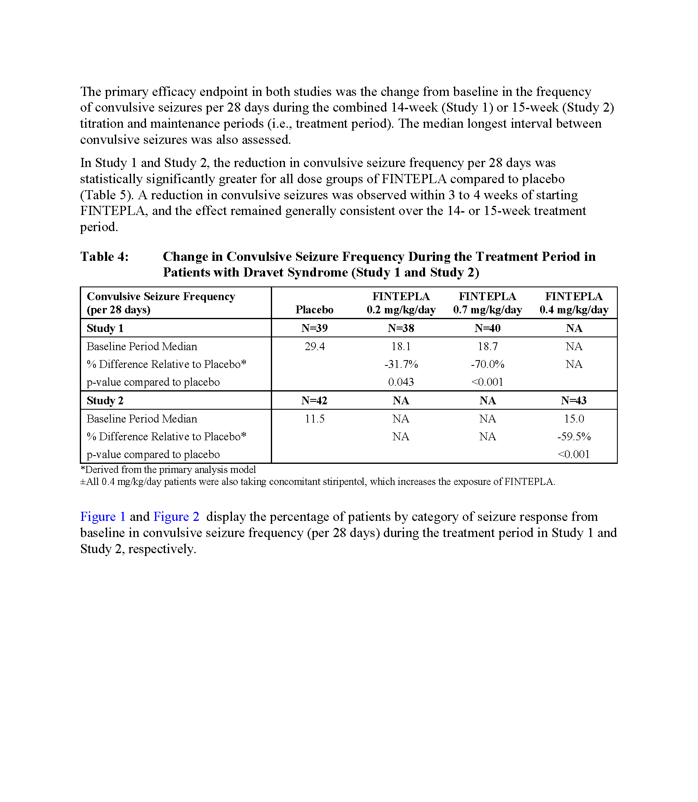
Results from Study 1 and Study 2 showed that the reduction in convulsive seizure frequency per 28 days (the primary endpoint) was statistically significantly greater for all dose groups of FINTEPLA (0.2 mg/kg/day and 0.7 mg/kg/day in Study 1 and FINTEPLA 0.4 mg/kg/day in Study 2) compared to placebo.
Within 3 to 4 weeks of starting FINTEPLA, a reduction in convulsive seizures was observed. This effect remained generally consistent over the entire 14-week (Study 1) or 15-week (Study 2) treatment period.
Table 5 presents the change in convulsive seizure frequency during the treatment period in both Study 1 and Study 2. As mentioned earlier, results were statistically significantly greater for all FINTEPLA dose groups compared to placebo. Note that results are considered statistically significant if the P-value is <0.05.
1
2
2

Slide 76
Figure 1 presents results from Study 1. Specifically, it shows the proportion of patients by category of seizure response from baseline in convulsive seizure frequency (per 28 days) for patients treated with either FINTEPLA 0.2 mg/kg/day, FINTEPLA 0.7 mg/kg/day, or placebo.
The five categories of seizure response were defined as the percentage reduction from baseline in convulsive seizure frequency, including:
<0%
≥0% to <25%
≥25% to <50%
≥50% to <75%
≥75% to 100%
As shown in the figure, FINTEPLA 0.7 mg/kg/day led to a ≥75% to 100% reduction from baseline in convulsive seizure frequency in >50% of patients.
Figure 2 presents results from Study 2. Specifically, it shows the proportion of patients by category of seizure response from baseline in convulsive seizure frequency (per 28 days) for patients treated with either FINTEPLA 0.4 mg/kg/day or placebo. Study 2 had the same five categories of seizure response as Study 1. As shown in the figure, FINTEPLA 0.4 mg/kg/day led to a ≥75% to 100% reduction from baseline in convulsive seizure frequency in 40% of patients.
1
2
2

Slide 77
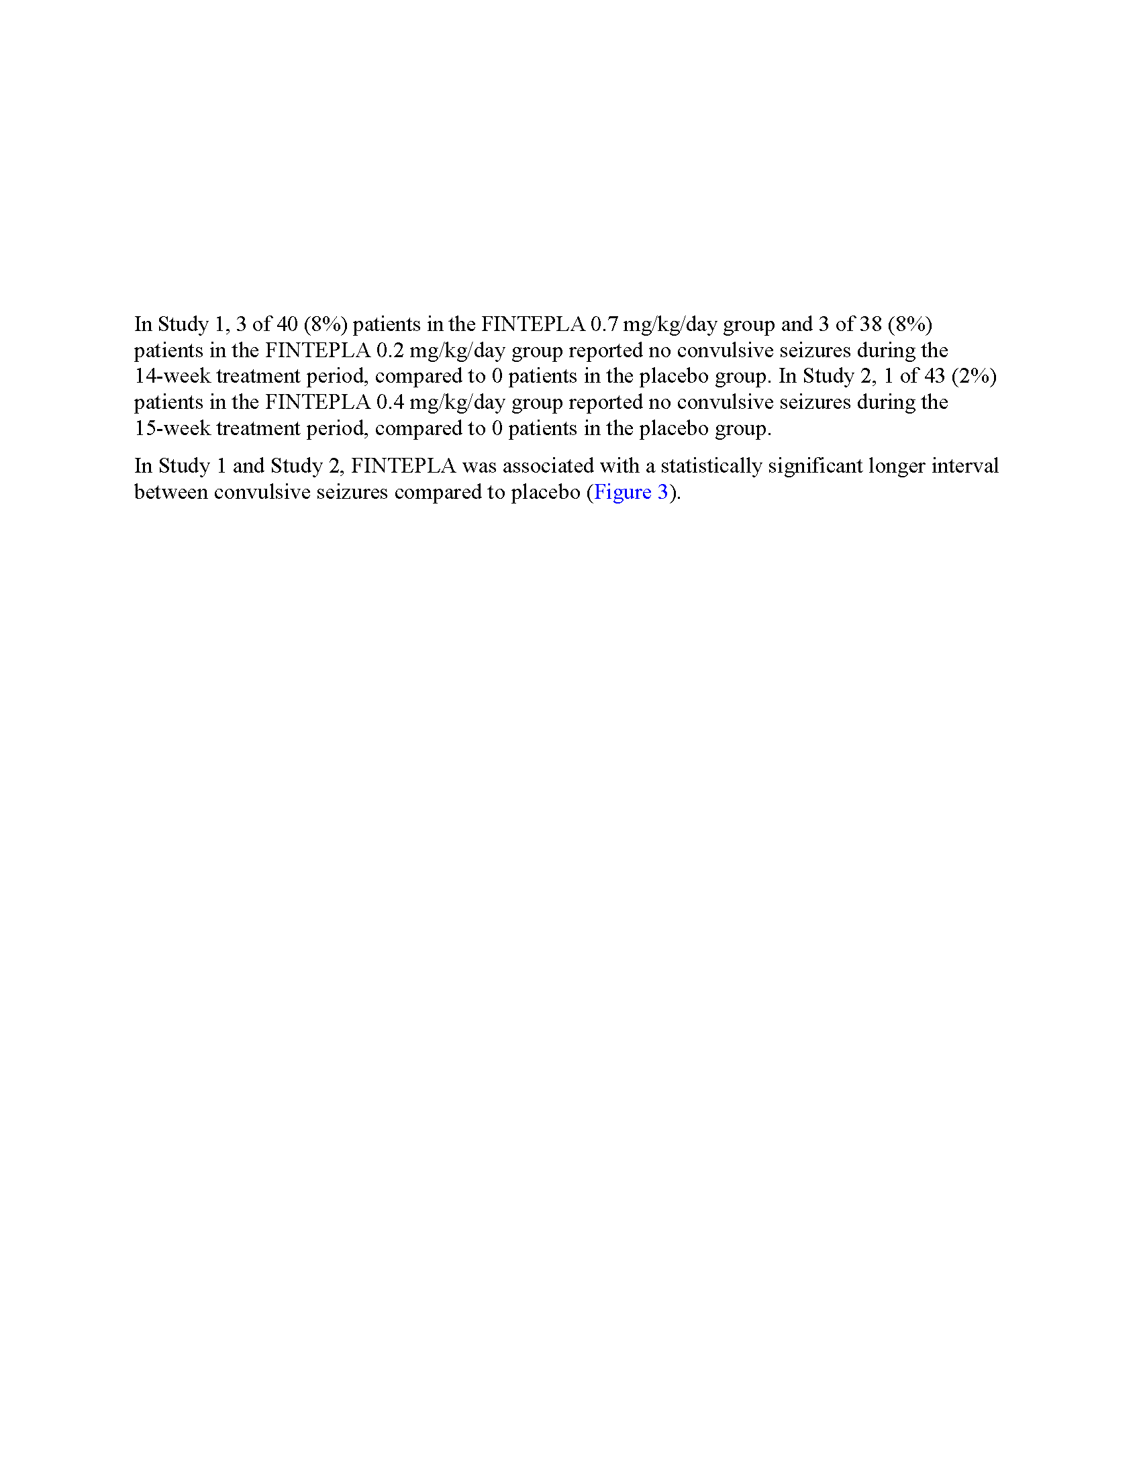
Section 14 continues by discussing the proportion of patients who reported no convulsive seizures during the treatment periods of Study 1 and Study 2. These results are summarized in the following table.
Patients Reporting No Convulsive Seizures During the Treatment Periods of Study 1 (14 Weeks) and Study 2 (15 weeks)
 | FINTEPLA 0.7 mg/kg/day | FINTEPLA 0.2 mg/kg/day | Placebo
Number of patients (percentage) | 3 of 40 (8%) | 3 of 38 (8%) | 0
Study 2 | FINTEPLA 0.4 mg/kg/day |  | Placebo
Number of patients (percentage) | 1 of 43 (2%) |  | 0
1

Slide 78
The FINTEPLA PI also explains that FINTEPLA was associated with a statistically significant longer interval between convulsive seizures compared to placebo in both Study 1 and Study 2.
Figure 3 presents the median longest seizure-free interval among patients in Study 1 and Study 2. As shown in the figure, results were statistically significantly greater for all FINTEPLA dose groups compared to placebo.
1

Slide 79
Lennox-Gastaut Syndrome
FINTEPLA Study 3 was a randomized, double-blind, placebo-controlled trial comparing 2 doses of FINTEPLA to placebo: 0.7 mg/kg/day and 0.2 mg/kg/day. A total of 263 patients 2 to 35 years of age participated in Study 3.
Patients had a diagnosis of LGS and were inadequately controlled on ≥1 AED or other antiseizure treatment, including vagal nerve stimulation and/or ketogenic diet. Prior to enrolling in Study 3, patients had tried between 1 and 20 AEDs, with a median of 7 prior AED failures.
The design of Study 3 included a:
4-week baseline period
2-week titration period
12-week maintenance period
During the 4-week baseline period, patients were required to have ≥8 drop seizures while on stable AED therapy. Drop seizures included generalized tonic-clonic (GTC) seizures, secondarily generalized tonic-clonic (SGTC) seizures, tonic seizures, atonic seizures, and tonic-atonic seizures that were confirmed to result in drops by the Epilepsy Study Consortium (ESC).
The most common types of drop seizures that occurred across all treatment groups during the 4-week baseline period were:
Tonic seizures: 77%
GTCs: 45%
Atonic seizures: 38%
1
14-week treatment period
Note that during the baseline period and throughout Study 3, patients were on a regimen of concomitant AEDs (median: 3). See next page for details.

Slide 80
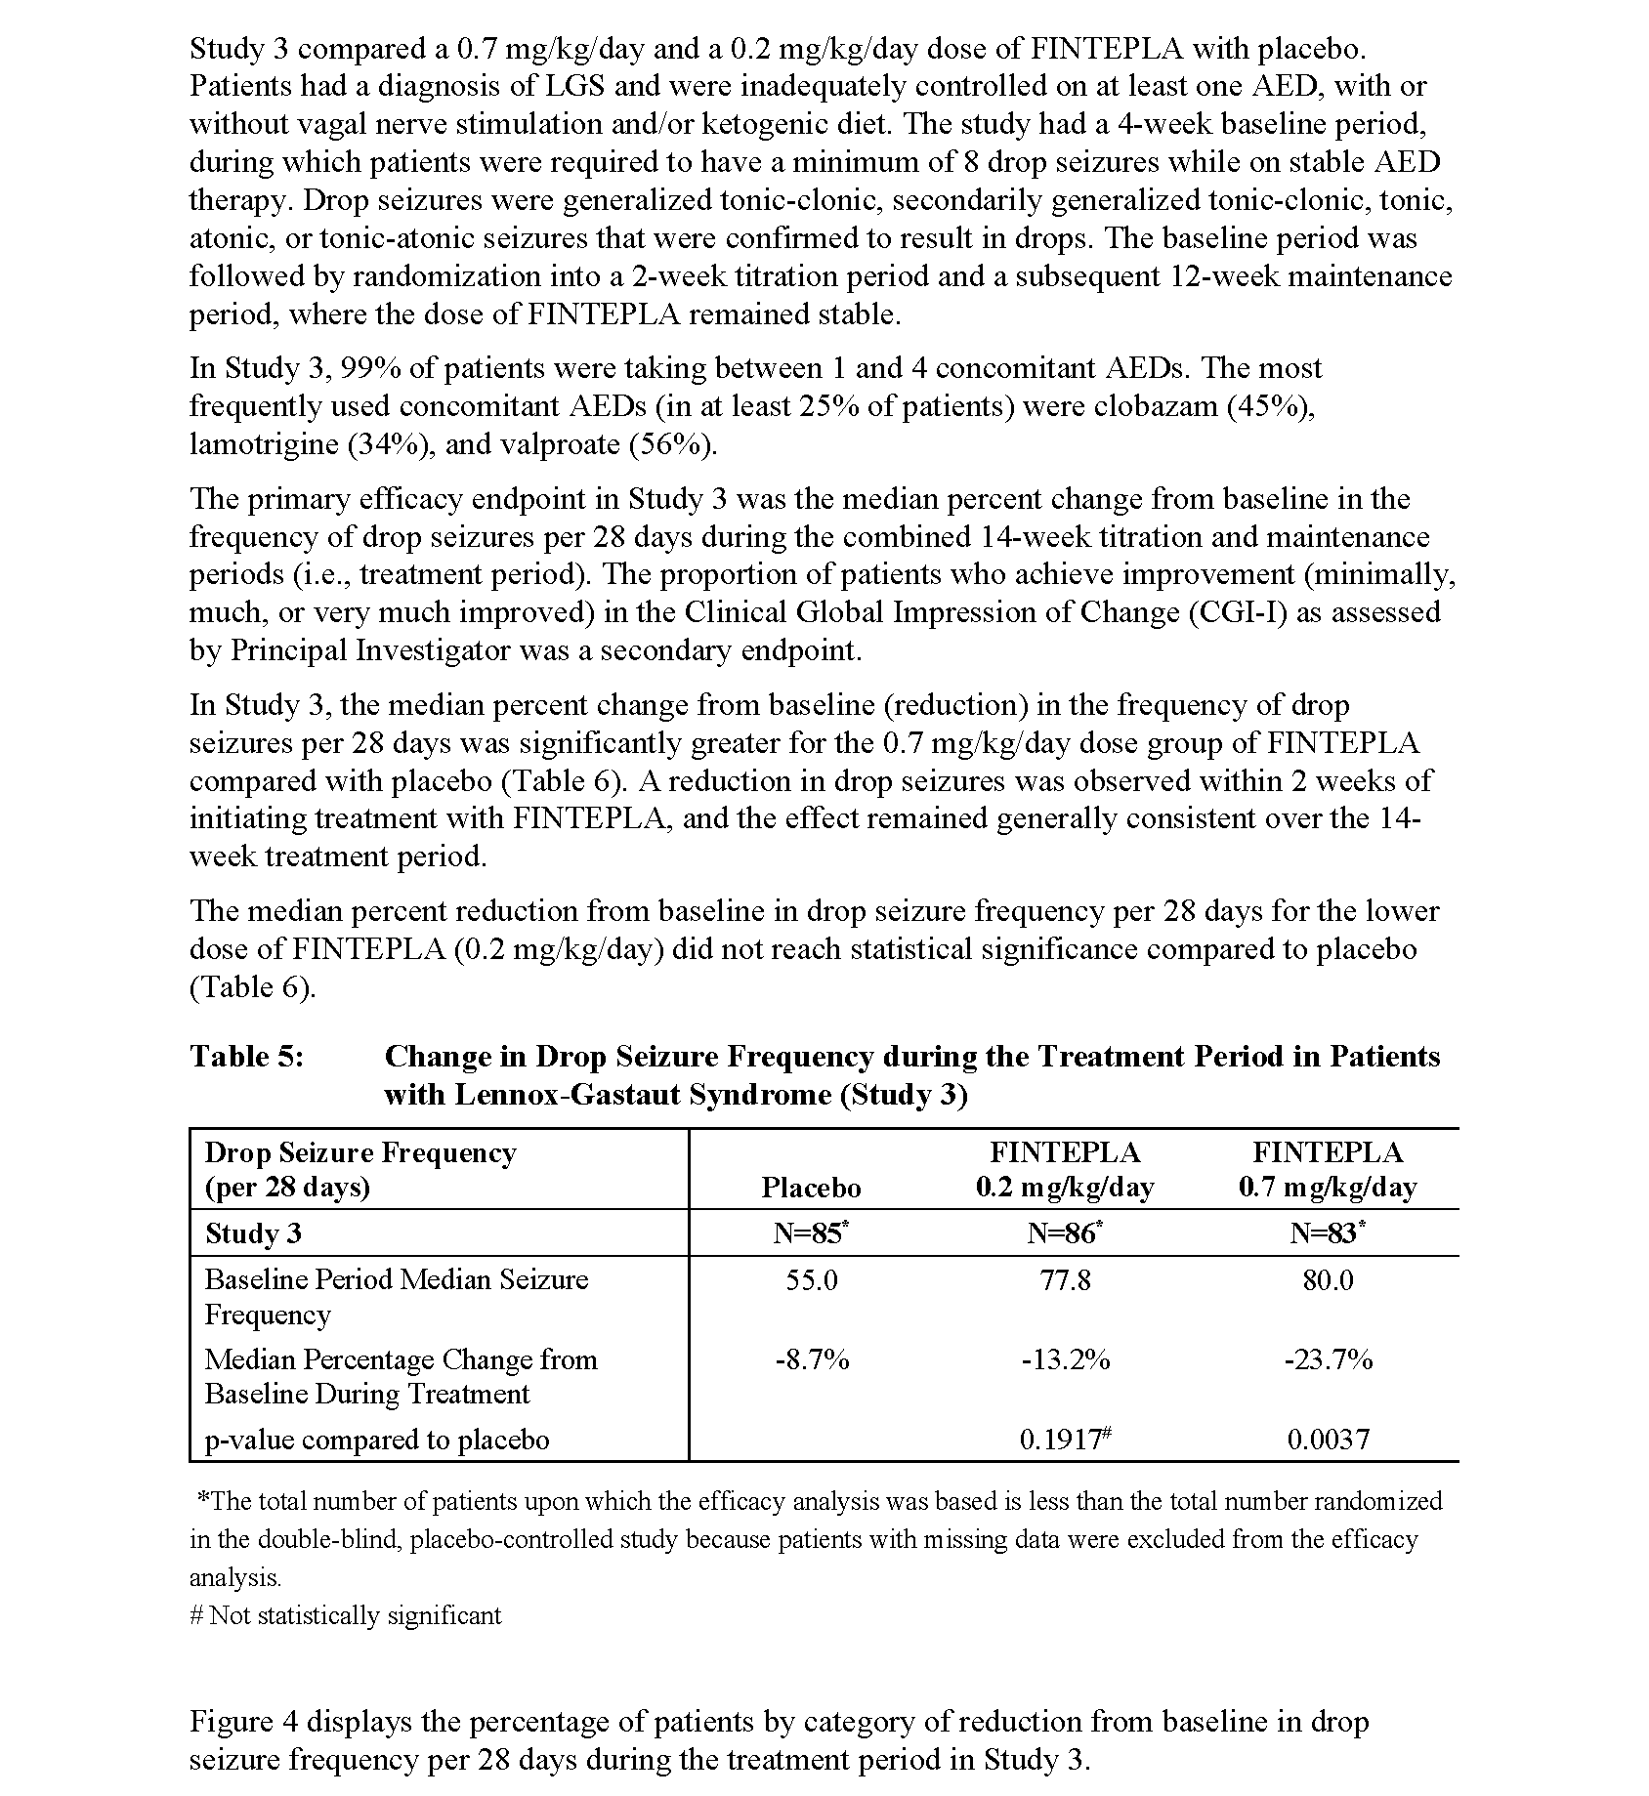
In Study 3, 99% of patients were taking between 1 and 4 concomitant AEDs (median 3). The most frequently used concomitant AEDs (in at least 25% of patients) were:
Valproate (55.9%)
Clobazam (45.2%)
Lamotrigine (33.5%)
2
The primary efficacy endpoint of Study 3 was the change in drop seizure frequency (DSF) per 28 days between baseline and the 14-week treatment period with FINTEPLA 0.7 mg/kg/day vs placebo. The proportion of subjects who achieved improvement (minimally improved, much improved, or very much improved) in the Clinical Global Impression of Improvement (CGI-I), as assessed by study investigators was a secondary endpoint.
1
2

Slide 81
Study 3 met the primary efficacy endpoint, demonstrating a statistically significant benefit for FINTEPLA 0.7 mg/kg/day in reducing DSF (per 28 days) compared with placebo:
FINTEPLA 0.7 mg/kg/day: -23.7% (P=0.0037)
Placebo: -8.7%
A reduction in drop seizures was observed within 2 weeks of initiating treatment with FINTEPLA, and the effect remained generally consistent over the 14-week treatment period.
Table 6 also shows that treatment with FINTEPLA 0.2 mg/kg/day did not reach statistical significance compared to placebo (-13.2% vs -8.7%, respectively; P=0.1917).
≈15% reduction compared to placebo
1

Slide 82
Figure 4 in the FINTEPLA PI shows the percentage of patients by category of reduction from baseline in DSF per 28 days during the treatment period in Study 3. Note that within the categories of ≥50% to <75% response and ≥75% to 100% response, results for FINTEPLA 0.2 mg/kg/day were slightly higher than results for FINTEPLA 0.7 mg/kg/day, despite the fact that FINTEPLA 0.2 mg/kg/day did not meet the primary endpoint.
Numerically greater improvements on the CGI-I by Investigator were observed in patients treated with FINTEPLA compared with placebo.
1
2
2

Slide 83
Take Home Points
Dravet Syndrome
Studies 1 and 2 were randomized, double-blind, placebo-controlled trials in patients aged 2 to 18 years with DS who were inadequately controlled on ≥1 AED or other antiseizure treatment:
Study 1 involved 117 patients and compared two doses of FINTEPLA (0.7 mg/kg/day and 0.2 mg/kg/day) with placebo in patients who were not receiving stiripentol
Study 2 involved 85 patients and compared a FINTEPLA 0.4 mg/kg/day dose with placebo in patients who were receiving stiripentol and either clobazam, valproate, or both
Both studies included a 6-week baseline period in which patients were required to have ≥6 convulsive seizures while on stable AED therapy
Study 1 included a 2-week titration period followed by a 12-week maintenance period with a stable FINTEPLA dose
Study 2 included a 3-week titration period followed by a 12-week maintenance period with a stable FINTEPLA dose
The primary efficacy endpoint in both studies was the change from baseline in the frequency of convulsive seizures per 28 days during the combined 14-week (Study 1) or 15-week (Study 2) titration and maintenance periods (i.e., treatment period)
Results were statistically significantly greater for all dose groups of FINTEPLA (0.2 mg/kg/day and 0.7 mg/kg/day in Study 1 and FINTEPLA 0.4 mg/kg/day in Study 2) compared to placebo
Seizure response results were as follows:
Study 1: FINTEPLA 0.7 mg/kg/day: ≥75% to 100% reduction from baseline in convulsive seizure frequency in >50% of patients
Study 2: FINTEPLA 0.4 mg/kg/day: ≥75% to 100% reduction from baseline in convulsive seizure frequency in 40% of patients
The proportion of patients who reported no convulsive seizures during the treatment periods was as follows:
Study 1 (14 weeks):
FINTEPLA 0.7 mg/kg/day: 8%
FINTEPLA 0.2 mg/kg/day: 8%
Placebo: 0
Study 2 (15 weeks):
FINTEPLA 0.4 mg/kg/day: 2%
Placebo: 0

Slide 84
Take Home Points (continued)
Lennox-Gastaut Syndrome
Study 3 was a randomized, double-blind, placebo-controlled trial comparing 2 doses of FINTEPLA to placebo: 0.7 mg/kg/day and 0.2 mg/kg/day
A total of 263 patients 2 to 35 years of age participated in Study 3; patients were inadequately controlled on ≥1 AED or other antiseizure treatment, including vagal nerve stimulation and/or ketogenic diet
The design of Study 3 included a 4-week baseline period, during which patients were required to have ≥8 drop seizures while on stable AED therapy; a 2-week titration period, and a 12-week maintenance period
The primary endpoint of Study 3 was the change in DSF per 28 days between baseline and the 14-week treatment period with fenfluramine 0.7 mg/kg/day vs placebo
Study 3 met the primary efficacy endpoint, demonstrating a statistically significant benefit for FINTEPLA 0.7 mg/kg/day in reducing DSF (per 28 days) compared with placebo:
FINTEPLA 0.7 mg/kg/day: -23.7% (P=0.0037)
Placebo: -8.7%
A reduction in drop seizures was observed within 2 weeks of initiating treatment with FINTEPLA, and the effect remained generally consistent over the 14-week treatment period
A secondary endpoint in Study 3 was the percentage of subjects who achieved investigator-assessed improvement in CGI-I. Numerically greater improvements on the CGI-I by Investigator were observed in patients treated with FINTEPLA compared with placebo.

Slide 85
Knowledge Check
During the 6-week baseline period of Study 1 and Study 2, patients were required to have ______ convulsive seizures.
≥2
≥4
≥6
≥8
○
○
○
○

Slide 86
Knowledge Check
During the 6-week baseline period of Study 1 and Study 2, patients were required to have ______ convulsive seizures.
≥2
≥4
≥6
≥8
○
○
✓
○
○

Slide 87
Knowledge Check
Which of the following statements about both Study 1 and Study 2 is (are) true? (Select all that apply.)
The reduction in convulsive seizure frequency per 28 days (the primary endpoint) was statistically significant for all dose groups of FINTEPLA (0.2 mg/kg/day and 0.7 mg/kg/day in Study 1 and FINTEPLA 0.4 mg/kg/day in Study 2) compared to placebo.
The frequency of patients who reported 0 or 1 convulsive seizure during the entire treatment period in both Studies 1 and 2 was the same in patients treated with FINTEPLA or placebo.
Only FINTEPLA 0.7 mg/kg/day was associated with a statistically significant longer interval between convulsive seizures compared to placebo.
All of the above
○
○
○
○

Slide 88
Knowledge Check
Which of the following statements about both Study 1 and Study 2 is (are) true? (Select all that apply.)
The reduction in convulsive seizure frequency per 28 days (the primary endpoint) was statistically significant for all dose groups of FINTEPLA (0.2 mg/kg/day and 0.7 mg/kg/day in Study 1 and FINTEPLA 0.4 mg/kg/day in Study 2) compared to placebo.
The frequency of patients who reported 0 or 1 convulsive seizure during the entire treatment period in both Studies 1 and 2 was the same in patients treated with FINTEPLA or placebo.
Only FINTEPLA 0.7 mg/kg/day was associated with a statistically significant longer interval between convulsive seizures compared to placebo.
All of the above
✓
○
○
○
○

Slide 89
Knowledge Check
What was the duration of the treatment period in Study 3?
6 weeks
10 weeks
14 weeks
20 weeks
○
○
○
○

Slide 90
Knowledge Check
What was the duration of the treatment period in Study 3?
6 weeks
10 weeks
14 weeks
20 weeks
○
○
✓
○
○

Slide 91
Knowledge Check
In Study 3, treatment with FINTEPLA 0.7 mg/kg/day was associated with a ____% reduction in DSF, compared with an 8.7% reduction in DSF in the placebo group.
23.7
33.3
41.7
46.8
○
○
○
○

Slide 92
Knowledge Check
In Study 3, treatment with FINTEPLA 0.7 mg/kg/day was associated with a ____% reduction in DSF, compared with an 8.7% reduction in DSF in the placebo group.
23.7
33.3
41.7
46.8
✓
○
○
○
○

Slide 93
Chapter 6: How Supplied, Storage and Handling, and Patient Counseling Information
Learning Objectives
Upon completion of this chapter, you will be able to:
Describe how FINTEPLA is supplied
Explain the storage and handling of FINTEPLA
Discuss the guidance provided in the patient counseling information section of the FINTEPLA PI

Slide 94
In Section 16 of the PI, how FINTEPLA is supplied and its storage and handling are presented.
As described in Section 16.1, FINTEPLA oral solution:
Is a clear, colorless, cherry flavored liquid
Contains 2.2 mg/mL fenfluramine
Is supplied in a white, plastic bottle with a child-resistant closure
FINTEPLA is supplied as a carton containing one 360 mL bottle or a carton containing one 30 mL bottle.
A press-in bottle adaptor will be inserted by the pharmacist before FINTEPLA is dispensed. In addition, 3 mL or 6 mL calibrated oral dosing syringes will be provided.
The storage and handling of FINTEPLA, as described in Section 16.2 of the PI, is as follows:
FINTEPLA should be stored at room temperature between 20ºC to 25ºC (68ºF to 77ºF); excursions are permitted between 15ºC to 30ºC (59ºF to 86ºF)
FINTEPLA should not be refrigerated or frozen
The bottle and syringe should be stored together
FINTEPLA should be discarded if there is any unused portion 3 months after first opening the bottle or the "Discard After” date on the bottle has been reached, whichever is sooner
2
1
2

Slide 95
Section 17 of the FINTEPLA PI is the patient counseling information. It explains that physicians should advise the patient to read the FDA-approved patient labeling. It also provides guidance on:
FINTEPLA administration
Monitoring of valvular heart disease and pulmonary arterial hypertension
The FINTEPLA REMS Program
Potential decreased appetite and decreased weight
Possible somnolence, sedation, and lethargy
Risk for suicidal thinking and behavior
1

Slide 96
Section 17 continues onto the next page of the FINTEPLA PI and provides further guidance on:
Potential for increased seizure frequency and status epilepticus when AEDs are withdrawn
Risk for serotonin syndrome
Potential for increase in blood pressure
Potential for glaucoma
This section also provides guidance if a patient becomes pregnant or intends to become pregnant during FINTEPLA therapy. It also discusses the NAAED Pregnancy Registry.
1

Slide 97
Take Home Points
FINTEPLA oral solution is a clear, colorless, cherry flavored liquid
FINTEPLA contains 2.2 mg/mL fenfluramine
FINTEPLA is supplied in a white, plastic bottle with a child-resistant closure
A press-in bottle adaptor will be inserted by the pharmacist before FINTEPLA is dispensed
3 mL or 6 mL calibrated oral dosing syringes will be provided
FINTEPLA should be stored at room temperature between 20ºC to 25ºC (68ºF to 77ºF); excursions are permitted between 15ºC to 30ºC (59ºF to 86ºF)
FINTEPLA should not be refrigerated or frozen
FINTEPLA should be discarded if there is any unused portion 3 months after first opening the bottle or the "Discard After” date on the bottle has been reached, whichever is sooner
The patient counseling information explains that physicians should advise the patient to read the FDA-approved patient labeling; it also provides guidance on:
FINTEPLA administration
Monitoring of valvular heart disease and pulmonary arterial hypertension
The FINTEPLA REMS Program
Potential decreased appetite and decreased weight
Possible somnolence, sedation, and lethargy
Risk for suicidal thinking and behavior
Potential for increased seizure frequency and status epilepticus when AEDs are withdrawn
Risk for serotonin syndrome
Potential for increase in blood pressure
Potential for glaucoma
Pregnancy registry

Slide 98
Knowledge Check
FINTEPLA oral solution is a clear, colorless, _____________ flavored liquid.
Grape
Cherry
Strawberry
Orange
○
○
○
○

Slide 99
Knowledge Check
FINTEPLA oral solution is a clear, colorless, _____________ flavored liquid.
Grape
Cherry
Strawberry
Orange
○
✓
○
○
○

Slide 100
Knowledge Check
FINTEPLA contains ________________ fenfluramine.
2.2 mg/mL
3.4 mg/mL
4.7 mg/mL
5.0 mg/mL
○
○
○
○

Slide 101
Knowledge Check
FINTEPLA contains ________________ fenfluramine.
2.2 mg/mL
3.4 mg/mL
4.7 mg/mL
5.0 mg/mL
✓
○
○
○
○

Slide 102
Knowledge Check
Which of the following statements about FINTEPLA is (are) true? (Select all that apply.)
2 mL and 4 mL calibrated oral dosing syringes will be provided.
FINTEPLA should be stored at room temperature between 20ºC to 25ºC (68ºF to 77ºF).
FINTEPLA may be frozen.
All of the above
○
○
○
○

Slide 103
Knowledge Check
Which of the following statements about FINTEPLA is (are) true? (Select all that apply.)
2 mL and 4 mL calibrated oral dosing syringes will be provided.
FINTEPLA should be stored at room temperature between 20ºC to 25ºC (68ºF to 77ºF).
FINTEPLA may be frozen.
All of the above
○
✓
○
○
○

Slide 104
Glossary
adjunctive | treatment added to the primary or first-line treatment
aortic regurgitation | the backward flow of blood from the aorta into the left ventricle due to an imperfect closure of the aortic valve; also called valvular insufficiency, incompetence, or “leaky valve”
area under the curve (AUC) | the integrated quantity of drug (the serum drug concentration with respect to time after taking a single dose)
ataxia | defective muscular coordination, especially that manifested when voluntary muscular movements are attempted
bioavailability | the rate and extent to which an active drug or metabolite enters the body, permitting access to the site of action; it is is determined either by measurement of the concentration of the drug in body fluids or by the magnitude of the pharmacologic response
cannabidiol (CBD) | an anxiolytic constituent of Cannabis sativa (marijuana); it is one of the two major psychoactive components of the drug; the other is tetrahydrocannabinol (THC)
carcinogenic | relating to any substance or agent that produces cancer or increases the risk of developing cancer in humans or animals
clonic seizure | seizure that causes repeated jerking movements of muscles on both sides of the body
C_{max} | maximum concentration of a drug achieved after dosing
cyproheptadine | an antihistamine that can also be used to prevent headache pain
developmental and epileptic encephalopathy (DEE) | condition in which cognitive development and behavior are impaired independently of epilepsy onset, and epilepsy is characterized by a high frequency of seizures and epileptiform abnormalities; in addition, both developmental impairment and epileptic activity have an impact on the cognitive and behavioral characteristics of the patient
dexfenfluramine | an isomer of fenfluramine (ie, a substance with the same molecular formula but different chemical and physical properties) approved by the FDA in 1996 for the long-term treatment of obesity and later withdrawn due to cardiac safety concerns

Slide 105
Glossary (continued)
double-blind | pertaining to a method, study, or clinical trial in which neither the subjects nor the investigators know the identities of the subjects nor what treatment or medication, if any, the subjects receive
fluvoxamine | antidepressant belonging to the class of products known as selective serotonin reuptake inhibitors
gene | functional unit of heredity that occupies a specific place on a chromosome and directs the formation of an enzyme or other protein
lethargy | sleepiness, drowsiness, somnolence, or mental sluggishness
ketogenic diet | special high-fat, low-carbohydrate regimen that is designed to mimic the metabolic effects of starvation; typically used in younger children as adjunctive therapy to reduce seizure frequency if first-line therapies are not effective
mutagenesis | production of a genetic mutation
neurotransmitter | chemical agent released by a presynaptic neuron that crosses the synapse to stimulate or inhibit the postsynaptic neuron
paroxetine | antidepressant belonging to the class of products known as selective serotonin reuptake inhibitors
placebo-controlled | method by which study patients are randomly assigned to test therapy or to an identical-appearing therapy that does contain the drug being studied
pyrexia | fever
QT interval | time from electrocardiogram Q wave to the end of the T wave corresponding to electrical systole
randomized | method used to assign subjects to experimental groups without introducing biases into a study
sedation | an act or process of calming nervous excitement
seizure | clinically detectable event caused by a sudden discharge of electrical activity in the brain
serotonin syndrome | refers to the adverse effects of excessive levels of serotonin in the brain, usually caused by exposure to multiple drugs (e.g., restlessness, agitation, tremor)

Slide 106
Glossary (continued)
somnolence | prolonged drowsiness or sleepiness
status epilepticus | defined as repeated seizure or a seizure prolonged for at least 30 minutes
time to maximum plasma concentration (T_{max}) | length of time it takes for a drug to achieve its maximal concentration in the body
tonic-clonic seizure | event during which a person loses consciousness and experiences muscle stiffening and jerking movements; also called a convulsion
vagal nerve stimulation (VNS) | a treatment for seizures and treatment-resistant depression in which a generator sends electrical impulses along the left vagus nerve; the impulse generator is typically inserted under the clavicle on the left side of the chest during a brief surgical procedure; the device is set to generate electrical impulses of appropriate amplitude, frequency, and pulse width to control a patient's symptoms

Slide 107
References
American Heart Association (AHA). Roles of your four heart valves. 2020. Accessed June 29, 2020. https://www.heart.org/en/health-topics/heart-valve-problems- and-disease/about-heart-valves/roles-of-your-four-heart-valves
American Lung Association (ALA). Learn about pulmonary arterial hypertension. 2020. Accessed June 29, 2020. https://www.lung.org/lung-health-and-diseases/lung-disease-lookup/pulmonary-arterial-hypertension/learn-pulmonary-arterial-hypertension.html
Camfield PR. Definition and natural history of Lennox-Gastaut syndrome. Epilepsia. 2011;52 Suppl 5:3-9.
Cross H, Auvin S, Falip M, et al. Expert opinion on the management of Lennox-Gastaut syndrome: treatment algorithms and practical considerations. Front Neurol. 2017;8(505):1-18.
Depakene (valproic acid) [prescribing information]. North Chicago, IL: AbbVie Inc.; February 2019.
Diacomit (stiripentol) [prescribing information]. France: Biocodex; August 2018.
Drug Enforcement Administration (DEA). Drug scheduling. Accessed June 29, 2020. https://www.dea.gov/drug-scheduling
Epilepsy Foundation. Ketogenic diet. 2017. Accessed June 29, 2020. https://www.epilepsy.com/learn/treating-seizures-and-epilepsy/dietary-therapies/ketogenic
Epilepsy Foundation. Tonic-clonic seizures. 2017. Accessed June 29, 2020. https://www.epilepsy.com/learn/types-seizures/tonic-clonic-seizures
Fisher RS, Acevedo C, Arzimanoglou, et al. A practical clinical definition of epilepsy. Epilepsia. 2014;55(4):475-482.
Food and Drug Administration (FDA). Guidance for industry: E 10 choice of control group and related issues in clinical trials. May 2001. Accessed June 29, 2020. https://www.fda.gov/media/71349/download
Fintepla. Prescribing information. Emeryville, CA: Zogenix, Inc.; March 2022.
Glaucoma Research Foundation. Angle-closure glaucoma. 2018. Accessed June 29, 2020. https://www.glaucoma.org/glaucoma/angle-closure-glaucoma.php
Lagae L, Sullivan J. Knupp K, et al. A randomized, placebo-controlled trial of fenfluramine for the treatment of seizures in Dravet Syndrome. Lancet manuscript draft 2019. (Study 1501).

Slide 108
References (continued)
Merriam-Webster Medical Dictionary. Accessed June 29, 2020. https://www.merriam-webster.com/medical
National Alliance of Mental Illness (NAMI). Types of Medication. Accessed November 17, 2021. https://www.nami.org/About-Mental-Illness/Treatments/Mental-Health-Medications/Types-of-Medication
National Institutes of Health (NIH): MedlinePlus. Heart valve diseases. Accessed June 29, 2020. https://medlineplus.gov/heartvalvediseases.html
National Institutes of Health (NIH): MedlinePlus. Valproic acid. 2019. Accessed June 29, 2020. https://medlineplus.gov/druginfo/meds/a682412.html
National Institute of Neurological Disorders and Stroke (NINDS). Epilepsy and seizures: hope through research. 2018. Accessed June 29, 2020. https://catalog.ninds.nih.gov/ninds/facet/Health-Topics/term/Epilepsy
Onfi (clobazam) [prescribing information]. Deerfield, IL: Lundbeck; June 2018.
Raga S, Specchio N, Rheims S, and Wilmshurst JM. Developmental and epileptic encephalopathies: recognition and approaches to care. Epileptic Disorders. 2021;23(1):40-52.
Resnick T and Sheth RD. Early diagnosis and treatment of Lennox-Gastaut Syndrome. J Child Neurol. 2017;32(11):947-955.
Shmuely S, Sisodiya S, Gunning WB, et al. Mortality in Dravet syndrome: a review. Epilepsy Behav. 2016;64:69-74.
Stedman’s Medical Dictionary. Accessed June 29, 2020. https://stedmansonline.com/
Taber’s Medical Dictionary. https://www.tabers.com/. Accessed June 29, 2020
Wirrell EC, Laux L, Donner E, et al. Optimizing the diagnosis and management of Dravet syndrome: recommendations from a North American Consensus Panel. Pediatr Neurol. 2017;68:18-34.
Zogenix Data on file. Study ZX008-1601: A Two-Part Study of ZX008 in Children and Adults with Lennox-Gastaut Syndrome (LGS); Part 1: A Randomized, Double-blind, Placebo-controlled Trial of Two Fixed Doses of ZX008 (Fenfluramine Hydrochloride) Oral Solution as Adjunctive Therapy for Seizures in Children and Adults with LGS. CLINICAL STUDY REPORT for Part 1 Cohort A. September 11, 2021.

