Slide 1
MOLECULAR AND CELLULAR BIOLOGY FUNDAMENTALS

Slide 2
MOLECULAR AND CELLULAR BIOLOGY FUNDAMENTALS
Contents
Introduction 3
Learning Objectives 4
Chapter 1: Nucleic Acids 5
Nucleic Acid Structure 5
Location and General Function of Nucleic Acids 8
Genes and Chromosomes 9
DNA Replication 11
DNA Repair Mechanisms 12
Chapter 1 Summary 13
Knowledge Check 14
Chapter 2: The Central Dogma of Molecular Biology 15
Gene Structure and Regulation 15
Transcription 17
RNA Splicing 18
Translation 19
Chapter 2 Summary 22
Knowledge Check 23
Chapter 3: Epigenetic Regulation of Gene Expression 24
What is Epigenetics? 24
DNA Methylation 25
Biochemistry of DNA Methylation 25
Role of Methylation in Gene Expression 27
CpG Islands 28
Tissue Specificity of Methylation Patterns 28
Histone Dynamics 29
Chapter 3 Summary 31
Knowledge Check 32

Slide 3
MOLECULAR AND CELLULAR BIOLOGY FUNDAMENTALS
Contents (continued)
Chapter 4: The Language of DNA Alterations 34
Single-Nucleotide Polymorphisms 34
Point Mutations: Missense, Nonsense, and Silent 35
Insertions, Deletions, and Duplications 36
Repeat Expansion 37
Chromosomal Translocations 37
Amplifications 38
Chapter 4 Summary 39
Knowledge Check 40
Chapter 5: Interrogating the Genome 41
Obtaining Samples for Analysis 41
Tissue Biopsy 41
Liquid Biopsy 41
Reading the Genome 43
Conventional Sequencing 43
Next-Generation Sequencing 46
Bisulfate Sequencing 49
Chapter 5 Summary 50
Knowledge Check 51
Glossary 52
References 53

Slide 4
MOLECULAR AND CELLULAR BIOLOGY FUNDAMENTALS
INTRODUCTION
Cancer is the second most common cause of death globally after cardiovascular disease. Approximately 9 million people around the world die from cancer each year, and this figure is expected to increase to more than 13 million in 2030.
There is no agreement among the cancer research community regarding what actually causes cancer. Scientists are however certain that many factors can be linked to cancer. Cancer risk factors include eating habits, lifestyle, living or working environments, genetics, age, and many others. Knowledge of cancer genetics is rapidly improving our understanding of cancer biology, helping to identify at-risk individuals, furthering our ability to characterize malignancies and helping to establish treatment tailored to the molecular fingerprint of the disease. This expanding knowledge base has implications for all aspects of cancer management, including prevention, screening, and therapy.
Cancer is, fundamentally, a genetic disease that begins with small changes in a single cell’s DNA that alter the behavior of the cell. This process often starts with mutations that inactivate the cell’s normal mechanisms for monitoring the fidelity of DNA replication. Subsequently, additional changes accumulate in genes involved in controlling the growth and death of cells, a small subset of which allows these cells to outgrow, out-divide, and outlive their neighboring normal cells. This competitive advantage ultimately results in a tumor—a mass of genetically abnormal cells.
Importantly , it has become increasingly recognized that there is another set of alterations to the genome—known as epigenetic changes—that can alter the structure and function of the genome without affecting the underlying DNA sequence. Some of these changes can influence the structure and function of the genome in ways that may promote cancer; others may serve simply as markers of specific cancers without causing any known functional alteration.

Slide 5
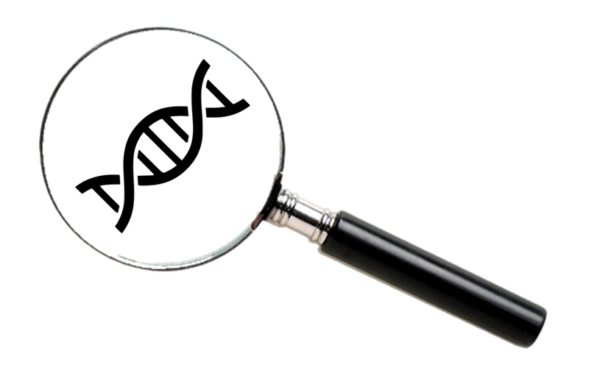
MOLECULAR AND CELLULAR BIOLOGY FUNDAMENTALS
INTRODUCTION (continued)
Until relatively recently, detecting these small cancer-promoting genetic and epigenetic changes was difficult, costly, and time-consuming. For this reason, cancer diagnosis has conventionally relied primarily on symptoms and/or findings on imaging. Often—and particularly in patients who are already symptomatic—cancer has been detected well after there is a possibility of curative treatment. Today, cutting-edge technologies are changing this paradigm, with the potential of enabling earlier detection of cancer when curative treatment remains a possibility.
To understand how cancer develops—and how it is detected and treated—it is essential to understand the language of molecular biology. This module will provide a basic refresher on molecular genetics, particularly with reference to cancer
LEARNING OBJECTIVES
When you have completed this module, you will be able to:
Describe the pathway from gene to protein
Describe the epigenetic regulation of gene expression
Identify different types of mutations
Describe modalities for obtaining samples for molecular analysis
Identify key technologies for interrogating the genome
CLOSER LOOK | Throughout this module, you will see “Closer Look” callouts. These sections are optional. This supplemental information may enhance the depth of your knowledge about certain topics, but you will not be tested on your knowledge of this information, nor is it critical for your product knowledge.

Slide 6
CHAPTER 1: NUCLEIC ACIDS
The genetic information of an organism is encoded by deoxyribonucleic acid (DNA). The human genome contains an estimated 20,000 to 25,000 genes, each of which serves as a blueprint for building a protein. Only a small percentage of the genome is composed of genes; the rest is composed of noncoding DNA containing regulatory regions and vast stretches of DNA whose function is unknown.
Nucleic Acid Structure
Nucleic acids are composed of carbon, oxygen, hydrogen, nitrogen, and phosphorous and represent the largest molecules in the body. They include 2 major classes of molecules, DNA and RNA.
The structural units of nucleic acids are called nucleotides. Each nucleotide consists of 3 components, as shown in Figure 1.1:
A nitrogen-containing base
A pentose (5-sided) sugar
A phosphate group
There are 5 major types of nitrogen-containing bases:
Adenine (A)
Guanine (G)
Cytosine (C)
Thymine (T)
Uracil (U)
Adenine and guanine are large, 2-ringed bases that are referred to as purines. Cytosine, thymine, and uracil are smaller, single-ring bases called pyrimidines. DNA is a long, double-stranded polymer—a double chain of nucleotides.
The bases in DNA include A, G, C, and T, and its pentose sugar is deoxyribose. The 2 chains of DNA are held together by hydrogen bonds between the bases, which results in a ladder-like molecule, with the alternating sugar and phosphate forming the backbone (or the “uprights”) of the ladder and the paired bases forming the “rungs.” The whole molecule is coiled into a spiral staircase-like structure called a double helix.

Slide 7
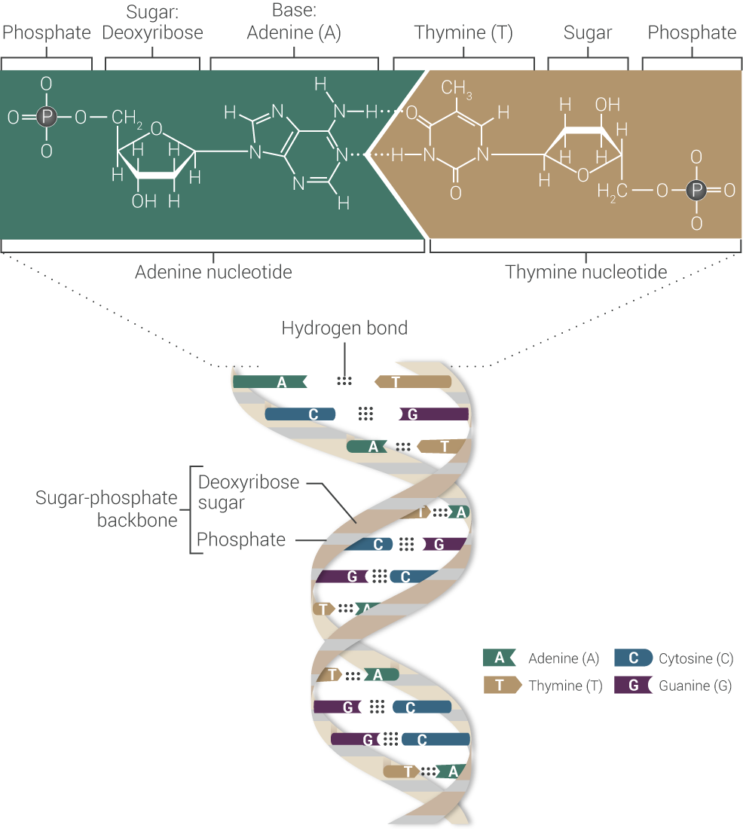
CHAPTER 1: NUCLEIC ACIDS
Figure 1.1 The structure of DNA, showing pairing between adenine (A) and thymine (T). Pairing between guanine (G) and cytosine (C) is conceptually similar. Adapted from Marieb 2015.

Slide 8
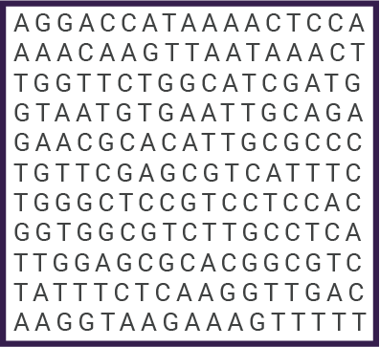
CHAPTER 1: NUCLEIC ACIDS
Base Pairing and Reading a DNA Sequence In DNA, A always pairs with T, and C always pairs with G. Each pair is referred to as a “base pair” (often abbreviated BP). Base pairs are arranged in a row to form a code. From a practical perspective, when DNA sequences are displayed, the sequence for only 1 of the 2 strands is usually shown. Because A always pairs with T, and C always pairs with G, the sequence of a complementary strand is implied. For example, the sequence above reads, in part, “AGGACCATAAA.” The complementary strand, which is not shown, would read “TCCTGGTATTT.” | Figure 1.2 A DNA Sequence

Slide 9
CHAPTER 1: NUCLEIC ACIDS
RNA, in contrast to DNA, consists of a single strand of nucleotides. RNA bases include A, G, C, and U (U replaces the T found in DNA), and its pentose sugar is ribose.
Location and General Function of Nucleic Acids
Although they are both nucleic acids, DNA and RNA play different roles in the pathway from gene to protein.
DNA is typically found in the nucleus of the cell, where it constitutes the genetic material of the cell. DNA has 2 key roles:
It replicates (reproduces) itself before the cell divides, ensuring that genetic information in the cell’s descendants is identical to the source copy.
It provides the fundamental instructions for building every protein in the body.
RNA is located primarily outside of the nucleus. It serves to carry out the genetic instructions for protein synthesis, as will be discussed later.
Table 1.1 summarizes some of the key differences between DNA and RNA.
Table 1.1 DNA vs RNA
Characteristic | Nucleus | RNA
Major cellular location | Nucleus | Cytoplasm
Major functions | Genetic material of the cell; directs protein synthesis and replicates itself before cell division | Carries out the genetic instructions for protein synthesis
Sugar | Deoxyribose | Ribose
Bases | Adenine (A), guanine (G), cytosine (C), thymine (T) | Adenine (A), guanine (G), cytosine (C), uracil (U)
Structure | Double-stranded helix | Single strand

Slide 10
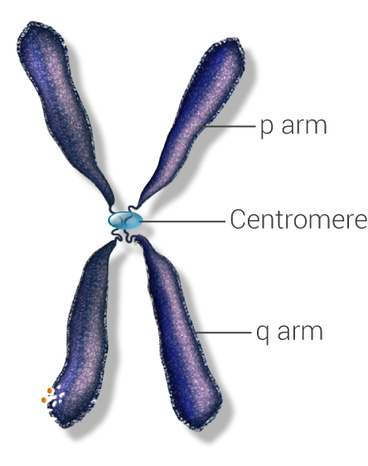
CHAPTER 1: NUCLEIC ACIDS
Genes and Chromosomes
The term “genome” refers to the totality of DNA in the nucleus. All of the DNA in the cell's nucleus is organized into chromosomes—a thread-like structure of nucleic acids and proteins.
The human haploid genome contains about 3 billion base pairs or about 6 billion base pairs for each diploid genome. The total length of DNA is about 2 meters, all of which must be accommodated in the nucleus. This is accomplished by specific proteins that compact chromosomal DNA, known as histones. The resulting complex of DNA wrapped around histones is called chromatin.
Humans have 23 pairs of chromosomes that are classified as either sex chromosomes or autosomes. The human chromosomal complement includes 1 pair of sex chromosomes (2 X chromosomes in females or 1 X and 1 Y in males) and 22 pairs of autosomes. From a structural standpoint, the short arm of chromosomes is referred to as the “p arm” (for petite), and the long arm is referred to as the “q arm.”
Figure 1.3 Chromosome Structure. Adapted from Allison 2015.
FAST FACT
When scientists talk about the genome, they are usually referring to the haploid genome—this is the complete set of DNA in a single haploid cell, such as a sperm or an egg. However, the vast majority of cells in the body are diploid—that is to say, they contain 2 complete sets of chromosomes (1 from each parent).

Slide 11
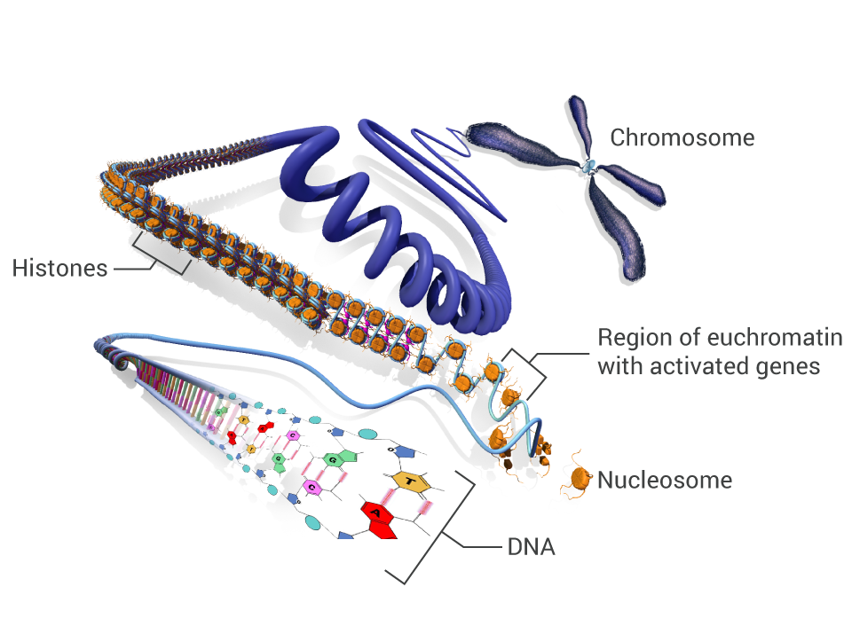
CHAPTER 1: NUCLEIC ACIDS
 | Learn More: Compacting the Genome
Negatively charged DNA is complexed with positively charged histones to form a nucleosome, which contains 8 histone proteins (Figure 1.2). DNA wraps around each histone complex 1.65 times. A further level of compaction is achieved through the folding of nucleosomes to form a 30-nanometer (nm) chromatin fiber, resulting in loops averaging 300 nm in length. In this manner, the 2 meters of DNA in each cell is compressed to the point that it can fit within a cell's nucleus. It is important to recognize that the compression (inactive state) and unwinding (active state) of DNA are tightly regulated through a number of processes that can “tighten” or “loosen” chromatin, allowing regions of the genome to be accessed to make proteins. These 300-nm fibers are compressed again and folded to produce a 250-nm-wide fiber, which is then tightly coiled into the chromatid of a chromosome. Each chromatid is connected at a constriction point called the centromere. Figure 1.2 DNA is packaged in multiple steps to compress its 2-meter length into a structure that can fit into the cell's nucleus. Adapted from Annunziato 2008. | Negatively charged DNA is complexed with positively charged histones to form a nucleosome, which contains 8 histone proteins (Figure 1.2). DNA wraps around each histone complex 1.65 times. A further level of compaction is achieved through the folding of nucleosomes to form a 30-nanometer (nm) chromatin fiber, resulting in loops averaging 300 nm in length. In this manner, the 2 meters of DNA in each cell is compressed to the point that it can fit within a cell's nucleus. It is important to recognize that the compression and unwinding of DNA are tightly regulated through a number of processes that can “tighten” or “loosen” chromatin, allowing regions of the genome to be accessed to make proteins. [Simmons 2008, p 1B] These 300-nm fibers are compressed again and folded to produce a 250-nm-wide fiber, which is then tightly coiled into the chromatid of a chromosome. Each chromatid is connected at a constriction point called the centromere. [Annunziato 2008, p 2A] Figure 1.2 DNA is packaged in multiple steps to compress its 2-meter length into a structure that can fit into the cell's nucleus. [Annunziato 2008, p 2A]

Slide 12
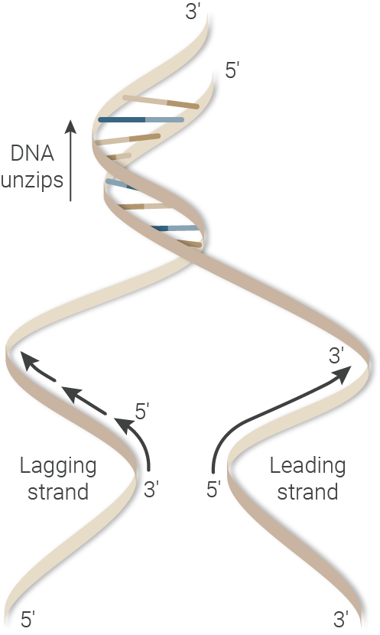
CHAPTER 1: NUCLEIC ACIDS
DNA Replication
The process by which a copy of DNA is produced from a DNA template is known as replication (Figure 1.4). This process is “semiconservative,” meaning that each replication gives rise to 2 daughter DNAs, each of which contains 1 original strand and 1 new strand.
DNA synthesis occurs in the 5' to 3' direction—nucleotides are added 1 at a time to the 3' end of the DNA chain, forming new bonds. Enzymes that join nucleotides together into a growing strand of DNA are known as DNA polymerases. The choice of the nucleotide incorporated at a particular position is governed by complementary base pairing (A to T and C to G) with the template strand.
Figure 1.4 Semiconservative DNA Replication When DNA replicates, each daughter consists of 1 strand of the original DNA and 1 new strand. Adapted from Allison 2017.
Each end of a DNA or RNA chain is chemically distinct. The ends are designated by the symbols 5' and 3'.
5' refers to the carbon in the sugar to which the phosphate group is attached.
3' refers to the carbon in the sugar to which a hydroxyl (OH) group is attached.
These properties confer polarity to DNA and RNA chains. This directionality is important to understand in the context of DNA replication, transcription, and reverse transcription.
Note that, by convention, DNA or RNA sequences are written and read from 5' to 3'.

Slide 13
CHAPTER 1: NUCLEIC ACIDS
DNA Repair Mechanisms
When a cell divides (a process known as mitosis), the genome is accurately copied and passed on to the next generation with minimal errors. To ensure this occurs, the replication process is accompanied by continuous “proofreading”—incorporation of an incorrect base causes the polymerase to pause, excise the mispaired base, and then resume elongation.
DNA Replication Is High Fidelity, but not Perfect
While DNA polymerases are extremely accurate at replicating DNA, they are not perfect. They generate errors spontaneously when copying DNA. This means that each time the DNA is replicated, there is 1 mistake for every 10,000 to 100,000 BP. While many of these are handled by the integrated “proofreading” function of DNA polymerase, some are left behind. These mutations can have important consequences for the cell, including initiating the development of cancer.
 | Learn More: The Importance of DNA Repair
Errors can occur during the replication of DNA. Further, DNA can be damaged in a variety of ways and occurs relatively commonly as a result of exposure to oxygen free radicals, radiation, and chemicals. Thus, DNA damage poses a continuous threat to genomic integrity. To cope with this problem, cells have evolved a range of DNA repair pathways that fix this damage. The genes that produce the components of these critical repair pathways are sometimes referred to as “caretaker” genes. DNA repair is critical in preventing cancer. Cancer is thought to occur as the result of a multi-step process: Inactivation of a “caretaker” gene, which is involved in maintaining the integrity of the genome—that is to say, repairing DNA and preventing mutations. Inactivation of these genes allows DNA damage to go unrepaired throughout the genome, resulting in mutations. Mutations in “gatekeeper” genes accumulate, resulting in tumor initiation. Gatekeeper genes are involved in processes that control cellular proliferation directly by inhibiting growth or preventing cell death. | Negatively charged DNA is complexed with positively charged histones to form a nucleosome, which contains 8 histone proteins (Figure 1.2). DNA wraps around each histone complex 1.65 times. A further level of compaction is achieved through the folding of nucleosomes to form a 30-nanometer (nm) chromatin fiber, resulting in loops averaging 300 nm in length. In this manner, the 2 meters of DNA in each cell is compressed to the point that it can fit within a cell's nucleus. It is important to recognize that the compression and unwinding of DNA are tightly regulated through a number of processes that can “tighten” or “loosen” chromatin, allowing regions of the genome to be accessed to make proteins. [Simmons 2008, p 1B] These 300-nm fibers are compressed again and folded to produce a 250-nm-wide fiber, which is then tightly coiled into the chromatid of a chromosome. Each chromatid is connected at a constriction point called the centromere. [Annunziato 2008, p 2A] Figure 1.2 DNA is packaged in multiple steps to compress its 2-meter length into a structure that can fit into the cell's nucleus. [Annunziato 2008, p 2A]

Slide 14
CHAPTER 1: NUCLEIC ACIDS
CHAPTER 1 SUMMARY
Nucleic acids include 2 major classes of molecules, DNA and RNA.
The structural units of nucleic acids are called nucleotides, each of which contains a base, a sugar, and a phosphate.
There are 5 major varieties of nitrogen-containing bases: the purines adenine and guanine and the pyrimidines cytosine, thymine, and uracil (which is present only in RNA).
In DNA, A always pairs with T, and C always pairs with G.
DNA is typically found in the nucleus of the cell, where it constitutes the genetic material of the cell; RNA is located primarily outside of the nucleus and acts to carry out the genetic instructions for protein synthesis.
DNA is compacted in the nucleus in multiple steps, beginning with wrapping around histones.
The winding and unwinding of DNA is tightly regulated to allow for access to the genome by the transcriptional machinery.
DNA replication is semiconservative—each replication gives rise to 2 daughter DNAs, each of which contains 1 original strand and 1 new strand.
DNA is subject to inaccurate copying and damage; these issues are addressed by integrated proofreading functions in DNA polymerase and a network of DNA repair pathways.

Slide 15
CHAPTER 1: NUCLEIC ACIDS
1. Which of the following bases is found only in RNA?
A. Adenosine
B. Cytosine
C. Guanine
D. Uracil
E. Thymine
2. Place a checkmark next to the characteristics of DNA.
Characteristic
Major cellular location |  | Cytoplasm |  | Nucleus
Major functions |  | Genetic material of the cell; directs protein synthesis and replicates itself before cell division |  | Carries out the genetic instructions for protein synthesis
Sugar |  | Ribose |  | Deoxyribose
Bases |  | Adenine (A), guanine (G), cytosine (C), uracil (U) |  | Adenine (A), guanine (G), cytosine (C), thymine (T)
Structure |  | Double-stranded helix |  | Single strand

Slide 16
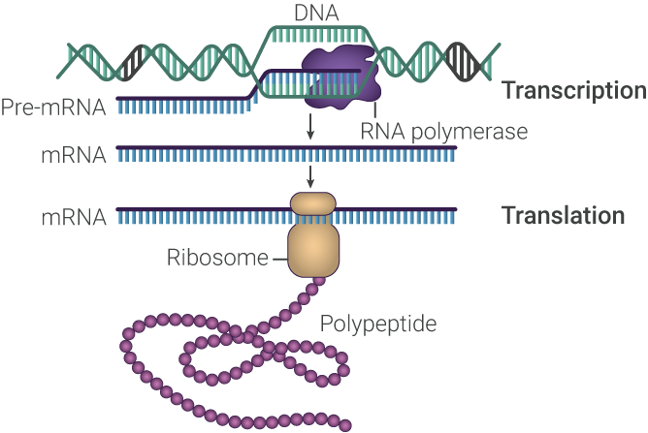
CHAPTER 2: THE CENTRAL DOGMA OF MOLECULAR BIOLOGY
To understand cancer and genetic screening, it is important to have a fundamental understanding of how genetic information flows from gene to protein, a process that has been termed the “central dogma of molecular biology” (Figure 2.1).
Every cell type in the body contains an identical genome with identical genes, and every gene encodes a specific protein. However, different cell types are differentiated by their specific pattern of gene expression. When a cell receives a signal to express a specific gene, the DNA sequence encoding that gene is used as a
template to produce RNA in a process called transcription. After transcription, the RNA transcript is processed to produce messenger RNA (mRNA), which is translated into a protein.
Here, we will explore each of these steps in more detail
Gene Structure and Regulation
Every somatic cell contains the exact same complement of DNA, yet they appear and behave differently. Thus, gene expression must be tightly regulated so that only appropriate genes are expressed in a particular cell type.
Figure 2.1 Flow of Genetic Information in a Cell. Adapted from Clancy 2008.

Slide 17
CHAPTER 2: THE CENTRAL DOGMA OF MOLECULAR BIOLOGY
Gene Structure and Regulation (continued)
In order to accomplish this, the typical eukaryotic gene (Figure 2.2) contains distinct regulatory elements, such as promoters and enhancers, that control transcription.
These elements are located upstream ahead of the 5' end of the gene. All protein coding genes require a promoter, a regulatory element that is necessary to initiate the process of transcription. The core promoter is noncoding DNA that is about 60 BP in length that overlaps the point at which gene transcription starts. Some genes may have additional upstream regulatory elements, such as enhancers, repressors, or insulators.
A gene is said to be “expressed” when it has received a signal and starts the production of an mRNA, which ultimately results in a protein product. Some genes are expressed all the time and are referred to as “constitutively expressed” genes. Other genes are regulated to varying degrees, with gene expression only occurring during specific stages of development or upon the receipt of a signal. Regulated expression requires interactions with DNA-binding proteins called transcription factors. In the nucleus, these factors bind to regulatory elements, such as gene promoters, to initiate transcription.
Figure 2.2 A Typical Transcription Unit. Adapted from Allison 2017.

Slide 18
CHAPTER 2: THE CENTRAL DOGMA OF MOLECULAR BIOLOGY
Transcription
Transcription is the first step in gene expression (Figure 2.3). In this process, the antisense strand of the DNA nucleotide sequence is transcribed into complementary pre-mRNA by an enzyme known as RNA polymerase.
Figure 2.3 Transcription. Adapted from Clancy 2008.
Note that the nontemplate strand of DNA is called the sense (coding) strand, and it is this strand that bears the same sequence as the pre-mRNA (U takes the place of T in the pre-mRNA). This process is carried out by a protein known as RNA polymerase.
Gene Expression and Cancer
Dysregulation of gene expression is one of the fundamental causes of cancer. For example, the anaplastic lymphoma kinase (ALK) gene is normally only expressed during embryonic and early development, where it provides a template for production of ALK receptor tyrosine kinase. Although the specific function of the ALK tyrosine kinase in humans is unknown, it is thought to play a role in the development of nervous system tissue. However, a chromosomal rearrangement identified in lung and some other cancers juxtaposes the EML4 gene and the ALK gene, resulting in the production of a constitutively expressed, continuously active fusion protein that can drive the development of cancer.

Slide 19
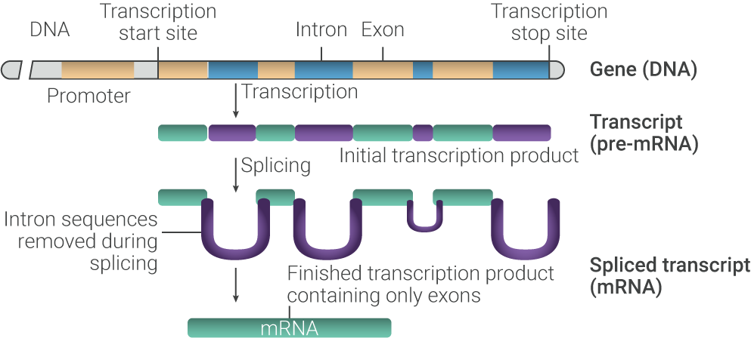
CHAPTER 2: THE CENTRAL DOGMA OF MOLECULAR BIOLOGY
RNA Splicing
Most eukaryotic genes contain exons, which are regions of a gene that code for protein, and introns, which are intervening noncoding sequences between exons.
In a process known as RNA splicing, the introns are removed and the exons are joined together to form an mRNA, which is then exported from the nucleus into the cytoplasm.
 | Learn More: RNA Splicing
Introns are removed from the pre-mRNA by cleavage and splicing at conserved sequences called splice sites, which are found at the 5' and 3' ends of introns. Splicing yields an mRNA, an RNA transcript that includes only the coding regions, or exons, of the gene (Figure 2.4). The mRNA is subsequently packaged and exported from the nucleus through nuclear pores. Figure 2.4 From Gene to mRNA. Adapted from Clancy 2008. Genetic alterations that occur at the boundary of an exon and an intron—the splice site—can result in the loss of exons or the inclusion of introns, and an altered protein-coding sequence. These alterations, known as splice-site mutations or splice-site variants, have been observed in cancers. For example, splice-site mutations in MET that affect exon 14 of the gene have been identified in cancer. | Negatively charged DNA is complexed with positively charged histones to form a nucleosome, which contains 8 histone proteins (Figure 1.2). DNA wraps around each histone complex 1.65 times. A further level of compaction is achieved through the folding of nucleosomes to form a 30-nanometer (nm) chromatin fiber, resulting in loops averaging 300 nm in length. In this manner, the 2 meters of DNA in each cell is compressed to the point that it can fit within a cell's nucleus. It is important to recognize that the compression and unwinding of DNA are tightly regulated through a number of processes that can “tighten” or “loosen” chromatin, allowing regions of the genome to be accessed to make proteins. [Simmons 2008, p 1B] These 300-nm fibers are compressed again and folded to produce a 250-nm-wide fiber, which is then tightly coiled into the chromatid of a chromosome. Each chromatid is connected at a constriction point called the centromere. [Annunziato 2008, p 2A] Figure 1.2 DNA is packaged in multiple steps to compress its 2-meter length into a structure that can fit into the cell's nucleus. [Annunziato 2008, p 2A]

Slide 20
CHAPTER 2: THE CENTRAL DOGMA OF MOLECULAR BIOLOGY
Translation
As we have already learned, the genetic code is composed of a sequence of the 4 DNA bases (A, T, G, C). This sequence is transcribed to mRNA (A, U, C, G), which is then used as a template for the production of proteins—which are, essentially, long strings of amino acids that have folded into a specific 3-dimensional shape. Proteins are the “workhorses” of the cell, carrying out all the functions necessary for life. For example, enzymes, including those that metabolize nutrients and synthesize new cellular constituents, as well as DNA and RNA polymerase, along with many other functions, are all proteins.
Genes and their resulting mRNA transcripts are arranged such that every 3 bases of the mRNA transcript make up a codon, and each codon corresponds to a specific amino acid (Figure 2.5). All protein-coding regions begin with the "start" codon, ATG (AUG in mRNA), and end with 1 of 3 "stop" codons to mark the end of the protein-coding region. After the ATG/AUG start codon, the nucleotides are translated in groups of 3. This is referred to as a “reading frame.”
The genetic code is degenerate or redundant, meaning that an amino acid may be coded for by >1 codon. Although it is a redundant code, it is not an ambiguous code: under normal circumstances, a given codon encodes only 1 amino acid. For example, leucine can be coded for by 6 different codons: UUA, UUG, CUU, CUC, CUA, and CUG. This has important implications for mutational changes in the genetic code: a mutation in the first “letter” of the codon would alter the amino acid at that position—a change to AUU would lead to isoleucine, a change to GUU would lead to valine, and a change to UUU would lead to phenylalanine being incorporated at that position.
However, a mutation in the third base of the CUU codon for leucine would not alter the protein, because CUC, CUA, and CUG also code for leucine. As you can see, the third nucleotide in a codon is generally less important than the first 2 in determining the amino acid to be incorporated.]
Reading Frames and Cancer
As you have seen, accurately synthesizing a protein from an mRNA template requires “reading” the template codon by codon in groups of 3. As we will discuss in the next chapter, mutations that result in the insertion or deletion of bases can often throw the resulting amino sequence off at all points downstream of the mutation. In fact, such mutations may lead to premature termination of the protein altogether when the ribosome encounters a stop codon.

Slide 21
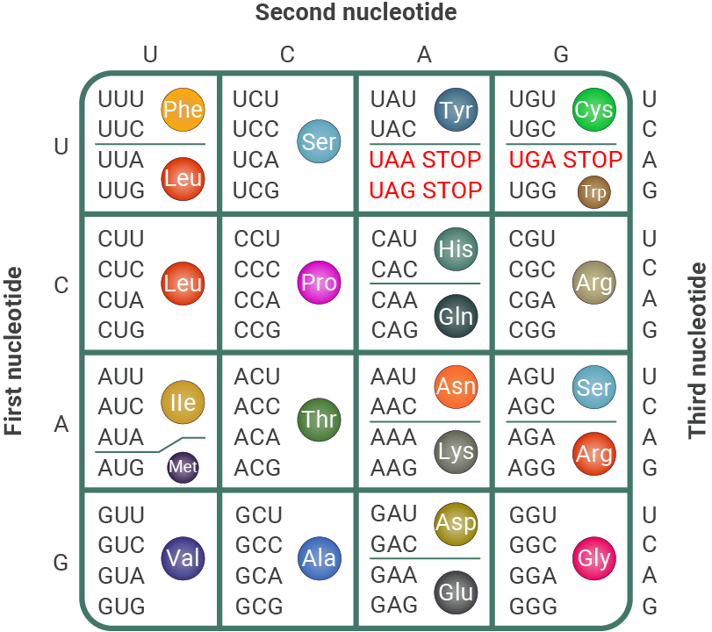
CHAPTER 2: THE CENTRAL DOGMA OF MOLECULAR BIOLOGY
Figure 2.5 (Top) Correspondence between mRNA codons and amino acids. (Bottom) RNA sequences are read in the 5' to 3' direction by the ribosome to assemble a polypeptide—a string of amino acids. Adapted from Clancy 2008.

Slide 22
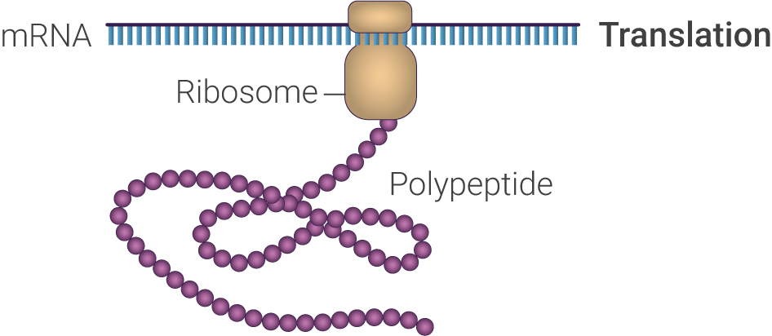
CHAPTER 2: THE CENTRAL DOGMA OF MOLECULAR BIOLOGY
As noted previously, mRNA is exported from the nucleus into the cytoplasm. Once in the cytoplasm, the mRNA transcript is bound by a ribosome , an organelle composed of ribosomal RNA (rRNA) and various proteins within a complex, to initiate the process of translation (Figure 2.6). Within the ribosomal complex, the mRNA codons are “read” sequentially from 5' to 3' to assemble a string of amino acids (polypeptide) that folds into a specific 3-dimensional structure.
Figure 2.6 Translation. Adapted from Clancy 2008.

Slide 23
CHAPTER 2: THE CENTRAL DOGMA OF MOLECULAR BIOLOGY
CHAPTER 2 SUMMARY
The “central dogma of molecular biology” describes the flow of information from DNA to protein.
Genes are expressed in a tightly regulated manner and contain regulatory elements, such as promoters, that drive transcription of the gene.
Transcription is the process by which DNA is “read” by RNA polymerase to generate a pre-mRNA.
The pre-mRNA is spliced to remove introns and join the protein-coding exons together, generating mRNA.
mRNA is “read” by ribosomes to generate a polypeptide—long strings of amino acids that fold into a specific 3-dimensional shape.

Slide 24
CHAPTER 2: THE CENTRAL DOGMA OF MOLECULAR BIOLOGY
Which of the following is a “control region” of a gene that lies directly upstream of the transcription start site?
A. Insulator
B. Enhancer
C. Promoter
D. Exon
True or false: All (or most) mammalian genes have alternating regions of coding and noncoding DNA.
A. True
B. False
The ______ nucleotide in a codon is generally least important in determining the amino acid to be incorporated.
A. First
B. Second
C. Third
D. They are all equally important

Slide 25
CHAPTER 3: EPIGENETIC REGULATION OF GENE EXPRESSION
What is Epigenetics?
The term “epigenetics” was initially coined by Conard Waddington in 1942, but in the modern context was formally defined in the 1990s as “the study of heritable changes in gene expression that occur without a change in DNA sequence.” Later, it was further defined as “the structural adaptation of chromosomal regions so as to register, signal, or perpetuate activity states.”
The term “epigenome” describes the epigenetic modifications of the entire genome, and the study of the epigenome is sometimes referred to as “epigenomics.”
There are 3 epigenetic systems that can interact with each other to regulate gene expression: DNA methylation, histone modifications, and RNA-associated silencing. DNA methylation involves the addition of a methyl group to DNA. Methylation occurs in DNA regions where a cytosine nucleotide is followed by a guanine nucleotide (referred to as a CpG site). CpG sites occur with high frequency in genomic regions called CpG islands.
Histone modifications involve a number of different post-translational modifications that govern chromatin structure. Some modifications “loosen” chromatin, allowing it to be readily accessed by transcriptional machinery; thus, these modifications result in a region of DNA that is transcriptionally active. Other modifications condense chromatin, creating a complex called heterochromatin, which is not transcriptionally active. Two common ways in which histones are modified include acetylation and methylation.
Antisense transcripts, noncoding RNAs, and RNA interference act to turn off gene expression, potentially through eliciting histone modifications, DNA methylation, and the formation of heterochromatin.
Here, we will look at DNA methylation in detail, and briefly discuss histone modifications. We will not consider RNA interference in this module.

Slide 26
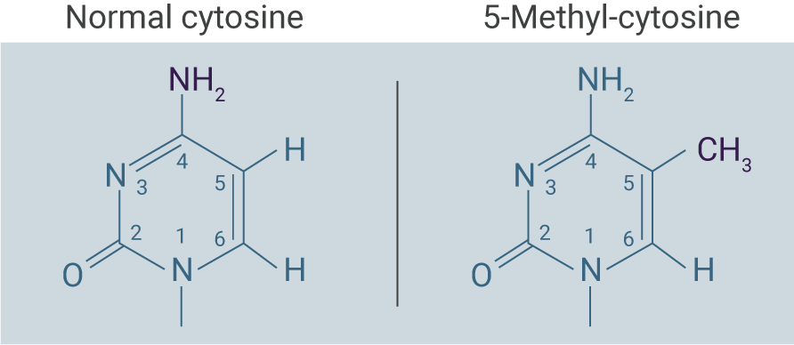
CHAPTER 3: EPIGENETIC REGULATION OF GENE EXPRESSION
DNA Methylation
Methylation of the DNA base cytosine is the major type of DNA modification present in most animals and plants.
Biochemistry of DNA Methylation
Cytosine DNA methylation is a covalent modification of DNA.
In this reaction, a methyl group, which consists of a carbon and 2 hydrogens (CH₃), is transferred from the chemical S-adenosylmethionine (SAM) to the carbon-5 position of cytosine by 1 of a family of enzymes known as cytosine DNA methyltransferases (Dnmts). 5-methyl-cytosine is the only modified base commonly found in most cells (Figure 3.1).
Epigenetics and Cancer
For nearly 30 years, it has been known that cancer cells exhibit abnormal DNA methylation patterns, in particular, hypomethylation (low levels of methylation) across the whole genome, combined with selective hypermethylation (high levels of methylation) of gene promoters, including the promoters of genes involved in suppressing tumor initiation and growth. Importantly, some changes in methylation are reproducibly found in nearly all cases of a specific type of cancer. In contrast, somatic mutations—those that occur at the level of the DNA sequence—are often neither specific nor sensitive for a particular cancer.
Figure 3.1 Unmodified Cytosine vs 5-Methyl-Cytosine. Note that the carbons are represented by junctions between the lines in the hexagonal structure of cytosine. Each carbon is numbered from 1 to 5. Cytosine is methylated on carbon-5. Adapted from Allison 2017.

Slide 27
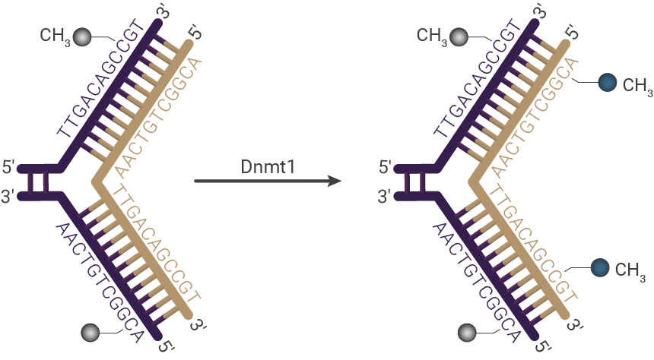
CHAPTER 3: EPIGENETIC REGULATION OF GENE EXPRESSION
DNA methylation occurs almost exclusively at the dinucleotide (pair of nucleotides) CG in mammals. The CG dinucleotide is often denoted as “CpG” (where p stands for the phosphate group). In mammals, the C locations on both strands of the DNA are methylated (Figure 3.2).
Importantly, methylation is maintained during DNA replication, so daughter cells after division retain the methylation patterns of the parent cell. After replication, the DNA double helix is “hemimethylated,” that is to say, the old template strand is methylated and the newly synthesized strand is unmethylated.
Figure 3.2 DNA Methyltransferases Catalyze the Transfer of a Methyl Group From S-adenosylmethionine (SAM) to the Fifth Carbon of Cytosine to Form 5-Methylcytosine. Adapted from Moore 2013.
A maintenance DNA methyltransferase, known as Dnmt1, recognizes only hemimethylated sites and methylates the new strand of DNA appropriately (Figure 3.3).
Figure 3.3 Dnmt1 Maintains the DNA Methylation Pattern of the Parent Cell During Semiconservative DNA Replication. Original DNA strand is shown in purple and new DNA strand in brown. Adapted from Moore 2013.

Slide 28
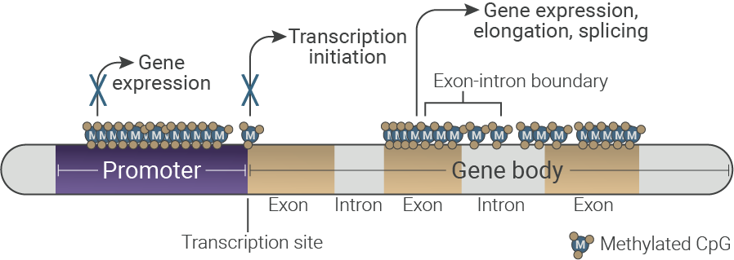
CHAPTER 3: EPIGENETIC REGULATION OF GENE EXPRESSION
Role of Methylation in Gene Expression
Methylation is usually, but not always, a way of marking genes for silencing, although the precise effect varies by the location of the methylated DNA region (Figure 3.4):
Methylation in the promoter region shuts off gene expression.
Methylation of the transcription initiation site also shuts off gene expression.
Methylation “inside” the body of the gene is strongly correlated with increased gene expression by increasing transcription.
In many genes, the methylation pattern is constant at most CG dinucleotide sites but varies at some sites. Genes in which the majority of CG dinucleotide sites are methylated (hypermethylation) tend to be inactive, while genes in which the minority of CG sites are methylated (hypomethylation) tend to be active, although exceptions to this rule exist.
Figure 3.4 The Effects of DNA Methylation Vary by Location. Adapted from Aquino 2018.
.
Methylation May Have Evolved as a Protective Mechanism
Most of the 5-methyl-cytosine in the genome lies within retrotransposons—remnants of ancestral retroviral infections that became fixed in the germline DNA and subsequently increased in copy number. It has been proposed that DNA methylation evolved as a defense mechanism to prevent mobilization of these elements and reduce the occurrence of chromosomal rearrangements

Slide 29
CHAPTER 3: EPIGENETIC REGULATION OF GENE EXPRESSION
CpG Islands
Approximately 70% to 80% of all CG dinucleotides in the mammalian genome are methylated. The remainder of the CG nucleotides occur in clusters known as “CpG islands,” which are found at the 5' end of genes and are protected from methylation. CpG islands are small regions of DNA that are rich in CG dinucleotides that range from 1000 to 2000 BPs in size. There are approximately 50,000 CpG islands in the human genome. CpG islands are found in between 40% and 50% of so-called “housekeeping” genes—genes that are typically constitutively expressed and are required for the maintenance of basic cellular function and are expressed in all cells of an organism under normal and pathologic conditions.
Tissue Specificity of Methylation Patterns
As noted previously, most CpG islands are thought to remain unmethylated in all adult tissues. This is logical because most CpG islands are present upstream of housekeeping genes, most of which are required for the day-to-day activities of all cells, regardless of tissue or pathology. However, CpG island methylation is also important for tissue-specific gene regulation. For example, the CpG islands of certain tissue-specific genes are methylated in the tissues in which they are not expressed, but not in tissues where they are expressed. As will be discussed elsewhere in this learning system, these differences in methylation patterns can be exploited as molecular “fingerprints” to identify the tissue source of DNA.
Figure 3.5 Tissue-Specific Methylation Patterns Provide a Tissue “Fingerprint”

Slide 30
CHAPTER 3: EPIGENETIC REGULATION OF GENE EXPRESSION
Histone Modifications
As discussed briefly above, histone modifications are another epigenetic mechanism for regulating gene expression.
Recall that the human haploid genome contains about 3 billion base pairs, or about 6 billion base pairs for each diploid genome. The total length of DNA is about 2 meters, all of which must be accommodated in the nucleus. This is accomplished by certain proteins that compact chromosomal DNA, known as histones. The resulting complex of DNA wrapped around histones is called chromatin.
DNA that is wrapped tightly around histones is not accessible to the transcription machinery. In order to make it accessible, the region wrapped around histones must “loosen.” The compressed state is referred to as “heterochromatin” and the loosened state as “euchromatin.” The transition between heterochromatin and euchromatin and back is accomplished by enzymatic modification of histones. This process is tightly regulated to control gene expression, and appears to be highly tissue specific, with each tissue displaying its own chromatin pattern.
 | Learn More: Histone Dynamics
There are 2 ways in which histones may be modified: Acetylation of histones is usually associated with active regions of gene transcription, while deacetylation is generally associated with inactive regions of gene transcription. Methylation of histones is more complex. Methylation of certain regions of specific histones can suppress transcription, while methylation of a different region may activate transcription of that region. Methylation and demethylation are accomplished by enzymes known as histone methyltransferases (HMTs) and histone demethylases (HDMs) (Figure 3.6). | Negatively charged DNA is complexed with positively charged histones to form a nucleosome, which contains 8 histone proteins (Figure 1.2). DNA wraps around each histone complex 1.65 times. A further level of compaction is achieved through the folding of nucleosomes to form a 30-nanometer (nm) chromatin fiber, resulting in loops averaging 300 nm in length. In this manner, the 2 meters of DNA in each cell is compressed to the point that it can fit within a cell's nucleus. It is important to recognize that the compression and unwinding of DNA are tightly regulated through a number of processes that can “tighten” or “loosen” chromatin, allowing regions of the genome to be accessed to make proteins. [Simmons 2008, p 1B] These 300-nm fibers are compressed again and folded to produce a 250-nm-wide fiber, which is then tightly coiled into the chromatid of a chromosome. Each chromatid is connected at a constriction point called the centromere. [Annunziato 2008, p 2A] Figure 1.2 DNA is packaged in multiple steps to compress its 2-meter length into a structure that can fit into the cell's nucleus. [Annunziato 2008, p 2A]

Slide 31
CHAPTER 3: EPIGENETIC REGULATION OF GENE EXPRESSION
 | Learn More: Histone Dynamics
As with DNA methylation, the 3-dimensional structure of chromatin—as determined by its interaction with histones—is partly tissue specific. This is because, while most or all cells require certain segments of the genome to be accessible for transcription to transcribe “housekeeping” genes, specific cell types suppress or activate selected regions of the genome containing tissue-specific genes using this mechanism. Figure 3.6 Methylation of Histones May “Relax” Chromatin, Allowing the Transcriptional Machinery to Access DNA Regions. Adapted from Allison 2017. | Negatively charged DNA is complexed with positively charged histones to form a nucleosome, which contains 8 histone proteins (Figure 1.2). DNA wraps around each histone complex 1.65 times. A further level of compaction is achieved through the folding of nucleosomes to form a 30-nanometer (nm) chromatin fiber, resulting in loops averaging 300 nm in length. In this manner, the 2 meters of DNA in each cell is compressed to the point that it can fit within a cell's nucleus. It is important to recognize that the compression and unwinding of DNA are tightly regulated through a number of processes that can “tighten” or “loosen” chromatin, allowing regions of the genome to be accessed to make proteins. [Simmons 2008, p 1B] These 300-nm fibers are compressed again and folded to produce a 250-nm-wide fiber, which is then tightly coiled into the chromatid of a chromosome. Each chromatid is connected at a constriction point called the centromere. [Annunziato 2008, p 2A] Figure 1.2 DNA is packaged in multiple steps to compress its 2-meter length into a structure that can fit into the cell's nucleus. [Annunziato 2008, p 2A]

Slide 32
CHAPTER 3: EPIGENETIC REGULATION OF GENE EXPRESSION
CHAPTER 3 SUMMARY
Epigenetics is the study of heritable changes in gene expression that occur without a change in DNA sequence.
DNA methylation, histone modification, and RNA interference are all epigenetic regulators of gene expression.
DNA methylation involves the addition of a methyl group (CH3) to the carbon-5 position of cytosine.
DNA methylation is maintained during DNA replication, so that the daughter cells contain DNA with an identical methylation pattern as the parent cell.
DNA methylation can perform multiple functions:
Methylation in the promoter region shuts off gene expression.
Methylation of the transcription initiation site also shuts off gene expression.
Methylation “inside” the body of the gene is strongly correlated with increased gene expression, potentially through promoting elongation during transcription.
CpG islands are generally found at the 5' end of genes and are protected from methylation.
Many CpG islands are found upstream of “housekeeping” genes, which are always “on.”
Some CpG islands of certain tissue-specific genes are methylated in the tissues in which they are not expressed, but not in tissues where they are expressed.
Differences in methylation patterns can act as molecular “fingerprints” indicating the source of DNA.
Histones can be modified via methylation and acetylation to modulate chromatin compaction and thus access of the transcriptional machinery to segments of the genome.

Slide 33
CHAPTER 3: EPIGENETIC REGULATION OF GENE EXPRESSION
KNOWLEDGE CHECK
Methylation occurs on:
A. Adenosine
B. Uracil
C. Thymine
D. Cytosine
Methylation occurs almost exclusively at:
A. CA dinucleotides
B. CG dinucleotides
C. CC dinucleotides
D. CT dinucleotides
True or false: DNA methylation only suppresses gene transcription.
A. True
B. False

Slide 34
CHAPTER 3: EPIGENETIC REGULATION OF GENE EXPRESSION
KNOWLEDGE CHECK
A CpG island is:
A. A region of DNA where CpG is heavily methylated
B. A region of DNA that is rich in CG nucleotides but is protected from methylation
C. A region of DNA that is involved in promoting the expansion of CG repeats
D. A region of DNA that is devoid of CG nucleotides
True or false: Access of the transcriptional machinery to DNA is regulated by histone modifications.
A. True
B. False
True or false: Both chromatin structure and methylation patterns are tissue specific.
A. True
B. False

Slide 35
CHAPTER 4: THE LANGUAGE OF DNA ALTERATIONS
As noted in the introduction, cancer is fundamentally a genetic disease that is caused by mutations in normal genes as well as the epigenetic changes that were described in the previous chapter.
The DNA sequence of a gene can be altered in a number of ways. Gene mutations have varying effects on health, depending on where they occur and whether they alter the function of essential proteins.
Note that mutations can be classified into 2 categories: somatic mutations, which occur in a single cell of the body and cannot be inherited, and germline mutations, which occur in gametes (sperm and egg) and can be passed on to offspring). In the latter case, every cell in the entire organism is affected by the mutation.
It is important to recognize that few somatic mutations have been identified that can aid in the screening and diagnosis of cancer. However, the evaluation of specific cancer genes for mutations in patients with cancer is becoming increasingly important for estimating disease prognosis and the selection of cancer therapy, as will be discussed in greater detail in the next module.
Single-Nucleotide Polymorphisms
Single-nucleotide polymorphisms (SNPs) are single base pair substitutions that occur within and outside genes. SNPs occur throughout the human genome at a rate ranging from about 3 to 50 per 10,000 base pairs. These polymorphic SNP markers can be used to map disease-associated genes.

Slide 36
CHAPTER 4: THE LANGUAGE OF DNA ALTERATIONS
Point Mutations: Missense, Nonsense, and Silent
These mutations involve changes in a single DNA base pair (Table 4.1).
Missense mutations result from a change in 1 DNA base pair that results in the substitution of 1 amino acid for another in the protein made by a gene. Nonsense mutations are also a change in 1 DNA base pair. Instead of substituting 1 amino acid for another, however, the altered DNA sequence introduces a stop codon, resulting in premature termination of the resulting protein.
Silent mutations occur when a substitution does not result in a change in the amino acid at that position, and thus do not change the function of the protein.
Remember that, because of the degeneracy of the genetic code, point mutations that occur in the first 2 base pairs of a given codon are more likely to result in a change in the amino acid inserted into the growing amino acid chain during translation.
Table 4.1 Consequences of a Point Mutation
Unmutated Codon | Point Mutation | Consequence
GGC | GCC | Alanine (GCC) incorporated into protein instead of glycine (GGC)
UGC | UGA | Synthesis prematurely stops at this codon, rather than incorporating a cytosine (UGC) into the protein
UUU | UUC | Phenylalanine is incorporated into the protein in both cases

Slide 37
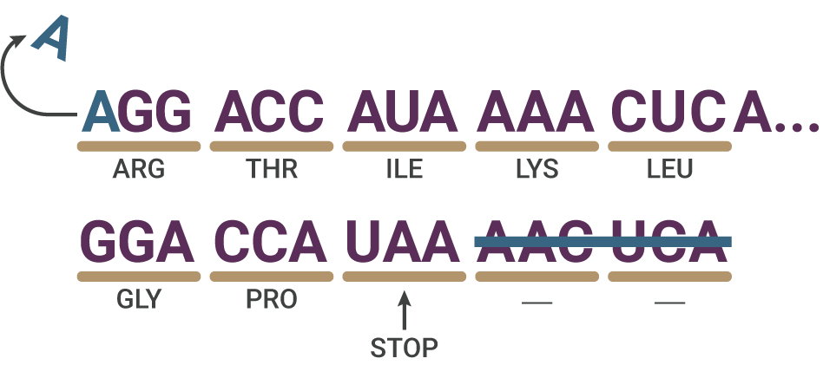
CHAPTER 4: THE LANGUAGE OF DNA ALTERATIONS
Insertions, Deletions, and Duplications
These mutations have the potential to alter the function of the resulting protein.
An insertion changes the number of DNA bases in a gene by adding a segment of DNA ranging from 1 to many hundreds or thousands of base pairs.
A deletion changes the number of DNA bases by removing a piece of DNA. Small deletions may remove 1 or a few base pairs within a gene, while larger deletions can remove an entire gene or several neighboring genes.
A duplication consists of a piece of DNA that is abnormally copied 1 or more times.
Insertions or deletions may result in frameshift mutations. This type of mutation occurs when the insertions or deletions of DNA bases change a gene's reading frame. Recall that a
reading frame consists of groups of 3 bases that each code for 1 amino acid. A frameshift mutation shifts the grouping of these bases and thus changes the code for amino acids. The resulting protein is garbled downstream of the frameshift. Furthermore, frameshift mutations can also result in the appearance of a stop codon, resulting in a polypeptide that is both garbled downstream of the mutation and prematurely terminated.
Insertions, deletions, and duplications can all be frameshift mutations. In Figure 4.1, a single nucleotide deletion (A) in the DNA sequence coding for a hypothetical protein has occurred, altering the reading frame in the resulting mRNA. Upon translation into protein, this deletion of a single nucleotide results in 2 abnormal amino acids (glycine [gly] and proline [pro]), followed by premature termination as the result of a stop codon (UAA).
.
Figure 4.1 Example of the consequences of a frameshift as a result of a single-base deletion.

Slide 38
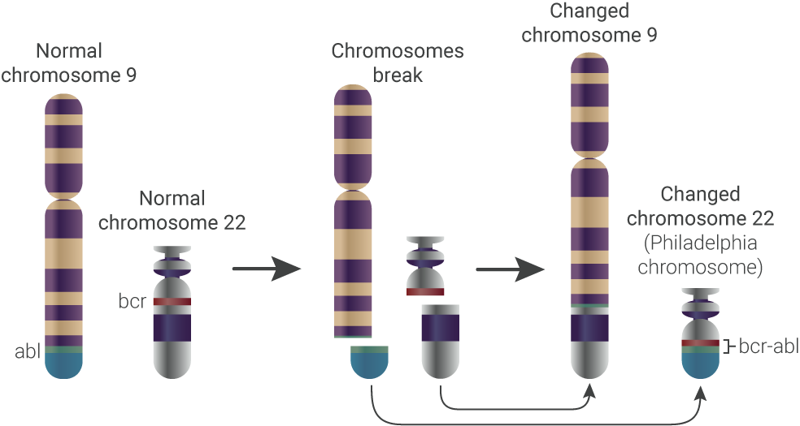
CHAPTER 4: THE LANGUAGE OF DNA ALTERATIONS
Repeat Expansion
Nucleotide repeats are short DNA sequences that are repeated in a row. A trinucleotide repeat is made up of 3-base-pair sequences, and a tetranucleotide repeat is made up of 4-base-pair sequences. Repeat expansions are mutations that increase the number of times that the short DNA sequence is repeated.
Chromosomal Translocations
Chromosomal translocations are a genetic change in which a piece of 1 chromosome breaks off and attaches to another chromosome or inverts on the same chromosome. Sometimes pieces from 2 different chromosomes will trade places with each other. This may result in a fusion protein with abnormal function.
The Philadelphia chromosome is the classic example of a chromosomal translocation that results in cancer, although many more have since been identified (Figure 4.2). A piece of chromosome 9 and a piece of chromosome 22 break off and trade places. This results in an abnormal fusion gene consisting of part of the BCR gene and part of the ABL gene.
The Philadelphia chromosome is frequently seen in patients with chronic myeloid leukemia (CML) and in some cases of acute lymphocytic leukemia (ALL).
Figure 4.2 The Philadelphia Chromosome is the Result of Swapping Between 2 Chromosomes. Adapted from the National Cancer Institute 2018.
.

Slide 39
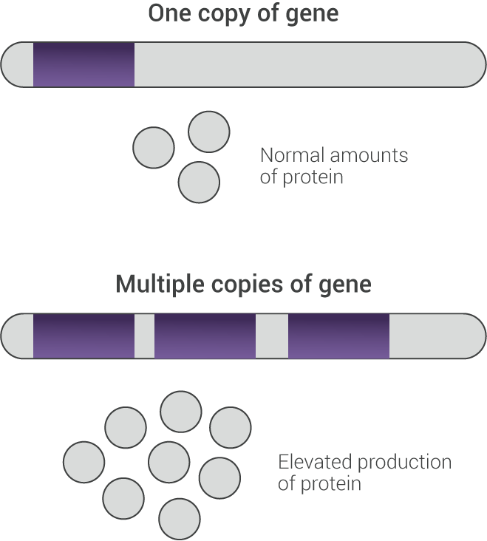
CHAPTER 4: THE LANGUAGE OF DNA ALTERATIONS
Amplifications
Amplifications are an increase in the number of copies of a gene. There may also be an increase in the RNA and protein made from that gene (Figure 4.3). Gene amplification is common in cancer cells, and some amplified genes may cause cancer cells to grow or become resistant to anticancer drugs. EGFR amplification, which is frequently observed in NSCLC, is a common example.
Figure 4.3 Amplification of a Gene May Result in Elevated Production of the Protein for Which it Codes.
.

Slide 40
CHAPTER 4: THE LANGUAGE OF DNA ALTERATIONS
CHAPTER 4 SUMMARY
Cancer is fundamentally a genetic disease that is caused by mutations in normal genes (often in concert with the epigenetic changes described in the previous chapter).
Mutation types:
Point mutations
Missense mutations result from a change in 1 DNA base pair that results in the substitution of 1 amino acid for another in the protein.
Nonsense mutations prematurely terminate translation by generating a stop codon.
Silent mutations occur when a substitution does not result in a change in the amino acid at that position.
Insertions, deletions, duplications
May result in “frameshift” mutations that change a gene’s reading frame
Repeat expansion
Expansion in the number of short DNA sequence repeats
Chromosomal translocations
A genetic change in which a piece of 1 chromosome breaks off and attaches to another chromosome or inverts on the same chromosome. Sometimes pieces from 2 different chromosomes will trade places with each other.
May result in a fusion protein with an abnormal function
Amplification
An increase in the number of copies of a gene; may be accompanied by increased protein production

Slide 41
CHAPTER 4: THE LANGUAGE OF DNA ALTERATIONS
KNOWLEDGE CHECK
A change in reading frame caused by a mutation is known as a:
A. Translocation
B. Frameshift
C. Insertion
D. Duplication
Which of the following types of mutations would affect all cells in the body?
A. Somatic
B. Germline

Slide 42
CHAPTER 5: INTERROGATING THE GENOME
The ability to interrogate the genome—that is to say, to analyze it for the presence of actionable characteristics—relies on 1) obtaining samples that are representative of the tissue or tumor being analyzed and 2) leveraging different analytic modalities to identify these actionable characteristics.
Samples are obtained via biopsy—the removal of tissue from the body. This tissue is used as a source for genetic material or other markers (such as proteins) that is analyzed using a variety of techniques.
This chapter will first examine biopsy modalities, with a brief look at tissue biopsies and a more comprehensive discussion of liquid biopsy. The next section of this chapter will provide a brief, top-line overview of some of the technologies used for interrogating the genome. Note that a comprehensive discussion of GRAIL’s technology will be provided in Module 3 of this learning system.
Obtaining Samples for Analysis
Tissue Biopsy
Although we will not consider it in depth here, obtaining tissue is the conventional first step in the diagnosis and molecular analysis of tumors. There are a broad range of modalities available for obtaining this tissue, ranging from completely noninvasive (for example, sputum cytology, in which mucus and other matter brought up from the lungs by coughing is evaluated), to minimally invasive (such as core needle biopsies) to the removal of large sections of cancerous tissue during surgery for the primary tumor.
Liquid Biopsy
At present, liquid biopsy is primarily used for the molecular analysis of tumor tissue from patients who have already been diagnosed with cancer. Analysis of circulating tumor DNA (ctDNA) in patients diagnosed with cancer helps to identify actionable mutations in the tumor and helps to identify appropriate treatments that target specific molecular abnormalities.
It is noteworthy that very small tumors, containing as few as approximately 50 million malignant cells can release sufficient tumor DNA for detection. In contrast, the most advanced imaging technologies require the tumor to be of 7 mm to 10 mm in size, at which size they contain approximately 1 billion cells or more—or about 20 times greater in size than those that can be detected by analysis of ctDNA.
It is critical to note that, while most current liquid biopsy-based assays focus on tumor cell-derived free DNA, all cell types, including normal tissues, shed DNA into the blood.
.

Slide 43
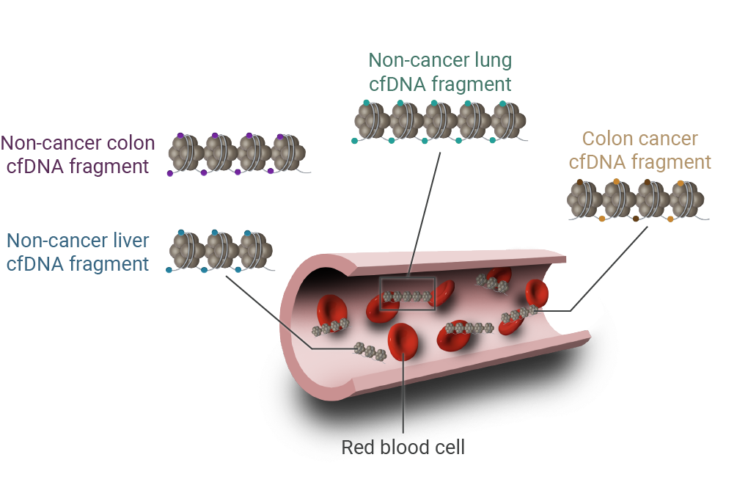
CHAPTER 5: INTERROGATING THE GENOME
Liquid Biopsy (continued)
Liquid biopsy is conducted via a simple blood draw. Blood contains several sources of genetic and/or tumor material that can provide the raw materials for genetic analyses (Figure 5.1):
Cell-free or complexed nucleic acids including circulating cell-free DNA (cfDNA), of which a subset represents circulating tumor DNA (ctDNA). cfDNA is composed of small fragments of DNA that are not associated with cells or cell fragments; instead, cfDNA is derived from dead or dying tumor and normal cells that, as they die, release their contents—including their nucleic acids—into the bloodstream.
Cell-free RNA (cfRNA), as with cfDNA, is derived from dead or dying cells that release RNA into the bloodstream.
Circulating tumor cells (CTCs) represent intact, viable non-blood cells with malignant features that can be isolated from blood. CTCs are released into the bloodstream during the spread of cancer through the bloodstream and present as single cells or clusters,
Exosomes are cell-derived, lipid-membrane bound packages that are released into the bloodstream. Exosomes may contain nucleic acids.
Figure 5.1 Both Normal Cells and Tumor Cells Shed Cell-free DNA Into the Bloodstream, Where It Can Be Collected in a Standard Plasma Sample. Adapted from Ofman 2020.
.

Slide 44
CHAPTER 5: INTERROGATING THE GENOME
Liquid Biopsy (continued)
Cell-free DNA has potential utility throughout the cancer detection and treatment paradigm:
Cell-free DNA derived from tumor tissues carries the same mutations as living tumor cells, and thus can be leveraged for the identification of mutations that can be targeted for treatment or that provide prognostic value.
Cell-free DNA retains the methylation patterns of its source tissue, and thus can be used to identify the source tissue and to evaluate methylation patterns that may be associated with specific cancers.
Cell-free DNA can be analyzed in various ways to indirectly assess chromatin structure, which can help to identify the tissue of origin.
Liquid biopsy can provide much the same information as tissue biopsies; however, it has a number of advantages over conventional biopsies:
Importantly, because tissues and tumors of all different types can shed DNA into the bloodstream, liquid biopsy can provide a sample that offers a “snapshot” of the genetic status of most or all of the tissues in the body.
Liquid biopsy is a source of fresh tumor-derived material that has not been subjected to preservatives like formalin.
It is minimally invasive, avoids the complications of biopsies, and allows for repeated sampling.
The processing of whole blood and preparation of the sample is straightforward and is becoming more and more automated.
Reading the Genome
The materials obtained during biopsy, which can be DNA, RNA, proteins, or other biochemical substances, are subsequently analyzed for the presence of molecular markers. Here, we will focus on the analysis of DNA.
Conventional Sequencing
Conventional sequencing is 1 of the original modalities used to “read” the genome base by base. In order to understand more advanced technologies, it is useful to understand how Sanger sequencing works.
This method was developed in the late 1970s by Frederick Sanger and is sometimes called Sanger sequencing. Sanger sequencing was more widely used in the past and has largely been supplanted by the multiplex or high-throughput assays that are described later in this chapter.

Slide 45
CHAPTER 5: INTERROGATING THE GENOME
Conventional Sequencing (continued)
In Sanger sequencing (Figure 5.2):
The DNA sample is combined in 4 tubes with primer, DNA polymerase, and DNA deoxynucleotides (either dATP, dTTP, dGTP, or dCTP) (Figure 9). In addition, 4 dye-labeled, chain-terminating nucleotides, known as dideoxynucleotides, are added in much smaller amounts than the ordinary nucleotides.
The mixture is first heated to denature the template DNA (separate the strands).
The mixture is cooled so that the primer can anneal to the single-stranded template.
Once the primer has bound, the temperature is raised again, allowing DNA polymerase to synthesize new DNA starting from the primer.
DNA polymerase will continue adding nucleotides to the chain until it adds a terminator dideoxynucleotide instead of a normal one. At that point, no further nucleotides can be added, so the strand will end with the fluorescently labeled dideoxynucleotide.
This process is repeated in a number of cycles. By the time the cycling is complete, it is virtually guaranteed that a fluorescent terminator dideoxynucleotide will have been incorporated at every single position of the target DNA in at least 1 reaction. This will result in a sample containing fragments of different lengths, each of which ends at a nucleotide position in the original DNA.
After the reaction is complete, the fragments are run through a long, thin tube containing a gel matrix—in a process called capillary gel electrophoresis. Short fragments move quickly through the pores of the gel, while long fragments move more slowly. As each fragment crosses the “finish line” at the end of the tube, it is illuminated by a laser, allowing the attached dye to be detected.

Slide 46
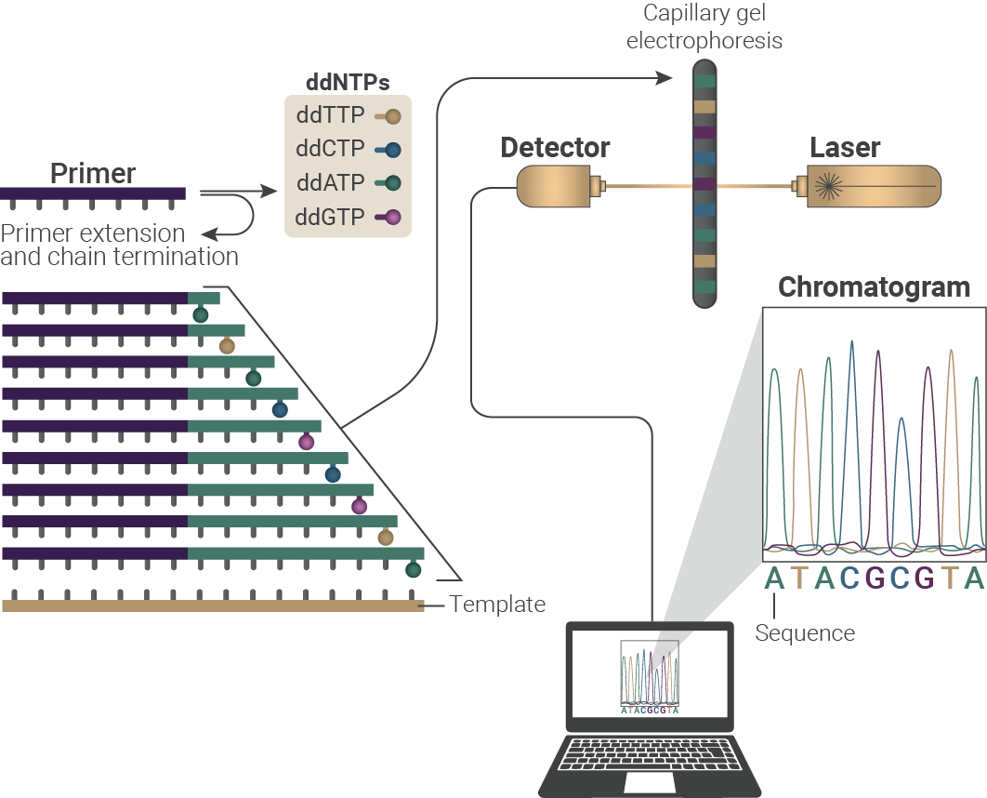
CHAPTER 5: INTERROGATING THE GENOME
Conventional Sequencing (continued)
The smallest fragment (ending 1 nucleotide after the primer) crosses the finish line first, followed by the next-smallest fragment (ending 2 nucleotides after the primer), and so forth. The colors of dyes are registered one after another on the detector; thus, the sequence of the original piece of DNA can be read one nucleotide at a time. The data recorded by the detector consist of a series of peaks in fluorescence intensity. The DNA sequence is read from these peaks.
Figure 5.2 Conventional (Sanger) Sequencing. Adapted from Munshi 2012.

Slide 47
CHAPTER 5: INTERROGATING THE GENOME
Next-Generation Sequencing
Like Sanger sequencing, next-generation sequencing (NGS) technologies produce a base-by-base read of target genes. While the Sanger method requires separate steps for sequencing, separation, and detection, NGS technologies sequence in a massively parallel, high-throughput manner that allows for multiple genes of interest to be rapidly evaluated at comparatively low cost. In fact, the human genome sequencing projects that took years with Sanger sequencing can now be completed in hours with NGS.
NGS is conducted in 4 steps:
Library preparation, in which random fragments of DNA from the subject are ligated to custom linkers
Amplification, in which the random fragments of DNA are amplified using various techniques
Sequencing, in which the amplified DNA is read base by base
Analysis and reporting of results
The first 3 of these steps occurs in a “wet lab”—a laboratory in which chemicals, drugs, or biological matter are tested and analyzed. The last step occurs in a “dry lab”—a laboratory where computers are used for analysis.
The following is a brief, general overview of the process. Note that there are multiple proprietary technologies used for NGS, and an individual technology may not follow these exact steps.

Slide 48
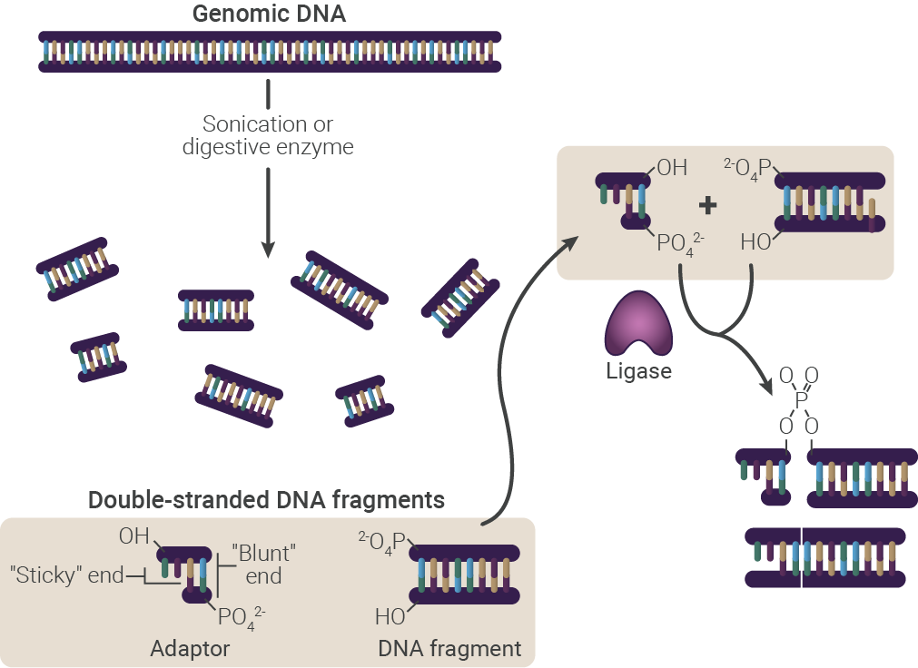
CHAPTER 5: INTERROGATING THE GENOME
Next-Generation Sequencing (continued)
Library preparation: DNA derived from the sample is fragmented, either using enzymes or by the application of high-frequency sound (sonication). Adapters, which are short, double-stranded pieces of synthetic DNA, are enzymatically joined to these fragments in a process known as ligation. These adapters serve as the “landing pad” for complementary primers, allowing the random sequences that are obtained through fragmentation to be amplified.
Figure 5.3 Library Preparation. Adapted from ATD Bio 2018.
.

Slide 49
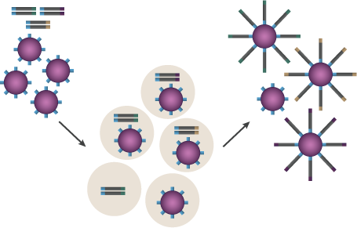
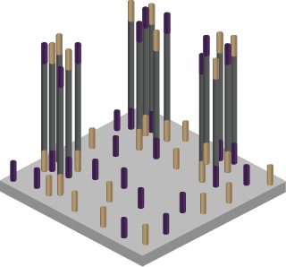
CHAPTER 5: INTERROGATING THE GENOME
Next-Generation Sequencing (continued)
Amplification: The library must be “amplified”—that is to say, each segment must be reproduced many times, in order to generate a signal that is strong enough to be detected. There are multiple technologies that are used for amplification (such as emulsion polymerase chain reaction [PCR] and bridge PCR), but all have in common the fact that they generate localized regions that consist of many copies of the same DNA template.
Sequencing: Several competing methods of next-generation sequencing—which generates base-by-base reads of the target DNAs—have been developed by different companies. The exact technologies used will not be discussed here.
Analysis and Reporting of the Results: A huge amount of data is generated by NGS in the form of base-by-base reads of all of the target DNAs in the sample. These data are collected and assembled computationally to generate complete DNA sequences.
Figure 5.4 Results of Amplification Using Emulsion PCR and Bridge PCR. Adapted from ATD Bio 2018
.
Emulsion PCR The end result of emulsion PCR is clusters of the same DNA template on individual beads. | Bridge PCR The end result of bridge PCR is clusters of identical DNA strands forming islands on the surface of a substrate.

Slide 50
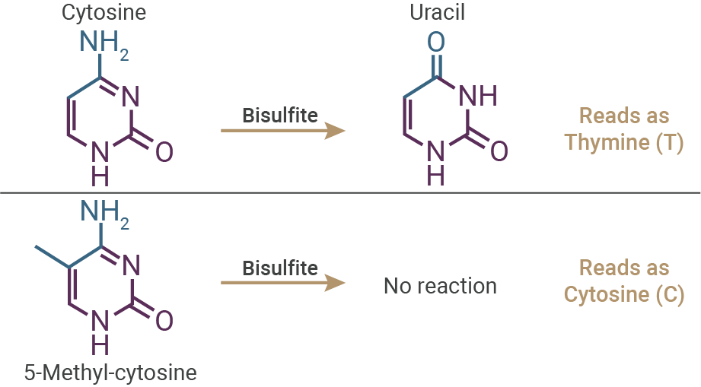
CHAPTER 5: INTERROGATING THE GENOME
Bisulfate Sequencing
As we have already discussed, the base-by-base genetic code does not contain all the information needed by organisms. Epigenetic modifications to DNA bases, in particular 5-methylcytosine, also convey important information.
No sequencing modality can directly detect modified DNA bases. In fact, 5-methyl-cytosine is treated as cytosine by the enzymes involved in sequencing; therefore, epigenetic information is lost during conventional NGS.
Bisulfate sequencing can be used to extract epigenetic information from DNA samples to overcome this limitation. It exploits the difference in reactivity of cytosine and 5-methylcytosine to bisulfite (Figure 5.5):
Cytosine is converted to uracil (which reads as T [thymine] when sequenced) via a chemical process known as deamination.
5-methylcytosine is unreactive (and thus reads as C [cytosine] when sequenced).
If 2 sequencing runs are done in parallel, 1 with bisulfite treatment and 1 without, the differences between the outputs of the 2 runs indicate methylated cytosines in the original sequence.
Figure 5.5 Sequencing Epigenetic Modifications Using Bisulfite. Adapted from ATD Bio 2018.

Slide 51
CHAPTER 5: INTERROGATING THE GENOME
CHAPTER 5 SUMMARY
Obtaining samples for analysis
Tissue biopsy involves the collection of tumor tissues for molecular analysis and may be conducted using modalities ranging from noninvasive to highly invasive.
Liquid biopsy is conducted by simple blood draw.
Blood contains multiple materials that can be used for genetic analysis:
Cell-free DNA (cfDNA) is DNA shed from normal and tumor cells when they die.
Cell-free RNA (cfRNA) is RNA derived from dead or dying cells.
Circulating tumor cells are intact, viable tumor cells that have been released into the blood.
Exosomes are cell-derived, lipid-membrane bound packages that may contain nucleic acids.
cfDNA carries the same mutations as living tumor cells.
cfDNA retains the methylation patterns of its source tissue.
cfDNA can be analyzed in various ways to assess chromatin structure.
Reading the genome
Conventional sequencing results in base-by-base reads of a relatively short segment of DNA.
Next-generation sequencing also results in base-by-base reads of DNA but is massively multiplexed to sequence many genes simultaneously.
Bisulfate sequencing allows for the extraction of epigenetic information—specifically, DNA methylation patterns.

Slide 52
CHAPTER 5: INTERROGATING THE GENOME
KNOWLEDGE CHECK
Detection of tumor DNA has the potential to detect cancers that are ______ the size of tumors that can be detected on imaging.
A. 1/2
B. 1/5
C. 1/20
D. 1/100
True or false: Cell-free DNA retains the methylation patterns of its source tissue.
A. True
B. False
In bisulfate sequencing:
A. Cytosine is converted to adenine by bisulfate
B. Cytosine is converted to uracil by bisulfate
C. 5-methylcytosine is converted to adenine by bisulfate
D. 5-methylcytosine is converted to uracil by bisulfate

Slide 53
MOLECULAR AND CELLULAR BIOLOGY FUNDAMENTALS
GLOSSARY
Autosome: Any chromosome other than a sex chromosome. Humans have 22 pairs of autosomes.
Centromere: The constricted region near the center of a human chromosome. This is the region of the chromosome where the 2 sister chromatids are joined to 1 another. The centromere attaches chromosomes to the spindle fibers during mitosis and ensures that sister chromatids segregate correctly to daughter cells.
Chromatid: Copies of a chromosome produced during cell division.
Chromatin: Chromosomal DNA with its associated proteins.
Covalent: A “strong” chemical bond that is formed by the sharing of electrons between atoms.
Diploid: The number of chromosomes in most cells except gametes (sperm and egg). In humans, the diploid number of chromosomes is 46, including 22 pairs of autosomes and 1 pair of sex chromosomes.
Enhancer: A DNA regulatory element that increases gene promoter activity. Enhancers are usually 700 to 1000 bp or more away from the start of transcription and can be downstream, upstream, or within an intron, and can function in either orientation relative to the promoter.
Genome: One complete set of genetic information contained within an organism or a cell. The term is often used interchangeably with the terms genomic DNA, chromosomal DNA, or nuclear DNA.
Haploid: The number of chromosomes in a sperm or egg cell (gamete), half the diploid number.
Insulator: A DNA regulatory element that acts as a chromatin boundary marker between regions of heterochromatin and euchromatin and can block enhancer or silencer activity of neighboring genes.
Mitosis: Cell division that produces 2 daughter cells having nuclei identical to the parental cell.
Nuclear pore: A selective gateway for the exchange of material between the nucleus and cytoplasm.
Promoter: The collection of DNA sequence elements, including the core promoter and promoter proximal elements, that are required for initiation of transcription or that increase the frequency of initiation only when positioned near the transcriptional start site.
Repressor: A protein that regulates a gene by turning it off.
Ribosome: An RNA-protein complex that translates mRNAs to produce proteins.

Slide 54
MOLECULAR AND CELLULAR BIOLOGY FUNDAMENTALS
REFERENCES
Allison LA. Fundamentals of Molecular Biology. Blackwell Publishing, Inc; 2017.
Alokail MS, Alenad AM. DNA methylation. A Concise Review of Molecular Pathology of Breast Cancer. InTech Open. 2015.
Annunziato A. DNA packaging: nucleosomes and chromatin. Nature Educ. 2008;1(1):26. /https://www.nature.com/scitable/topicpage/dna-packaging-nucleosomes-and-chromatin-310
Aquino EM, Benton MC, Haupt LM, et al. Current understanding of DNA methylation and age-related disease. OBM Genetics. 2018;(2)2:016. doi:10.21926/obm.genet.1802016
ATD Bio. Next-generation sequencing. Accessed June 5, 2018. https://www.atdbio.com/content/58/Next-generation-sequencing
Bethune G, Bethune D, Ridgway N, et al. Epidermal growth factor receptor (EGFR) in lung cancer: an overview and update. J Thorac Dis.2010;2:48-51.
Bird A. Perceptions of epigenetics. Nature. 2007;447:396-398. doi:10.1038/nature05913
Clancy S. RNA splicing: introns, exons, and spliceosome. Accessed December 5, 2019. https://www.nature.com/scitable/topicpage/rna-splicing-introns-exons-and-spliceosome-12375/
Clancy S. Transcription. Nature Educ. 2008;1(1):41. https://www.nature.com/scitable/topicpage/dna-transcription-426/
Clancy S, Brown W. Translation: DNA to mRNA to protein. Nature Educ. 2008;1(101):101. https://www.nature.com/scitable/topicpage/translation-dna-to-mrna-to-protein-393/
Epigentek. Histone modification studies. Accessed February 7, 2021. https://www.epigentek.com/catalog/histone-modification.php
Ghosh S, Yates AJ, Fruhwald MC, et al. Tissue specific DNA methylation of CpG islands in normal human adult somatic tissues distinguishes neural from non-neural tissues. Epigenetics. 2010;5:527-538. doi: 10.4161/epi.5.6.12228
Hallberg B, Palmer RH. The role of the ALK receptor in cancer biology. Ann Oncol. 2016;27(suppl 3):iii4-iii15. doi: 10.1093/annonc/mdw301
Hao X, Luo H, Krawczyk M, et al. DNA methylation markers for diagnosis and prognosis of common cancers. Proc Natl Acad Sci. 2017;114:7414-7419. doi/10.1073/pnas.1703577114
Ilie M, Hofman P. Pros: Can tissue biopsy be replaced by liquid biopsy? Transl Lung Cancer Res. 2016;5:420-423. doi: 10.21037/tlcr.2016.08.06

Slide 55
MOLECULAR AND CELLULAR BIOLOGY FUNDAMENTALS
REFERENCES
Jacob M, Varghese J, Weil PA. Cancer: an overview. In: Rodwell VW, Bender DA, Botham KM, Kennelly PJ, Weil PA, eds. Harper's Illustrated Biochemistry. 31st ed. McGraw-Hill Education; 2018:chapter 56.
Kinzler KW, Vogelstein B. Cancer–susceptibility genes. Gatekeepers and caretakers. Nature. 1997;386:761-762. doi: 10.1038/386761a0
Liu Y, Liu T-Y, Weinberg DE, et al. Spatial co-fragmentation pattern of cell-free DNA recapitulates in vivo chromatin organization and identifies tissues-of-origin. BioRxiv. 2019. doi: https://doi.org/10.1101/564773
Marieb EN, Hoehn K. Chemistry comes alive. Chapter 2 In: Human Anatomy & Physiology. 10th ed. Pearson Educational Ltd; 2015.
Moore LD, Le T, Fan G. DNA methylation and its basic function. Neuropsychopharmacology. 2013;38:23-38. https://doi.org/10.1038/npp.2012.112
Munshi A Ed. DNA sequencing - methods and applications. InTech Publishing. 2012. https://www.intechopen.com/books/dna-sequencing-methods-and-applications
Naidoo J, Drilon A. Molecular diagnostic testing in non-small cell lung cancer. Am J Hematol Oncol. 2014;10:4-11. https://gotoper-com.s3.amazonaws.com/_media/_pdf/AJHO14Sept_01_NSCLC.pdf
National Cancer Institute. Amplification. Accessed February 7, 2021. https://www.cancer.gov/publications/dictionaries/cancer-terms/def/gene-amplification
National Cancer Institute. Philadelphia chromosome. Accessed February 6, 2020. https://www.cancer.gov/publications/dictionaries/genetics-dictionary/def/philadelphia-chromosome
National Cancer Institute. Splice-site mutation. Accessed February 6, 2020. https://www.cancer.gov/publications/dictionaries/genetics-dictionary/def/splice-site-mutation
National Cancer Institute. Translocation. Accessed June 20, 2018. https://www.cancer.gov/publications/dictionaries/cancer-terms/def/translocation.
National Institutes of Health. What types of mutations are possible? Accessed February 6, 2020. https://ghr.nlm.nih.gov/primer/mutationsanddisorders/possiblemutations
Ofman JJ, Hall MP, Aravanis AM. GRAIL and the quest for earlier multi-cancer detection. Nature Sponsor Feature. 2020. Accessed February 17, 2021. https://www.nature.com/articles/d42473-020-00079-y
Pfister SX, Ashworth A. Marked for death: targeting epigenetic changes in cancer. Nat Rev Drug Discov. 2017;16:241-263. doi: 10.1038/nrd.2016.256

Slide 56
MOLECULAR AND CELLULAR BIOLOGY FUNDAMENTALS
REFERENCES
Pilotto S, Gkountakos A, Carbognin L, et al. MET exon 14 juxtamembrane splicing mutations: clinical and therapeutic perspectives for cancer therapy. Ann Transl Med. 2017;5:1-11. doi: 10.21037/atm.2016.12.33
Pray LA. Eukaryotic genome complexity. Nature Educ. 2008;1(1):96. https://www.nature.com/scitable/topicpage/eukaryotic-genome-complexity-437/
Shen LX, Basilion JP, Stanton VP. Single-nucleotide polymorphisms can cause different structural folds of mRNA. Proc Natl Acad Sci USA. 1999;96(14):7871-7876. https://doi.org/10.1073/pnas.96.14.7871
Simmons D. Epigenetic influences and disease. Nature Educ. 2008;1(1):6. https://www.nature.com/scitable/topicpage/epigenetic-influences-and-disease-895/
Wan J, Oliver VF, Wang G, et al. Characterization of tissue-specific differential DNA methylation suggests distinct modes of positive and negative gene expression regulation. BMC Genomics. 2015;16(1)49. doi: 10.1186/s12864-015-1271-4
Weil PA. Protein synthesis & the genetic code. In: Rodwell VW, Bender DA, Botham KM, Kennelly PJ, Weil PA, eds. Harper's Illustrated Biochemistry. 31st ed. McGraw-Hill Education; 2018:chapter 37.
Wolffe AP, Matzke MA. Epigenetics: Regulation through repression. Science. 1999;286:481-486. doi:10.1126/science.286.5439,48

