Slide 1
Hepatocellular Carcinoma
Virtual Learning Experience 1
Notes:
TIME: 2 min
Welcome participants.
Make introductions as appropriate.
NOTE:
This virtual learning experience (VLE) is based on the Exact Sciences Module 1: Hepatocellular Carcinoma.
This interactive virtual workshop is designed to provide foundational knowledge about HCC to help you during conversations with healthcare providers.
There are several opportunities to apply your knowledge through exercises and engagement.
HOUSEKEEPING:
You should be able to see my screen, which shows the title slide.
You should also have dialed into the conference line.
As a general rule, use the chat to communicate during the VLE.
Mute your phone to prevent background noise from disrupting the VLE.
Unmute your phone if called on to verbalize your response.
TRANSITION to the next slide.

Slide 2
Agenda
Activity | Duration
HCC Background and Epidemiology | 8 minutes
HCC Etiology | 20–25 minutes
Disease Pathogenesis | 10 minutes
Diagnosis and Staging | 10 minutes
Treatment | 15–20 minutes
Questions | 2 minutes
Total VLE Time: | 65–75 minutes
Notes:
TIME: 1 min
REVIEW the agenda.
TRANSITION to the next slide.

Slide 3
HCC Background and Epidemiology

Slide 4
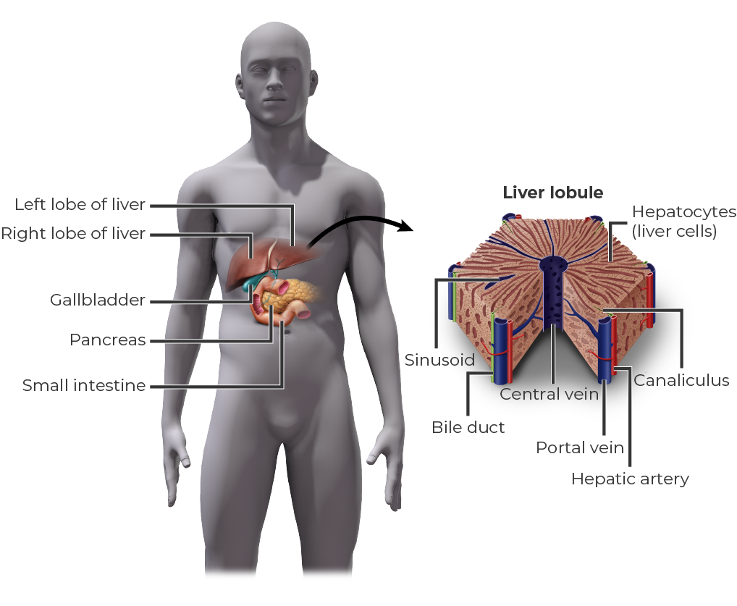
Hepatocellular Carcinoma (HCC): The Most Common Type of Liver Cancer^{1,2}
What Does the Liver Do?
Production of bile³ Production of certain proteins for blood plasma³ Production of cholesterol and special proteins³ Conversion of excess glucose into glycogen for storage and to balance and make glucose as needed³ Regulation of blood levels of amino acids³ Processing of hemoglobin for use of its iron content³ Conversion of poisonous ammonia to urea Clearing the blood of drugs and poisonous substances³ Producing factors that regulate blood clotting³ Resisting infections by making immune factors and removing bacteria from the bloodstream³ Clearance of bilirubin³
EXS_001
Notes:
TIME: 2–3 min
SAY:
Hepatocellular carcinoma (HCC) is the most common type of liver cancer.^{1,2} [Villanueva 2019, p 1450A; Bray 2018, p 25A]
Before we discuss HCC, it is important to understand the many important, complex functions the liver has in the body. This helps to shed light on why people who have HCC become so sick, and why HCC is difficult to treat.
The liver has more than 500 known functions.³ [Johns Hopkins 2020, pp 2-3A]
REVIEW:
Production of bile, which helps carry away waste and break down fats in the small intestine during digestion
Production of certain proteins for blood plasma
Production of cholesterol and special proteins to help carry fats through the body
Conversion of excess glucose into glycogen for storage (glycogen can later be converted back to glucose for energy) and to balance and make glucose as needed
Regulation of blood levels of amino acids, which form the building blocks of proteins
Processing of hemoglobin for use of its iron content (the liver stores iron)
Conversion of poisonous ammonia to urea (urea is an end product of protein metabolism that is excreted in the urine)
Clearing the blood of drugs and poisonous substances
Producing factors that regulate blood clotting
Resisting infections by making immune factors and removing bacteria from the bloodstream
Clearance of bilirubin (jaundice, which is characterized by yellow skin and eyes, is caused by an accumulation of bilirubin) [Johns Hopkins 2020, pp 2-3A]
TRANSITION to the next slide.
[Villanueva 2019, p 1450A; Bray 2018, p 25A]
[Johns Hopkins 2020, pp 2-3A]

Slide 5
How Common Is HCC?
Globally, liver cancer⁴:
Is much more common in men vs women (71% vs 29%)
Is associated with a high degree of variability (incidence rates per capita)
Represents ~5% of new cancer cases
Is the fourth-leading cause of cancer-related deaths, accounting for >8% of cancer-related deaths
Notes:
TIME: 2–3 min
NOTE: These statistics are for liver cancer, of which HCC represents the vast majority (up to 85% of liver cancers are HCC).^{1,2} [Villanueva 2019, p 1450A; Bray 2018, p 25A]
READ: bullets
What about in the United States?
TRANSITION to the next slide.
[GLOBOCAN (Liver) 2018, p 1B; percentages calculated from data indicated]
[GLOBOCAN (Liver) 2018, p 1A]
[GLOBOCAN (Liver) 2018, p 2A, B]

Slide 6
How Common Is HCC?
Globally, liver cancer⁴:
Is much more common in men vs women (71% vs 29%)
Is associated with a high degree of variability (incidence rates per capita)
Represents ~5% of new cancer cases
Is the fourth-leading cause of cancer-related deaths, accounting for >8% of cancer-related deaths
In the United States:
Liver cancer is the 13th most common cancer, representing about 2.4% of new cancer cases⁵
Notes:
TIME: 2–3 min (cont)
In the US, liver cancer is the 13th most common cancer, representing about 2.4% of new cancer cases in the US.⁵ [NCI SEER (Liver) 2020, p 5A, B, C; American Cancer Society 2020, p 4 (table 1)]
TRANSITION to the next slide.
[GLOBOCAN (Liver) 2018, p 1B; percentages calculated from data indicated]
[GLOBOCAN (Liver) 2018, p 1A]
[GLOBOCAN (Liver) 2018, p 2A, B]
[NCI SEER (Liver) 2020, p 5A, B, C; American Cancer Society 2020, p 4 (table 1)]

Slide 7
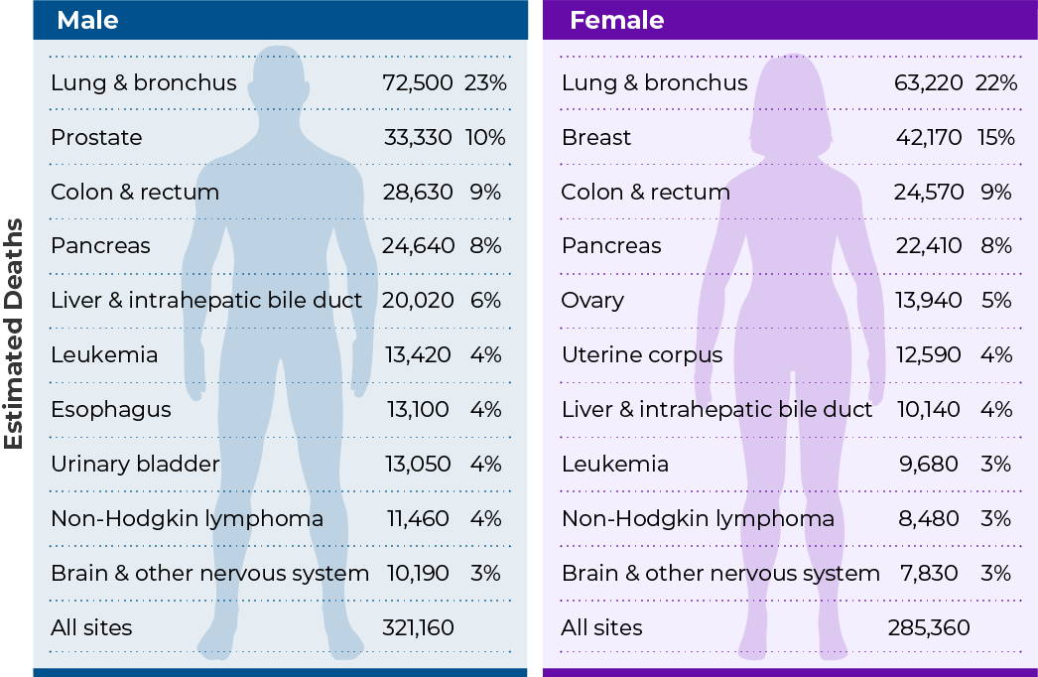
How Common Is HCC?
Globally, liver cancer⁴:
Is much more common in men vs women (71% vs 29%)
Is associated with a high degree of variability (incidence rates per capita)
Represents ~5% of new cancer cases
Is the fourth-leading cause of cancer-related deaths, accounting for >8% of cancer-related deaths
In the United States:
Liver cancer is the 13th most common cancer, representing about 2.4% of new cancer cases⁵
Liver cancer is the 5th leading cause of cancer-related deaths among men and the 7th leading cause of cancer-related deaths among women⁶
Estimated Deaths From Cancer, United States, 2020⁶
EXS_002
Notes:
TIME: 2–3 min (cont)
Despite being less common than other cancers, liver cancer is a common cause of cancer-related mortality.⁶ [American Cancer Society 2020, p 10A]
It is the 5th most common cause of cancer-related deaths among men and the 7th most common cause of cancer-related deaths among women in the US.⁶ [American Cancer Society 2020, p 10A]
Importantly, it is also the fastest growing cause of cancer-related deaths in the US. (33% increase over 16-year period)⁵ [NCI SEER (Liver) 2020, p 2B]
TRANSITION to the next slide.
[GLOBOCAN (Liver) 2018, p 1B; percentages calculated from data indicated]
[GLOBOCAN (Liver) 2018, p 1A]
[GLOBOCAN (Liver) 2018, p 2A, B]
[NCI SEER (Liver) 2020, p 5A, B, C; American Cancer Society 2020, p 4 (table 1)]
[American Cancer Society 2020, p 10A]
[American Cancer Society 2020, p 10A]

Slide 8
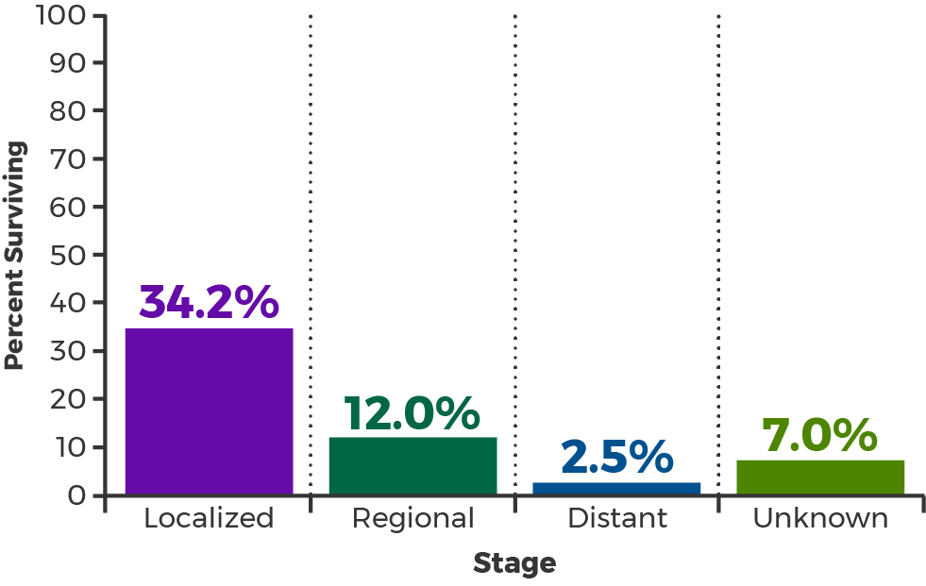
Survival in Liver Cancer
Liver and Intrahepatic Bile Duct Cancer: 5-year Relative Survival, United States⁵
60%-70% 5-year survival rate in patients diagnosed early enough for potentially curative treatment^{1,7}
EXS_003
Notes:
TIME: 2 min
Now that we have talked about the epidemiology, let’s examine the prognosis in people with liver cancer.
In the United States, the estimated 5-year survival is 19.6%. [NCI SEER (Liver) 2020, p 3A] However, survival rates are highly dependent on the stage at which the cancer is diagnosed.⁵ [NCI SEER (Liver) 2020, p 4A]
SAY: The breakdown of the 5-year survival by stage is⁵: [NCI SEER (Liver) 2020, p 4A]
34.2% if the cancer is still localized,
12.0% if it is considered regional disease,
2.5% if there are distant metastases, and
7.0% for those diagnosed when the stage is unknown.
It is important to note that the prognosis is far better (than what is shown in the graph for localized) when diagnosed early enough for potentially curative interventions, such as resection and liver transplantation.^{1,7} [Onaca 2009, p 574A] [Villanueva 2019, p 1457A]
CLICK and NOTE:
For patients with solitary tumors, good performance, and preserved liver function, resection is associated with 60% 5-year survival.¹ [Villanueva 2019, p 1457A]
For those at early stage who qualify for a liver transplant, the 5-year survival rate is closer to 70%.⁷ [Onaca 2009, p 574A]
SAY: So, catching it early is important. But when are people typically diagnosed in reality?
TRANSITION to the next slide.
[NCI SEER (Liver) 2020, p 4A]
[Onaca 2009, p 574A]
[Villanueva 2019, p 1457A]

Slide 9
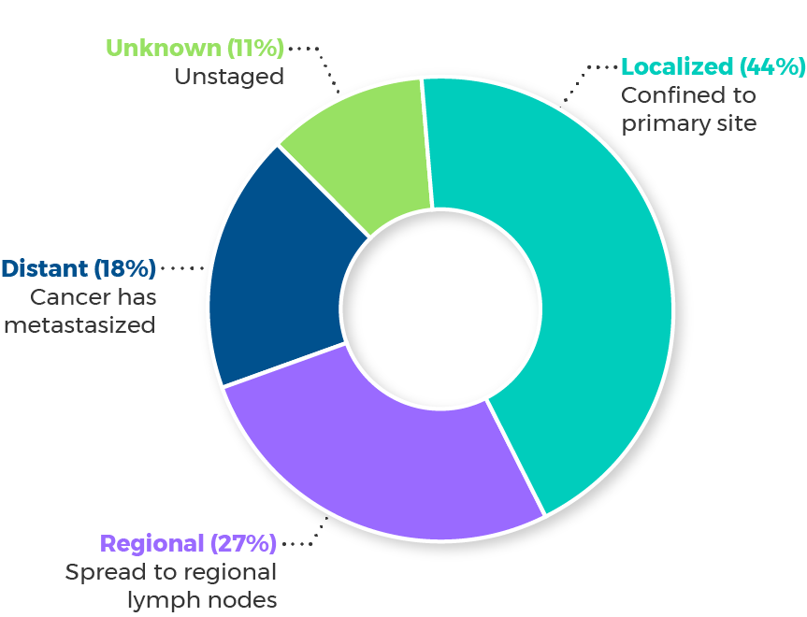
Survival in HCC
Liver and Intrahepatic Bile Duct Cancer: 5-year Relative Survival, United States⁵
Liver and Intrahepatic Bile Duct Cancer: Stage at Diagnosis, United States⁵
60%-70% 5-year survival rate in patients diagnosed early enough for potentially curative treatment^{1,7}
Notes:
TIME: 2 min (cont)
SAY: A large segment of the population is diagnosed with regional disease or distant metastases, when survival is poor.
Review the graphic.
[NCI SEER (Liver) 2020, p 4B]
TRANSITION to the next slide.
[NCI SEER (Liver) 2020, p 4A]
[Onaca 2009, p 574A]
[Villanueva 2019, p 1457A]
[NCI SEER (Liver) 2020, p 4B]

Slide 10
HCC Etiology

Slide 11
Understanding the Main Contributors of HCC
What are the main contributors that lead to cirrhosis and HCC or to non-cirrhotic HCC in the United States?
Notes:
TIME: 3–5 min
Cirrhosis is the most common precursor to HCC.⁹ [Schuppan: p6A]
But what are the main contributors leading to cirrhosis, or that cause HCC without causing cirrhosis?
Facilitator: There are 2 parts to this exercise.
First, ask the group to use the chat to suggest the main contributors (causes) of HCC. Once you have received input, click to reveal the top causes.
Second, prompt the group to place these causes in order of importance (which ones are known to be associated with the most cases?). Once you have received input, reveal the order according to a study covered in the module. Then, reveal the population attributable fraction.
Note: The participants should be able to approximate the order but should not be expected to know the attributable fraction.
Exercise: ASK: What are the main contributors in HCC?
Listen for ⁸: [Makarova-Rusher 2016, p 16A]
Hepatitis B virus
Hepatitis C virus
Metabolic disorders
Alcohol
Smoking
Genetic disorders
TRANSITION to the next slide.

Slide 12
Understanding the Main Contributors of HCC
What are the main contributors that lead to cirrhosis and HCC or to non-cirrhotic HCC in the United States?
Hepatitis B virus (HBV)⁸
Hepatitis C virus (HCV)⁸
Metabolic disorders⁸
Alcohol⁸
Smoking⁸
Genetic disorders⁸
Notes:
TIME: 3–5 min (cont)
Cirrhosis is the most common precursor to HCC.⁹ [Schuppan: p6A]
But what are the main contributors leading to cirrhosis, or that cause HCC without causing cirrhosis?
Facilitator: There are 2 parts to this exercise.
Part 1: Ask the group to use the chat to suggest the main contributors (causes) of cirrhosis that then lead to HCC or drivers that lead to non-cirrhotic HCC. Once you have received input, click to reveal the top causes.
Part 2: Prompt the group to place these causes in order of importance from greatest contribution to least (ie, which ones are known to be associated with the most cases?). Once you have received input, reveal the order.
Exercise: REVIEW the answers to part 1.
Other acceptable answers include NASH, fatty liver disease, NAFLD, and obesity—which are related to metabolic disorders—as well as CHC, CHB, and ALD.¹⁰ [Younossi 2019, p 748A]
ASK: In what order would you place these in terms of how much each contributes to HCC—from most to least significant?
Listen for ⁸:
Metabolic disorders
Hepatitis C virus (HCV)
Alcohol
Smoking
Hepatitis B virus (HBV)
Genetic disorders [Makarova-Rusher 2016, p 16A]
TRANSITION to the next slide.
[Makarova-Rusher 2016, p 16A]

Slide 13
Understanding the Main Contributors of HCC
What are the main contributors that lead to cirrhosis and HCC or to non-cirrhotic HCC in the United States?
Factor⁸
Metabolic disorders
Hepatitis C virus
Alcohol
Smoking
Hepatitis B virus
Genetic disorders
Total
Hepatitis B virus (HBV)⁸
Hepatitis C virus (HCV)⁸
Metabolic disorders⁸
Alcohol⁸
Smoking⁸
Genetic disorders⁸
Notes:
TIME: 3–5 min (cont)
Facilitator: There are 2 parts to this exercise.
Part 1: Ask the group to use the chat to suggest the main drivers (causes) of cirrhosis that then lead to HCC or drivers that lead to non-cirrhotic HCC. Once you have received input, click to reveal the top causes.
Part 2: Prompt the group to place these causes in order of importance (which ones are known to be associated with the most cases?). Once you have received input, reveal the order.
REVIEW the order in the table (Part 2 answers).
SAY: How much does each of these contribute (participants are not expected to know these numbers)?
[Makarova-Rusher 2016, p 16A]
TRANSITION to the next slide.
[Makarova-Rusher 2016, p 16A]

Slide 14
Understanding the Main Contributors of HCC
What are the main contributors that lead to cirrhosis and HCC or to non-cirrhotic HCC in the United States?
Factor⁸ | Attributable fraction, %⁸
Metabolic disorders | 32.0
Hepatitis C virus | 20.5
Alcohol | 13.4
Smoking | 9.0
Hepatitis B virus | 4.3
Genetic disorders | 1.5
Total | 59.5
Hepatitis B virus (HBV)⁸
Hepatitis C virus (HCV)⁸
Metabolic disorders⁸
Alcohol⁸
Smoking⁸
Genetic disorders⁸
Notes:
TIME: 3–5 min (cont)
NOTE:
One study looked at the population attributable fraction [Makarova-Rusher 2016, p 2A], defined as the reduction in a population’s disease burden that would occur if the risk factor were reduced to an alternative ideal exposure scenario (for example, no tobacco use).^{8,11} [WHO (for definition): p1A]
The study found metabolic disorders were responsible for the largest population attributable fraction of risk.⁸
[Makarova-Rusher 2016, p 16A]
TRANSITION to the next slide.
[Makarova-Rusher 2016, p 16A]

Slide 15
Understanding the Main Contributors of HCC
Prevalence of Liver Disease Etiologies
in Patients With HCC¹⁰
EXS_004
Notes:
TIME: 3 minutes
SAY: In the US, cirrhosis caused by viral hepatitis C conventionally has been considered the main contributor in HCC. However, recent data suggest that the patterns of HCC etiology are changing rapidly.¹⁰ [Younossi 2019, p 748A]
This line graph shows the trends for the prevalence of chronic hepatitis C in patients with HCC from 2002 to 2016.¹⁰ [Younossi 2019, p 748A,752A]
Although it is still the largest contributor, notice the recent downward trend.¹⁰ [Younossi 2019, p 748A,752A]
Now, let's look at chronic hepatitis B over that same period.
CLICK and NOTE: It is also trending downward.
What about alcohol?
CLICK and NOTE: Alcohol and chronic hepatitis C combined?
CLICK and NOTE: And finally, the prevalence of nonalcoholic steatohepatitis (NASH).
CLICK and NOTE: NASH has shown a nearly 12-fold increase in prevalence in patients with HCC from 2002 to 2016.
NASH now accounts for the second-most common underlying etiology of hepatocellular carcinoma, exceeded only by chronic hepatitis C.¹⁰
[Younossi 2019, p 748A,752A]
ASK: Why is this happening? In other words, what is behind this trend in NASH prevalence?
TRANSITION to the next slide.
[Younossi 2019, p 752A]

Slide 16
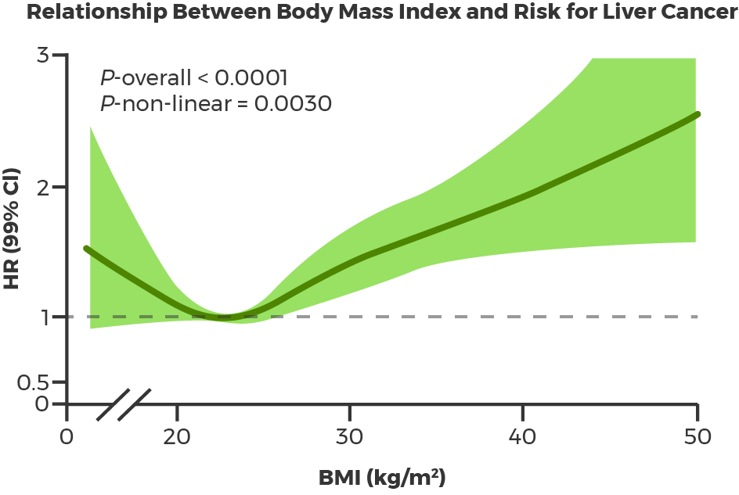
Understanding the Main Contributors of HCC
Prevalence of Liver Disease Etiologies
in Patients With HCC¹⁰
Relationship Between Body Mass Index and Risk for Liver Cancer¹²
Notes:
TIME: 3 min
SAY: To answer this question, it is helpful to consider the relationship between body mass index and the risk for liver cancer.
Nonalcoholic fatty liver disease (NAFLD) is a spectrum of chronic liver disease that ranges from simple steatosis—a condition that is defined as liver fat composing at least 5% of liver weight [Nassir 2015, p 167A] —to NASH, which is characterized by inflammation of the liver (hepatitis) and hepatocyte necrosis. [Anstee 2019, p 413B] NAFLD is primarily a complication of obesity.^{13,14} [Anstee 2019, p 411A]
The study shown here, which was conducted using data from 5.24 million adults in the United Kingdom, found that the risk for liver cancer increased by about 19% for each incremental increase in body mass index (BMI) of 5 kg/m².¹² [Bhaskaran 2014, p 755B, C]
TRANSITION to the next slide.
[Younossi 2019, p 752A]
[Bhaskaran 2014, p 759A]

Slide 17
Main HCC Contributors Exercise: Fill in the Blanks
HCV
accounts for more than 50% of HCC cases.¹⁵
There is a linear relationship between the amount of consumed and the risk for and HCC.¹⁶
NAFLD is strongly associated with the syndrome, which is a multifaceted syndrome consisting of the combination of obesity, , dyslipidemia, and hypertension.¹⁴
About of patients infected with HCV go on to develop a chronic infection, and will go on to develop cirrhosis.¹⁷
can be treated, and often cured, with direct-acting antiviral agents.¹⁸
alcohol
cirrhosis
metabolic
type 2 diabetes
75%–80%
10%–20%
HCV
Notes:
TIME: 5 min
Facilitator: For this exercise, participants are asked to help fill in the blanks to complete sentences regarding the main drivers in HCC. Select a participant from the participant list to fill in the blanks in the first sentence. Once the answers have been provided, reveal the answers for all the blanks in that statement at the same time. The participant answering may call on other participants to assist using the chat. Once the answers are revealed, the participant chooses a participant to fill in the blank(s) in the next statement.
SAY: For this exercise, I will select a participant at random to fill in the blanks in the first sentence. Once the answers are provided, I will reveal the correct answers, and that participant can select another participant to help me complete the next sentence. If you are selected, you may ask for help from the group. Other participants may then type their suggestions in the chat.
ANSWERS:
HCV¹⁵ [Smith 2012, p 2B]
Alcohol, cirrhosis¹⁶ [Matsushita 2019, p 2A]
Metabolic, type 2 diabetes¹⁴ [Anstee 2019, p 411B]
75%-85%, 10%-20%¹⁷ [CDC (HCV) 2020, p 2A]
HCV¹⁸ [Kanwal 2017, p 996A]
TRANSITION to the next slide.
[Smith 2012, p 2B]
[Matsushita 2019, p 2A]
[Anstee 2019, p 411B]
[CDC (HCV) 2020, p 2A]
[Kanwal 2017, p 996A]

Slide 18
Poll Questions
Notes:
Poll Questions (answers are bolded):
Question 1: What age group is associated with the highest incidence of liver and intrahepatic bile duct cancer?
35-44
35-44
45-54
55-64⁵ [NCI SEER (Liver) 2020, p 7B]
NOTE: The peak is observed in the Baby Boom generation, which may be due to the very high prevalence of HCV infection in this age group. The median age at diagnosis is 65 years.^{5,15} [Smith 2012, p 2A] [NCI SEER (Liver) 2020, p 7A,B]

Slide 19
Poll Questions
Notes:
Poll Questions (answers are bolded):
Question 2. Which of the following is true about NASH?
A. It is characterized by inflammation of the liver.¹⁴ [Anstee 2019, p 413B]
B. It is associated with metabolic syndrome.¹⁴ [Anstee 2019, p 411B]
C. It is associated with alcoholism.
D. A and B only
E. A, B & C
NOTE:
NASH is a type of nonalcoholic fatty liver disease, or NAFLD.¹⁴ [Anstee 2019, p 413B]
NASH is characterized by inflammation of the liver (hepatitis) and is associated with metabolic syndrome (eg, obesity).¹⁴ [Anstee 2019, p 411B,413B]
In the population of patients with the metabolic syndrome, the prevalence of NAFLD is more than three-fold higher than for those without metabolic syndrome, and data suggest that the likelihood of NASH increases with the number of metabolic risk factors an individual exhibits.¹⁴ [Anstee 2019, p 411B]

Slide 20
Disease Pathogenesis

Slide 21
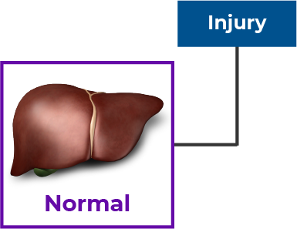
Pathogenesis of HCC¹⁹
EXS_005
Notes:
TIME: 4–5 min
Facilitator: Time permitting, ask participants to suggest what happens next in the pathogenesis of HCC. Participants may use the chat to offer their answers.
SAY: First, injury to the liver occurs as a result of metabolic diseases, hepatitis B or C infections, excess alcohol, etc.¹⁹ [Weiskirchen 2016, p 95A]
ASK: What is the next step?
Listen for:
Inflammation of the liver, or hepatitis¹⁹
[Weiskirchen 2016, p 95A]
TRANSITION to the next slide.
[Weiskirchen 2016, p 95A]

Slide 22
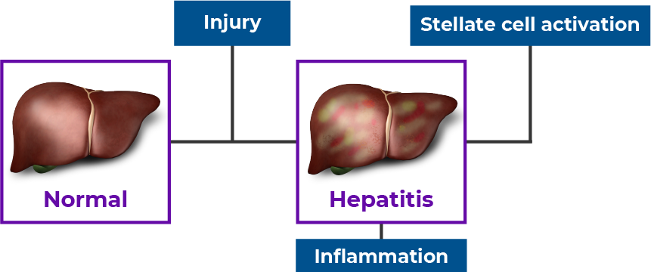
Pathogenesis of HCC¹⁹
EXS_005
Notes:
TIME: 4–5 min (cont)
NOTE: inflammation of the liver, or hepatitis.¹⁹ [Weiskirchen 2016, p 95A]
SAY:
Following this stage, hepatic stellate cells are activated and differentiate into myofibroblasts (a cell type that forms connective tissue).¹⁹ [Weiskirchen 2016, p 95A]
ASK: what happens next?
Listen for:
Fibrosis, scarring, and the development of dysplastic nodules¹⁹ [Weiskirchen 2016, p 95A]
TRANSITION to the next slide.
[Weiskirchen 2016, p 95A]

Slide 23
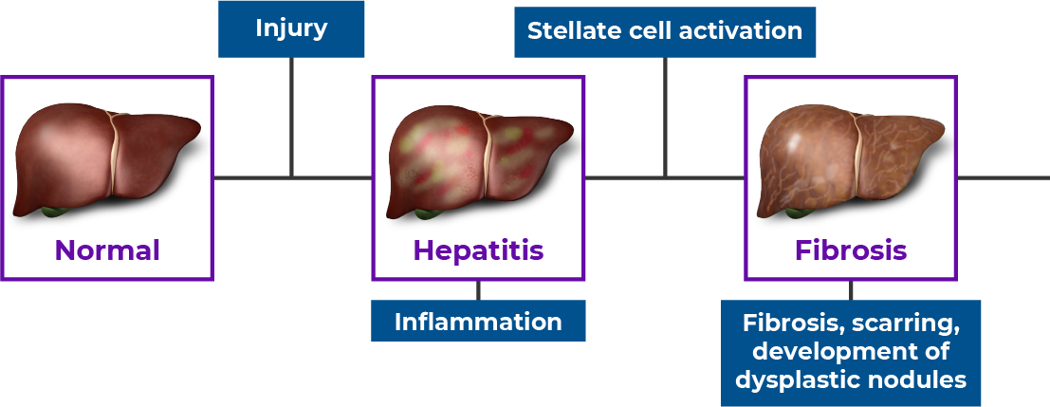
Pathogenesis of HCC¹⁹
EXS_005
Notes:
TIME: 4–5 min (cont)
SAY:
Fibrosis, scarring, and the development of dysplastic nodules¹⁹ [Weiskirchen 2016, p 95A]
Fibrosis is the repair and replacement of inflamed tissues or organs by connective tissues. This process results in the replacement of normal cells by fibroblasts, and eventually, the replacement of normal tissue by scar tissue.²⁰ [Tabers p2A]
ASK: What can occur next?
Listen for:
Cirrhosis¹⁹ [Weiskirchen 2016, p 95A]
Regression of fibrosis¹⁹ [Weiskirchen 2016, p 95A]
TRANSITION to the next slide.
[Weiskirchen 2016, p 95A]

Slide 24
Pathogenesis of HCC¹⁹
EXS_005
Notes:
TIME: 4–5 min (cont)
SAY:
Cirrhosis or regression of fibrosis¹⁹ [Weiskirchen 2016, p 95A]
Cirrhosis is a chronic disease characterized by scarring with the loss of functioning liver cells, areas of ineffective regeneration, and increased resistance of blood flow through the liver (called portal hypertension).²⁰ [Tabers p1A]
This may then lead to HCC, or in the case of regression, the return of tissue to a normal, healthy state.¹⁹ [Weiskirchen 2016, p 95A]
HCC can occur in the absence of cirrhosis. (This is called fibrolamellar carcinoma and occurs in an estimated 1%–9% of cases.)²¹ [Desai 2019, p 2A]
TRANSITION to the next slide.
[Weiskirchen 2016, p 95A]

Slide 25
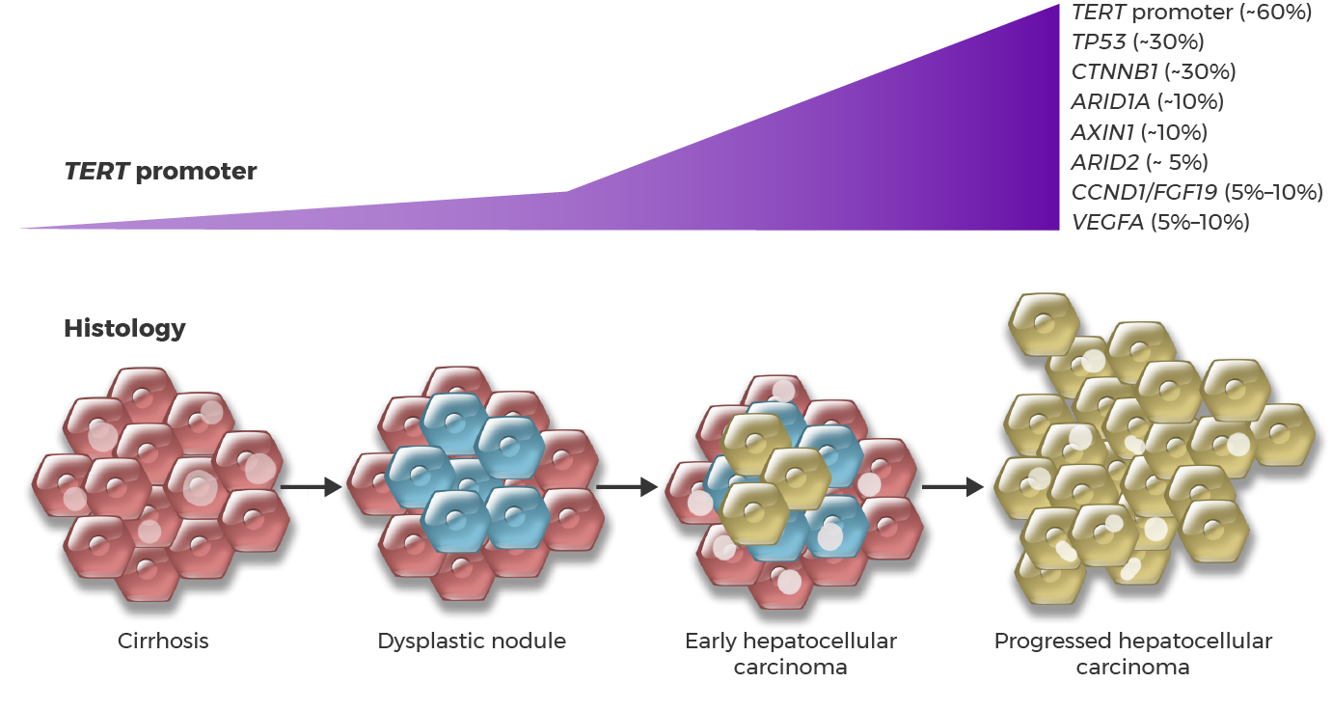
Genetic Drivers
The Progression to Hepatocellular Carcinoma Is Marked by Accumulation of Mutations¹
EXS_006
Notes:
TIME: 2 minutes
There are also genetic drivers in HCC.
HCC is characterized by the abundant presence of DNA alterations, including mutations and chromosomal aberrations.¹ [Villanueva 2019, p 1450C]
The most common genetic alterations are mutations in a region of DNA known as a promoter that controls expression of the gene TERT. Such alterations occur in about 60% of hepatocellular carcinomas.¹ [Villanueva 2019, p 1450C]
As the disease progresses from cirrhosis to a dysplastic nodule and finally to hepatocellular carcinoma, additional mutations accumulate, including in genes that affect the cell cycle (TP53, which is seen in 30% of cases), signaling (particularly in the CTNNB1 and AXIN1 genes, which is seen in 30% and 10% of cases, respectively), and in genes involved in chromatin remodeling (such as ARID1A and ARID2, seen in 10% and 5% of cases, respectively). [Villanueva 2019, p 1452A,B] In addition to these mutations, in some cases amplifications of genes such as vascular endothelial growth factor (VEGF) and CCND1/FGF19 are seen.¹ [Villanueva 2019, p 1452A,B]
[Villanueva 2019, p 1452B]

Slide 26
Pathogenesis of NAFLD-related HCC¹⁴
Answer Bank
NASH Advanced fibrosis and cirrhosis Mild fibrosis Steatosis and lobular inflammation
EXS_007
Notes:
TIME: 4–5 min
SAY: How does the development of HCC differ in the presence of fatty liver disease?
The pathogenesis of NAFLD-associated hepatocellular carcinoma is shown in the figure.
NAFLD is initiated by a number of diet-related risk factors, most prominently dyslipidemia and high-fructose and/or -glucose diets, as well as a sedentary lifestyle.¹⁴ [Anstee 2019, p 415A, B]
Patients with NAFLD commonly consume low-nutrient, high-sodium, meat-derived, fatty foods and lower amounts of fruit. These changes result in the accumulation of fat in the liver (steatosis).¹⁴ [Anstee 2019, p 415A, B]
Facilitator: This is a labeling exercise. The graphic shows the first step (Steatosis) and the final stage (HCC). Choose 2 or 3 participants to unmute their phones and discuss and come up with the correct order of the steps with omitted labels. If they are correct, reveal the answers. If they are not correct, choose another group of 2 or 3 participants to try to provide the correct answers.
Labeling exercise. What stages are next?
Listen for:
Steatosis and lobular inflammation
NASH
Mild fibrosis
Advanced fibrosis and cirrhosis [Anstee 2019, p 415A]
TRANSITION to the next slide.
[Anstee 2019, p 415A]

Slide 27
Pathogenesis of NAFLD-related HCC¹⁴
Answer Bank
EXS_007
Notes:
TIME: 4–5 min (cont)
SAY: Here is the correct order after steatosis.
Answers¹⁴: [Anstee 2019, p 415A]
Steatosis and lobular inflammation
NASH
Mild fibrosis
Advanced fibrosis and cirrhosis
REVIEW:
Accumulation of lipids in hepatocytes leads to metabolic reprogramming, which is characterized by changes in cellular metabolism, accumulation of potentially toxic metabolites, and the chronic inflammatory state seen in NASH.¹⁴ [Anstee 2019, p 415C]
From here, the pathway to hepatocellular carcinoma is the same as what we discussed in non-NAFLD–related disease (fibrosis, cirrhosis, HCC).¹⁴ [Anstee 2019, p 415A]
The resulting stress and damage to hepatocytes results in upregulation of inflammatory pathways and fibrosis (scarring of the liver), leading to advanced fibrosis and overt cirrhosis.¹⁴ [Anstee 2019, p 415A]
Accumulation of mutations throughout the process ultimately leads to the development and initiation of hepatocellular carcinoma.¹⁴ [Anstee 2019, p 417A]
Some patients with NASH who develop HCC do not have cirrhosis. [Cholankeril 2017, p 533A] In one study, 6 of 8 patients with NASH-related HCC did not demonstrate cirrhosis.²² [Cholankeril 2017, p 535A, p 536B]
TRANSITION to the next slide.
[Anstee 2019, p 415A]

Slide 28
Diagnosis and Staging

Slide 29
Signs and Symptoms in HCC
Cirrhosis⁹
Jaundice Spider angiomas Ascites Caput medusae Palmar erythema White nails Nodular liver, with an irregular, hard surface on palpation Finger clubbing Tremors Anorexia, fatigue, weight loss, and muscle wasting Type 2 diabetes
Notes:
TIME: 3 min
SAY:
Cirrhosis is often asymptomatic, especially prior to the patient having any complications. [Schuppan 2008, p 2A] But there are several signs and symptoms that may be present.⁹ [Schuppan 2008, p 21A]
REVIEW: Signs and Symptoms of Cirrhosis⁹: [Schuppan 2008, p 21A, B]
Jaundice: yellowing of the skin and whites of the eyes
Spider angiomas: arterioles with tiny radiating vessels, usually on the trunk and face
Ascites: accumulation of fluid in the abdomen
Caput medusae: prominent veins radiating from the umbilicus
Palmar erythema: redness spreading from the central portion of the palm
White nails: horizontal white bands and or a proximal white nail plate
Nodular liver with an irregular, hard surface on palpation
Finger clubbing
Tremors
Anorexia, fatigue, weight loss, and muscle wasting
Type 2 diabetes
NOTE: In asymptomatic patients, diagnosis may be made when blood tests, conducted for other reasons, reveal elevations in liver enzymes and/or when radiologic findings suggest liver disease.⁹ [Schuppan 2008, p 2A]
TRANSITION to the next slide.
[Schuppan 2008, p 21A, B]

Slide 30
Signs and Symptoms in HCC
Cirrhosis⁹
Jaundice Spider angiomas Ascites Caput medusae Palmar erythema White nails Nodular liver, with an irregular, hard surface on palpation Finger clubbing Tremors Anorexia, fatigue, weight loss, and muscle wasting Type 2 diabetes
HCC²³
Jaundice Ascites Firm mass on the right side Discomfort in the upper abdomen/right side Pain near the right shoulder blade/ in the back Easy bruising/bleeding Unusual fatigue Nausea/vomiting Loss of appetite/early satiety Unexplained weight loss Pale, chalky bowel movements/ dark urine Fever
Notes:
TIME: 3 min (cont)
REVIEW: Signs and Symptoms of HCC
SAY: People with HCC are generally asymptomatic in the early stages of the disease. When signs and symptoms do occur, they include²³: [NCI (Patient PDQ) 2020, p 3A, p 4A]
Jaundice
Ascites
A firm mass on the right side, just below the rib cage
Discomfort in the upper abdomen on the right side
Pain near the right shoulder blade or in the back
Easy bruising or bleeding
Unusual fatigue
Nausea and vomiting
Loss of appetite or early satiety
Unexplained weight loss
Pale, chalky bowel movements and dark urine
Fever
SAY: The complexities in treating HCC and poor prognosis are related to the fact that in many patients, there are really 2 diseases to consider- the cancer itself and the underlying liver disease (cirrhosis).
TRANSITION to the next slide.
[Schuppan 2008, p 21A, B]
[NCI (Patient PDQ) 2020, p 3A, p 4A]

Slide 31
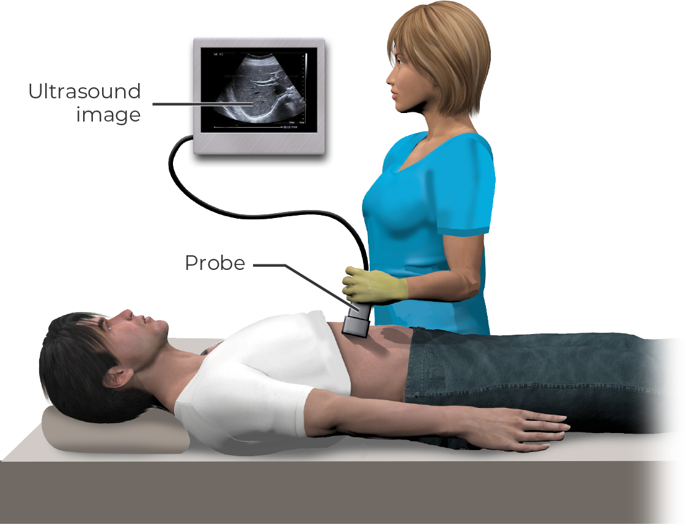
Surveillance in HCC
Surveillance
Routine surveillance is recommended in higher-risk groups²⁴ Guidelines recommend abdominal ultrasound at 6-month intervals²⁴ Test for AFP²⁴ Imaging (eg, CT or MRI) is used to diagnose patients with suspect lesions on ultrasound (>1 cm)¹ Physicians look for patterns in lesion blood supply¹
EXS_008
Notes:
TIME: 3 min (cont)
REVIEW: Surveillance
Module 2 focuses on surveillance in HCC. For now, it is important to know that current American Association for the Study of Liver Diseases (AASLD) guidelines recommend routine surveillance in certain high-risk patient populations.²⁴ [Marrero (AASLD Guidelines) 2018, p 728A]
Recommendations:
Abdominal ultrasound at 6-month intervals either with or without a biochemical test for the marker alpha fetoprotein (AFP).²⁴ [Marrero (AASLD Guidelines) 2018, p 728A]
Among patients with suspect lesions on ultrasound, the diagnosis of hepatocellular carcinoma is established with the use of imaging techniques, such as computed tomography (CT) or magnetic resonance imaging (MRI).¹ [Villanueva 2019, p 1454A]
SAY: What are physicians looking for on MRI or CT?
Benign lesions (such as dysplastic nodules) are supplied with blood from branches of the portal system; whereas, malignant nodules are supplied with blood from the hepatic artery.¹ [Villanueva 2019, p 1454A]
This results in distinct patterns that can help distinguish HCC from benign lesions on imaging.¹ [Villanueva 2019, p 1454A]
TRANSITION to the next slide.
[Marrero (AASLD Guidelines) 2018, p 728A]
[Villanueva 2019, p 1454A]

Slide 32
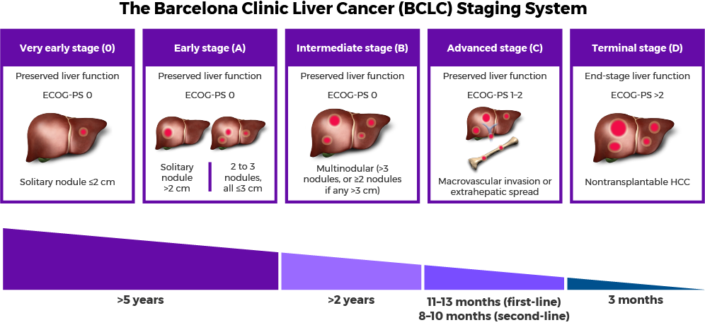
Diagnostic/Prognostic Classification Systems
The Barcelona Clinic Liver Cancer (BCLC) Staging System¹
ECOG Performance Status²⁵
Grade | Description
0 | Fully active, able to carry on all pre-disease performance without restriction
1 | Restricted in physically strenuous activity but ambulatory and able to carry out work of a light or sedentary nature (such as light housework, office work)
2 | Ambulatory and capable of all self-care but unable to carry out any work activities; up and about more than 50% of waking hours
3 | Capable of only limited self-care; confined to bed or chair more than 50% of waking hours
4 | Completely disabled; cannot carry on any self-care; totally confined to bed or chair
5 | Dead
EXS_009
Relative length of survival.
Notes:
TIME: 6–7 min
SAY: Let’s discuss important diagnostic and prognostic classification systems used in HCC.
The TNM—or tumor, node, and metastasis—system of staging is widely used system in oncology (TNM is not shown here). In HCC, TNM is not as useful as the Barcelona Clinic Liver Cancer (BCLC) staging system, which is a 5-stage system that takes into account²⁶: [Forner 2018, p 1305A]
The size and number of nodules,
Liver function, and
The Eastern Cooperative Oncology Group, or ECOG performance status.
ECOG scoring goes from 0 (fully active, able to carry on pre-disease performance without restriction) to 5 (dead).²⁵ [ECOG 2020, p 1A]
REVIEW the table.
ASK: What are the 2 most often used standards for understanding liver function?
Listen for:
Child-Pugh²⁷ [Tsoris 2019, p 1A,1B]
MELD²⁸ [NCCN 2020, p 61A,61B]
TRANSITION to the next slide.
[Villanueva 2019, p 1456A]
[ECOG 2020, p 1A]

Slide 33
Diagnostic/Prognostic Classification Systems
The Barcelona Clinic Liver Cancer (BCLC) Staging System¹
ECOG Performance Status²⁵
Grade | Description
0 | Fully active, able to carry on all pre-disease performance without restriction
1 | Restricted in physically strenuous activity but ambulatory and able to carry out work of a light or sedentary nature (such as light housework, office work)
2 | Ambulatory and capable of all self-care but unable to carry out any work activities; up and about more than 50% of waking hours
3 | Capable of only limited self-care; confined to bed or chair more than 50% of waking hours
4 | Completely disabled; cannot carry on any self-care; totally confined to bed or chair
5 | Dead
Relative length of survival.
Child-Pugh Score (A, B, or C)²⁷
Good hepatic function
Moderately impaired hepatic function
Advanced hepatic dysfunction
MELD Score (6–40)²⁸
Serum bilirubin
Creatinine
INR
Notes:
TIME: 6–7 min (cont)
REVIEW: The Child-Pugh score is widely used and focuses on the degree of cirrhosis in the liver. [Tsoris 2019, p 1A]
Scoring is A, B, or C.²⁷
Child-Pugh A denotes good hepatic function.
Child-Pugh B indicates moderately impaired hepatic function.
Child-Pugh C indicates advanced hepatic dysfunction.
MELD SCORE²⁸
The Model of End-Stage Liver Disease (MELD) score is sometimes used in place of the Child-Pugh score to assess prognosis in patients with cirrhosis. [NCCN 2020, p 61A,61B]
MELD uses a numerical scale ranging from 6 (less ill) to 40 (gravely ill) for individuals aged 12 years or older. It is derived from 3 laboratory values: [NCCN 2020, p 61B]
Serum bilirubin
Creatinine (a measure of renal function)
International normalized ratio, or INR (a measure of the blood’s ability to clot)
Advantages of the MELD score include the inclusion of a measurement of renal function and an objective scoring system based on widely available laboratory tests, although clinical assessments of ascites and encephalopathy are not included. It is not currently clear if the MELD score is superior to the Child-Pugh score as a predictor of survival in patients with cirrhosis.²⁸ [NCCN 2020, p 61A]
ASK: When are the Milan criteria used?
Listen for: In liver transplantation²⁹ [Lee 2017, p 79A]
TRANSITION to the next slide.
[NCCN 2020, p 61B]
[Villanueva 2019, p 1456A]
[ECOG 2020, p 1A]
[Tsoris 2019, p 1A]

Slide 34
Diagnostic/Prognostic Classification Systems
The Barcelona Clinic Liver Cancer (BCLC) Staging System¹
ECOG Performance Status²⁵
Grade | Description
0 | Fully active, able to carry on all pre-disease performance without restriction
1 | Restricted in physically strenuous activity but ambulatory and able to carry out work of a light or sedentary nature (such as light housework, office work)
2 | Ambulatory and capable of all self-care but unable to carry out any work activities; up and about more than 50% of waking hours
3 | Capable of only limited self-care; confined to bed or chair more than 50% of waking hours
4 | Completely disabled; cannot carry on any self-care; totally confined to bed or chair
5 | Dead
Relative length of survival.
Child-Pugh Score (A, B, or C)²⁷
Good hepatic function
Moderately impaired hepatic function
Advanced hepatic dysfunction
Milan Criteria (Transplantation)²⁹
Single tumor diameters <5 cm
No more than 3 tumor foci, each ≤3 cm
No invasion of local blood vessels
No extrahepatic involvement
MELD Score (6–40)²⁸
Serum bilirubin
Creatinine
INR
Notes:
TIME: 6–7 min (cont)
SAY:
The Milan criteria are used to help determine candidacy for liver transplantation.²⁹ [Lee 2017, p 79A]
Patients are selected for transplantation based on the Milan criteria, which restrict transplantation to²⁹: [Lee 2017, p 79A]
Single tumor diameters <5 cm,
No more than 3 tumor foci, each one not exceeding 3 cm,
No invasion of local blood vessels (angioinvasion), and
No extrahepatic involvement.
TRANSITION to the next slide.
[NCCN 2020, p 61B]
[Tsoris 2019, p 1A]
[Lee 2017, p 79A]

Slide 35
Treatment

Slide 36
The Barcelona Clinic Liver Cancer (BCLC) Staging System¹
EXS_010
Notes:
TIME: 5 min
SAY: The treatment options include many treatment modalities and depend on a host of factors. This figure captures the options as they pertain to BCLC stage, liver function, ECOG performance status, and tumor burden.¹ [Villanueva 2019, p 1456A]
Let’s look at early stage HCC.
REVIEW the figure.
NOTE:
These early stages are associated with relatively low tumor burden. At this point, interventions are potentially curative.
Decisions largely depend on whether there is a solitary nodule or multiple nodules, and the size of the nodules.^{1,29} [Villanueva 2019, p 1457A] [Lee 2017, p 79A]
In solitary nodules, both ablation (which involves local techniques that destroy the tumors without removing them) and resection (surgical removal of the tumor and affected area of the liver) are options.^{1,30} [Villanueva 2019, p 1457A] [ACS (Ablation) 2020, p 1A]
Resection is associated with a 5-year survival of about 60% at this stage, but a recurrence rate of about 70% within 5 years.¹ [Villanueva 2019, p 1457A]
For multiple small nodules (early stage), ablation and liver transplantation are options.^{29,30} [Lee 2017, p 79A] [ACS 2020, p 1A]
Transplantation is generally used in those who are not candidates for resection and is associated with a 60% to 80% 5-year survival rate.¹ [Villanueva 2019, p 1457D, E, F]
Ablation at this stage is used when transplantation and resection are not options.³⁰ [ACS (Ablation) 2020, p 1A]
TRANSITION to the next slide.
[Villanueva 2019, p 1456A]

Slide 37
The Barcelona Clinic Liver Cancer (BCLC) Staging System¹
EXS_010
Notes:
TIME: 5 min
REVIEW the figure.
NOTE:
In patients with good performance status and liver function and larger tumors, chemoembolization may be appropriate. [ACS (Embolization) 2020, p 1A] Transarterial chemoembolization, or TACE, is a type of chemoembolization that involves cytotoxic therapy (chemotherapy) to kill the cancer cells and embolization of the vessels to block the blood supply to the tumor.^{1,31} [Villanueva 2019, p 1457C; ACS (Embolization) 2020, p 1A]
TRANSITION to the next slide.
[Villanueva 2019, p 1456A]

Slide 38
The Barcelona Clinic Liver Cancer (BCLC) Staging System¹
EXS_010
Notes:
TIME: 5 min
NOTE:
Systemic therapy is generally used in advanced-stage HCC. Sorafenib has been the standard of care for several years.¹ [Villanueva 2019, p 1458D, E]
First-line and second-line therapies are listed here.¹ [Villanueva 2019, p 1458F,1458G,1458H,1459A]
More recently, the FDA approved an immunotherapy combination in patients who progress on sorafenib, which is ipilimumab and nivolumab.³² [FDA_Nivo ipi approval: p1A]
TRANSITION to the next slide.
[Villanueva 2019, p 1456A]

Slide 39
The Barcelona Clinic Liver Cancer (BCLC) Staging System¹
EXS_010
Notes:
TIME: 5 min
In patients whose liver function is compromised and performance status is poor, best supportive care may be the most appropriate option.¹ [Villanueva 2019, p 1456A]
TRANSITION to the next slide.
[Villanueva 2019, p 1456A]

Slide 40
The Barcelona Clinic Liver Cancer (BCLC) Staging System¹
EXS_010
Notes:
TIME: 5 min
SAY: Below the graphic, you can see that estimated survival decreases substantially with each stage of progression.¹ [Villanueva 2019, p 1456A]
TRANSITION to the next slide.
[Villanueva 2019, p 1456A]

Slide 41
Exercise: HCC Treatments
Resection
Transplantation
Ablation
Transarterial Therapies
Systemic Therapies
Involves removal of part of the liver
Based on Milan criteria
Uses radio waves to “burn” the tumor
Block the blood supply to the tumor(s)
Used in patients with advanced disease
Associated with 60%-80% 5-year, 50% 10-year survival rates
Used only in patients with small, solitary tumors, ECOG PS 0, preserved liver function
Destroys tumors without removing them
TACE
Sorafenib and lenvatinib
Can be used in patients with larger tumors
Used in patients who have progressed on transarterial therapies
Used in patients with no disease outside the liver (extrahepatic) who are not candidates for resection
Used in patients with 1–3 small tumors (<3 cm), poor performance status, reduced liver function
Used in conjunction with ablation
Associated with a 60% 5-year survival rate
Associated with a 70% 5-year recurrence rate
“Cures” underlying liver disease
Notes:
TIME: 10–15 min
Facilitator: Ask the participants to unmute their phones. For this exercise, you will read a “clue” that belongs in one of the categories in the table. Select a participant to suggest which category each clue belongs to. Once the participant answers, click to reveal the correct placement of the clue. The participant who answered can choose a participant to go next. Continue until all the clues have been placed in the appropriate columns.
SAY:
I will read a clue and choose someone to tell me which column it should be placed in.
Once that participant has answered and I have revealed the correct placement of the clue, he/she selects another participant to go next.
CLUES:
Uses radio waves to “burn” the tumor [answer: ablation]¹ [Villanueva 2019, p 1457B]
Based on Milan criteria [answer: transplantation]²⁹ [Lee 2017, p 79A]
Blocks the blood supply to the tumor(s) [answer: transarterial]¹ [Villanueva 2019, p 1457C] [ACS (Embolization) 2020, p 1A,1B]
Involves removal of part of the liver [answer: resection]¹ [Villanueva 2019, p 1457A]
Used in patients with advanced disease [answer: systemic]¹ [Villanueva 2019, p 1458D, E]
TACE [answer: transarterial]^{1,31} [Villanueva 2019, p 1457C] [ACS (Embolization) 2020, p 1A,1B]
Used only in patients with small, solitary tumors, ECOG PS 0, preserved liver function [answer: resection]¹ [Villanueva 2019, p 1456A/1457A]
Associated with 60%–80% 5-year and 50% 10-year survival rates [answer: transplantation in patients who meet Milan criteria]¹ [Villanueva 2019, p 1457E, F]
Associated with a 60% 5-year survival rate [answer: resection]¹ [Villanueva 2019, p 1457A]
Can be used in patients with larger tumors [answer: transarterial]^{1,31} [Villanueva 2019, p 1457C] [ACS (Embolization) 2020, p 1A,B]
Destroys tumors without removing them [answer: ablation]³⁰ [ACS (Ablation) 2020, p 1A]
Sorafenib and lenvatinib [answer: systemic]¹ [Villanueva 2019, p 1458E, G]
Used in patients with 1–3 small tumors (<3 cm), poor performance status, reduced liver function [answer: ablation]^{1,31}[ACS (Ablation) 2020, p 1A] [Villanueva 2019, p 1456A,1457B]
Associated with a 70% 5-year recurrence rate [answer: resection]¹ [Villanueva 2019, p 1457A]
Used in patients who have progressed on transarterial therapies [answer: systemic]¹ [Villanueva 2019, p 1458D, E]
Used in patients with no disease outside the liver (extrahepatic) who are not candidates for resection [answer: transplantation]²⁹ [Lee 2017, p 79A]
Used in conjunction with ablation [answer: transarterial]¹ [Villanueva 2019, p 1457C] [ACS (Embolization) 2020, p 1A,1B]
“Cures” underlying liver disease [answer: transplantation]²⁹ [Lee 2017, p 79A]
[Villanueva 2019, p 1457E, F]
[Lee 2017, p 79A]
[Villanueva 2019, p 1457B]
[ACS 2020, p 1A]
[Villanueva 2019, p 1456A, 1457B] [ACS 2020, p 1A]
[Villanueva 2019, p 1457C] [ACS (Embolization) 2020, p 1A,1B]
[Villanueva 2019, p 1458D, E, G]
[Villanueva 2019, p 1456 A/1457A]

Slide 42
Summary
Although not as common as some other cancers, HCC is a leading cause of cancer-related mortality in the US.⁶
Survival rates are low and are highly dependent on the stage at which the cancer is diagnosed. However, a large segment of the population is diagnosed with regional disease or distant metastases, when survival is poor.⁵
The main drivers for HCC include cirrhosis, metabolic disorders/NASH, chronic hepatitis B, chronic hepatitis C, and alcoholic liver disease. In addition, there are important genetic drivers.^{1,8,10}
Diagnostic/prognostic classification systems include BCLC (staging), Milan criteria (transplantation), and Child-Pugh and MELD (liver function).²⁶⁻²⁹
There are many treatment modalities and the choice largely depends on the BCLC stage, liver function, ECOG performance status, and tumor burden.¹
Notes:
TIME: 1 min
REVIEW bullets.
TRANSITION to the next slide.
[American Cancer Society 2020, p 10A]
[NCI SEER (Liver) 2020, p 4A]
[NCI SEER (Liver) 2020, p 4B]
[Younossi 2019, p 748A] [Makarova-Rusher 2016, p 16A]
[Villanueva 2019, p 1450C,1452A,B]
[Forner 2018, p 1305A],
[Lee 2017, p 79A,B],
[Tsoris 2019, p 1A]
[NCCN 2020, p 61B]
[Villanueva 2019, p 1456A]

Slide 43
Questions?

Slide 44
References
Villanueva A. Hepatocellular carcinoma. N Engl J Med. 2019;380:1450-1462.
Bray F, Ferlay J, Soerjomataram I, et al. Global cancer statistics 2018: GLOBOCAN estimates of incidence and mortality worldwide for 36 cancers in 185 countries. CA Cancer J Clin. 2018;0:1-31.
Johns Hopkins Medicine. Liver: Anatomy and Functions. https://www.hopkinsmedicine.org/health/conditions-and-diseases/liver-anatomy-and-functions. Accessed January 26, 2020
World Health Organization. Globocan 2018: Liver. https://gco.iarc.fr/today/data/factsheets/cancers/11-Liver-fact-sheet.pdf. Accessed January 26, 2020.
National Cancer Institute. Cancer of the Liver and Intrahepatic Bile Duct (Invasive) 1975-2015. https://seer.cancer.gov/archive/csr/1975_2015/results_merged/sect_14_liver_bile.pdf. Accessed January 27, 2020.
American Cancer Society. Cancer Facts and Figures 2020. https://www.cancer.org/research/cancer-facts-statistics/all-cancer-facts-figures/cancer-facts-figures-2020.html. Accessed March 9, 2020.
Onaca N, Davis GL, Jennings JW, et al. Improved results of transplantation for hepatocellular carcinoma: a report from the international registry of hepatic tumors in liver transplantation. Liver Transpl. 2009;15:574-580.
Makarova-Rusher OV, Altekruse SF, McNeel TS, et al. Population attributable fractions of risk factors for hepatocellular carcinoma in the United States. Cancer. 2016;122:1757-1765.
Schuppan D, Afdhal NH. Liver Cirrhosis. Lancet. 2008;371(9615):838–851.
Younossi Z, Stepanova M, Ong JP et al. Nonalcoholic steatohepatitis is the fastest growing cause of hepatocellular carcinoma in liver transplant candidates. Clin Gastroenterol Hepatol. 2019;17:748-755.
World Health Organization. Metrics: Population Attributable Fraction (PAF). https://www.who.int/healthinfo/global_burden_disease/metrics_paf/en/. Accessed July 2, 2020.
Bhaskaran K, Douglas I, Forbes H et al. Body-mass index and risk of 22 specific cancers: a population-based cohort study of 5.24 million adults. Lancet. 2014;384:755-765.

Slide 45
References
Nassir F, Rector RS, Hammoud GM. Pathogenesis and prevention of hepatic steatosis. Gastroenterol Hepatol. 2015;11:167-176.
Anstee QM, Reeves HL, Kotsiliti E, et al. Nat Rev Gastroenterol Hepatol. 2019;16:411-430.
Smith BD, Morgan RL, Beckett GA et al. Hepatitis C virus testing of persons born during 1945 to 1965: Recommendations from the Centers for Disease Control and Prevention. Ann Intern Med. 2012;157:817-822.
Matsushita H, Takaki A. Alcohol and hepatocellular carcinoma. BMJ Open Gastroenterol. 2019;6:e000260.
Centers for Disease Control and Prevention. Viral Hepatitis. https://www.cdc.gov/hepatitis/hcv/hcvfaq.htm#section1. Accessed January 26, 2020.
Kanwal F, Kramer J, Asch SM et al. Risk of hepatocellular carcinoma in HCV patients treated with direct-acting antiviral agents. Gastroenterology. 2017;153:996-1005.
Weiskirchen R, Tacke F. Liver fibrosis: which mechanisms matter? Clin Liv Dis. 2016;8:94-100.
Taber’s Online Cyclopedic Medical Dictionary. 22nd ed. https://www.tabers.com/tabersonline/pview/Tabers-Dictionary. Accessed April 17, 2020
Desai A, Sandhu S, Lai J-P, et al. Hepatocellular carcinoma in non-cirrhotic liver: a comprehensive review. World J Hepatol. 2019;11:1-18.
Cholankeril G, Patel R, Khurana S, et al. Hepatocellular carcinoma in non-alcoholic steatohepatitis: current knowledge and implications for management. World J Hepatol. 2017;9:533-543.
National Cancer Institute. Adult Primary Liver Cancer Treatment (PDQ®) – Patient Version. https://www.cancer.gov/types/liver/patient/adult-liver-treatment-pdq. Accessed January 27, 2020.
Marrero JA, Kulik LM, Sirlin CB, et al. Diagnosis, Staging, and Management of Hepatocellular Carcinoma: 2018 Practice Guidance by the American Association for the Study of Liver Diseases. Hepatology. 2018;68:723-750
ECOG-ACRIN Cancer Research Group. ECOG Performance Status. https://ecog-acrin.org/resources/ecog-performance-status. Accessed January 27, 2020.
Forner A, Reig M, Bruix J. Hepatocellular carcinoma. Lancet. 2018;391:1301-1314.

Slide 46
References
Tsoris A, Marlar CA. Use of the Child Pugh score in liver disease. StatPearls. https://www.ncbi.nlm.nih.gov/books/NBK542308/. Accessed January 27, 2020.
National Comprehensive Cancer Institute. Hepatobiliary Cancers. Version 1.2020. nccn.org. Accessed April 27, 2020.
Lee K, Lee K-B, Yi N-M, et al. Prognosis of hepatocellular carcinoma after liver transplantation: Comparative analysis with partial hepatectomy. J Pathol Transl Med. 2017;51:79-96.
American Cancer Society. Ablation for liver cancer. https://www.cancer.org/cancer/liver-cancer/treating/tumor-ablation.html. Accessed January 30, 2020
American Cancer Society. Embolization therapy for liver cancer. https://www.cancer.org/cancer/liver-cancer/treating/embolization-therapy.html. Accessed January 30, 2020.
U.S. Food and Drug Administration. Drug Approvals and Databases-Approved Drugs. https://www.fda.gov/drugs/resources-information-approved-drugs/fda-grants-accelerated-approval-nivolumab-and-ipilimumab-combination-hepatocellular-carcinoma Accessed July 13, 2020

Slide 47
ENDING THANK YOU

