Slide 1
Intra-Abdominal Pressure/Surgical Conditions and Neuromuscular Blockade in Laparoscopic Procedures

Slide 2
Table of Contents
Learning Objectives .…….……………………….………….………………………………….……………………….………….…………………………………3
Review of the Pneumoperitoneum…………….………….………………………………….……………………….………….…………………………….4
Intra-Abdominal Pressure.…….……………………….………….………………………………….……………………….………….…………………………5
Pressure/Volume Relationships …….……………………….………….………………………………….……………………….………….…………….….6
Effects of Positioning………….……………………………….………………….………….………………………………....…………………………….………7
Effects of Pneumoperitoneum………….……………………………….………………….………….………………………………....………………………8
Neuromuscular Blockade.……………….………….………………………………….……………………….………….………………………………………11
Effect on Surgical Conditions.……………….………….………………………………….……………………….………….…………………………………13
Consensus Recommendations….……….………………………………….……………………….………….……………………………………………….21
Case Scenarios……………….………….………………………………….……………………….………….……………………………………………………….22
Summary………...……………………….…….….………………………………………….……………….………………….………………….…………………..25
Progress Check….………………...……………………….….....………………………..………………..…………………….………………..…………….…..26
Glossary…….....…….……………………….…….………………………………………….…………..…………………….………………..……………………...27

Slide 3
Learning Objectives
intra-abdominal pressure, normal levels of intra-abdominal pressure, and the pressure/volume relationship of the abdomen under a pneumoperitoneum.
DESCRIBE
UNDERSTAND
the physiologic effects of pneumoperitoneum.
the differences in muscle sensitivity to neuromuscular blockers, particularly the diaphragm vs peripheral muscles, and how depth of neuromuscular blockade is monitored.
DESCRIBE
DISCUSS
the effect of neuromuscular blockade and the intra-abdominal pressure on surgical conditions during laparoscopy.

Slide 4
Review of the Pneumoperitoneum
Role of the Pneumoperitoneum
Creation of the Pneumoperitoneum
Veress needle
In order to perform laparoscopic surgery, it is necessary to lift the abdominal wall away from the abdominal organs in order to provide a space to work in. [Spight: p3A] Abdominal lift devices have been developed for this purpose, but they are bulky and intrusive, and surgical exposure is not ideal. [Spight: p5B] For these reasons, most surgeons prefer to rely on a pneumoperitoneum. [Spight: p3A]
Veress needle
Pneumoperitoneum involves the expansion of the peritoneal cavity by insufflation of gas. It provides exposure for the surgeon and a working space for the manipulation of surgical instruments. Carbon dioxide (CO₂) is most commonly used to establish pneumoperitoneum. [Avci: p4A]
To gain access to the peritoneal cavity and create a pneumoperitoneum, the surgeon makes a small incision in or near the umbilicus. [Spight: p9A]
A spring-loaded needle, called a Veress needle, is used to puncture the abdominal wall and enter the peritoneal cavity. [Spight: p9A]
An insufflator is then used to pump gas, usually CO₂, into the peritoneal cavity. The pressure is carefully monitored during insufflation. [Spight: p9B]
Glossary Terms
Peritoneal cavity: The potential space between the parietal peritoneum and the visceral peritoneum. It contains a serous fluid to provide lubrication. [Tabers: p3A]
Peritoneum: The membrane that lines the abdominal cavity and covers the abdominal organs. [Tabers: p5A]
Parietal peritoneum: The part of the peritoneum that lines the abdominal wall and the underside of the diaphragm. [Tabers: p5B]
Visceral peritoneum: The part of the peritoneum that surrounds and covers the abdominal organs. [Tabers: p5C]

Slide 5
Intra-Abdominal Pressure
The World Society of the Abdominal Compartment Syndrome defines intra-abdominal hypertension (IAH) as the sustained or repeated pathological elevation of intra-abdominal pressure (IAP) ≥12 mmHg. [World: p 4A]
IAH is classified into the following grades: [World: p4B]
Grade I
IAP 12–15 mmHg
IAP
Grade II
IAP 16–20 mmHg
Grade III
IAP 21–25 mmHg
Grade IV
IAP >25 mmHg
Abdominal compartment syndrome is defined as a sustained IAP >20 mmHg associated with new onset of organ dysfunction or failure. [World: p10A]
For consistency, IAP should always be expressed in mmHg. It should be measured at the end of expiration in the supine position. Abdominal muscle contractions should be absent, and the transducer used to measure the pressure should be zeroed at the level of the patient’s midaxillary line. [World: p7A]

Slide 6
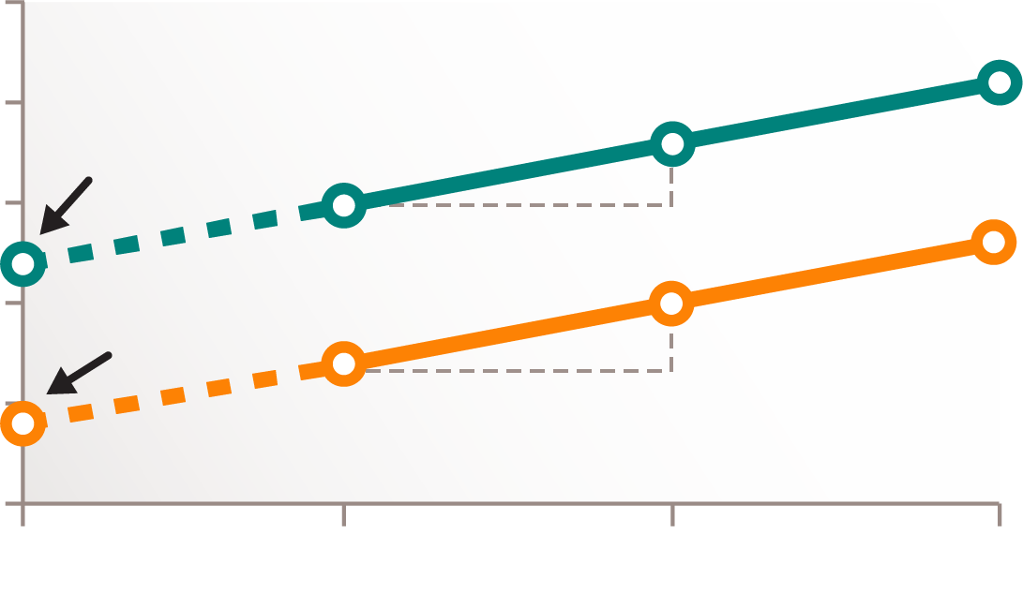
Pressure/Volume Relationships
Intra-abdominal pressure (IAP) is the pressure within the abdominal cavity. [Tabers: p51A] The intra-abdominal volume can be measured by a CO₂ insufflator as the pneumoperitoneum is created. [Mulier(2008): p2C] From these 2 parameters, the abdominal pressure/volume relationship can be calculated. [Mulier(2008): p1A]
After induction of anesthesia, the patient is intubated. [Mulier(2008): p2A] After initial insufflation for placement of the trocar, all CO₂ is allowed to escape and the stomach is completely emptied. [Mulier(2008): p2B] The abdominal cavity can then be insufflated at a low flow rate. The IAP and the total volume of insufflated CO₂ can be measured and recorded at 100-mL increments. [Mulier(2008): p2C] The pressure/volume relationship can be calculated from these data points. [Mulier(2008): p2D, 2E]
This relationship can be described by the equation:
25
Pressure = E x Volume + PV₀
20
No NMB
(TOF >90%)
PV₀ = 12
15
E
Deep NMB
(PTC = 5)
Intra-abdominal
Pressure (mmHg)
10
PV₀ = 4
E
PV₀ = pressure to 0 volume
E = Elastance
5
E = mmHg/L
0
0
1
2
3
Intra-abdominal Volume (L)
[Danneels: p1A, 1B]
PV0 is the initial pressure when no volume is inflated. This value cannot be measured directly. It is a theoretical parameter and can be determined from the pressure/volume calculation as the point where the pressure/volume curve crosses the Y-axis. [Mulier(2008): p5A, 5B]
The pressure/volume relationship is linear between pressures of 0 and 12 mmHg. The slope of the pressure/volume relationship is determined by elastance. [Mulier(2008): 5B] A minimum of 3 data points are required to construct the curve. [Mulier(2008): p5C]
Elastance and PV0 both vary widely among patients. [Mulier(2008): p5D]
Elastance
Increased age [Mulier(2006): p1A, 1B]
Male, short stature [Malbrain: p16A]
Pregnancy, previous abdominal surgery [Mulier(2006): p1A, 1B]
PV0
Increased body weight [Mulier(2006): p1A, 1B]
Neuromuscular blockade [Mulier(2006): p1A, 1B]
Glossary Terms
PV0 increases significantly with increasing body weight and decreases significantly with neuromuscular blockade. [Mulier(2006): p1A, 1B]
Elastance increases significantly with increasing age and decreases significantly with pregnancy and with previous abdominal surgeries. [Mulier(2006): p1A, 1B] Additional factors contributing to increased elastance include male sex and short stature. [Malbrain: p16A]
Elastance: The tendency of body tissues to return to their original form after being stretched. [Tabers: p48A]
Trocar: A sharply pointed surgical instrument contained in a cannula. [Tabers: p56A]

Slide 7
Effects of Positioning on Intra-Abdominal Volume
The position of the patient during surgery can have a significant effect on intra-abdominal volume. [Mulier(2010): p3A]
Supine: 3.22 L [Mulier(2010): p3A]
Using an intra-abdominal volume of 3.22 L in the supine position as a baseline, changes in volume can be determined for other positions using a constant IAP of 14 mmHg. [Mulier(2010): p3A]
V
Beach chair: 3.76 L [Mulier(2010): p3A]
Placing a patient in the beach chair position increases the intra-abdominal volume to 3.76 L. [Mulier(2010): p3A]
P
2
Reverse Trendelenburg: 2.99 L [Mulier(2010): p3A]
1
4
Elevating the head of the bed to the reverse Trendelenburg position decreases intra-abdominal volume to 2.99 L. [Mulier(2010): p3A] Elevating the head of the bed by 45° can also increase IAP by 5 to 15 mmHg. [Malbrain: p18A]
V
Horizontal with legs elevated: 4.13 L
[Mulier(2010): p3A]
5
Placing a patient in the horizontal position with the hips flexed and the legs elevated increases the intra-abdominal volume to 4.13 L. [Mulier(2010): p3A]
Trendelenburg: 4.14 L [Mulier(2010): p3A]
V
Lowering the head of the bed to the Trendelenburg position increases the intra-abdominal volume to 4.14 L. [Mulier(2010): p3A]
V

Slide 8
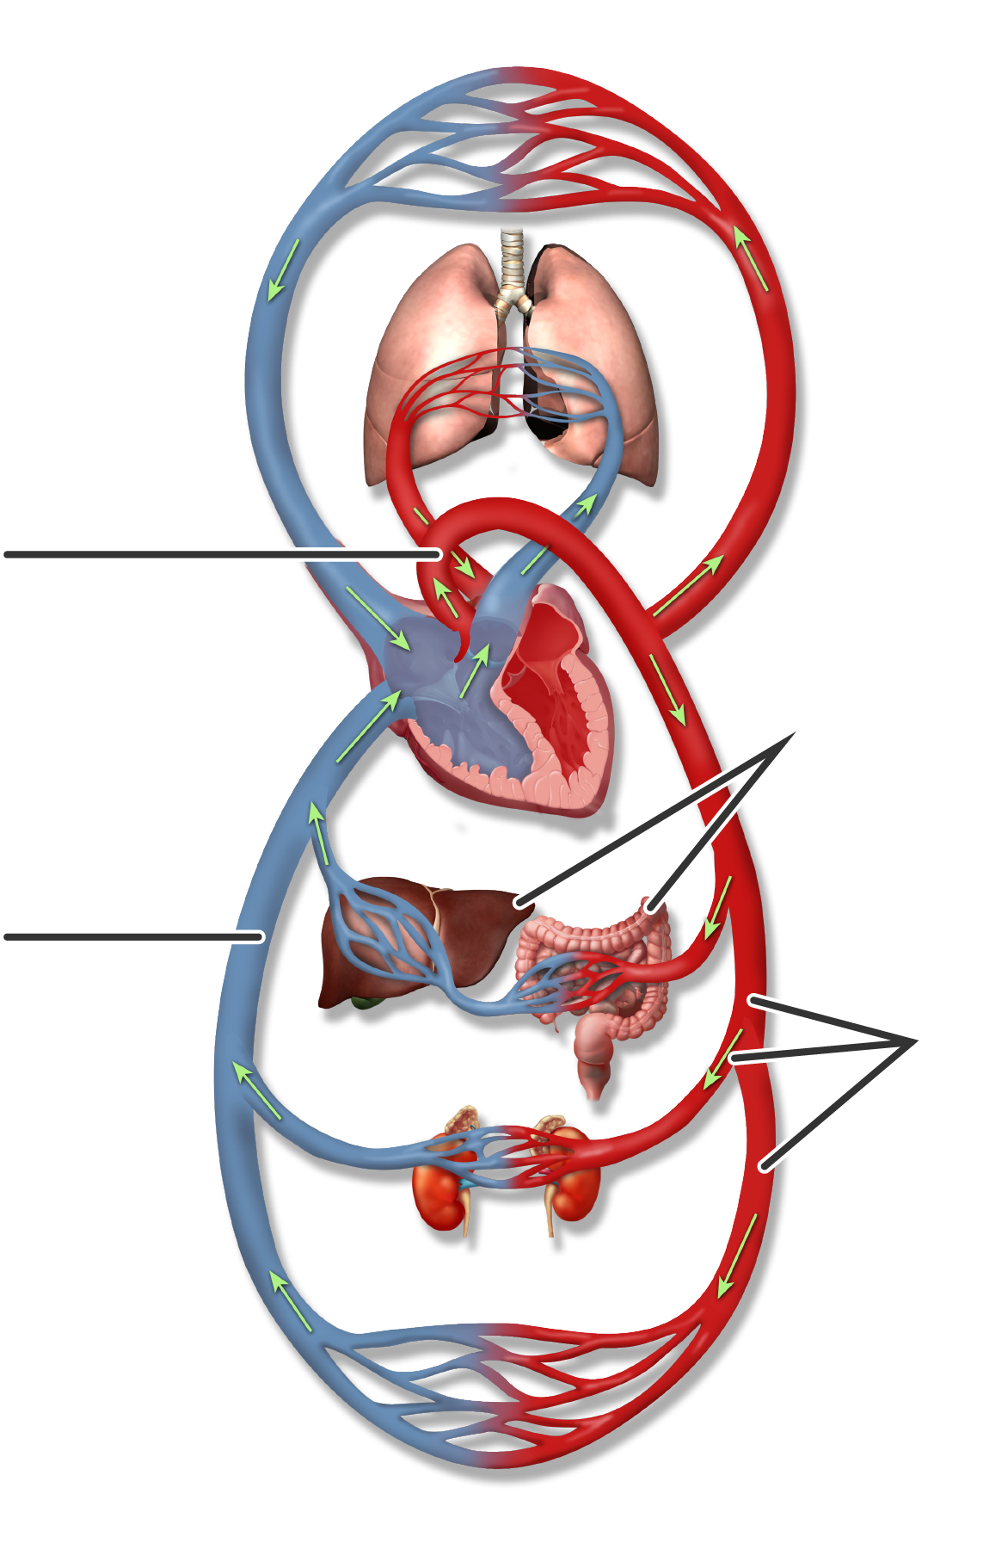
Cardiovascular Effects of Pneumoperitoneum
Capillary Region of the Upper Body (Head and Arms)
Glossary Terms
Jugular Vein
Carotid Artery
Systemic vascular resistance: The resistance to blood flow through the body’s blood vessels. [Tabers: p14A]
Mean arterial pressure: The average blood pressure over the cardiac cycle. [Medical Dictionary: p11A]
Cardiac output: The amount of blood pumped from the left or right ventricle per minute. [Tabers: p15A]
Lungs
Pulmonary
Vein
Pulmonary Artery
Cardiac
Output
Superior
Vena Cava
Aorta
[Nguyen: p2A]
3
2
Pneumoperitoneum compresses abdominal organs and blood vessels, causing an increase in systemic vascular resistance that leads to increased mean arterial pressure. [Nguyen: p2A]
Compression of the inferior vena cava leads to decreased return of venous blood to the heart. This, in turn, causes cardiac output to decrease by 10% to 30%. [Nguyen: p2A]
In spite of decreased blood volume in the heart, cardiac filling pressures may be increased as the pressure from the pneumoperitoneum is transmitted to the heart across the diaphragm. [Nguyen: p2A]
The effects of pneumoperitoneum on the heart and circulatory system are proportional to the increase in IAP. [Nguyen: p2A] Additional factors affecting the cardiovascular effects of pneumoperitoneum include the volume of CO₂ absorbed by the patient, the patient’s volume status, the patient’s position, and anesthetic agents used. [Agresta: p5A]
Inferior
Vena Cava
Pressure
1
[Nguyen: p2A]
Venous
return
Liver
Digestive Tract
Resistance
[Nguyen: p2A]
[Nguyen: p2A]
Iliac Vein
Kidneys
Iliac Artery
Capillary Region of the Lower Body (Trunk and Legs)

Slide 9
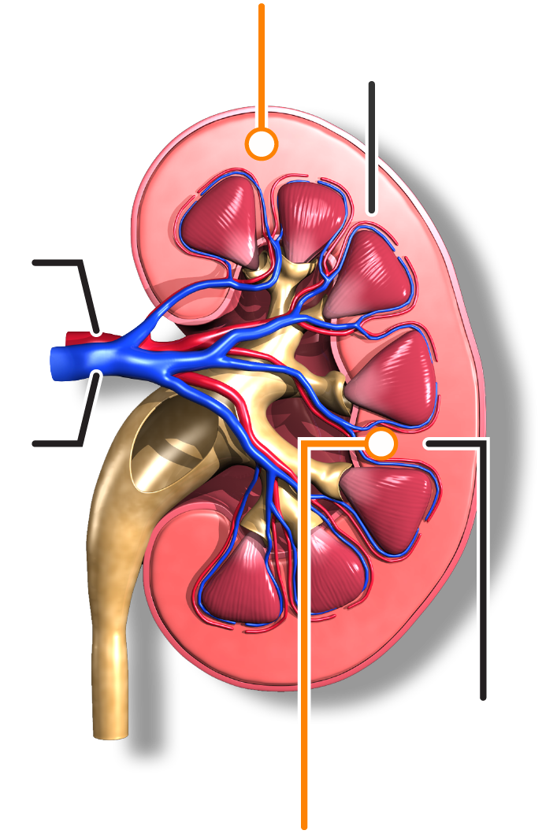
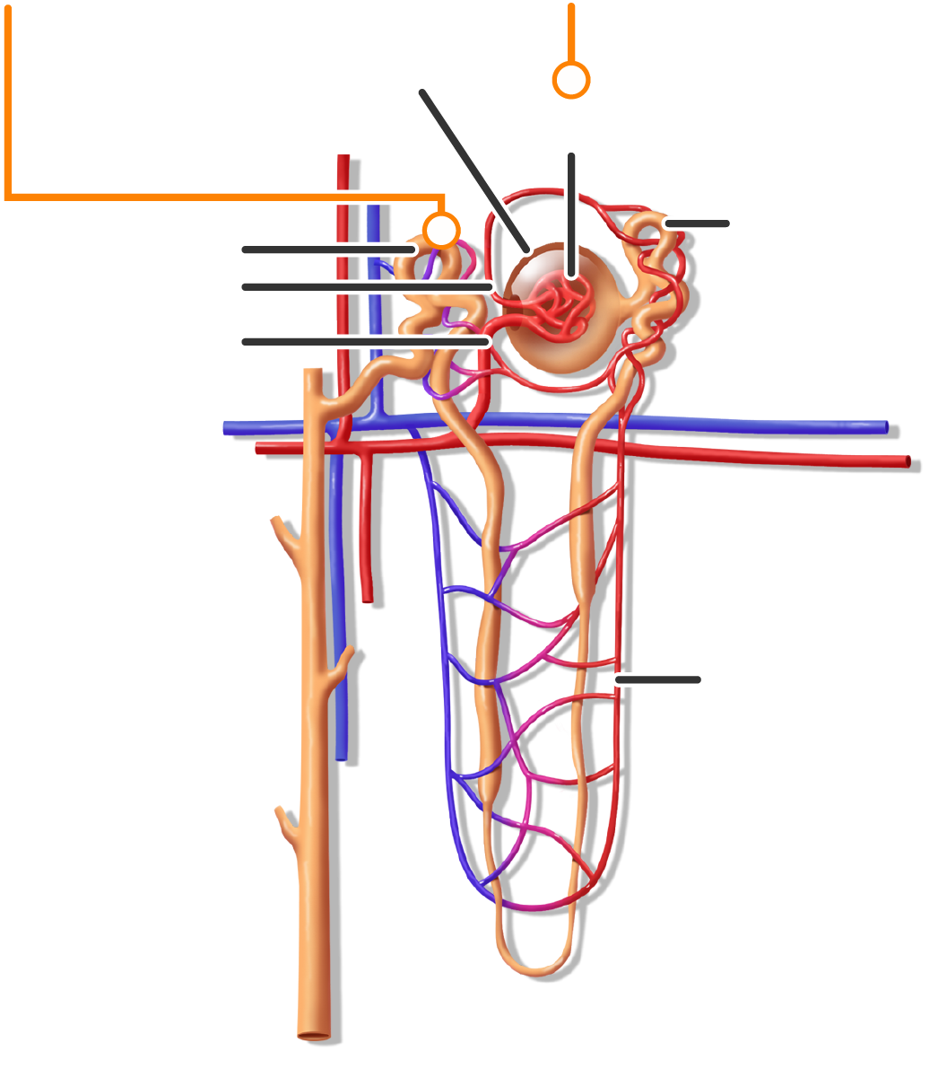
Renal Effects of Pneumoperitoneum
Increases in IAP decrease renal blood flow. Direct pressure on the kidney and the blood vessels mediate part of this effect. Hormonal effects also contribute. [Spight: p5A]
Blood flow decreased 28%
Increased water reabsorption
[Ott: p4A]
Glomerular filtration rate decreased 18–31% [Ott: p4A]
Cortex
[Spight: p5A]
Bowman’s Capsule
Glomerulus
At 15 mmHg, blood flow to the renal cortex decreases by 28% and blood flow to the renal medulla decreases by 31%. Glomerular filtration rate decreases to 18-31% of normal values. [Ott: p4A]
Renal
Artery
Proximal Tubule
Distal Tubule
Afferent Arteriole
Efferent Arteriole
Renal
Vein
Arcuate Vein
Decreases in renal blood flow lead to increased release of renin, which increases sodium retention. [Spight: p5A]
Arcuate Artery
Peritubular
Capillaries
Increased levels of antidiuretic hormone increase the absorption of free water in the distal tubules of the kidney. [Spight: p5A]
Medulla
Blood flow decreased 31%
Collecting
Duct
The combination of these effects leads to a decrease in urine output during laparoscopy. [Ott: p5A] This decrease in output is not related to the patient’s volume status. [Spight: p5A]
[Ott: p4A]
Glossary Terms
The pressure effects of pneumoperitoneum on the kidney can be quickly reversed, but the hormonal effects can continue to affect urine output for up to an hour after surgery is competed. [Spight: p5A]
Renal cortex: The outer layer of the kidney. [Medical Dictionary: p1A]
Renal medulla: The inner portion of the kidney. [Medical Dictionary: p6A]
Glomerular filtration rate: The rate of urine formation as blood passes through the kidney. [Tabers: p8A]

Slide 10
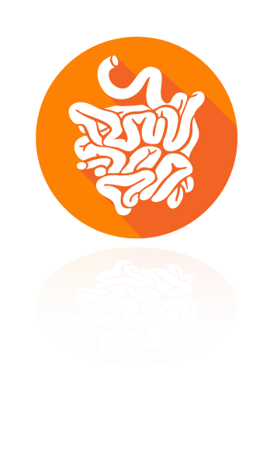
Effects of Pneumoperitoneum on Abdominal Circulation
Increasing the pressure of the pneumoperitoneum from 10 mmHg to 15 mmHg decreases blood flow to abdominal organs. [Ott: p5A]
Blood flow to the stomach decreases
Blood flow to the jejunum decreases
Blood flow to the colon decreases
Blood flow to the liver decreases
Blood flow to the peritoneum decreases
40–54%
32%
44%
39%
60%
[Ott: p5A]
[Ott: p5A]
5
[Ott: p5A]
[Ott: p5A]
[Ott: p5A]
The effects on blood flow can be reduced if IAP is maintained <12 mmHg. [Ott: p5A]
Increases in IAP and the associated decreases in perfusion of the abdominal organs leads to progressive acidosis in the mucosa. [Ott: p5B]
Decreased perfusion of the abdominal organs can lead to oxidative stress. In addition, elevated IAP can increase the spread of tumor cells, increase the risk of septicemia, and increase the incidence of postoperative adhesions. These effects can be minimized by maintaining IAP in the range of 8–12 mmHg. [Ott: p5C]
Glossary Terms
Acidosis: The accumulation of acid or depletion of bicarbonate in blood and body tissues leading to a reduction in pH. [Medical Dictionary: p15A]
Jejunum: The second section of the small intestine. [Tabers: p17A]

Slide 11
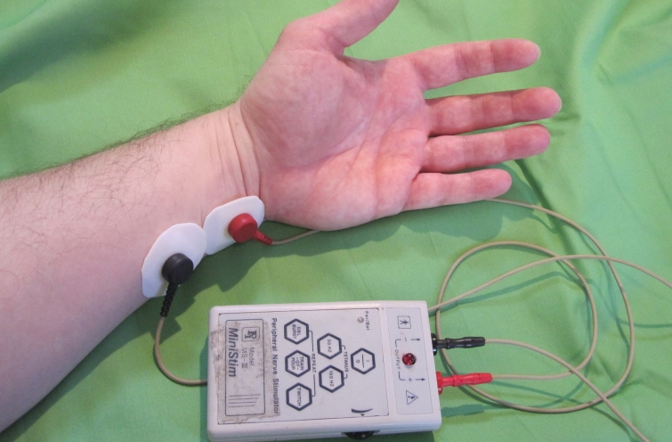
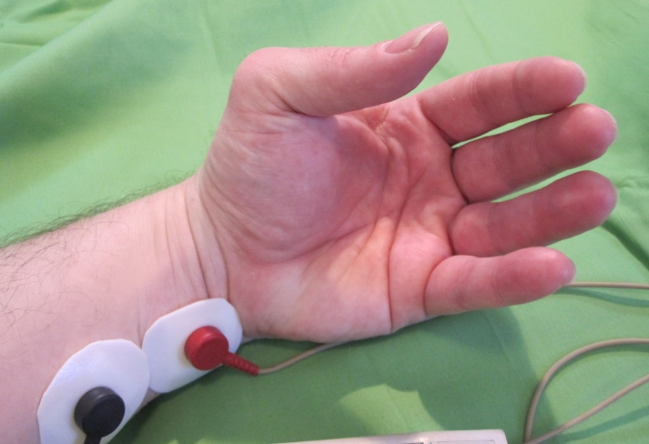
Monitoring Depth of Neuromuscular Blockade
The depth of neuromuscular blockade can be monitored through the use of either qualitative or quantitative methods. Quantitative methods provide more reliable and consistent results, but the equipment required is bulky, and the monitoring procedures are elaborate. For these reasons, quantitative methods are impractical for use in the operating room, and qualitative methods are used instead. [Sikka(Ch6): p14A]
Nerve stimulation is a commonly used qualitative method for assessing neuromuscular function. [Sikka: p14F] It involves the application of electrical stimulation to a nerve and assessment of the resulting muscle contraction. The ulnar nerve, which stimulates the adductor pollicis muscle, most accurately correlates with return of neuromuscular function. [Sikka(Ch6): p14B]
The most commonly used nerve stimulation method for monitoring neuromuscular block is train-of-four. This method applies 4 equally timed stimuli. [Sikka(Ch6): p14C] The presence of 3 twitches indicates a 75% blockade of neuromuscular receptors. Two twitches indicates 80% blockade, and 1 twitch indicates 90% blockade. [Sikka(Ch6): p14D]
Tetanic stimulation involves the application of a continuous electrical stimulus for 5 seconds. Sustained tetanic contraction of the muscle without any fading is consistent with clinically adequate recovery of muscle function. [Sikka(Ch6): p14E]
Application of a tetanic stimulus >50 Hz causes muscles to fatigue and acetylcholine to be released. This can lead to the phenomenon of post-tetanic potentiation. If no twitches are observed with train-of-four stimulation, the application of tetanic stimulation can result in the return of twitches. [Sikka(Ch6): p14E]
The post-tetanic count refers to the number of
twitches present after the application of a
tetanic stimulus. [Sikka: p9F]
Peripheral nerve stimulation of the ulnar nerve.
Twitch response.
3
2
1
4
5
It is important to remember that different muscles in the body have different sensitivities to neuromuscular blockers. The diaphragm is relatively resistant to neuromuscular blockers, so it requires more time to reach maximum effect than the adductor pollicis muscle. As neuromuscular blockers wear off, the diaphragm recovers full strength before the adductor pollicis. [Sikka(Ch13): p8A]
Glossary Terms
Adductor pollicis muscle: A muscle in the hand that adducts the thumb. [Tabers: p21A]
Adduct: To draw toward the long axis of a limb. [Tabers: p38A]
Tetanic contraction: A continuous muscle contraction. [Tabers: p40A]
Post-tetanic count: The number of twitches present after tetanic stimulation. [Sikka: p9F]

Slide 12
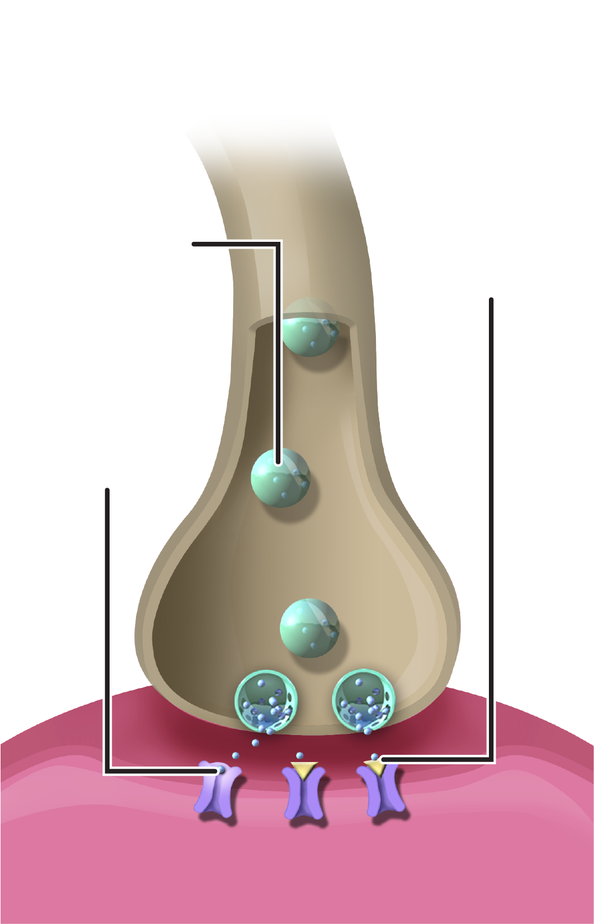
Reversal of Neuromuscular Blockade
Neuromuscular blockers work by interfering with the interaction of neurotransmitters and receptors at the neuromuscular junction. [Sikka(Ch13): p4A]
Normally, propagation of an impulse along a motor nerve causes the release of acetylcholine. [Sikka(Ch13): p4B] Acetylcholine interacts with a receptor on the muscle cell and causes the muscle to contract. [Sikka(Ch13): p4C]
By interfering with the interaction of acetylcholine and its receptor, neuromuscular blockers inhibit muscle contraction. [Sikka(Ch13): p4D]
It is important to reverse neuromuscular blockade at the end of a procedure in order to prevent residual muscle weakness. [Sikka(Ch13): p9B]
Several reversal agents are available:
Neuromuscular blockers bind to receptors
interfering with
neurotransmitters
Acetylcholine is transported
to the axon
terminal
Agent | Mechanism of Action | Time to Effect | Potential Side Effects | Requires Coadministration of Anticholinergic Agent
Neostigmine | Binds acetylcholinesterase Stimulates release of acetylcholine [Sikka(Ch13): p9C] | Initial effects 3–5 min Peak effect 10 min Duration 30–45 min [Sikka(Ch13): p9C] | Cholinergic side effects: Bradycardia, bronchoconstriction, salivation, emesis, GI upset [Sikka(Ch13): p9D] | Yes [Sikka(Ch13): p9D]
Edrophonium | Binds acetylcholinesterase [Sikka(Ch13): p9E] | Onset 30–60 sec Duration 10 min [Sikka(Ch13): p10A] | Similar to neostigmine [Sikka(Ch13): p10B] | Yes [Sikka(Ch13): p10B]
Sugammadex | Binds directly to steroidal neuromuscular blockers Highest affinity for rocuronium [Sikka(Ch13): p10C] | Mean time to recovery of train-of-four 1.4 min [Sikka(Ch13): p10D] | Anaphylaxis Marked bradycardia [Bridion: p6A] | No [Sikka(Ch13): p10E]
Acetylcholine
binding to
receptors
Glossary Terms
Acetylcholine: The neurotransmitter that affects muscle cells at the neuromuscular junction. [Tabers: p47A]
Acetylcholinesterase: The enzyme that breaks down acetylcholine. [Sikka(Ch13): p9A]
Neuromuscular junction: A structure that includes the end of a motor nerve, the synaptic cleft, and a muscle cell. [Tabers: p43A]
Neurotransmitter: A molecule released by a nerve cell that interacts with a target cell. [Tabers: p41A]
Synaptic cleft: The space between the end of a motor nerve and the muscle cell. [Tabers: p45A]

Slide 13
Deep NMB Effect on Surgical Conditions: Increased Space
Average Intra-Abdominal Space
Deep neuromuscular blockade can have a significant effect on intra-abdominal space during laparoscopy. [Lindekaer: p2B]
In a study by Lindekaer et al, the distance from the sacral promontory to the surface of the skin at the umbilicus was measured at insufflation pressures of 8 mmHg and 12 mmHg. For both pressures, measurements were taken without neuromuscular blockade and with deep neuromuscular blockade , defined as a post-tetanic count <2 twitches. [Lindekaer: p2A, 2C, 2D, 2E, 2F]
The average intra-abdominal space increased by approximately 9% at 8 mmHg and approximately 7.5% at 12 mmHg with deep blockade compared with no blockade. [Lindekaer: p3A]
The relationship between neuromuscular blockade and intra-abdominal space was not affected by patient age, body mass index, height, or weight. [Lindekaer: p3B, 4A]
Without
Blockade
17.3
8 mmHg
With Deep
Blockade
18.9
9%
Increase
10
12
14
16
18
20
Average Intra-Abdominal Space in cm
[Lindekaer: p3A]
Average Intra-Abdominal Space
Without
Blockade
18.4
12 mmHg
With Deep
Blockade
19.8
7.5%
Increase
10
12
14
16
18
20
Average Intra-Abdominal Space in cm
[Lindekaer: p3A]

Slide 14
Effect on Surgical Conditions: Deep Block Allows Better Management of IAP During Surgery
Average IAP, Deep vs Moderate NMB
Deep neuromuscular blockade facilitates the use of lower IAP during pneumoperitoneum while maintaining surgical conditions. [Kim: p1A]
In a study by Kim et al, patients were given continuous infusions of rocuronium during laparoscopy. The dose was titrated to maintain either deep neuromuscular blockade (defined in this study as a post-tetanic count of 1 or 2) or moderate neuromuscular blockade (defined as a train-of-four count of 1 or 2). [Kim: p2A]
The IAP for the pneumoperitoneum was initially set at 12 mmHg. During the procedure, the surgeon titrated the IAP to maintain surgical conditions in the operative field. [Kim: p2B]
There were no significant differences in patient age, gender, height, weight, or body mass index between the groups. [Kim: p3A, 3B]
The group receiving deep neuromuscular blockade had significantly lower average IAP compared with the group receiving moderate neuromuscular blockade. [Kim: p3C]
Average IAP
(mmHg)
Average IAP
(mmHg)
9.3
12
out of 14
out of 14
Deep NMB
Moderate NMB
[Kim: p3C]

Slide 15
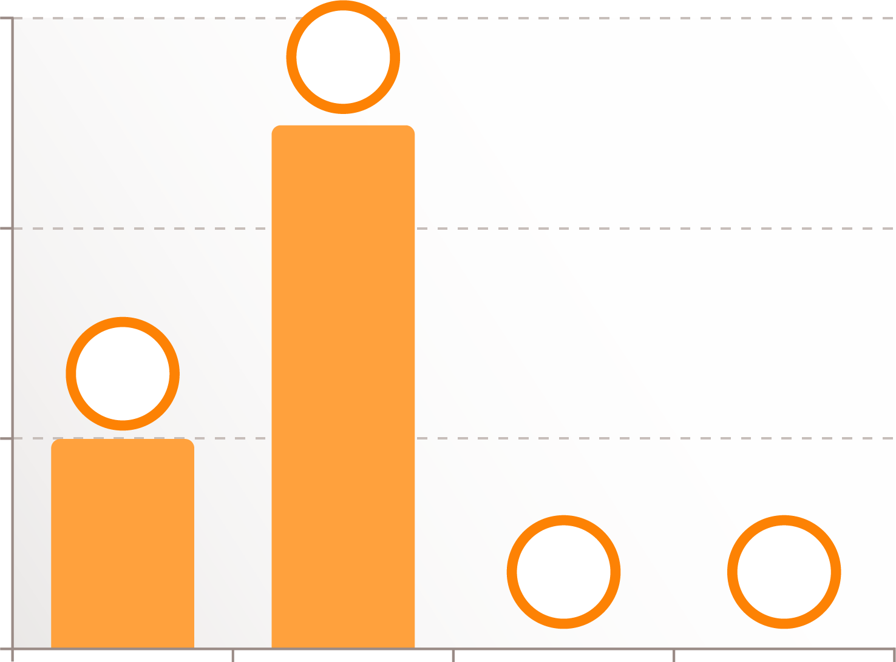
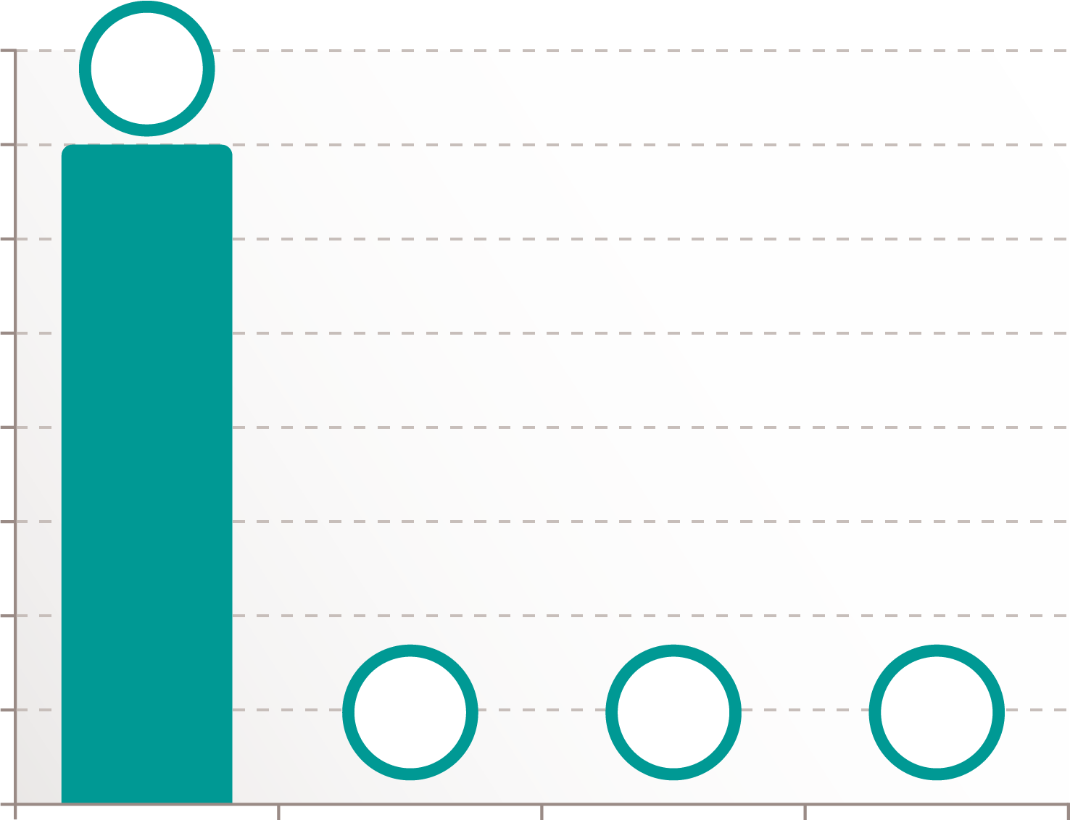
Effect on Surgical Conditions: Deep Block Allows Better Conditions for Suturing Fascia
In a study by Madsen et al, surgical conditions during suturing of the fascia after laparoscopy were rated by gynecologists using a 4 point subjective scale. [Madsen: p3B] Pneumoperitoneum of 12 mmHg was maintained during suturing, and conditions were assessed for patients either without neuromuscular blockade or with deep neuromuscular blockade. A rating of 1 was considered optimal and a rating of 4 was considered bad. [Madsen: p3C]
Surgical conditions for suturing fascia were rated significantly better for the group receiving deep neuromuscular blockade. An optimal rating of 1 was assigned to 100% of the patients in the deep neuromuscular blockade group. [Madsen: p5A, 5B]
No Neuromuscular Blockade (n=7)
Deep Neuromuscular Blockade (n=7)
6
5
8
7
7
6
4
5
Number of Patients
Number of Patients
2
4
2
3
2
0
0
1
0
0
0
0
0
1
2
3
4
1
2
3
4
Rating of Surgical Conditions
[Madsen: p5B]
Rating of Surgical Conditions
[Madsen: p5B]

Slide 16
Effect on Surgical Conditions: Deep NMB Improves Conditions During Retroperitoneal Laparoscopy
5
4.7
Deep neuromuscular blockade improved the quality of surgical conditions during retroperitoneal laparoscopy compared with moderate blockade. [Martini: p1A]
Martini et al compared deep neuromuscular blockade (defined as a post-tetanic count of 1 or 2) with moderate blockade (defined as a train-of-four of 1 or 2) in patients during retroperitoneal laparoscopy. An experienced surgeon used a 5-point scale to rate surgical conditions. [Martini: p2A] For this subjective scale, a rating of 1 was considered extremely poor and a rating of 5 was considered optimal. [Martini: p3A]
Patients in the moderate blockade group received a bolus dose of atracurium followed by a continuous infusion of mivacurium titrated to maintain the desired level of blockade. [Martini: p2B] Patients in the deep blockade group received a bolus dose and continuous infusion of rocuronium. [Martini: p2C]
Patient characteristics were similar between the groups. [Martini: p4A, 5A]
Surgical conditions were rated significantly better in the group receiving deep blockade. The mean rating in the deep group was 4.7 compared with a mean rating of 4.0 in the moderate group. [Martini: p4B]
99% of the rating scores in the deep group were in the range of 4 to 5. [Martini: p4C, 5B]
4.5
4
4
3.5
3
Rating of Surgical Conditions
2.5
2
1.5
1
0.5
0
Deep NMB
Moderate NMB
[Martini: p4B]

Slide 17
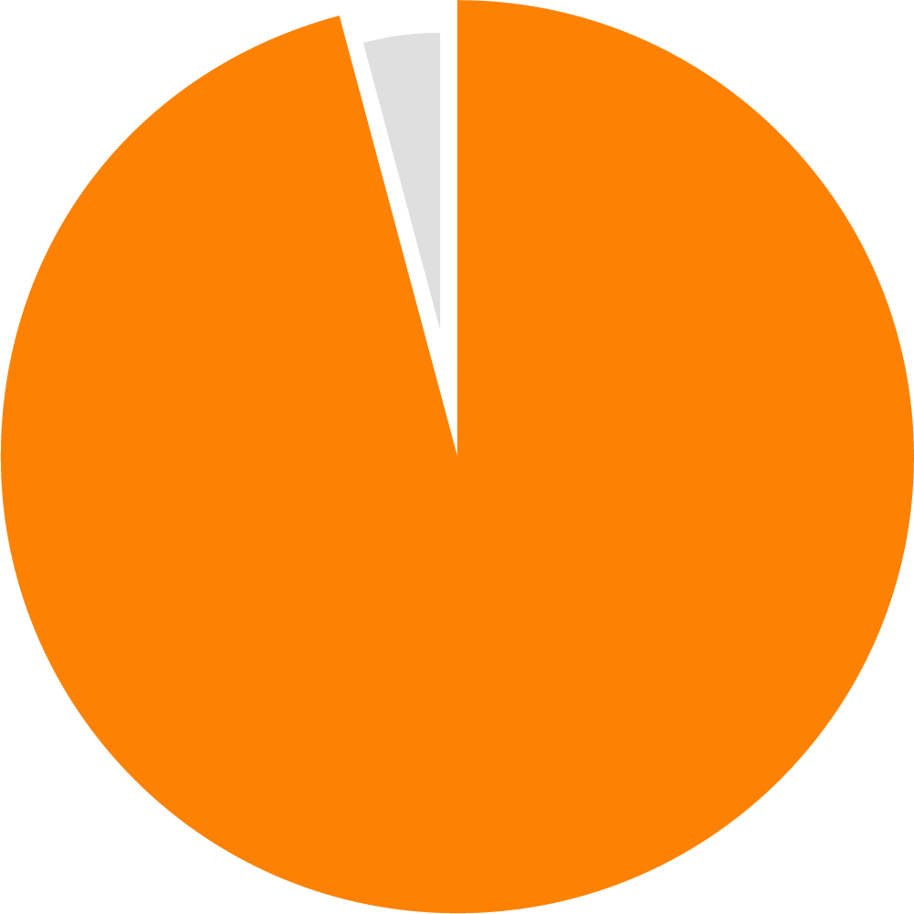
Effect on Surgical Conditions: Deep NMB in Laparoscopic Bariatric Surgery
Deep neuromuscular blockade provides improved surgical conditions during laparoscopic bariatric surgery. [Torensma: p1A]
Torensma et al assessed the effects of deep vs moderate neuromuscular blockade in patients undergoing Roux-Y gastric bypass surgery. [Torensma: p2B, 3A]
Patients were randomized to receive either deep neuromuscular blockade (defined as a post-tetanic count of 2 to 3) or moderate blockade (defined as a train-of-four count of 1 to 2). Bolus doses of rocuronium were administered to maintain the desired level of blockade. [Torensma: p3B]
Surgical conditions were rated on a 5-point scale from 1 (extremely poor) to 5 (optimal). [Torensma: p2A] There were no significant differences in patient characteristics between the groups. [Torensma: p5A, 7A] All patients had a body mass index over 35. [Torensma: p5A]
Ratings for surgical conditions were significantly different between the groups. The mean rating in the group receiving deep neuromuscular blockade was 4.8 compared with a mean rating of 4.2 in the group receiving moderate blockade (P < 0.001), a difference of 14%. [Torensma: p5B] The 3 surgeons involved in the study considered this difference to be clinically relevant. [Torensma: p9A] All rating scores for the deep blockade group were in the range of 4-5. [Torensma: p5C]
Rating of Surgical Conditions
Deep NMB
Moderate NMB
4.8
4.2
out of 5
out of 5
(P < 0.001)
[Torensma: p5B]

Slide 18
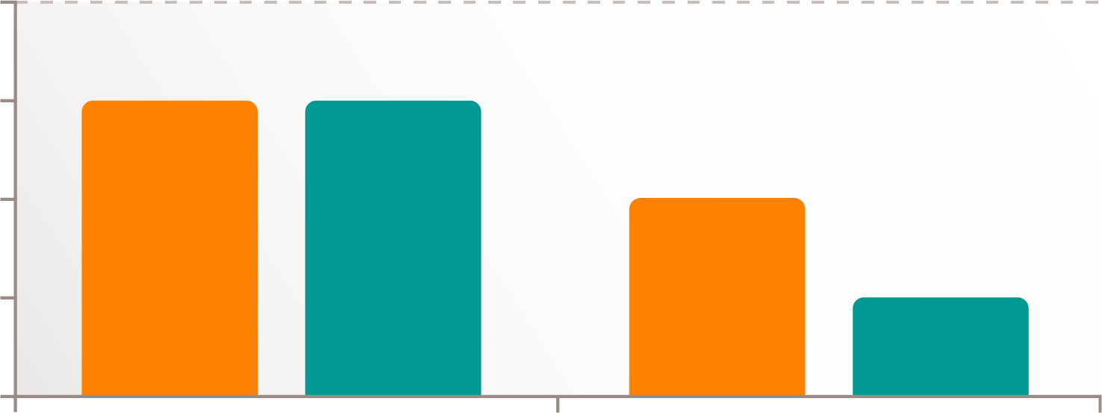
Effect on Surgical Conditions: Deep NMB in Robotic-assisted Laparoscopic Radical Prostatectomy
Surgical Conditions
Deep neuromuscular blockade results in lower intraocular pressure, improves surgical conditions, and facilitates performance of surgery at lower IAP for patients undergoing robotic-assisted laparoscopic radical prostatectomy. [Yoo: p1A]
In a study by Yoo et al, patients were randomized to receive either deep or moderate neuromuscular blockade. [Yoo: p3A] The deep group received a bolus dose and continuous infusion of rocuronium to maintain a post-tetanic count of 1 to 2. [Yoo: p3A] The moderate group received a bolus dose and continuous infusion of atracurium to maintain a train-of-four count of 1 to 2. [Yoo: p4A]
The IAP of the pneumoperitoneum was set at 8 mmHg after placement of trocars, and the patients were placed in Trendelenburg position for the procedure. [Yoo: p4B] Surgical conditions were evaluated by the surgeon. If conditions were inadequate, IAP was increased until conditions were acceptable. [Yoo: p4C]
5
4
Overall
Worst
Rating
3
2
1
[Yoo: p7B]
Deep NMB
Moderate NMB
Ratings for both overall surgical conditions and worst surgical conditions were significantly different between groups. The deep group had an overall rating of 4.0 and a worst rating of 4.0 compared with ratings of 3.0 and 2.0, respectively, in the moderate group. [Yoo: p7B]
Percentage Completed at 8 mmHg
The surgeon rated the overall surgical conditions and the worst conditions at the end of the procedure using a 5-point scale from 1 (extremely poor) to 5 (optimal). [Yoo: p6A]
Intraocular pressure was assessed by an ophthalmologist for all patients. [Yoo: p5A, 5B] Intraocular pressure during pneumoperitoneum was significantly lower in the deep blockade group compared with the moderate blockade group. [Yoo: p7D]
The characteristics of the patients and the durations of anesthesia, surgery, pneumoperitoneum, and Trendelenburg position were comparable between the groups. [Yoo: p6B, 7A, 8A]
88%
25%
Deep NMB
Moderate NMB
[Yoo: p7C]
An IAP of 8 mmHg was sufficient to complete the procedure in 88% of the deep group and 25% of the moderate group. [Yoo: p7C]

Slide 19
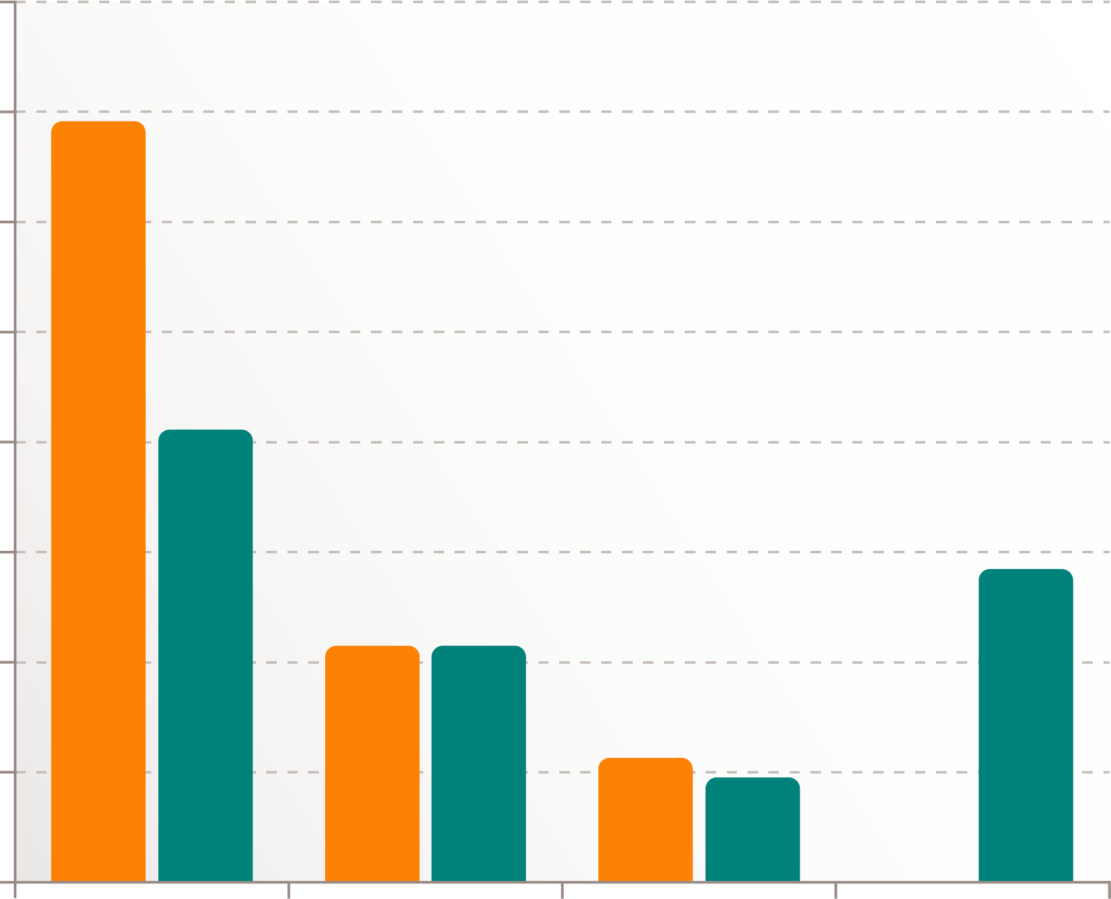
Effect on Surgical Conditions: Deep NMB in Laparoscopic Hysterectomy
Deep neuromuscular blockade maintained optimal surgical conditions during laparoscopic hysterectomy. [Dubois: p6A]
In a study by Dubois et al, patients were randomized to receive either shallow or deep neuromuscular blockade. The shallow group received an intubating dose of rocuronium and were then allowed to spontaneously recover. The deep group received a higher intubating dose of rocuronium and then received additional rocuronium whenever the train-of-four was greater than 2. [Dubois: p2A]
Patient characteristics were similar between the groups. [Dubois: p4A]
The IAP of the pneumoperitoneum was maintained at 13 mmHg. [Dubois: p3A]
Surgical conditions were rated every 10 minutes using a 4-point scale from 1 (excellent) to 4 (impossible to continue the operation). [Dubois: p3B]
Statistical analysis confirmed the trend toward worse surgical conditions in the shallow group (P < 0.001). [Dubois: p4B]
Most of the surgical conditions rated as 3 and all of the conditions rated as 4 were associated with a high pressure alarm. [Dubois: p4B, 4C]
Surgical conditions rated 2 or higher only occurred when the train-of-four count was at least 1. [Dubois: p4D]
Deep NMB with a train-of-four count of less than 1 maintained optimal surgical conditions. [Dubois: p4B]
40
34
Deep NMB
Shallow NMB
35
30
25
21
Number of Patients
20
14
15
11
11
10
5
4
5
0
0
1
2
3
4
Surgical Conditions
[Dubois: p4C]

Slide 20
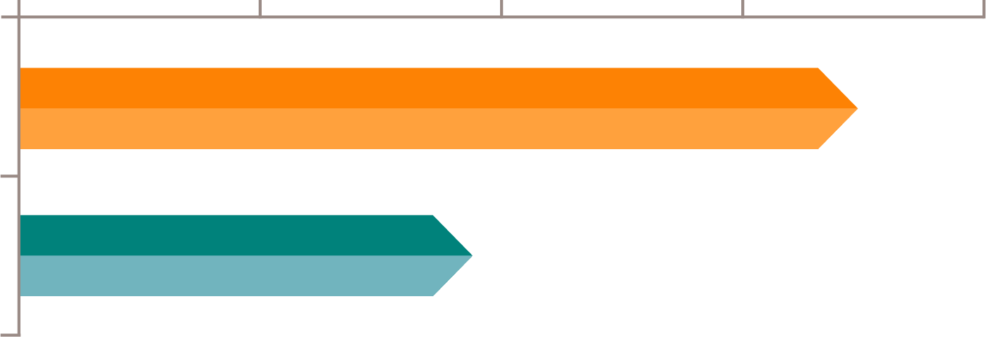
Effect on Surgical Conditions: Deep NMB in Laparoscopic Cholecystectomy
Deep NMB
Moderate NMB
Deep neuromuscular blockade improved surgical conditions and facilitated the use of low-pressure pneumoperitoneum during laparoscopic cholecystectomy. [Koo: p4C]
In a study by Koo et al, patients were randomized to receive either deep or moderate neuromuscular blockade. [Koo: p2A] Both groups received rocuronium for intubation. [Koo: p2B] Additional rocuronium was given to maintain a train-of-four of 1 or 2 in the moderate group or a post-tetanic count of 1 or 2 in the deep group. [Koo: p2C]
The IAP of the pneumoperitoneum was initially set 8 mmHg. Surgeons could increase the IAP to 12 mmHg if surgical conditions were unacceptable. [Koo: p2C] Surgeons rated the conditions at the end of the procedure using a 4-point scale from 1 (excellent) to 4 (poor). [Koo: p2D]
There were no significant differences in patient characteristics between the groups. [Koo: p3A, 4A]
20
18
11
10
10
7
Number of Patients
6
4
4
4
0
1
2
3
4
Surgical Conditions
[Koo: p5A]
There was a significant difference in surgical conditions between the groups (P = 0.001). [Koo: p4B]
Required Increased IAP (%)
Optimal or Good Conditions (%)
0
20
40
60
80
12.5
34.4
Deep NMB
68.8
Moderate
NMB
34.4
[Koo: p3A]
[Koo: p4B]
12.5% of the deep group and 34.4% of the moderate group required increased IAP. [Koo: p3A]
Surgical conditions were rated optimal or good (1 or 2) in 68.8% of the deep group and 34.4% of the moderate group. [Koo: p4B]

Slide 21
Deep NMB: Consensus Recommendations
The Spanish Society of Anaesthesiology and the Spanish Association of Surgeons appointed a scientific committee to develop a questionnaire that was given to surgeons and anesthesiologists. [Errando-Oyonarte: p3A] The goal was to develop a set of consensus recommendations for the clinical use of neuromuscular blockade. [Errando-Oyonarte: p3B]
Recommendation 1
Recommendation 2
The use of deep neuromuscular blockade is recommended for abdominal surgery. [Errando-Oyonarte: p3C]
The use of deep neuromuscular blockade is recommended for obese patients. [Errando-Oyonarte: p4A]
94.1% of participants considered deep neuromuscular blockade to be highly suitable for abdominal surgery. [Errando-Oyonarte: p3D]
76.2% of participants agreed to the recommendation for use of deep neuromuscular blockade in obese patients. [Errando-Oyonarte: p4A]
Recommendation 3
Recommendation 4
The use of deep neuromuscular blockade until the end of surgery optimizes intraoperative working conditions. [Errando-Oyonarte: p4B]
The use of reversal agents to improve the safety of deep neuromuscular blockade is recommended. [Errando-Oyonarte: p5A]
Improved visualization of the surgical field, creation of a sufficiently large working area, and patient immobility achieved the highest consensus for benefits of deep neuromuscular blockade until the end of surgery. [Errando-Oyonarte: p4C]
Most participants felt that use of reversal agents would increase anesthesiologists’ confidence in deep neuromuscular blockade (94.1%), expedite extubation (90.1%), and improve patient safety (87.1%). [Errando-Oyonarte: p5B]

Slide 22
Case Scenario 1: Effect on Intra-Abdominal Space
Following are 3 hypothetical case scenarios to help illustrate how neuromuscular blockade might be used to improve conditions in clinical practice.
The distance from the sacral promontory to the inside edge of the trocar located in the umbilicus is measured and found to be 9.0 cm. The surgeon decides that she doesn’t have quite enough space to work. The anesthesiologist administers additional neuromuscular blocking agents and creates a deep neuromuscular blockade with a post-tetanic count <2. The distance from the promontory to the edge of the trocar is measured again and found to be 9.33 cm. Deep neuromuscular blockade has increased the intra-abdominal space by 0.33 cm, an increase of 3.7%. [Madsen: p3A, 3D, 5D, 5E]
In the first case scenario, the hypothetical patient is a 44-year-old woman undergoing gynecological laparoscopic surgery. Her medical history includes 1 pregnancy, and her body mass index is 22. [Madsen: p2A, 5C]
Anesthetic: The patient is taken to the OR, and induction of anesthesia is accomplished using a combination of propofol and fentanyl. She is intubated, and anesthesia is maintained with infusions of propofol and remifentanil. [Madsen: p2B]
44 y/o
BMI 22
9.3 cm
9.0 cm
Deep NMB
No NMB
Pneumoperitoneum 12 mmHg
No
NMB
9
Intra-abdominal space: A pneumoperitoneum of 12 mmHg is established. The patient initially has no neuromuscular blockade. [Madsen: p3A]
Deep
NMB
9.3
12 mmHg
5
5.5
6
6.5
7
7.5
8
8.5
9
9.5
10
Intra-abdominal Space (cm)
[Madsen: p5D]
As illustrated in this scenario, deep neuromuscular blockade may increase intra-abdominal space in some patients. [Madsen: p5F]

Slide 23
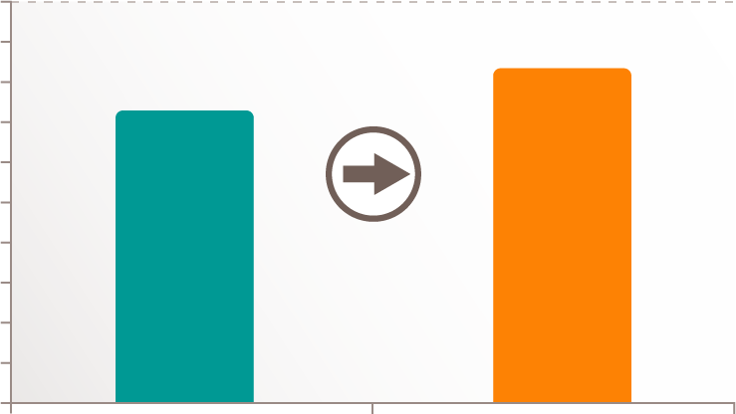
Case Scenario 2: Effect on Intra-Abdominal Volume
The next hypothetical patient is a 46-year-old woman presenting for laparoscopic surgery. She is 5 feet 5 inches tall with a BMI of 25. She has had one previous surgery and is classified as ASA physical status 2. [Barrio: p2A, 4A]
Anesthetic: The patient receives dexamethasone 4 mg, midazolam 1mg, and fentanyl 75 mcg. Induction of anesthesia is performed with propofol 2 mg/kg. Rocuronium 0.4 mg/kg is administered and the patient is intubated. Anesthesia is maintained with infusions of propofol and remifentanil. The anesthesiologist uses rocuronium to establish moderate neuromuscular blockade with a train-of-four count of 2. [Barrio: p2B, 3B]
Pneumoperitoneum 12 mmHg
5
4.5
4
4.09
46 y/o
5’ 5”
BMI 25
ASA 2
3.5
3
3.52
Intra-abdominal Volume (L)
16% Increase with deep NMB
2.5
2
More rocuronium given
1.5
1
0.5
0
Moderate NMB
Deep NMB
[Barrio: p4B]
Pneumoperitoneum is established at 12 mmHg. [Barrio: 4B]
The volume of CO₂ is measured and found to be 3.52 L. [Barrio: 4B] At this point, the surgeon decides that the working space is not adequate. The anesthesiologist gives additional rocuronium to establish deep neuromuscular blockade with a post-tetanic count of less than 5. [Barrio: 3B] The pressure of the pneumoperitoneum is maintained at 12 mmHg. The volume of CO₂ is measured again and found to be significantly greater at 4.09 L, an increase of 16%. [Barrio: p4B]
12 mmHg
This scenario shows that deep neuromuscular blockade may increase the intra-abdominal volume in some patients. [Barrio: p1A]

Slide 24
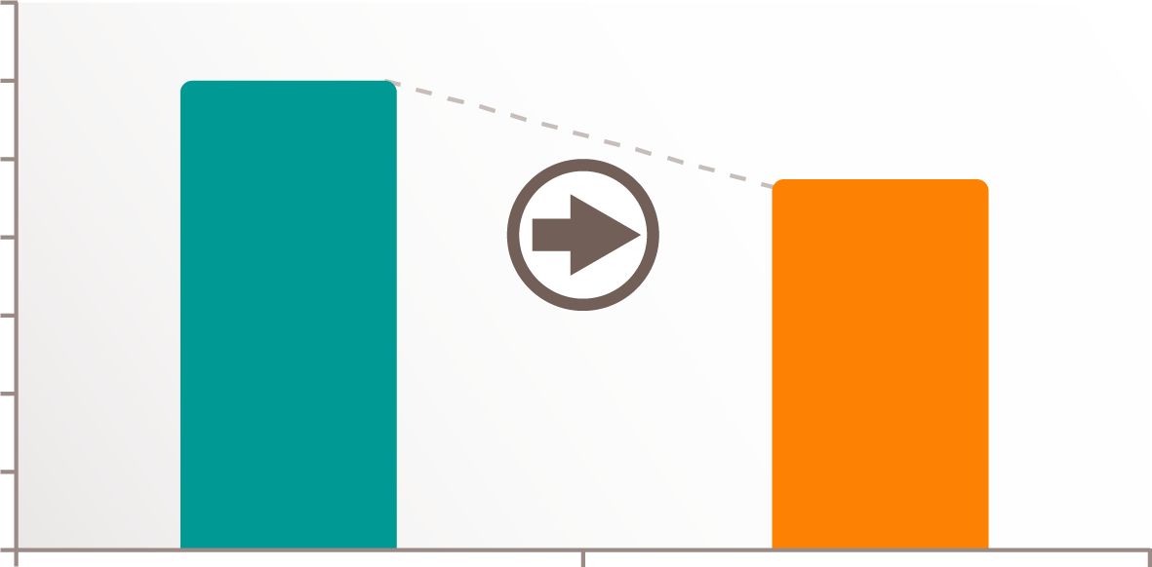
Case Scenario 3: Effect on Intra-Abdominal Pressure
The final hypothetical patient is a 57-year-old man presenting for laparoscopic colorectal surgery. [Kim: p2C, 3B] He is 5 feet 4 inches tall with a BMI of 23. He is in good health with an ASA physical status of 1. [Kim: p3B]
Anesthetic: The patient is taken to the OR and given propofol, remifentanil, and rocuronium for induction. He is intubated, and anesthesia is maintained with desflurane and an infusion of remifentanil. [Kim: p2D]
The surgeon would like to keep the IAP as low as possible, but does not want to struggle with poor surgical conditions. The anesthesiologist increases the rocuronium infusion to maintain a deep neuromuscular blockade with a post-tetanic count of 1 to 2. [Kim: p2A] The surgeon gradually lowers the IAP while maintaining the same operative field. [Kim: p2B] While maintaining surgical conditions, the surgeon is able to titrate the IAP down to 9.3 mmHg, a decrease of 22.5%. [Kim: p3C]
57 y/o
5’4”
BMI 23
ASA 1
9.3 mmHg
14
12
10
12
Pneumoperitoneum is initially established at 12 mmHg. [Kim: p2B] A continuous infusion of rocuronium is titrated to maintain a moderate level of neuromuscular block with a train-of-four of 1 to 2. [Kim: p2A]
8
IAP
9.3
22.5%
decrease in IAP with deep NMB
6
4
Rocuronium infusion increased.
12 mmHg
2
0
[Kim: p3C]
Moderate NMB
Deep NMB
This scenario shows that deep neuromuscular blockade may help to maintain surgical conditions at low IAP. [Kim: p6A]

Slide 25
Summary
The intra-abdominal volume and intra-abdominal pressure can be measured as the pneumoperitoneum is created. [Mulier(2008): p2C] The abdominal pressure/volume relationship can be calculated from these 2 measurements. [Mulier(2008): p1A]
PV0 is the initial pressure when no volume is inflated. It can be determined from the pressure/volume calculation as the point where the pressure/volume curve crosses the Y-axis. [Mulier(2008): p5A, 5B] The pressure/volume relationship is linear between pressures of 0 and 12 mmHg. The slope of the pressure/volume relationship is determined by elastance. [Mulier(2008): 5B]
The position of the patient during surgery can have a significant effect on intra-abdominal volume. [Mulier(2010): p3A]
Intra-abdominal hypertension is defined as the sustained or repeated pathological elevation of intra-abdominal pressure ≥12 mmHg. [World: p 4A]
Increases in IAP decrease renal blood flow [Spight: p5A] and urine output during laparoscopy. [Ott: p5A]
Pneumoperitoneum compresses abdominal organs and blood vessels, causing increased systemic vascular resistance, [Nguyen: p2A] decreased cardiac output, [Nguyen: p2A] and decreased cardiac filling pressures. [Nguyen: p2A] The effects of pneumoperitoneum on the heart and circulatory system are proportional to the increase in IAP. [Nguyen: p2A]
The pressure of the pneumoperitoneum decreases blood flow to abdominal organs. [Ott: p5A]
Deep neuromuscular blockade can have a significant effect on intra-abdominal space during laparoscopy. [Lindekaer: p2B]
Deep neuromuscular blockade facilitates the use of lower IAP during pneumoperitoneum while maintaining surgical conditions. [Kim: p1A]
Deep neuromuscular blockade improved the quality of surgical conditions during retroperitoneal laparoscopy. [Martini: p1A]
Deep neuromuscular blockade provides improved surgical conditions during laparoscopic bariatric surgery. [Torensma: p1A]
Deep neuromuscular blockade results in lower intraocular pressure, improves surgical conditions, and facilitates performance of surgery at lower IAP for patients undergoing robotic-assisted laparoscopic radical prostatectomy. [Yoo: p1A]
The Spanish Society of Anaesthesiology and the Spanish Association of Surgeons published the following consensus recommendations:
The use of deep neuromuscular blockade is recommended for abdominal surgery. [Errando-Oyonarte: p3C]
The use of deep neuromuscular blockade is recommended for obese patients. [Errando-Oyonarte: p4A]
The use of deep neuromuscular blockade until the end of surgery optimizes intraoperative working conditions. [Errando-Oyonarte: p4B]
The use of reversal agents to improve the safety of deep neuromuscular blockade is recommended. [Errando-Oyonarte: p5A]

Slide 26
Progress Check
Which of the following patient characteristics are associated with increased elastance? (Choose all that apply)
Increasing age [Mulier(2006): p1A, 1B]
Male sex [Malbrain: p16A]
Pregnancy
Previous abdominal surgery
Pneumoperitoneum causes which of the following physiological effects? (Choose all that apply)
Decreased renal blood flow [Spight: p5A]
Decreased systemic vascular resistance
Decreased cardiac output [Nguyen: p2A]
Decreased blood flow to the liver [Ott: p5A]
Which of the following surgical positions decreases intra-abdominal volume? (Choose all that apply)
Reverse Trendelenburg [Mulier(2010): p3A]
Trendelenburg
Beach chair
Horizontal with hips flexed
Which of the following medications for reversal of neuromuscular blockade does not require the coadministration of an anticholinergic agent?
Neostigmine
Edrophonium
Sugammadex [Sikka(Ch13): p10E]
None of the above (All require an anticholinergic agent)
Which of the following is the threshold IAP level for intra-abdominal hypertension as defined by the World Society of the Abdominal Compartment Syndrome?
≥8 mmHg
≥10 mmHg
≥12 mmHg [World: p 4A]
≥14 mmHg
Which of the following surgical conditions are improved by deep neuromuscular blockade? (Choose all that apply)
Surgical space [Lindekaer: p2B]
Conditions for suturing fascia [Madsen: p5A, 5B]
Surgical exposure at low IAP [Kim: p1A]
Overall surgical conditions [Martini: p1A]
Answers appear on page 28

Slide 27
Glossary
Click on each term to navigate to the page it appears on
Acetylcholine: The neurotransmitter that affects muscle cells at the neuromuscular junction. [Tabers: p47A]
Acetylcholinesterase: The enzyme that breaks down acetylcholine. [Sikka(Ch13): p9A]
Acidosis: The accumulation of acid or depletion of bicarbonate in blood and body tissues leading to a reduction of pH. [Medical Dictionary: p15A]
Adduct: To draw toward the long axis of a limb. [Tabers: p38A]
Adductor pollicis muscle: A muscle in the hand that adducts the thumb. [Tabers: p21A]
Cardiac output: The amount of blood pumped from the left or right ventricle per minute. [Tabers: p15A]
Elastance: The tendency of body tissues to return to their original form after being stretched. [Tabers: p48A]
Glomerular filtration rate: The rate of urine formation as blood passes through the kidney. [Tabers: p8A]
Intra-abdominal hypertension: The sustained or repeated pathological elevation of intra-abdominal pressure ≥12 mmHg. [World: p 4A]
Jejunum: The second section of the small intestine. [Tabers: p17A]
Mean arterial pressure: The average blood pressure over the cardiac cycle. [Medical Dictionary: p11A]
Neuromuscular junction: A structure that includes the end of a motor nerve, the synaptic cleft, and a muscle cell. [Tabers: p43A]
Neurotransmitter: A molecule released by a nerve cell that interacts with a target cell. [Tabers: p41A]
Parietal peritoneum: The part of the peritoneum that lines the abdominal wall and the underside of the diaphragm. [Tabers: p5B]
Peritoneal cavity: The potential space between the parietal peritoneum and the visceral peritoneum. It contains a serous fluid to provide lubrication. [Tabers: p3A]
Peritoneum: The membrane that lines the abdominal cavity and covers the abdominal organs. [Tabers: p5A]
Pneumoperitoneum: The expansion of the peritoneal cavity by insufflation of gas. It provides exposure for the surgeon and a working space for the manipulation of surgical instruments. [Avci: p4A]
Post-tetanic count: The number of twitches present after tetanic stimulation. [Sikka: p9F]
Renal cortex: The outer layer of the kidney. [Medical Dictionary: p1A]

Slide 28
Glossary
Click on each term to navigate to the page it appears on
Renal medulla: The inner portion of the kidney. [Medical Dictionary: p6A]
Synaptic cleft: The space between the end of a motor nerve and the muscle cell. [Tabers: p45A]
Systemic vascular resistance: The resistance to blood flow through the body’s blood vessels. [Tabers: p14A]
Tetanic contraction: A continuous muscle contraction. [Tabers: p40A]
Trocar: A sharply pointed surgical instrument contained in a cannula. [Tabers: p56A]
Visceral peritoneum: The part of the peritoneum that surrounds and covers the abdominal organs. [Tabers: p5C]
Progress Check Answers
A, B [Mulier(2006): p1A, 1B] [Malbrain: p16A] (See page 7)
A [Mulier(2010): p3A] (See page 4)
C [World: p 4A] (See page 6)
A, C, D [Spight: p5A] [Nguyen: p2A] [Ott: p5A] (See pages 8, 9, and 10)
C [Sikka(Ch13): p10E] (See page 12)
A, B, C, D [Lindekaer: p2B] [Madsen: p5A, 5B] [Kim: p1A] [Martini: p1A] (See pages 13, 14, 15, and 16)

