Slide 1
Execute
Total Time – 15 Minutes
CTEPH recurrent persistent
CTEPH inoperable
PAH, treatment Naive
PAH with PCA therapy
PAH with ERA therapy
Dr. Jensen
Dr. Sanjip
Dr. Lee
Click to Spin

Slide 2
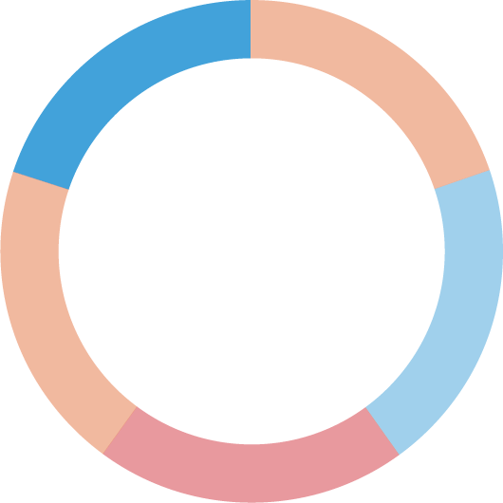
Execute
Total Time – 15 Minutes
CTEPH recurrent persistent
CTEPH inoperable
PAH, treatment Naive
PAH with PCA therapy
PAH with ERA therapy
Dr. Jensen
Dr. Sanjip
Dr. Lee

Slide 3
Scenario 1
Total Time – 5 Minutes
Dr Jensen
Gerontologist
Practicing for 24 years
Partner at a small outpatient facility
Mostly sees older patients
Knows a little about ADEMPAS
Usually prescribes an ERA for patients with PAH
Very cautious about making changes in prescriptions
BACK

Slide 4
Execute
Total Time – 15 Minutes
CTEPH recurrent persistent
CTEPH inoperable
PAH, treatment Naive
PAH with PCA therapy
PAH with ERA therapy
Dr. Jensen
Dr. Sanjip
Dr. Lee
Click to Spin

Slide 5
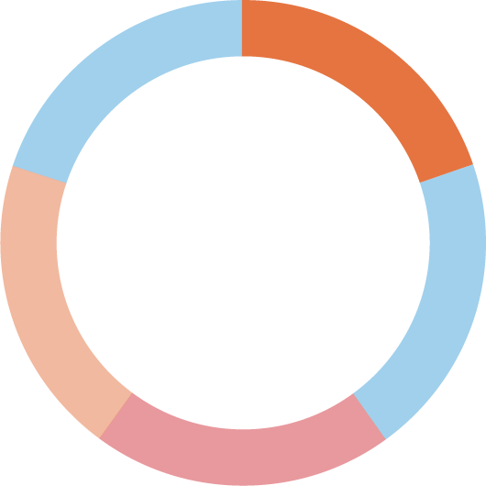
Execute
Total Time – 15 Minutes
CTEPH recurrent persistent
CTEPH inoperable
PAH, treatment Naive
PAH with PCA therapy
PAH with ERA therapy
Dr. Jensen
Dr. Sanjip
Dr. Lee

Slide 6
Scenario 2
Total Time – 5 Minutes
Dr Lee
HCP
Practicing for 15 years
Private practice
Sees a wide range of patients
A few patients have PAH
No knowledge about ADEMPAS
Primarily relies on prostacyclins for PAH treatment
Prefers medications that are well established
CONTINUE

