Slide 1
Insomnia Learning Program
Module 8 Pharmacologic Therapy

Slide 2




Table of Contents
1. Introduction and Learning Objectives
2. Pharmacologic Therapies
3. Self-Assessment
4. Glossary Terms

Slide 3
Introduction
In Module 7, you learned about the role of nonpharmacologic therapies for the management of chronic insomnia disorder. In this module, you will learn about the pharmacologic therapies that may be used to treat insomnia.
Learning Objectives
Describe the mechanism of action, clinical use, and examples of each
of the following pharmacologic classes:
  Benzodiazepine receptor agonists:
  benzodiazepine and nonbenzodiazepine benzodiazepine receptor agonists
  Melatonin receptor agonists
  Orexin receptor antagonists
  H₁ receptor antagonist
  Nonprescription medications

Slide 4





Patient Vignette
Let’s return to our patient from Module 6.
“When my doctor and I talked about how best to manage my insomnia, I asked her what she thinks about using a medication to help
me sleep.
“She said that her preference is to start with cognitive behavioral therapy for insomnia, or CBT-I, but in some cases it might be appropriate to combine CBT-I with medication.”

Slide 5

Role of Pharmacotherapy in Treatment of Insomnia
[Sateia: p308B,308C] Current…CBT-I
Current treatment guidelines recommend using CBT-I therapy first line; however, there are some situations in which pharmacologic agents may be used in addition to,
or instead of, CBT-I.
[Edinger: p 1A,B] title
Short-term use of
medication alone
Combination
therapy
[Mihic G&G Ch19 p27A,B] In…event
In patients who are experiencing transient or short-term insomnia in response to a situational or environmental stressor, it may be appropriate to prescribe short-term medication alone—for example, for a person who is experiencing insomnia after a job loss or other life event.
Combination therapy involves prescribing both CBT-I and a medication. CBT combined with medication may produce faster
sleep improvements.
[Carney: p4A] [Edinger: p1A,B, 3A] combination…improvements
When used in conjunction, CBT-I and insomnia medication can play complementary roles in the management of insomnia, with medication providing symptomatic relief and CBT-I providing longer-lasting results.
[Edinger: p1A,B,3A] when … results

Slide 6




Medication Overview
[Sateia: p315A] stem, all bullets and subbullets
The main classifications of medications used for insomnia are:
[Schweitzer: p6A] the main classifications
[Mihic G&G Ch19: p7A,30C] [Bertisch: p2A][Schweitzer: p5A] Benzodiazepine bullet and subbullets
Benzodiazepine receptor agonists (BzRAs)
  Benzodiazepines
  Nonbenzodiazepine benzodiazepine receptor agonists (also known as Z-drugs)
Melatonin receptor agonists
  Ramelteon
  Melatonin (non-prescription)
Orexin receptor antagonists (ORAs)
  Suvorexant
  Lemborexant
  Daridorexant
An H₁ receptor antagonist
  Doxepin
[Mihic G&G Ch19 p17A] (also known…Z-drugs)
[Matheson 2017 p2B] z-drugs
[Mihic G&G Ch19 p30A] Melatonin receptor agonist …Ramelteon
[Matheson 2017 p4A] [Sateia 2017: p311A] melatonin (non-prescription)
[Belsomra PI: p11A]
[Dayvigo PI: p11A]
[Quviviq PI: p11A]
[Mihic G&G Ch19 p30B] An H₁ receptor agonist
[Silenor PI 2020: p1A; p14A] An…doxepin
In addition to these main drug classes, other agents may be used. Many patients will have already tried some of these remedies before seeking help from an HCP.
[Schweitzer: p6A, 7A, 8A] In addition…may be used
“
My doctor went over some information with me about the different types of medications for insomnia and how they are used.
“I had already heard about those ‘Z-drugs’ like zolpidem, but I didn’t know there were other types of medication for insomnia.
”

Slide 7





Treatment Considerations
Weighing risks vs benefits
In deciding whether to prescribe a medication to help with insomnia, the HCP should consider the potential benefits
and risks of the medication.
The HCP must also consider patient-specific factors that could tip the benefit-risk balance, such as the presence of other comorbid conditions.
[Matheson: p1A] [Sateia 2017: p308D] In…medication
[Matheson: p1A] [Sateia 2017 p308A,308B,308C,308D] The HCP… conditions
Choosing among medications
When selecting among medications for a specific patient, factors that may be considered include:
[Sateia 2017 p308B] When…costs
Specific treatment goals
Comorbidities
Prior treatment responses
Availability
Safety
Patient preferences
Cost

Slide 8



Treatment Considerations (continued)
[Matheson: p3A]
[Sateia 2017 p315A] Compounds…ramelteon
Patients with sleep onset insomnia
Compounds with short half-lives may be appropriate for some patients who have sleep onset insomnia but do not struggle with sleep maintenance. This includes agents such as triazolam, zaleplon, and ramelteon.
Patient with sleep maintenance insomnia
Compounds with longer half-lives may be appropriate for some patients who primarily have trouble maintaining sleep. This includes agents such as doxepin and some benzodiazepines.
[Matheson 2017 p3A] Sentences 1-2
[Sateia 2017 p315A] Sentences 1-2
[Mihic 2018 p28A,28B] Because…next day
[Sateia 2017 p315A] Most…lemborexant
Patients with sleep onset and maintenance insomnia
Many insomnia treatments are indicated for both sleep onset and maintenance insomnia. This includes agents such as eszopiclone, zolpidem extended release, suvorexant, lemborexant, and daridorexant.
[Dayvigo PI 2022 p2A] [Lunesta PI 2019 p3B] [Belsomra PI 2021: p2A] [Ambien CR PI 2020: p2A] [Quviviq PI: p2A] This…lemborexant
In the next several pages we’ll be looking more closely at each of the major classes
of medication approved for insomnia.

Slide 9
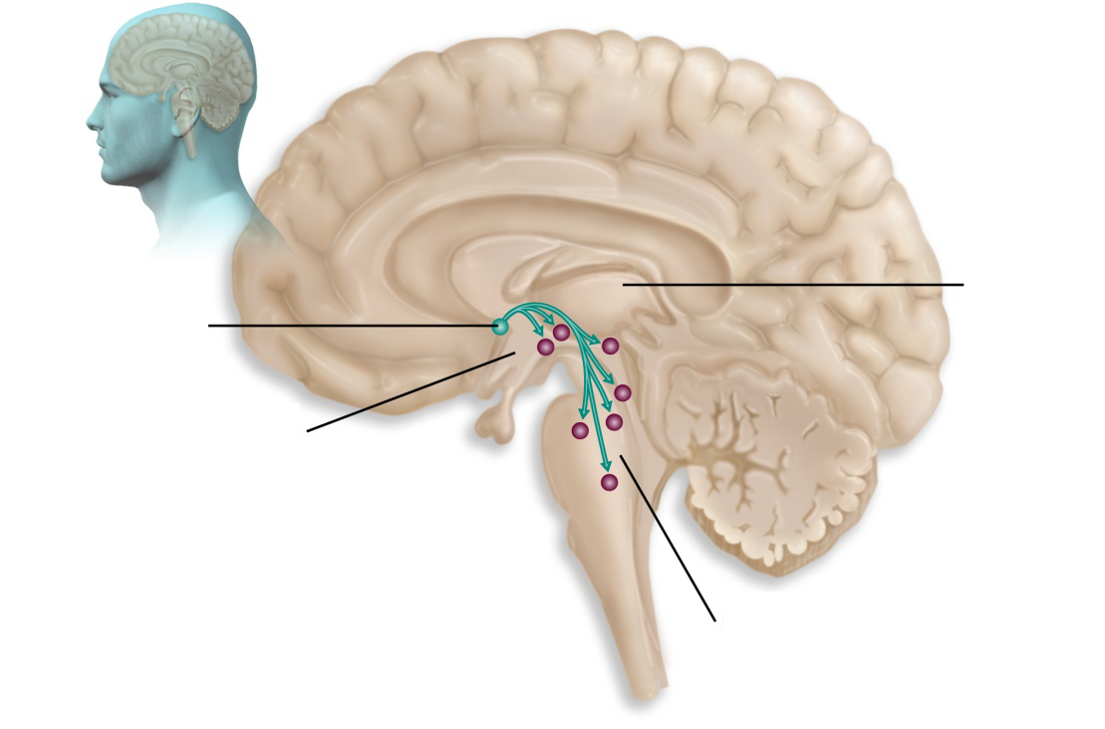
Introduction to
Benzodiazepine Receptor Agonists (BzRAs)
[Mihic 2018 Ch 19: p17A] Benzodiazepine…receptors
Benzodiazepine receptor agonists (BzRAs) work by acting as agonists at specific types of GABA receptors. Therefore, let’s take a moment to look at GABA and GABA receptors.
As you learned in
Module 5, GABA is the primary inhibitory neurotransmitter in the brain and is one of
the neurotransmitters utilized by the neurons
of the ventrolateral preoptic nucleus (VLPO), a key sleep-promoting system in
the brain.
Ventrolateral
preoptic
nucleus
(VLPO)
Thalamus
Hypothalamus
GABA is utilized in the VLPO
[Scammell 2022 Ch 27: p14ABC]
[Scammell 2022 Ch 27: p14A,B,C] GABA …brain [Jewett 2021_new: p1C) GABA as…neuro
Brainstem
[Saper nature 2005: p2A] visual

Slide 10
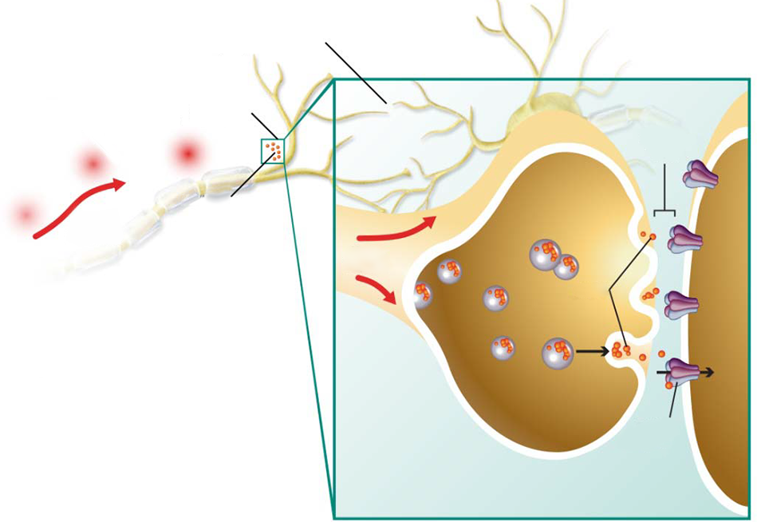
GABA Neurotransmission
[Jewett 2021 p1AB] GABA…effect
GABA is released by presynaptic neurons and binds to GABA receptors on the postsynaptic neuron, where it has an inhibitory effect.
[Rye: p4A,] image
[Jewett 2021 p1B] There…GABA_{B}
Postsynaptic neuron
Axon of presynaptic neuron
Synapse
There are 2 major postsynaptic GABA receptors:
GABA_{A}
GABA_{B}
GABA receptor agonists
(i.e., benzodiazepines and nonbenzodiazepines) act at GABA_{A} receptors.
Synaptic cleft
Nerve
impulse
GABA
Nerve impulse
GABA
GABA receptor
[Knoflach 2016 p11A,D; p12A; p13A] Visual
[Rye: p1A, 4A,] Gaba…receptors

Slide 11
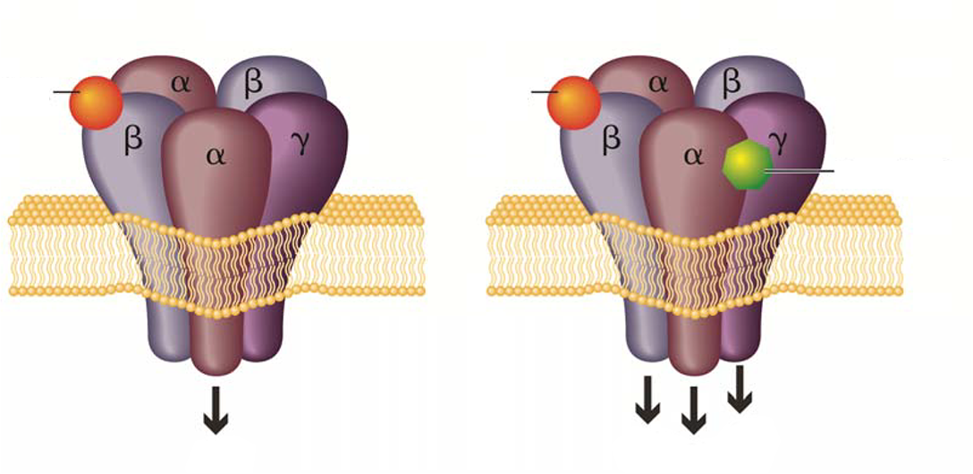
GABA Receptors
The …ions [Rye: p2A, 4A, 5A] [Jewett 2021 p1AB]
The GABA_{A}-benzodiazepine receptor is composed of combinations of different subunits from different families. Together, these subunits form a benzodiazepine recognition site, a GABA_{A} recognition site, and a channel for chloride ions (Cl-).
[Mihic 2018 Ch 19 p9A,D] The…membrane
[Stedman’s: p2A] goes…membrane
The GABA_{A} receptor is a transmembrane receptor, meaning that it goes through or across the
cell membrane.
GABA
[Mihic 2018 Ch 19: p9D,10A] Benzodiazepine…activity
[Jewett 2021: p1A,B] Benzodiazepine…activity
Benzodiazepine binding to GABA_{A} receptors enhances the effects of GABA-induced Cl- channels, helping to prevent an action potential, and thus, inhibiting neuronal activity.
Cl⁻
Image [Rye: p4A,5A]

Slide 12
Benzodiazepine
Mechanism of Action
[Mihic 2018 Ch 19: p9A,9D, 10A] When…neuron ]
When a benzodiazepine binds to the benzodiazepine binding site, it results in an increased influx of negatively charged chloride ions into the neuron.
Benzodiazepines bind to GABA_{A} receptors
GABA
GABA
Benzodiazepine
Cl⁻
Cl⁻
Cl⁻
[Rye: p1B, 4A,5A] Visual
Cl⁻
As a class, benzodiazepines produce sedation, hypnosis, decreased anxiety,
muscle relaxation, anterograde amnesia, and anticonvulsant activity.
[Mihic 2018 Ch 19: p10C] As…activity

Slide 13

Role of Benzodiazepines in Insomnia Therapy
For Image
[Flurazepam PI 2021 p3A, 4A Doral PI 2020 p3A, 7A,B] longer acting
[Restoril PI 2021 p4A, Estazolam PI 2021 p3B,4A] Intermediate Acting
[Halcion PI 2021, p3A] Shorter acting
[Mihic 2018 Ch 19 p15A,16C] There…states
There are 14 benzodiazepines
marketed in the United States.
Of these, 5 are indicated
for the short-term treatment
of insomnia:
Estazolam
Flurazepam
Quazepam
Temazepam
Triazolam
Longer acting:
Flurazepam
Quazepam
[Estazolam PI 2021 p3B,4A] estazolam
[Flurazepam PI 2021 p3A, 4A] flurazepam
[Doral PI 2020 p3A, 7A,B] quazepam
[Restoril PI 2021 p4A] temazepam
[Halcion PI 2021 p1A,3A] triazolam
Intermediate
acting:
Estazolam
Temazepam
Shorter
acting:
Triazolam
These medications vary in terms of half-life and duration of action.
[Estazolam PI 2021 p2A,3A] These…action
[Flurazepam PI 2021 p10A] These…action
[Doral PI 2020 p8A,B] These…action
[Restoril PI 2021 p3A] These…action
[Halcion PI 2021 p15A] These…action
[Mihic 2018 Ch 19: p12A] visual

Slide 14
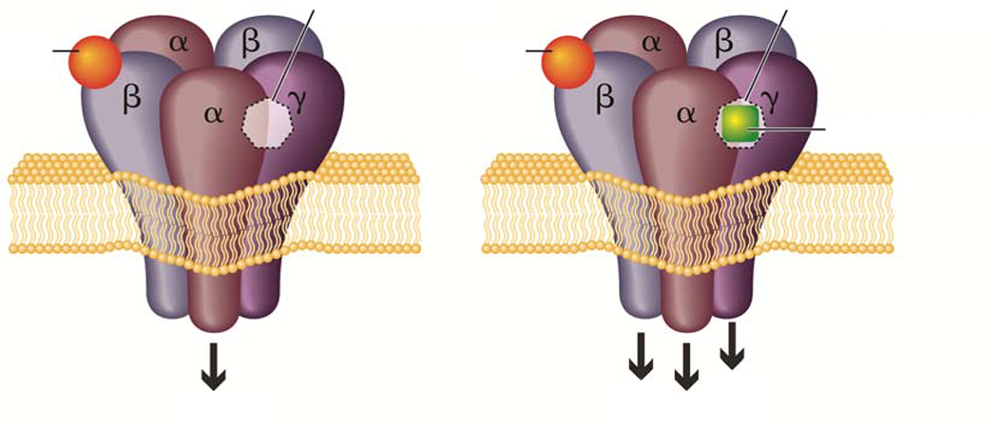
Nonbenzodiazepine BzRAs –
Mechanism of Action
[Mihic 2018 Ch 19 p17A] Like…ions
[Rye: p4A, 6A,B, 7A] Like…ions
Like benzodiazepines, nonbenzodiazepine BzRAs (or Z-drugs) work by acting as agonists at the benzodiazepine site of the GABA_{A} receptor. Here, they potentiate the activation of the GABA_{A} receptor (by GABA) causing an influx of chloride ions.
Benzodiazepine site
Benzodiazepine site
GABA
GABA
Nonbenzodiazepine
Cl⁻
Cl⁻
Cl⁻
[Rye: p4A, 5A,7A] Visual
Cl⁻
Compared with benzodiazepines, nonbenzodiazepine BzRAs are less effective as muscle relaxants or anticonvulsants.
[Mihic 2018 Ch 19: p17A] Compared…anticonvulsants

Slide 15

Role of Nonbenzodiazepine
BzRAs in Insomnia Therapy
Nonbenzodiazepine BzRAs approved for the treatment of insomnia include:
Zolpidem
Zaleplon
Eszopiclone
Zolpidem
Zaleplon
Eszopiclone
Indicated for short-term treatment of insomnia characterized by difficulties with sleep initiation (and/or sleep maintenance for Zolpidem extended release tablets) *
Indicated for short-term treatment of insomnia; decreased time to sleep onset
Indicated for treatment of insomnia; decreased sleep latency and improved
sleep maintenance
[Ambien PI 2020 p3A] zolpidem
[Sonata PI 2019 p1B,C,6A] zaleplon
[Lunesta PI 2019 p3B] eszopiclone
[Ambien PI 2020 p3A] NTRIndicated…initiation
[Sonata PI 2019 p6A] Indicated…insomnia
[Lunesta PI 2019 p3B] Indicated…maintenance
Mean half-life:
~2.6 hours (5 mg tablet);
~2.5 hours (10 mg tablet)
Mean half-life: ~1 hour
Mean half-life: ~6 hours
[Sonata PI 2019 p3A] Mean…hour
[Lunesta PI 2019 p18A] Mean…hour
[Ambien PI 2020 p17A] Mean…tablet
Available in immediate- release, extended-release, or sublingual tablets, and oral spray formulations
Capsule
Tablet
[Ambien PI 2020 p21A; Intermezzo PI 2019: p3A; Zolpimist PI: p1A; Ambien CR PI 2020: p7A] Available…formulations
[Sonata PI 2019 p19A] Capsule
[Lunesta PI 2019 p1A] Tablet
*Zolpidem extended release tablets are indicated for the treatment of insomnia characterized by difficulties with sleep onset and/or sleep maintenance.
[Ambien CR PI 2019_2022: p2A] footnote

Slide 16



Safety Considerations
[Krystal 2019 p9A] The…here
The adverse reactions associated with benzodiazepines and nonbenzodiazepine receptor agonists are similar, and therefore are discussed together here.
[Mihic 2018 Ch 19 p16A] The…amnesia
Boxed warning:
complex sleep behaviors
Common adverse reactions
Hypnotic doses of benzodiazepines cause varying degrees of the following adverse reactions:
Light-headedness
Lassitude (lack of energy)
Increased reaction time
Motor incoordination
Impairment of mental and motor functions
Confusion
Anterograde amnesia
In general, insomnia treatments are associated with increased risk of complex sleep behaviors, such as sleep-walking, sleep-driving, and engaging in other behaviors while not fully awake.
Nonbenzodiazepine BzRAs products are contraindicated in patients who have experienced these behaviors. At present the nonbenzodiazepine BzRAs products are also required to have a boxed warning regarding these behaviors.
[FDA Boxed warning 2019, p1A] In…awake
[FDA DSC Zdrugs, p1A,B] Nonbenzodiazepine…behaviors
[Sonata PI: p1A] Boxed warning
[Lunesta PI: p1B] Boxed warning
[Zolpimist PI: p1B] Boxed warning
Did You Know? Benzodiazepines and nonbenzodiazepine BzRAs are classified by the
DEA (Drug Enforcement Agency) as schedule IV drugs under the Controlled Substances Act.
This classification indicates that although there is some potential for abuse, dependence, or misuse,
this risk is lower than that of drugs in Schedule I, II, and III.
[Mihic 2018 Ch 19 p17A] nonbenzodiazepine…act
[DOJ DEA 2020 p1A] Benzodiazepine…act
[Stedman’s online: p1A] This…III
[Taber’s online: p11A] This…III

Slide 17
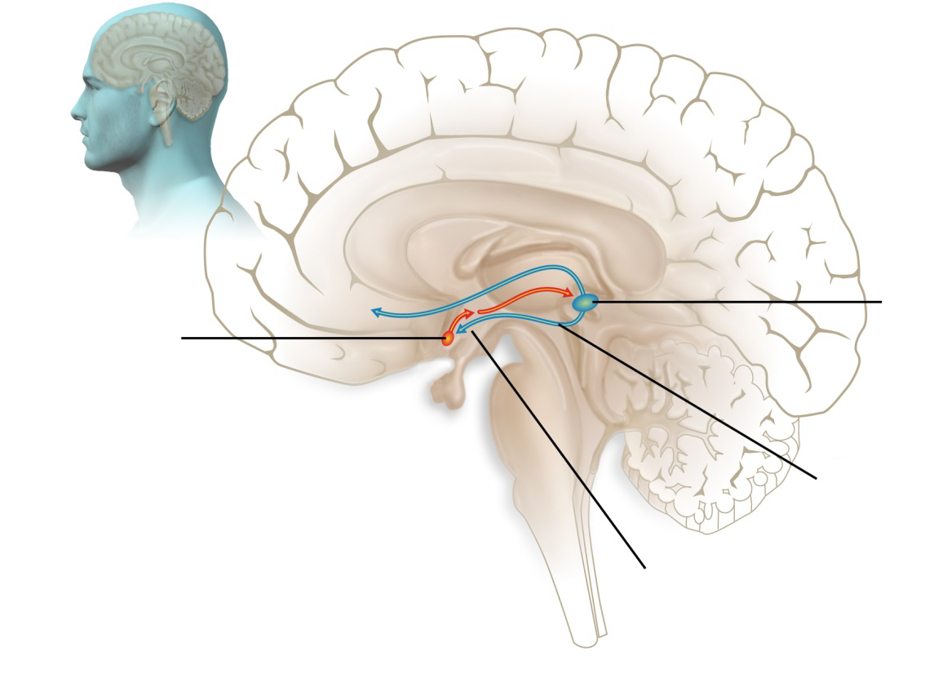
Melatonin Receptor Agonists –
Mechanism of Action
[Tortora(Ch14_2021): p30A,31A] Melatonin…rhythms
As you learned previously, melatonin is a hormone secreted by the pineal gland that participates in the regulation of circadian rhythms, and thus impacts sleep/wake cycles. It is thought to play a role in resetting the suprachiasmatic nucleus (SCN), the master clock of circadian rhythms.
[Rozerem PI 2020 p11AB] Ramelteon…receptors
Ramelteon
is a melatonin
receptor agonist, and acts at melatonin
MT₁ and MT₂ receptors
Pineal
gland
SCN
[Tortora(Ch14_2021): p26A,30A,31A] [Hastings 2018 p454A] visual
Melatonin
Hypothalamus

Slide 18





Melatonin Receptor Agonists –
Role in Insomnia Treatment and Safety
[Rozerem PI 2020 p3A,B] Ramelteon…latency
[Rozerem PI 2020 p16A-D] This…latency
Ramelteon is indicated for the treatment of insomnia characterized by difficulty with sleep onset. This indication is based on data from three randomized controlled trials in adults up to 6 months in duration showing that ramelteon reduced sleep latency.
[Rozerem PI 2020 p6A] The…insomnia
Adverse Reactions
The most commonly reported adverse reactions with ramelteon,
occurring at ≥2% and more common than with placebo, are:
Somnolence
Dizziness
Fatigue
Nausea
Exacerbated insomnia
[Rozerem PI 2020 p4A5A] Complex…effect
As with many other insomnia treatments, complex sleep behaviors have been reported with ramelteon and the package insert carries a warning to this effect.

Slide 19
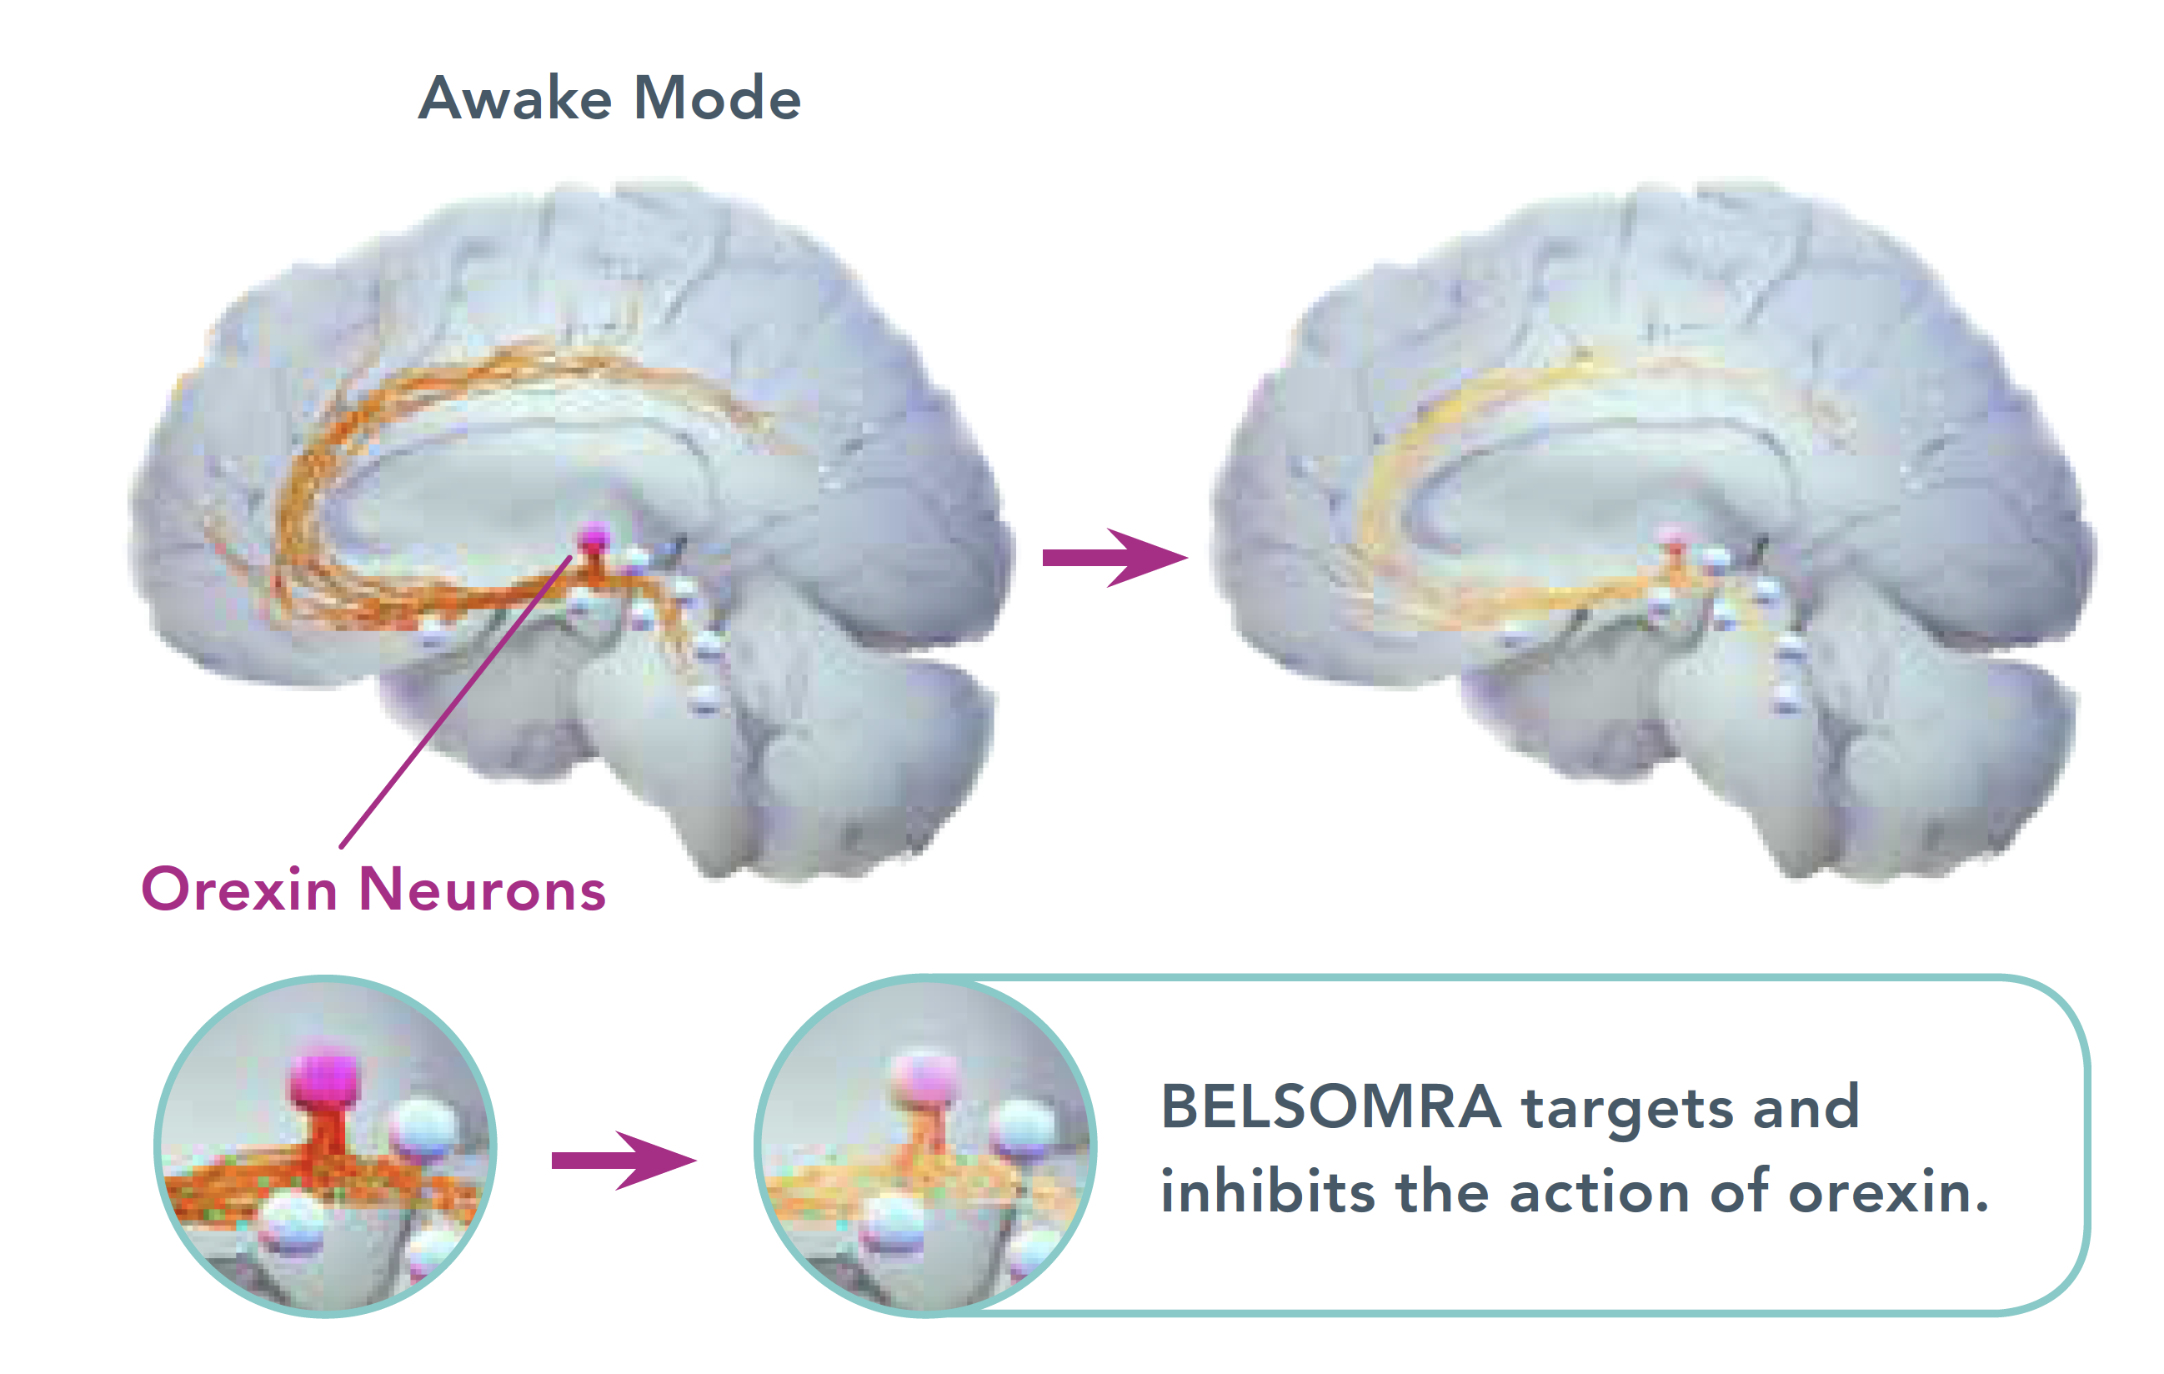
Orexin Receptor Antagonists (ORAs)
Orexins, produced by neurons in the hypothalamus of the brain, play a major role in regulation of the sleep cycle along with other neurotransmitters. Neurons in the orexin system are not active during sleep but are active during wakefulness. Thus, orexins promote wakefulness, and orexin receptor antagonists enhance sleep.
[Mihic 2018 Ch 19 p26A] Orexins…sleep
ORAs approved for the treatment of insomnia include:
Suvorexant
Lemborexant
Daridorexant
Awake Mode
[Dayvigo PI 2022: p2A, 10A] lemborexant
[Belsomra PI 2021: p2A, 10A] suvorexant
[Quviviq PI: p 1B, 11A] Daridorexant
Orexin Neurons
ORAs target and inhibit the action of orexin
[Original illustration based on Sakurai 2007: p4A] Visual
[Dayvigo PI 2022: p11A][Belsomra PI 2021: p11B] [Quviviq PI: p 11A,B] ORAs…orexin

Slide 20

Orexin Receptor Antagonists (ORAs) –
Role in Insomnia Treatment and Safety
[Belsomra PI 2021 p2A] Suvorexant…maintenance
[Dayvigo PI 2021 p2A] lemborexant…maintenance [Quviviq PI: p1B] daridorexant…sleep maintenance
Suvorexant, lemborexant, and daridorexant are indicated for the treatment of insomnia characterized by difficulty with sleep onset and/or sleep maintenance. This indication is based on data from three clinical trials (suvorexant) or two clinical trials (daridorexant, lemborexant) in patients with insomnia characterized by difficulties with sleep onset and sleep maintenance.
[Belsomra PI 2021 p15A, Section 14.1, Indication…(suvorexant), patients…maintenance; Dayvigo PI 2022 p15A, two…maintenance] [Quviviq PI: p5A, 16A] three clinical trials
Most Common Adverse Reactions for ORAs
The most common adverse reactions associated with ORAs include:
[Quviviq PI: p5B,
Most common…]
[Belsomra PI 2021: p5A-6A,
The…headache]
[Dayvigo PI 2022: p6A, The…headache]
Dizziness
Headache
Somnolence
The package inserts for suvorexant, lemborexant and daridorexant carry a warning regarding the potential for complex sleep behaviors in patients taking medication for insomnia.
Suvorexant, Lemborexant and Daridorexant are classified by the DEA (Drug Enforcement Agency) as schedule IV drugs under the Controlled Substances Act.
[Belsomra PI 2021 p3A The…insomnia ; Dayvigo PI 2022: p3A, The …insomnia] [Quviviq PI: p4A] the package… insomnia
[Belsomra PI: p1A] suvorexant…act; Dayvigo PI 2022: p21A, lemborexant…act] [Quviviq PI: p22A] daridorexant…Act

Slide 21


Other Medications
Let’s finish by looking at some other medications that may be used for insomnia.
H₁ receptor antagonist
[Mihic 2018 Ch 19: p26B; Silenor PI 2020 p2A,3A,14A] Silenor…behaviors
Silenor® (doxepin) is an H₁ receptor antagonist indicated for the treatment of insomnia characterized by difficulties with sleep maintenance. Like other prescription medications for insomnia, it may be associated with complex sleep behaviors.
[Mihic 2018 Ch 19: p26C; [Schweitzer: p3A,5A,18A] Certain…pathways
Over-the-counter antihistamines
Certain antihistamines, such as diphenhydramine and doxylamine are
FDA approved for use in nonprescription over-the-counter sleep aids.
These drugs produce drowsiness by inhibiting wake-promoting histaminergic pathways.
Routine use of these agents is not recommended. Sedating antihistamines are known to have significant anticholinergic effects, which may include dry mouth and blurred vision.
[Sateia 2017: p316B] Routine…recommended [Matheson 2017: p5A] Routine…effects [Tabers:p3A] anticholinergic…vision

Slide 22
Self-Assessment
Under which circumstance might an HCP prescribe a hypnotic medication alone?
  A patient who has trouble waking up in the morning
  A patient with short-term insomnia due to a situational stressor
  A patient who has unexplained difficulty maintaining sleep
  A patient with sleep apnea who requires extra help falling asleep
Benzodiazepines and nonbenzodiazepine BzRAs act at ____________ receptors.
  GABA_{A}
  Glutamate
  Cholinergic
  Adrenergic
Eszopiclone is classified as a(n):
  Antihistamine
  Benzodiazepine
  Nonbenzodiazepine BzRA
  Melatonin receptor agonist
Triazolam is classified as a(n):
  Antihistamine
  Benzodiazepine
  Nonbenzodiazepine BzRA
  Melatonin receptor agonist
[Mihic G&G Ch19: p27A]
[Mihic 2018 Ch 19: p9A, 17A]
[Mihic 2018 Ch 19: p30C]
[Mihic 2018 Ch 19: p29A]

Slide 23
Self-Assessment
Ramelteon is classified as a(n):
  Antihistamine
  Benzodiazepine
  Nonbenzodiazepine BzRA
  Melatonin receptor agonist
[Mihic G&G Ch19 p30A]

Slide 24

Self-Assessment
Answers:
B
A
C
B
D

Slide 25
Glossary Terms
Word | Definition
agonist | a drug that binds to a particular receptor and stimulates its function
anterograde amnesia | loss of memory for events that occurred after a precipitating event or medication
circadian rhythm | diverse yet predictable changes in physiological variables, including sleep, appetite, temperature, and hormone secretion, over a 24-hour period
GABA | gamma-aminobutyric acid; a major inhibitory neurotransmitter in the central nervous system
suprachiasmatic nucleus | a small nucleus in the hypothalamus that generates the brain’s circadian rhythm
[Taber’s: p1A] a…function
[Taber’s:: p4A] loss…medication
[Taber’s: p8A] diverse…period
[Mihic 2018 p8AB] Gamma…system [Rye:p1A,9A] [Jewett 2021_new: p1C]
[Taber’s : p28A]a…rhythm

Slide 26
References
Ambien (zolpidem) [Package insert]. Sanofi-aventis U.S., LLC; 2022.
Ambien CR (zolpidem tartrate extended-release) [Package insert]. Sanofi-aventis U.S., LLC; 2020.
Belsomra (suvorexant) [Package insert]. Merck & Co., Inc.; 2022.
Benzodiazepines. Department of Justice/Drug Enforcement Administration. Published April 2020. Accessed May 25, 2022. https://www.dea.gov/sites/default/files/2020-06/Benzodiazepenes-2020_1.pdf
Bertisch SM, Buysse DJ. Pharmacologic treatment I: Therapeutic approaches and implementation. In: Kryger M, Roth T, Dement WC, eds. Principles and Practice of Sleep Medicine. 7th ed. Philadelphia, PA: Elsevier; 2022.
Carney CE, Danforth M . Behavioral treatment I: Therapeutic approaches and implementation. In: Kryger M, Roth T,
Dement WC, eds. Principles and Practice of Sleep Medicine. 7th ed. Philadelphia, PA: Elsevier; 2022.
Dayvigo (lemborexant) [Package insert]. Eisai Inc.; 2022.
Doral (quazepam) [Package insert]. Sallus Laboratories, LLC.; 2020.
Edinger JD, Morin CM, Pigeon WR. Pharmacologic treatment III: Sequenced and combined psychologic and pharmacologic treatments for insomnia. In: Kryger M, Roth T, Dement WC, eds. Principles and Practice of Sleep Medicine. 7th ed. Philadelphia, PA: Elsevier; 2022.
Estazolam [Package insert]. Actavis Pharma, Inc.; 2021.
FDA adds boxed warning for risk of serious injuries caused by sleepwalking with certain prescription insomnia medicines. FDA Drug Safety Communications. Accessed May 25, 2022. https://www.fda.gov/media/123819/download
Flurazepam [Package insert]. Mylan Pharmaceuticals Inc.; 2021.
Halcion (triazolam) [Package insert]. Pharmacia and Upjohn Co.; 2021.
Hastings MH, Maywood ES, Brancaccio M. Generation of circadian rhythms in the suprachiasmatic nucleus. Nature Reviews Neuroscience 2018;19:453-469.
Intermezzo (zolpidem) [Package insert]. Transcept Pharmaceuticals, Inc.; 2019.
[Ambien PI 2022]
[Ambien CR PI 2020]
[Belsomra PI 2021]
[DOJ DEA 2020 p1A]
[Bertisch]
[Carney]
[Dayvigo PI 2022]
[Doral PI 2020]
[Edinger]
[Estazolam PI 2021]
[FDA DSC Zdrugs]
[Flurazepam PI 2021]
[Halcion PI 2021]
[Hastings 2018]
[Intermezzo PI 2019]

Slide 27
References (continued)
Jewett BE, Sharma S. Physiology, GABA. StatPearls. Published January 2021. Accessed May 25, 2022. https://www.ncbi.nlm.nih.gov/books/NBK513311/?report=printable
Knoflach F, Hernandez M-C, Bertrand D. GABAA receptor mediated neurotransmission: not so simple after all. Biochem Pharmacol. 2016;115:1-17.
Krystal AD, Prather AA, Ashbrook LH. The assessment and management of insomnia: an update. World Psychiatry. 2019;18:337-352.
Lunesta (eszopiclone) [Package insert]. Sunovion Pharmaceuticals Inc.; 2019.
Matheson E, Hainer BL. Insomnia: pharmacologic therapy. Am Fam Physician 2017;96(1):29-35.
Mihic JS, Mayfield J, Harris RA. Hypnotics and sedatives. In: Brunton LL, Hilal-Dandan R, Knollmann BC, eds. Goodman & Gilman’s: The Pharmacological Basis of Therapeutics. 13th ed. Mc-Graw Hill Education; 2018.
Quviviq (daridorexant) [Package insert]. Idorsia Pharmaceuticals; 2022
Restoril (temazepam) [Package insert]. Mallinckrodt Pharmaceuticals; 2021.
Rozerem (ramelteon) [Package insert]. Takeda Pharmaceuticals America, Inc.; 2020.
Rye DB, Wisden W. GABA: Its metabolism, receptors, and the drugs for treating insomnias and hypersomnias. In: Kryger M, Roth T, Dement WC, eds. Principles and Practice of Sleep Medicine. 7th ed. Philadelphia, PA: Elsevier; 2022.
Sakurai T. The neural circuit of orexin (hypocretin): maintaining sleep and wakefulness. Nature Reviews Neuroscience. 2007;8:171-181.
[Jewett 2021 ]
[Knoflach 2016]
[Krystal]
[Lunesta PI 2019]
[Matheson 2017]
[Mihic 2018]
[Restoril PI 2021]
[Rozerem PI 2020]
[Rye]
[Sakurai 2007]

Slide 28
References (continued)
Saper CB, Scammall TE, Lu J. Hypothalamic regulation of sleep and circadian rhythms. Nature. 2005;437(27):1257-1263.
Sateia MJ, Buysse, DJ, Krystal AD, Neubauer DN, Heald JL. Clinical practice guideline for the pharmacologic treatment of chronic insomnia in adults: an American Academy of Sleep Medicine clinical practice guideline. J Clin Sleep Med. 2017;13(2):307-346.
Scammell TE, Saper CB, Czeisler CA. Sleep disorders. In: Jameson JL, Fauci AS, Kasper DL, Hauser SL, Longo DL, Loscalzo J, eds. Harrison’s Principles of Internal Medicine. 21st ed. McGraw-Hill Education; 2022. https://accessmedicine.mhmedical.com/content.aspx?bookid=2129&sectionid=192344545
Schweitzer PK, Malhotra. Clinical pharmacology of drugs that affect sleep and wake. In: Kryger M, Roth T, Dement WC, eds. Principles and Practice of Sleep Medicine. 7th ed. Philadelphia, PA: Elsevier; 2022.
Silenor (doxepin) [Package insert]. Pernix Therapeutics, LLC; 2020.
Sonata (zaleplon) [Package insert]. Pfizer Inc.; 2019.
Stedman's Online Medical Dictionary. Accessed May 25, 2022. http://www.stedmansonline.com/
Taber’s Online Medical Dictionary. 23rd ed. Accessed May 25, 2022. http://www.tabers.com/tabersonline/
Tortora J, Derrickson B. The brain and cranial nerves. Chapter 14 in: Principles of Anatomy and Physiology. 16th ed. Hoboken, NJ: Wiley; 2021.
Zolpimist (zolpidem tartrate) [Package insert]. Aytu BioScience, Inc.; 2019.
[Saper 2005]
[Sateia 2017]
[Scammell 2022 Ch 27]
[Schweitzer]
[Silenor PI 2020]
[Sonata PI 2019]
[Stedman’s online]
[Taber’s online]
[Tortora(Ch14_2021) 2021]
[Zolpimist PI 2019]

